Slide 1
Preliminary Exam Summary
Vision based American Sign Language (ASL) Recognition
Shuang Lu
Department of Electrical and Computer Engineering
Temple University
presented to:
Dr. Joseph Picone, Examining Committee Chair
Dr. Li Bai, Committee Member, Department of ECE
Dr. Seong Kong, Committee Member, Department of ECE
Dr. Rolf Lakaemper, Committee Member, Department of CIS
Dr. Haibin Ling, Committee Member, Department of CIS
URL:

Slide 2
Objective & Motivation
ASL is the primary mode of communication for many deaf people. It also provides an appealing test bed for understanding more general principles governing human motion and gesturing including human-computer gesture interfaces.
A system allow hearing people to communicate with people using ASL
A dictionary for deaf people to learn how to read and write English

Slide 3
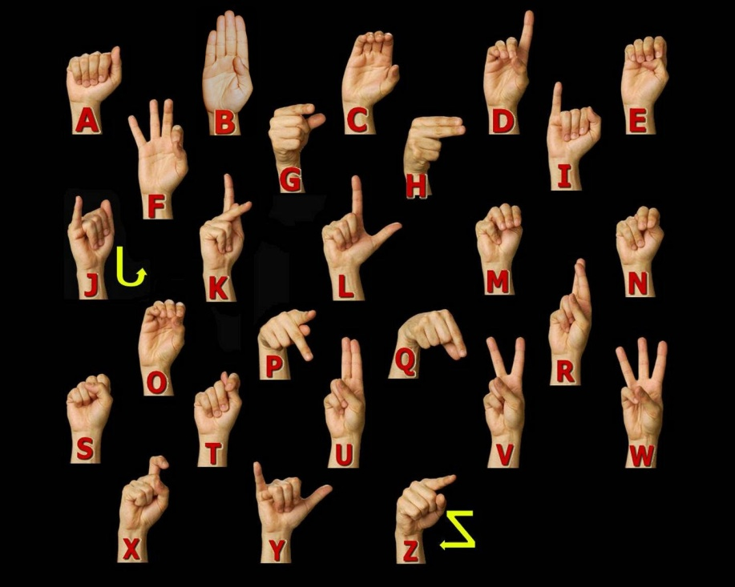
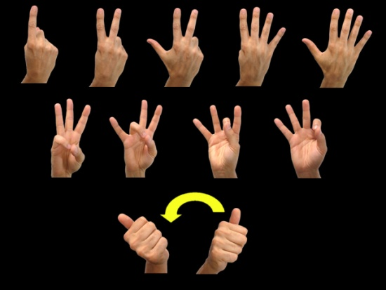
American Sign Language
Who use ASL?
ASL is used in the United States, Canada, Malaysia, Germany, Austria, Norway, and Finland.
Sign language is becoming a popular teaching style for young children. Since the muscles in babies' hands grow and develop quicker than their mouths, sign language is a beneficial option for better communication.
Finger spelling
10,000 signs

Slide 4
Related work in Sign Language
Researchers | Classification Methods | Vocabulary | Error rate
Starner et al., 1996 | HMM, color cameras at angular views, with/without color gloves | 40 ASL | 2%-8% 25% (without)
Vogler, 1998 | HMM, 3 cameras, data gloves | 53 ASL | 8%-12%
Cui&Weng, 2000 | NN in most expressive features space (first consider complex background & hand shape) | 28 ASL | 4.8%
Tanibata et al., 2002 | HMM, correctly extracted face hand hands | 65 JSL | 0%
Wang et al., 2002 | HMM model, CyberGloves, 4 training each 3D tracker,2400 phonemes, 3 states | 5119 CSL | 7.2%
Parashar, 2003 | Relational Histograms+PCA | 39 ASL | 5%-12%
Yang et al., 2007 | Relational Histograms+PCA | 147 ASL | 19.7%

Slide 5
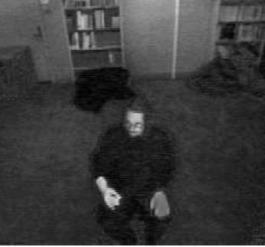
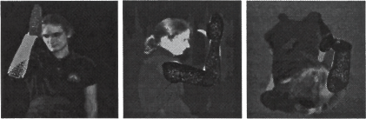
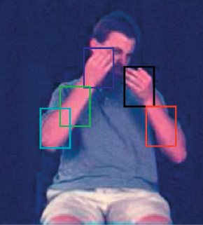
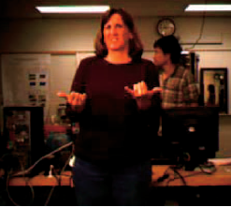
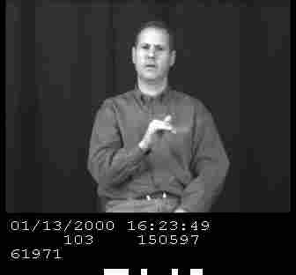
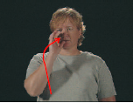
Related work in Sign Language
1991 Cambridge & MIT
1997 U Penn
2008 USF
2007 Boston
2004 RWTH
2002 Puedue

Slide 6
Database
Research Institute | Year | Short Sleeves | Background | Number of Signer | Data Size | Data Type
Purdue University | 2002 | Some | Simple | Three | Medium | Letter spelling
Boston University | 2001 | Yes | Multiple | Three | Large | Lexicon/continuous
RWTH-Boston | 2004 | Some | Multiple | Three | Large | Sentence/Lexicon/ Continuous
University of South Florida | 2006 | Some | Complex | One | Small | Sentence

Slide 7
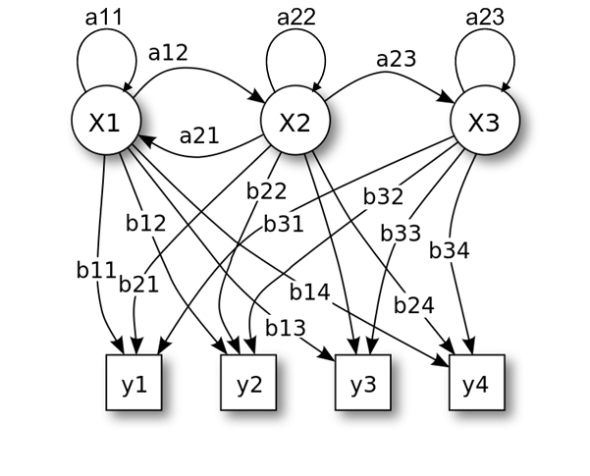
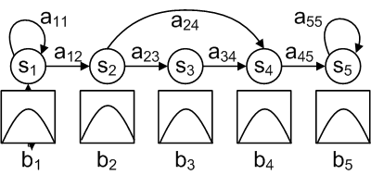
Hidden Markov Model (HMM) for ASL Recognition
x — states
y — possible observations
a — state transition probabilities
b — output probabilities
Probabilistic parameters of a HMM
A HMM model for isolated sign
?

Slide 8
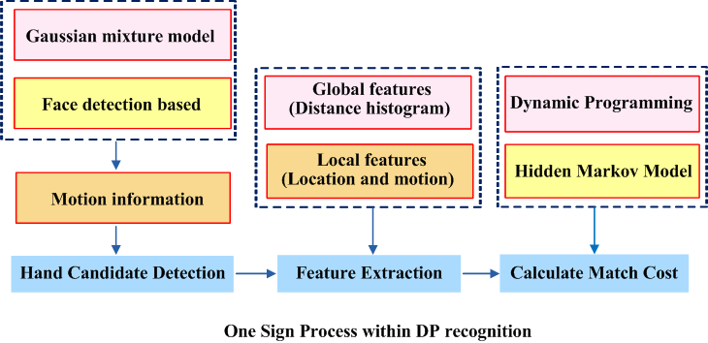
ASL Recognition System based on DP
2010 PAMI
2009 PAMI
Both

Slide 9
Challenges
Movement Epenthesis
Hand segmentation
Processing speed
Large vocabulary
The transition between signs in a sentence.
Illumination, complex background, short sleeves and skin-color like object will all affect the segmentation
DP Pruning, multiple constraints

Slide 10
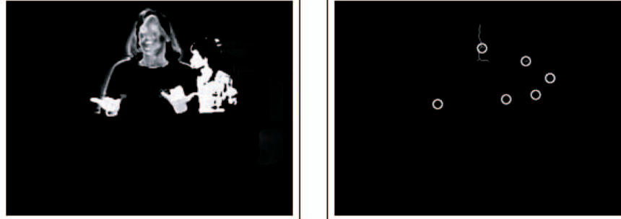
Hands detection (1)
Skin color segmentation
Accuracy?
15 pairs
GMM (1999)
skin color detection
Edge detection
Connected components
2010 PAMI
Neural Network
(90% ,130 picture)
K 40 * 30 sub-windows
2009 PAMI
Motion Cue
Frame differences
(Only two frames)
Frame differences
(Two times)
Good to fix the size?

Slide 11
Hands detection (2)
bottom-up: the video is input into the analysis module, which estimates the hand pose and shape model parameters, and these parameters are in turn fed into the recognition module, which classifies the gesture.
top-down: information from the model is used in the matching algorithm to select, among the exponentially many possible sequences of hand locations, a single optimal sequence. This sequence specifies the hand location at each frame.
Gesture classification
Bottom - up
Top - down
Video
Matching a optimal sequence
Hand segmentation
Model parameters estimations
Backtracking to find hand locations
Video

Slide 12
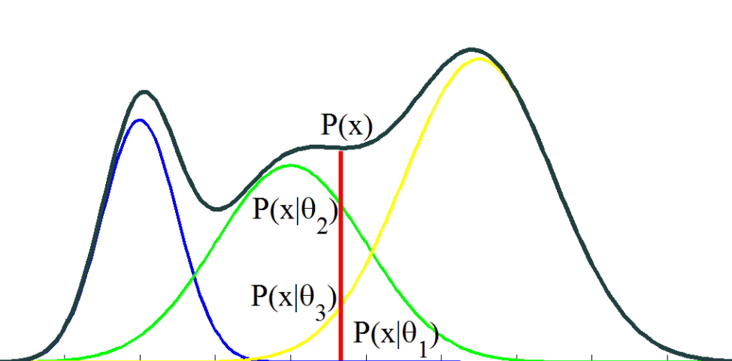
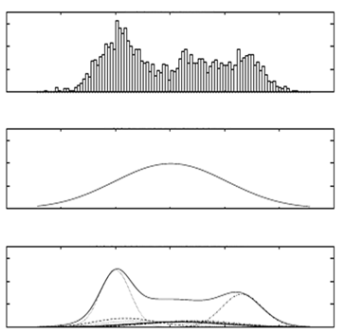





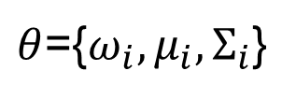
GMM skin color likelihood image
A Gaussian Mixture Model (GMM) is a parametric probability density function represented as a weighted sum of Gaussian component densities
$θ$={$ω_{i},μ_{i},Σ_{i}$}
Essential EM ideas:
  If we had an estimate of the joint density, the conditional densities would tell us how the missing data is distributed.
  If we had an estimate of the missing data distribution, we could use it to estimate the joint density.
There is a way to iterate the above two steps which will steadily improve the overall likelihood P(skin, non-skin|$ω$,μ,Σ) .
$$P\left(x | θ\right)$$
$$ω_{2}$$
$$ω_{3}$$
$$ω_{1}$$
Histogram
Unimodel Gaussian
Gaussian Mixture Density

Slide 13
Maximum Likelihood
We have observed a set of outcomes in the real world. It is then possible to choose a set of parameters which are most likely to have produced the observed results.
0
Log likelihood function

Slide 14
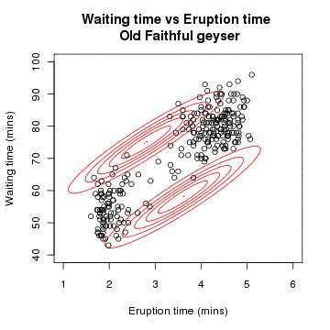

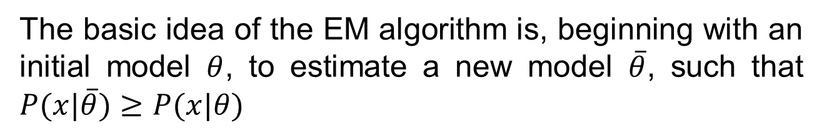
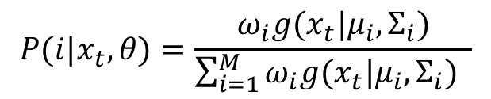
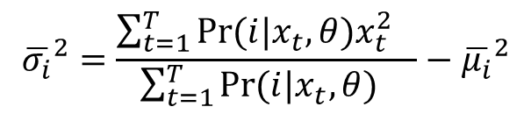
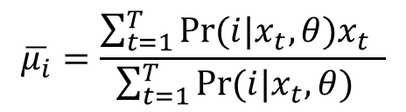
EM algorithm
The basic idea of the EM algorithm is, beginning with an initial model $θ$, to estimate a new model $\overline{θ}$, such that $P(x|\overline{θ})≥P(x|θ)$
$$\overline{ω_{i}}=\frac{1}{T}\sum_{t=1}^{T}{Pr⁡(i|x_{t},θ)}$$
$$\overline{μ_{i}}=\frac{\sum_{t=1}^{T}{Pr⁡(i|x_{t},θ)x_{t}} }{\sum_{t=1}^{T}{Pr⁡(i|x_{t},θ)} }$$
$${\overline{σ_{i}}}^{2}=\frac{\sum_{t=1}^{T}{Pr⁡(i|x_{t},θ)x_{t}^{2} } }{\sum_{t=1}^{T}{Pr⁡(i|x_{t},θ)} }−{\overline{μ_{i}}}^{2}$$
$$P(i|x_{t},θ)=\frac{ω_{i}g(x_{t}|μ_{i},Σ_{i})}{\sum_{i=1}^{M}{ω_{i}g(x_{t}|μ_{i},Σ_{i})} }$$

Slide 15
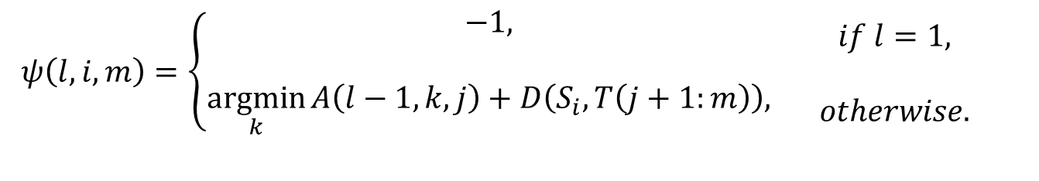
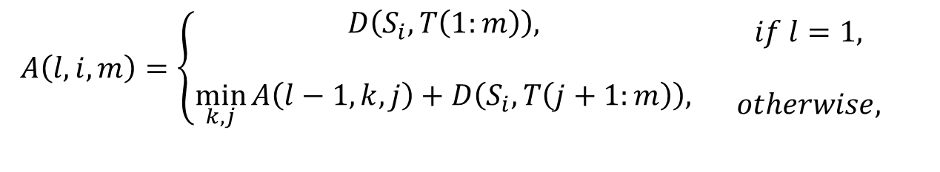
Level building
Goal: match an observation sequence to a number of models.
The LB algorithm jointly optimizes the segmentation of the sequence into subsequences produced by different models, and the matching of the subsequences to particular models
$$A\left(l,i,m\right)=\left\{\begin{matrix}D\left(S_{i}, T\left(1:m\right)\right), \\ \\ \min_{k,j}{A\left(l−1,k,j\right)+D\left(S_{i},T\left(j+1:m\right)\right),}\end{matrix}\right.\begin{matrix}if l=1, \\ \\ otherwise,\end{matrix}$$
$$ψ\left(l,i,m\right)=\left\{\begin{matrix}−1, \\ \\ \underset{k}{argmin}{A\left(l−1,k,j\right)+D\left(S_{i},T\left(j+1:m\right)\right),}\end{matrix}\begin{matrix}if l=1, \\ \\ otherwise.\end{matrix}\right.$$
number of levels = number of words in a sentence

Slide 16
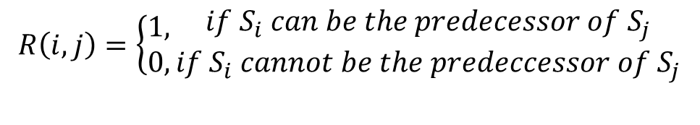
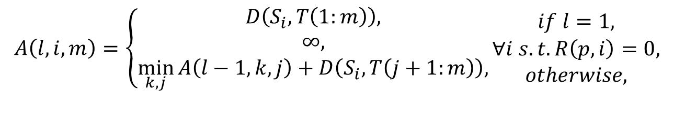
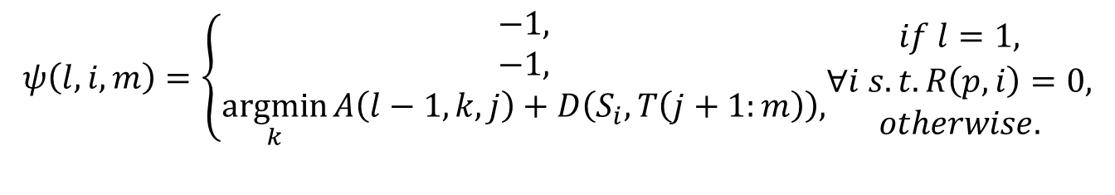
Level building
Goal: match an observation sequence to a number of models.
The LB algorithm jointly optimizes the segmentation of the sequence into subsequences produced by different models, and the matching of the subsequences to particular models
$$A\left(l,i,m\right)=\left\{\begin{matrix}D\left(S_{i}, T\left(1:m\right)\right), \\ ∞, \\ \min_{k,j}{A\left(l−1,k,j\right)+D\left(S_{i},T\left(j+1:m\right)\right),}\end{matrix}\right.\begin{matrix}if l=1, \\ ∀i s.t.R\left(p,i\right)=0, \\ otherwise,\end{matrix}$$
$$ψ\left(l,i,m\right)=\left\{\begin{matrix}−1, \\ −1, \\ \underset{k}{argmin}{A\left(l−1,k,j\right)+D\left(S_{i},T\left(j+1:m\right)\right),}\end{matrix}\begin{matrix}if l=1, \\ ∀i s.t.R\left(p,i\right)=0, \\ otherwise.\end{matrix}\right.$$
$$R\left(i,j\right)=\left\{\begin{matrix}1, \\ 0,\end{matrix}\right.\begin{matrix}if S_{i} can be the predecessor of S_{j} \\ if S_{i} cannot be the predeccessor of S_{j}\end{matrix}$$
Bigram constraint

Slide 17
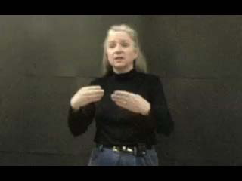
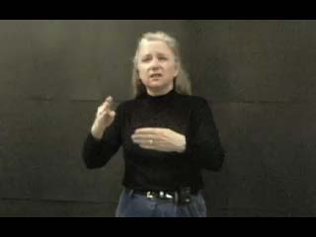
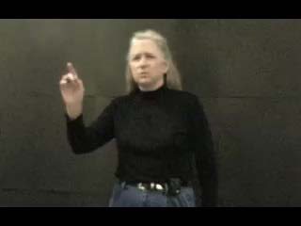
Movement Epenthesis
ME is very hard to model. For 40 signs, there could be 40x40=1600 different ME models.
Read
Newspaper
Newspaper Read I
Write
Book
Read Newspaper I
Gate
ME
Where

Slide 18

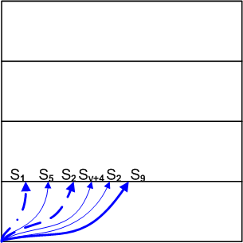
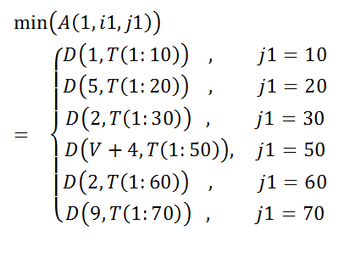
Enhanced Level building (eLB)
Possible Sign Number (i1) | 1 | 5 | 2 | V+4 | 2 | 9
Possible sign end frame (j1) | 10 | 20 | 30 | 50 | 60 | 70

Slide 19
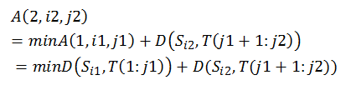
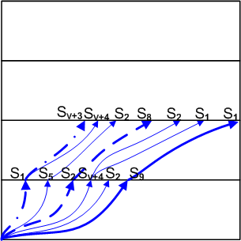
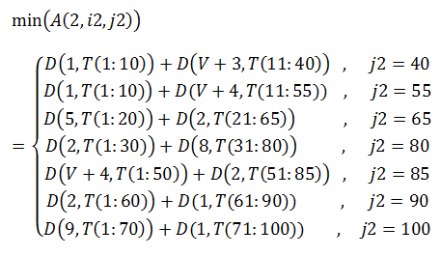
Enhanced Level building (eLB)
S9 S1
Possible Sign Number (i2) | V+3 | V+4 | 2 | 8 | 2 | 1 | 1
Possible sign end frame (j2) | 40 | 55 | 65 | 80 | 85 | 90 | 100

Slide 20
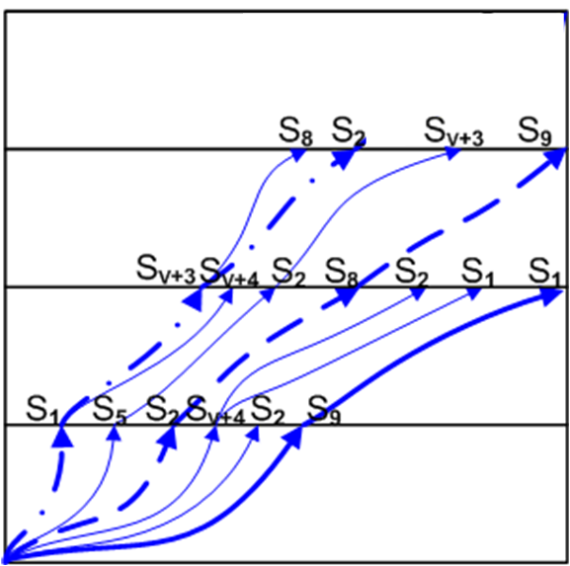
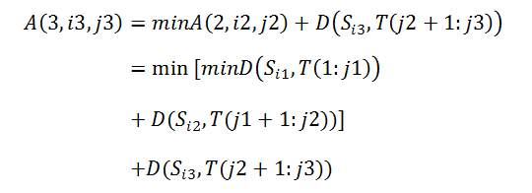
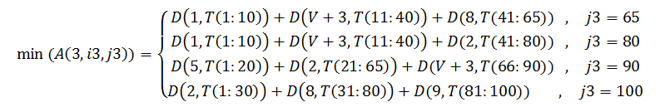
Enhanced Level building
S2 S8 S9
Possible Sign Number (i3) | 8 | 2 | V+3 | 9
Possible sign end frame (j3) | 65 | 80 | 90 | 100

Slide 21
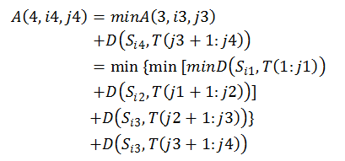
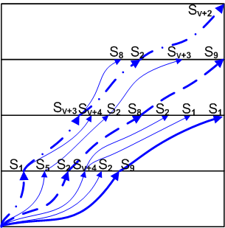
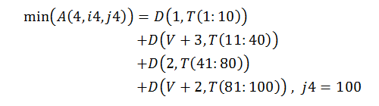
Enhanced Level building
S1 ME S2 ME
Possible Sign Number (i4) | V+2
Possible sign end frame (j4) | 100

Slide 22
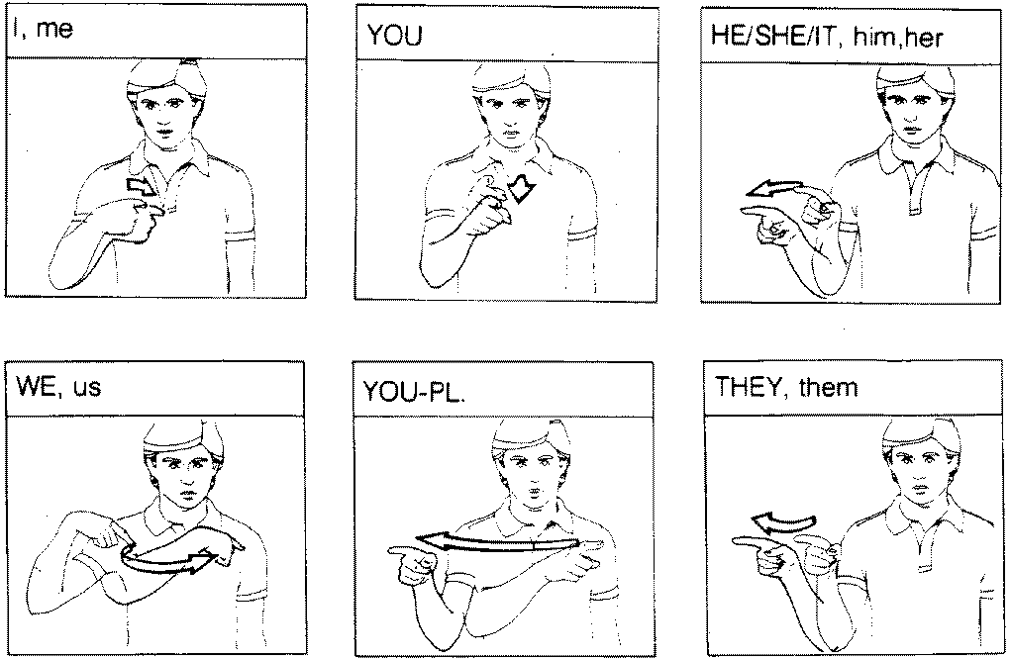
Sign examples

Slide 23
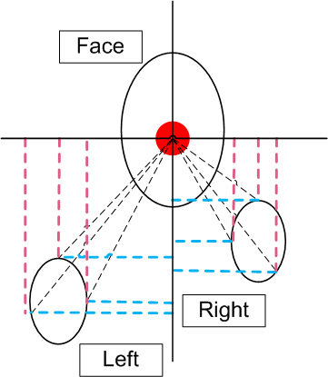
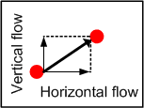
Global feature and local feature
Global
Error rate
Local

Slide 24
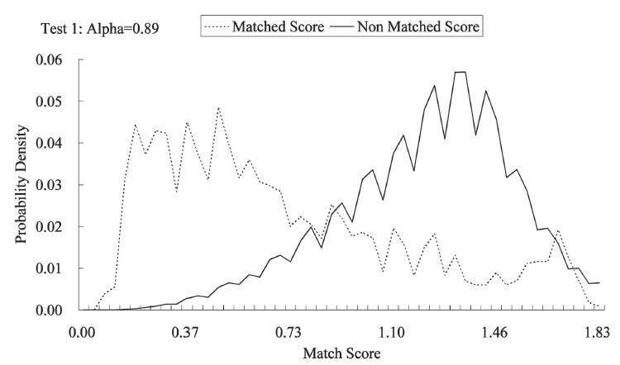
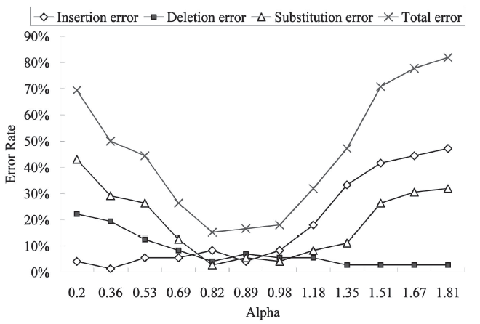

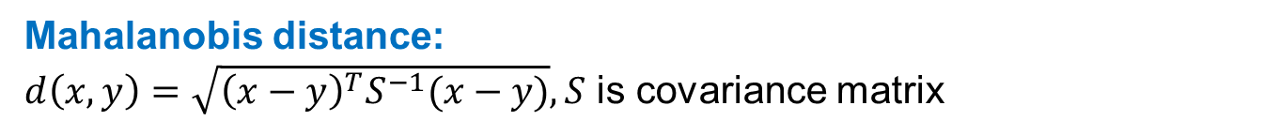
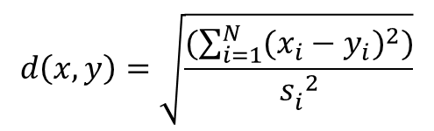
Matching Single Sign
Mahalanobis distance:
$d\left(x,y\right)=\sqrt{{\left(x−y\right)}^{T}S^{−1}(x−y)}, S$ is covariance matrix
Diagonal covariance matrix: Normalized Euclidean distance
It means all features are independent
$$d\left(x,y\right)=\sqrt{\frac{(\sum_{i=1}^{N}{({x_{i}−y_{i})}^{2}})}{{s_{i}^{}}_{}^{2}}}$$
Cost of ME label
$$D\left(S_{v+k},T\left(j+1,m\right)\right)=(m−j)α$$

Slide 25

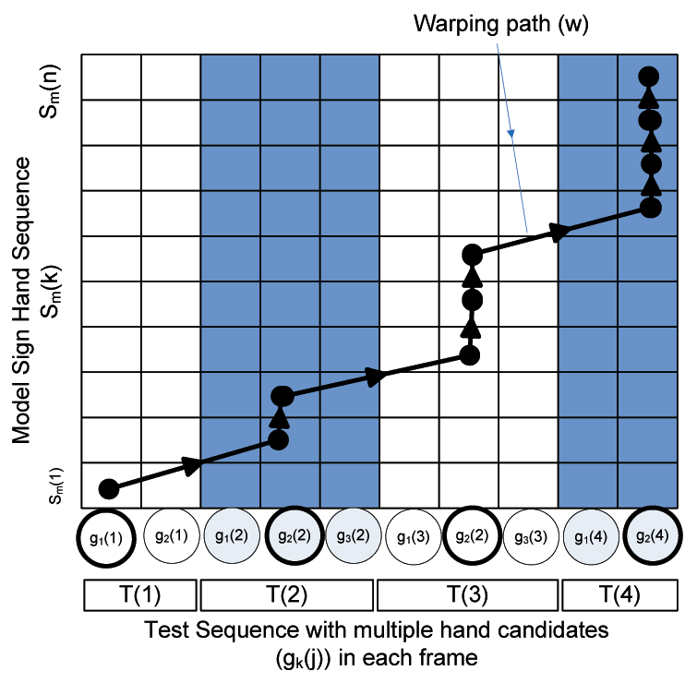
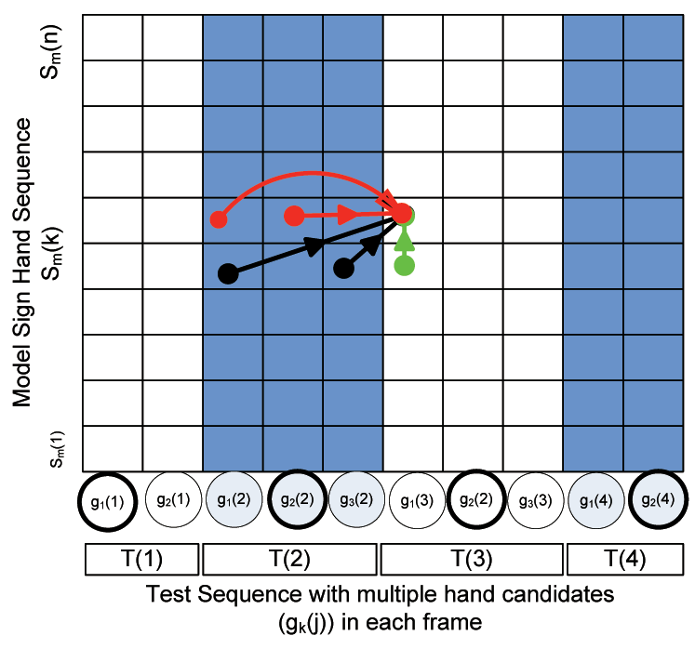
3D DP Matching
is model of sign m which contain n gestures
First order local constraint
One mistake

Slide 26










Binary Pruning of DP mapping
$ε$ derived from cross-validation
$$τ_{1}$$
$$τ_{2}$$
$$τ_{3}$$
$$τ_{4}$$
$$ε=\max\left(τ\right)−min⁡(τ)$$
N training examples and N test examples
0.5
Reject
A path is being pruned
d(6,3,2)>$τ_{0}$?
Delete
$τ_{0}:$ Maximum distance in training
States number of model

Slide 27
Sub-gesture Relationship
Sub-gesture | Super-gesture
“1” | {“7”, “9”}
“3” | {“2”, “7”}
“4” | {“5”, “8”, “9”}
“5” | {“8”}
“7” | {“2”, “3”}
“9” | {“5”, “8”}
3,7,8
1, 7
Mistake?
Delete digit 1
Delete 3 and 7?
Delete min cost between 7 & 8
Section 7.2 (2009 PAMI)

Slide 28
Experiment Results (1)
retrieval ratio: the ratio between the number of frames retrieved using that threshold and the total number of frames.
30 video sequences, three sequences from each of 10 users
ASL story of 1071 signs
24 signs: 7 one hand; 17 two hands. 10 train (color gloves), 10 test (short sleeves) for each sign. Total 32060 frames.
“BETTER” “HERE” “WOW”
Continuous digit recognition: 5.4% error rate, 5 false positive
Sign | Arrive | Big | Car | Decide | Here | Many | Now | Rain | Read
FP | 0 | 249 | 0 | 7 | 1 | 164 | 65 | 35 | 0
RR | 1/139 | 1/33 | 1/64 | 1/120 | 1/47 | 1/38 | 1/78 | 1/48 | 1/159

Slide 29


Experiment Results (2)
 | S | a | t | u | r | d | a | y
S | 0 | 1 | 2 | 3 | 4 | 5 | 6 | 7
u | 1 | 1 | 2 | 2 | 3 | 4 | 5 | 6
n | 2 | 2 | 2 | 3 | 3 | 4 | 5 | 6
d | 3 | 3 | 3 | 3 | 4 | 3 | 4 | 5
a | 4 | 3 | 4 | 4 | 4 | 4 | 3 | 4
y | 5 | 4 | 4 | 5 | 5 | 5 | 4 | 3
$$\frac{\text{number} \text{of} \text{correctly} \text{labeled} \text{frames}}{\text{total} \text{number} \text{of} \text{frames} }$$
(Levenshtein Distance)
the amount of difference

Slide 30
Experiment Results (3)
20 test sequences
5 test sequences 10 test sequences
Error rate
Error rate
Test
Error rate for complex background test
Error rate for cross signer test
train
Error rate
Error rate

Slide 31
Hand shape based model matching

Slide 32







Hand shape Bayesian Network (HSBN)
Independent
${P(x}_{s},x_{e}\left|i_{s}, i_{e}\right)=\frac{1}{P\left(i_{s},i_{e}\right)}P\left(x_{s},x_{e},i_{s},i_{e}\right)$
$$=\frac{1}{P\left(i_{s},i_{e}\right)}P\left(i_{s} | x_{s}\right)P\left(i_{e} | x_{e}\right)P(x_{s},x_{e})$$
$$∝P\left(x_{s} | i_{s}\right)P(x_{e}|i_{e})\frac{P(x_{s},x_{e})}{P\left(x_{s}\right)P(x_{e})}$$
Not independent
$$P\left(x_{s} | i_{s}\right) \begin{matrix}define \\ ∝\end{matrix} \sum_{i=1}^{k}{e^{−βi}}δ(x_{DB}^{i},x_{s})$$
$$P\left(x_{s}, x_{e}\right)=\sum_{φ_{s},φ_{e}}{π_{φ_{s}}a_{φ_{s},φ_{e}}}b_{φ_{s}}^{s}\left(x_{s}\right)b_{φ_{e}}^{e}\left(x_{e}\right)$$

Slide 33









Hand Shape Bayesian Network (HSBN)
$$P(x_{s},x_{e}|λ)$$
$$x_{i}$$
$$x_{ij}$$
$$\ln{P\left(x_{i},φ_{i} | λ\right)}=\ln{π_{φ_{s}^{i}}}+\ln{a_{φ_{s}^{i},φ_{e}^{i}}}+\sum_{j=1}^{\left|x_{i}\right|}{\ln{b_{φ_{s}^{i}}^{s}\left(x_{s}^{ij}\right)}}+\sum_{j=1}^{\left|x_{i}\right|}{\ln{b_{φ_{e}^{i}}^{e}\left(x_{e}^{ij}\right)}}$$

Slide 34

Variational Bayes
Exact inference is intractable?
$$lnP\left(x\right)=\ln{\int{dλ}P\left(x | λ\right)P\left(λ\right)}$$
$$=\ln{\int{dλQ_{λ}\left(λ\right)P\left(x | λ\right)\frac{P\left(λ\right)}{Q_{λ}\left(λ\right)}}}$$
$$≥\int{dλQ_{λ}\left(λ\right)\ln{P(x|λ)}\frac{P(λ)}{Q_{λ}(λ)}}$$
$=\int{dλQ_{λ}\left(λ\right)\left[\sum_{i=1}^{N}{\ln{P(x_{i}|λ)}}+\ln{\frac{P(λ)}{Q_{λ}(λ)}}\right]}$
$=\int{dλQ_{λ}\left(λ\right)\left[\sum_{i}{\ln{\sum_{φ_{i}}{P\left(x_{i},φ_{i} | λ\right)}}}+\ln{\frac{P\left(λ\right)}{Q_{λ}\left(λ\right)}}\right]}$
$≥\int{dλQ_{λ}\left(λ\right)\left[\sum_{i}{\sum_{φ_{i}}{Q_{φ_{i}}\left(φ_{i}\right)\ln{\frac{P\left(x_{i},φ_{i} | λ\right)}{Q_{φ_{i}}\left(φ_{i}\right)}}}}+\ln{\frac{P\left(λ\right)}{Q_{λ}\left(λ\right)}}\right]}$ $=ℱ(Q_{λ}\left(λ\right),Q_{φ_{i}}(φ_{i}))$
Variational Methods
Approximate the probability distribution
Use the role of convexity
Lower Bound

Slide 35











Jensen’s Inequality
A concave function value of expectation of a random variable is larger than or equal to the expectation of the concave function value of a random variable.
$$f{E\left[x\right]}≥E[f\left(x\right)]$$
$$f({λx}_{1}+\left(1−λ\right)x_{2})$$
$${λf(x}_{1})+(1−λ){f(x}_{2})$$
$\ln\left(x\right)$is strictly concave on $(0,∞)$
$$\ln{E\left[x\right]}≥E[\ln\left(x\right)]$$
$$a$$
$$x_{1}$$
$${λx}_{1}+(1−λ)x_{2}$$
$$x_{2}$$
$$b$$
Concave function

Slide 36


Dirichlet Distribution
Dirichlet distribution is from the same family as multinomial distribution which is called the exponential family
$$Mult\left(x | λ\right)=\frac{\left(\sum_{k}{x_{k}}\right)!}{\prod_{k=1}^{m}{(x_{k}!)}}\prod_{k=1}^{m}{λ_{k}^{x_{k}}}$$
Multinomial and Dirichlet distributions form a conjugate prior pair
$$P\left(x | λ\right)p\left(λ\right)=Mult\left(x | λ\right)Dir\left(λ | α\right)$$
$$\sim \prod_{k=1}^{m}{λ_{k}^{x_{k}}}\prod_{k=1}^{m}{λ_{k}^{α_{k}−1}}$$
$$\sim \prod_{k}{λ^{x_{k}+α_{k}−1}}$$
$$=Dir(λ|x+α)$$

Slide 37



VB-EM
$$\frac{∂ℱ}{∂Q_{λ}\left(λ\right)}=0 \underset{⇒}{ }$$
$$\ln{Q_{λ}\left(λ\right)}=\sum_{i}{\sum_{φ_{i}}{Q_{φ_{i}}\left(φ_{i}\right)[}}lnP\left(x_{i},φ_{i} | λ\right)−\ln{Q_{φ_{i}}\left(φ_{i}\right)}]+\ln{P\left(λ\right)}−C_{Q_{λ}}$$
$$\frac{∂ℱ}{∂Q_{φ_{i}}\left(φ_{i}\right)}=0 \underset{⇒}{ }$$
$$\ln{Q_{φ_{i}}\left(φ_{i}\right)}= \int{dλQ_{λ}\left(λ\right)\ln{P\left(x_{i},φ_{i} | λ\right)}}−C_{Q_{φ_{i}}}$$
new Log likelihood
new lower bound
Log likelihood
Log likelihood
new lower bound
$KL(p|\left|q\right)=\int_{x∈D}^{ }{p(x)log\frac{p(x)}{q(x)}}$
lower bound

Slide 38


Non-rigid Alignment
Eq. (10) 2011 CVPR
Mistake?
Stiffness Matrix
Local minima condition
Let , Local displacements to decrease

Slide 39


Feature Matching
Image size is 90*90
Each node compare with 17*17*9 feature points
Different

Slide 40



Non-rigid Alignment Smooth Component
Contribution: iteratively adapts the smoothness prior
Free Form Deformation (FFD) smooth prior:
Stiffness
 | 1 | 2 | 3 | 4 | 5 | 6 | 7 | 8 | 9
1 | 0 | kl12 | 0 | kl14 | kl15 | 0 | 0 | 0 | 0
2 | kl21 | 0 | kl23 | kl24 | kl25 | kl26 | 0 | 0 | 0
3 | 0 | kl32 | 0 | 0 | kl35 | kl36 | 0 | 0 | 0
4 | kl41 | kl42 | 0 | 0 | kl45 | 0 | kl47 | kl48 | 0
5 | kl51 | kl52 | kl53 | kl54 | 0 | kl56 | kl57 | kl58 | kl59
6 | 0 | kl62 | kl63 | 0 | kl65 | 0 | 0 | kl68 | kl69
7 | 0 | 0 | 0 | kl74 | kl75 | 0 | 0 | kl78 | 0
8 | 0 | 0 | 0 | kl84 | kl85 | kl86 | kl87 | 0 | kl89
9 | 0 | 0 | 0 | 0 | kl95 | kl96 | 0 | kl98 | 0
1
2
3
4
5
6
Matrix K
7
8
9

Slide 41
Conclusion
Pruning for DP map (Grammar)
Nested DP technique
Multiple hand candidates for ambiguous segmentation
Non-rigid hand shape Alignment
Variational Bayes network for hand shape recognition

Slide 42


Future Work
Blur
Reduction of hand pair candidate
Signer independent, especially kids
More data/Change text or speech to signs
Features other than HOG
Facial expression
Motion Blur

Slide 43

Thank You

