Slide 1
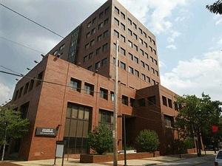
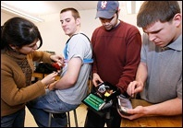
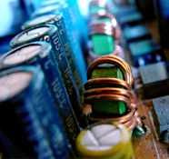
THE DEPARTMENT OF
ELECTRICAL AND COMPUTER ENGINEERING
Outline:
• ECE At a Glance
Research Clusters
Department Initiatives
Li Bai, PhD and Joseph Picone, PhD
Department of Electrical and Computer Engineering
College of Engineering
Temple University

Slide 2
ECE at a Glance
Faculty By Rank:
By the Numbers (2010-11):
Track | Full | Assoc | Assist | Total
TT | 6 | 4 | 1 | 11
NTT | 0 | 1 | 0 | 1
Adj. |  |  |  | 9
Post-Doc |  |  |  | 1
Staff |  |  |  | 2.5
TOTAL |  |  |  | 24.5
Degree | Enrolled | Graduated
BS: EE CpE BioE | 233 198 31 4 | 40 33 9 2
MS: EE CpE BioE | 37 29 6 2 | 29 25 4 0
PhD: EE CpE BioE | 16 10 2 4 | 5 5 0 0
Total: | 286 | 74
Faculty By Area of Specialization:
Area | Full | Assoc | Assist
Computer Engineering | 1 | 1
Signal Processing | 1 | 1 | 1
Controls | 1 | 2
Microelectronics | 2
Power and Energy | 1
Research Expenditures:
FY07: $888K
FY08: $421K
FY09: $453K
FY10: $450K
FY11: $510K
FY12: TBD

Slide 3
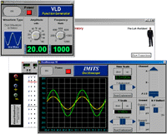
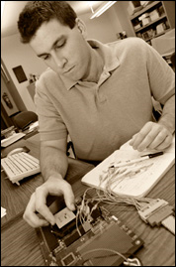
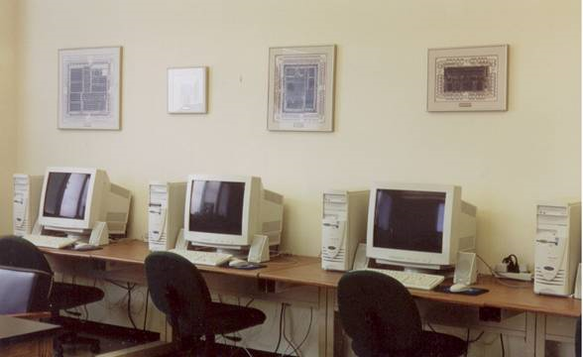
Facilities
Laboratory Space:
Unique Capabilities:
Universal Virtual Lab
Neural Instrumentation Laboratory
Multi-agent Systems Test Lab
System Chip Design
Robotics and Atmospheric Testing
Image Processing System Development
Sensors, Networks and Devices
Speech Processing
Type | Sqft
Offices | 3,290
Instructional Labs | 6,303
Research Labs | 3,903
TOTAL | 13,496

Slide 4
Notable Accomplishments in FY11 and FY12
ABET Accreditation:
Focused on the undergraduate program
250+ page comprehensive report
Should receive a 6-year accreditation with no deficiencies
Forced us to put rigorous assessment processes in place
Internal Program Review (Temple):
Based on ABET, but includes the graduate program
Forward-looking and focused on strategic plan
Comprehensive look at research productivity
Reviewers will probably cite a lack of resources and investment
Other departments will be reviewed very soon

Slide 5
Department Initiatives
Academics
In the process of restructuring the UG curriculum to reduce our circuits sequence to one course and increase the amount of programming and engineering science
Overhaul of Intro to Engineering completed
Advising
Advising spreadsheets for undergraduates and graduates has matured
Implementation of prerequisite checks
Infrastructure
Shared disk drive
Linux servers using Computer Services’ cloud
Open laboratories and recitation sections for theory courses
Creation of power/energy lab (Dr. Biswas)
Request tracking system
Efficiency
Metrics! Metrics! Metrics!: We have got to get better at tracking our productivity and maintaining historical records.

