Slide 1
Medical Aspects of our EEG Work
D. Jungreis

Slide 2
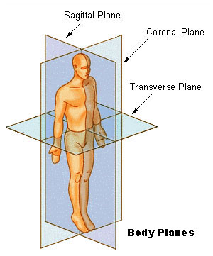
Body Planes
Note that this body is in standard anatomical position!
Notes:
Sagittal plane: Anterior to posterior, dividing the body into left and right halves
Midsagittal: dead center
Parasagittal: parallel to the midsagittal plane
Coronal plane: left to right, dividing the body into anterior and posterior halves
Transverse plane: Horizontal, dividing the body into top and bottom
Images in this plane are called “axial”.
In addition to noting the unusual way the body is oriented in standard anatomical position (the palms facing forward), note that in the male body, the penis is against the abdomen.

Slide 3
Anatomy Terminology
Anterior vs Posterior
Ventral vs Dorsal
Medial vs Lateral
Superior vs Inferior
Proximal vs Distal
Notes:
These are always with respect to standard anatomical position, meaning that relationships don’t change if you do a handstand.
Anterior: Front
Posterior: Back
“The eyes are posterior to the nose and anterior to the back of the head.”
Note: "Ventral" and "dorsal" also mean "front" and "back", respectively, though these terms tend not to be used in EEG.
Left and right describe left and right; we have no fancy terms.
Superior: Not a judgment, just “above”
Inferior: below
“The knee is superior to the foot and inferior to the heart.”
Medial: near the sagittal plane
Lateral: far from the sagittal plane
“The eyes lie lateral to the nose and medial to the ears.”
Proximal: Relatively near the beginning of a structure, usually a limb
Distal: Relatively distant from the beginning of a structure
“The wrist is proximal to the fingers and distal to the elbow.”
These are unlikely to come up in EEGing.

Slide 4
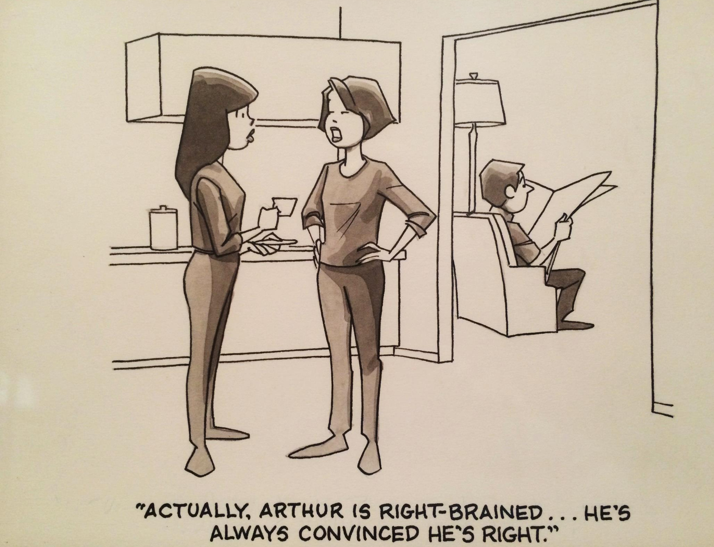
Notes:
Hoest/Reiner

Slide 5
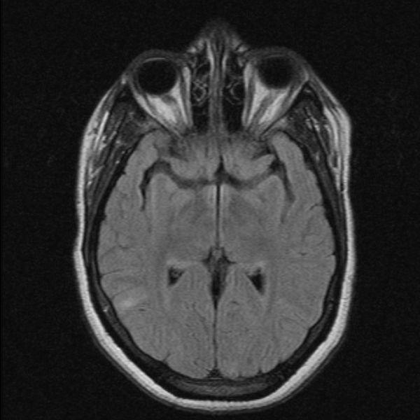
Brain Hemispheres
A
R
Notes:
Axial slice of the head. Note how the left and right sides of the brain have a dividing line.

Slide 6
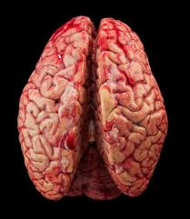
Notes:
Photograph of a brain. The hemispheres here have a clear division. Superior view with anterior at the top of the image.

Slide 7
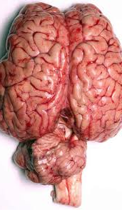
Notes:
Photograph of a brain. The hemispheres here have a clear division. Superior view with anterior at the top of the image. The cerebellum and brainstem are still attached.

Slide 8
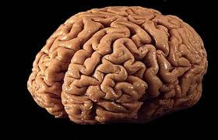
Notes:
Photograph of a brain. The hemispheres here have a clear division. Oblique view. Anterior of brain to left of page.

Slide 9
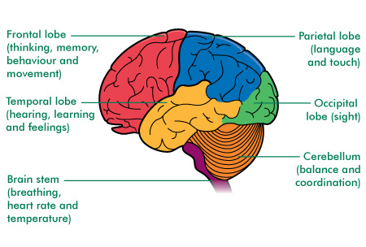
Lobes of the Brain
A
P

Slide 10
EEG
Electroencephalogram
Electro: Measuring electricity
Neurons (brain and nerve cells) communicate with electrical impulses
EEG measures voltages between two points
Encephalo: Brain
Gram: Display as graph (c.f. histogram)

Slide 11
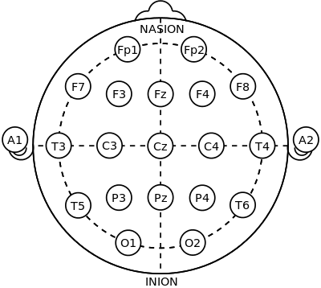
10-20 System
Notes:
This is how electrodes are placed on the head. Odd numbers are left; even numbers are right.
Fp: Pre-frontal
F: Frontal
T: Temporal
C: Central
P: Parietal
O: Occipital

Slide 12
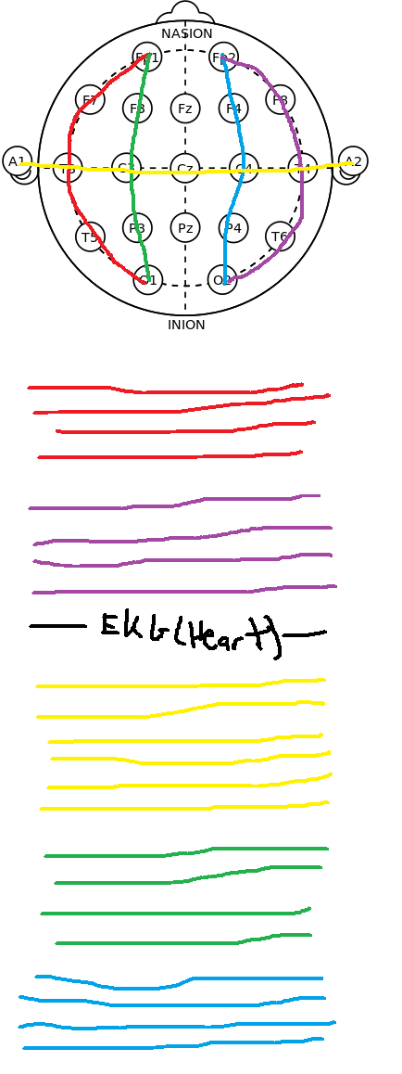
TCP Montage
Notes:
Each color shows a cluster of channels shown in a EEG. The order in TCP is red, purple, yellow, green, blue. This is a common montage used for general analysis of an EEG.

Slide 13
Four Main Waves
Delta 1-4 Hz
Theta 5-7 Hz
Alpha 8-13 Hz
Beta >13 Hz

Slide 14
Notes:
Alpha waves

Slide 15
Notes:
Beta waves

Slide 16
Notes:
Delta waves

Slide 17
Notes:
Theta waves

Slide 18
Photic Driving
Photic stimulation
Strobe light in the face
To provoke seizures
Patient must have event for location to be determined

Slide 19
Photic Driving
Most patients have no reaction
Some patients exhibit epileptiform activity
Benign variant: driving response
Brain waves synchronize with flash frequency

Slide 20
Photic Driving Response
Notes:
From 12.2105.s04
The green channel gives the flash frequency. Particularly in the P4-O2 channel right above, it is evident that the posterior frequency is synchronized with the flash frequency.

Slide 21
Epileptiform Response
Notes:
From 12.2105.s04
I see no driving in this image, but photic stimulation is provoking epileptiform spike-and-wave complexes.

Slide 22
Epileptiform Response
Notes:
From 12.2105.s04
This shows only the posterior channels from the previous slide. The spike-and-wave complexes are seen better.

Slide 23
Sleep Spindles
Student research

Slide 24
Sleep Spindles
Indicate stage 2 sleep
12-14 Hz, though depends on source
At least 0.5 seconds
Warby’s lower threshold was 0.3s
Experts identified spindles in the 0.3-0.5 range
Can last many (could be 20) seconds
I’ve never seen this, often 0.5-2 or even just 0.5-1
Warby: 15% >1s
Often found in “C” channels of TCP
Symmetrical across hemispheres in adults
Notes:
Frequency is disputed. 12-14 is what I first heard. Warby says 11-16. Vague definition in Ebersole/Pedley. Duman says “around 13Hz”.

Slide 25
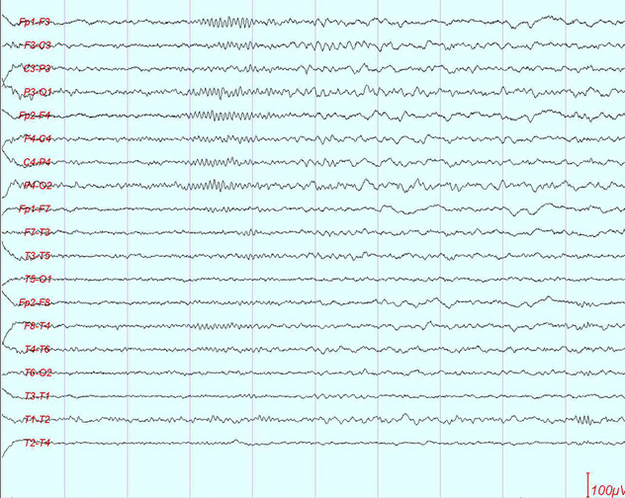
Sleep Spindles

Slide 26
Sleep Spindles
Notes:
http://emedicine.medscape.com/article/1140322-overview#aw2aab6b4
The red box outlines some spindles. The green outlines a few channels where they don’t look right. The highest green one could be a sleep spindle after the midway point of that second; the lower one does not have the right morphology, I think—not enough amplitude.

Slide 27
Normal/Abnormal
Posterior-dominant rhythm: 8.5-11Hz
Alpha rhythm vs alpha frequency
Anterior-posterior gradient
Reactivity
Notes:
Alpha frequency: same as before—8-13Hz.
Alpha rhythm: another name for the PDR.
AP Gradient: Faster frequencies with low amplitude in the frontal and central regions (during wakefulness) moving more to higher amplitude waves between 8.5-11Hz posteriorly.
Reactivity: With eyes closed, expect PDR to emerge. Likewise, opening eyes causes posterior channels to oscillate in the beta range.

Slide 28
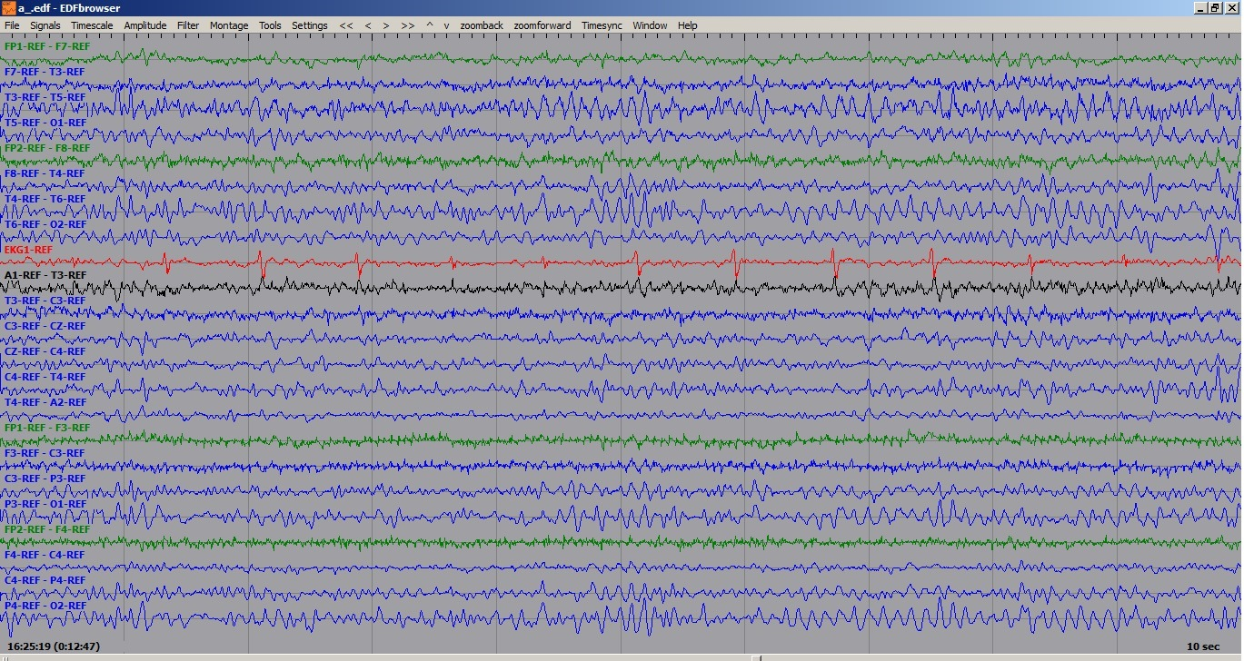
PDR screenshot
Notes:
EEG v0.6.0 103.7244
Note fast frequencies frontally and centrally and a PDR. The PDR creeps anteriorly a bit; this is common in drowsiness.

Slide 29
PLEDs
Periodic Lateralized Epileptiform Discharge
Need not indicate epilepsy or even seizures
Often indicate gross (macroscopic) pathology
Stroke: ischemic and hemorrhagic
Tumor
Not well understood
Want to investigate frequency
Notes:
Periodic: Happening over and over with some time (period) between events
Lateralized: Happens on one side of the brain
Epileptiform: Looks like event from epilepsy; need not be epileptic/seizure
Ischemic: Lack of blood. This is what most people think of when they think of a stroke. It is when something blocks a blood vessel, preventing blood (and thus oxygen) from reaching target tissue.
Hemorrhagic: Bleeding.
Tumor: …
Frequency investigation: Dr. Peter Crino’s (TUH professor) idea. From my discussions with him, it seems like when PLED frequencies are between 1-2Hz, it is not understood what that means, and it would be big for neurology to be able to say when the frequency corresponds to seizures.

Slide 30
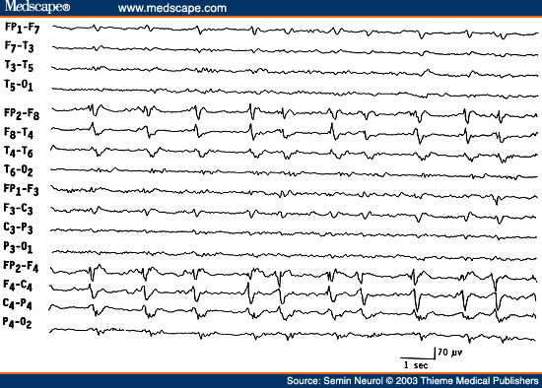
Notes:
PLEDs are occurring in the left hemisphere.

