Slide 1
Weekly Presentation
Pedro Henrique da Rocha Garrit
Date:05/15/2015

Slide 2
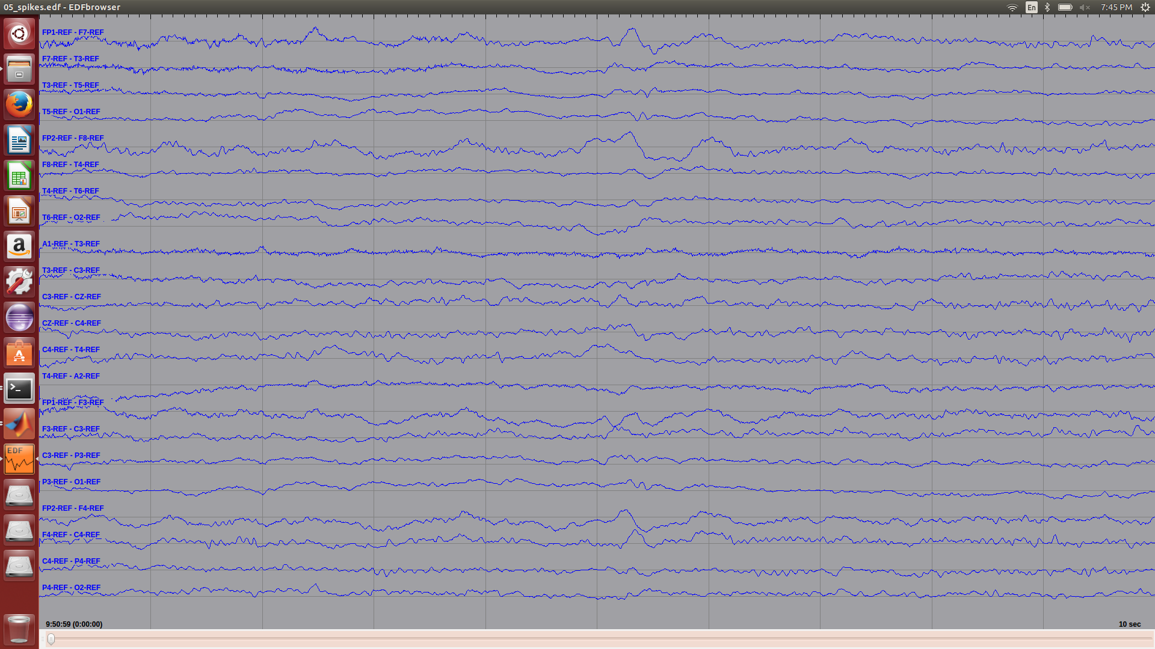
Goals:
Use EDFbrowser to monitor and perform montages on .EDF files content.
Write a program in MatLab to perform the same operations.
Fig .1 EDFbrowser displaying an example file with a montage applied to it

Slide 3
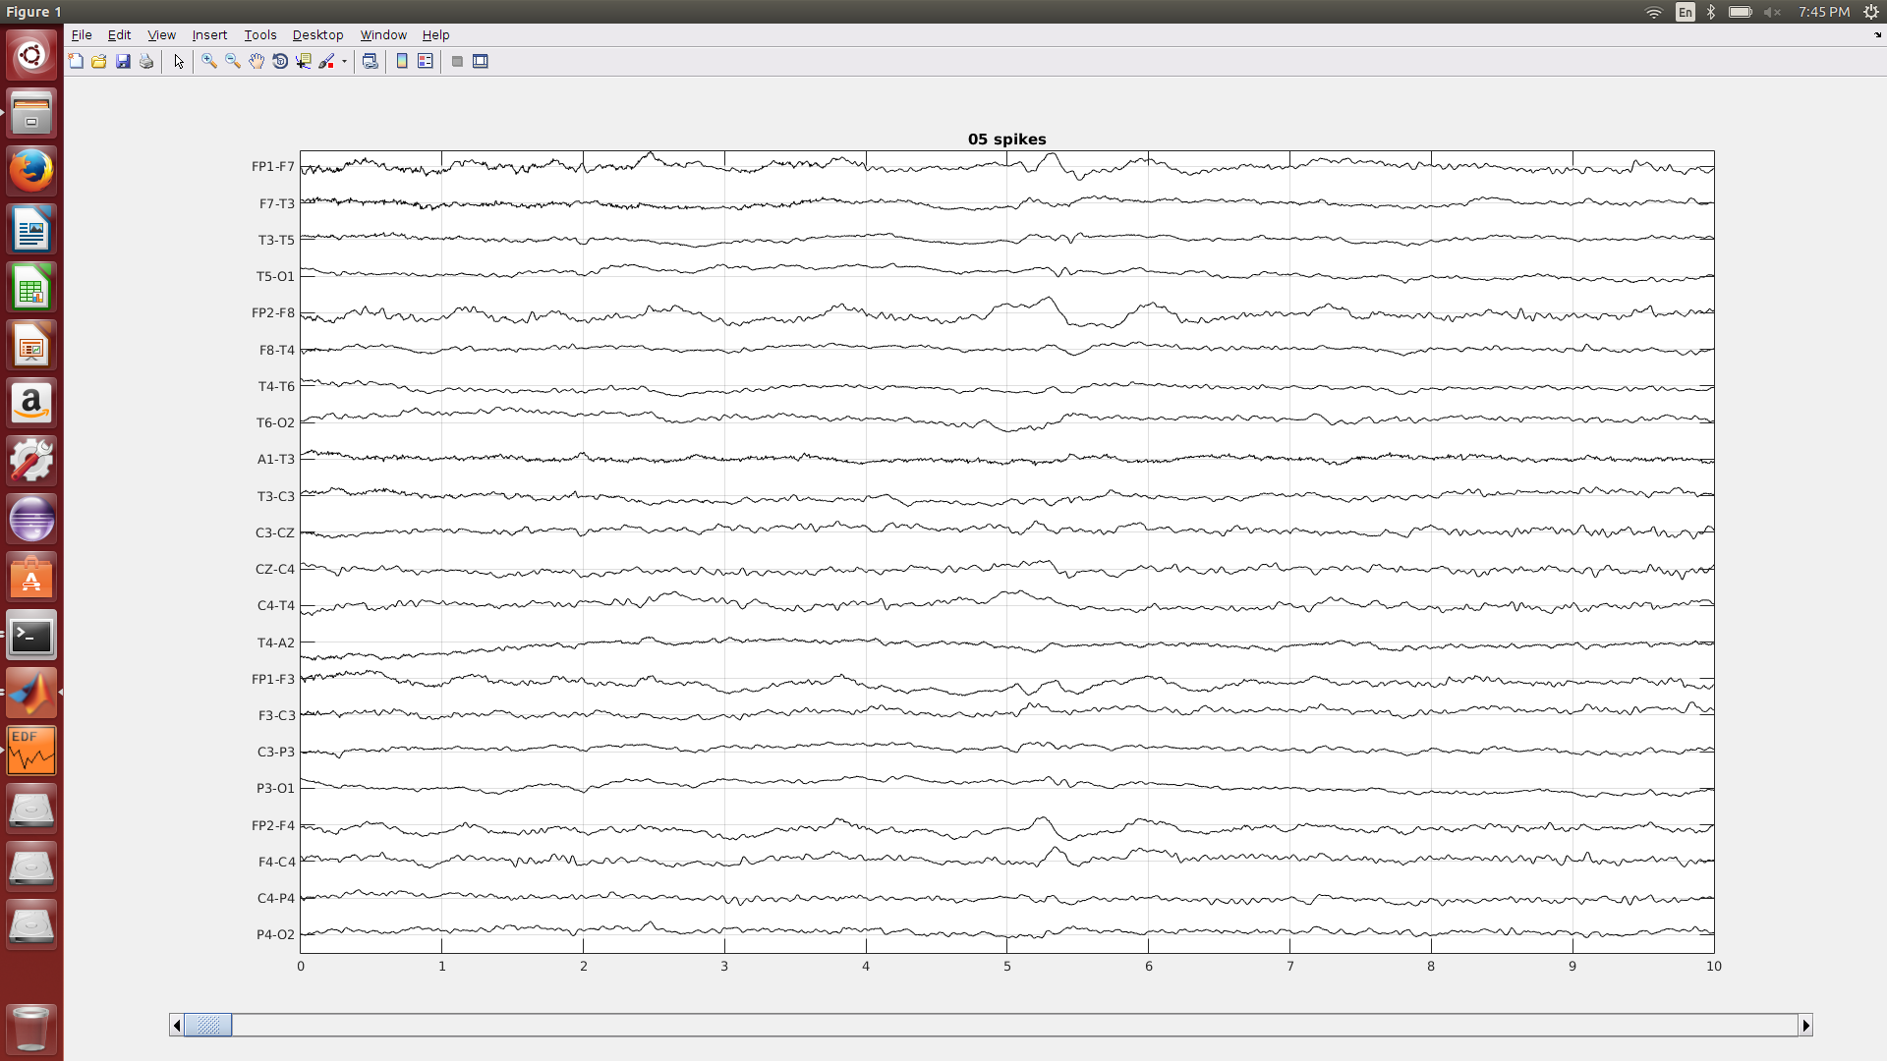
Acomplishiments:
Successfully created a montage file (.mtg) for EDFbrowser.
A MatLab program analogue to EDFbrowser was created.
Used EDFbrowser to validate the results shown by the MatLab program.
Fig .2 EDFbrowser analogue program created on MatlLab displaying the same waveforms shown in Fig.1

Slide 4
Plans:
Implement the feature extraction for EEG signals using wavelet based on the paper: "A new algorithm for wavelet-based heart rate variability analysis."

