Slide 1
Weekly Presentation
Fabricio Teles Dutra Goncalves
05/29/2015

Slide 2
Goals
Define an approach to implement the interpolation utility in dsp code.
Write code to deal with the channel processing regarding Interpolation project.
Create a new channel by averaging the first 3 channels of an .edf file;
Retrieve a channel by label;
Create a method to loop over all adjacent channels and compute interpolation;
Approach to add the new channel into the original set of channels;
Create new .edf file;
Replicate baseline experiment exp_0014.

Slide 3
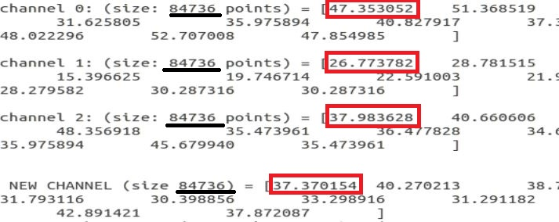
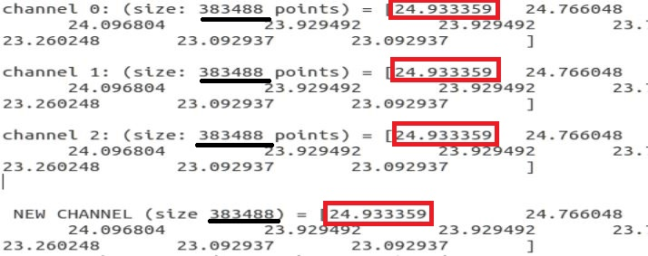
Accomplishments
Agreement to build Interpolation utility on top of gen_feats.
Existing functions are being modified in order to implement Interpolation algorithm.
Channel created by averaging the first 3 channels of an .edf file.
Edf::select method used to retrieve discrete points of a channel by label.
Baseline experiment exp_0014 replicated into t_000_002 directory.

Slide 4
Next Week
Implement approach to add the new channel.
Propose another parameter file
New variable indicating the right order of the channels (including the missing channels) by label.
Work on creating a new .edf file with the new set of channels.
Attach the parsing and channel processing functionality into the dsp code.
Make experiments evaluating functionality.

