Slide 1
Weekly Presentation
Fabricio Teles Dutra Goncalves
06/08/2015

Slide 2
Goals
Implement approach to add the new channel.
Work on creating a new .edf file with the new set of channels.
Attach the parsing and channel processing functionality into the dsp code.
Make experiments evaluating functionality

Slide 3
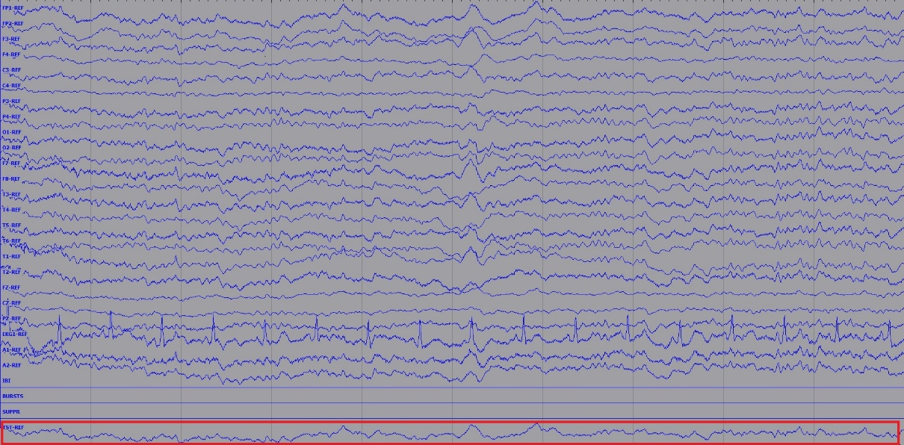
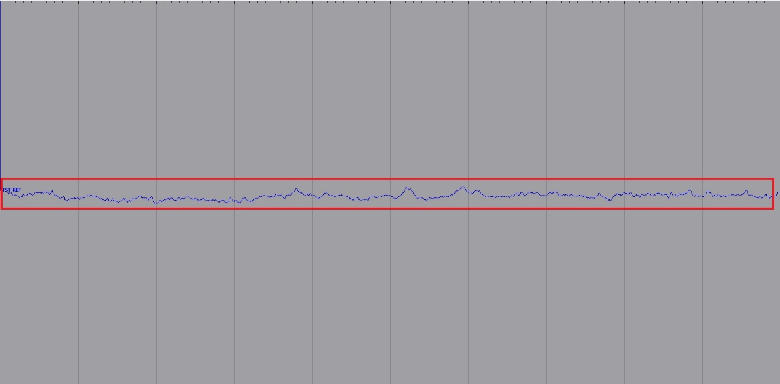
Accomplishments
New channel and its discrete points added in the original set of channels.
New .edf file created.
The .edf file was tested in MatLab, EDFbrowser, and print_signal utility.

Slide 4
Next Week
Combine parsing and channel processing code.
Correct error when the new channel is written to the file.
Check documentation.
Perform tests using the parameter file.
Work on PLED analysis.

