Slide 1
Weekly Report
By: Devin Trejo
Week of May 30, 2015 -> June 5, 2015

Slide 2
Previous Goals
Hadoop
Gather 6 computers from the Engineering IT office to use as a Hadoop Test Cluster
Network and initialize the Hadoop Cluster following a guide
Setup NameNode, JobTracker, and 4 DataNodes
Initialize the Hadoop cluster with test data
Perform a standardized test (Word Count) testing the performance of the Cluster
NEDC EEG Database
Process 2014 for errors and push for final release status.

Slide 3
Week Overview
Monday | Tuesday | Wednesday | Thursday | Friday | Saturday
Gather Hardware from ENGR IT | Try to create a locally hosted repository | Create a LAN for the NEDC Cluster Project | Try to create a PXE server | Swap Hardware between PCs | NEDC EEG Corpus
Download software (over WiFi) | Setup Apache Web Server to host PXE files | Internet access! | First try at Hadoop installation | Re-install CentOS 6.6
Install CentOs 7 | Try to create a PXE server | Install CentOs 6.6 | Hadoop installation errors | Hadoop startup successful!
Interact w/ ENGR IT trying to get Internet | Try to create a client Linux image to distributed to all clients |  | Hadoop hardware problems | Run first job on Hadoop server

Slide 4
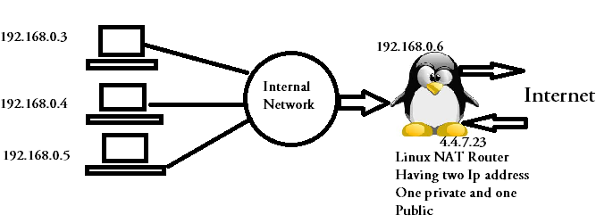
Obstacles
Problem
Solution
Temple Internet Restrictions = Network Problems
Need internet to access repositories.
Setup a LAN using a Linux DHCP server
Requires to LAN ports

Slide 5
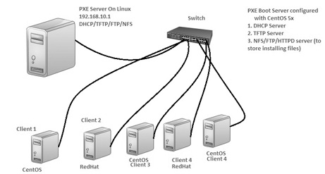
Obstacles (cont.)
Problem
Solution
Install Centos 6.6 on 6 PCs with SSH access
Setup a PXE server that hosts the OS.
Note: Client’s need to have a NIC that supports boot off PXE
Uses a combination of DHCP sever, TFTP Server and FTP/HTTP server
Failed to initialize

Slide 6
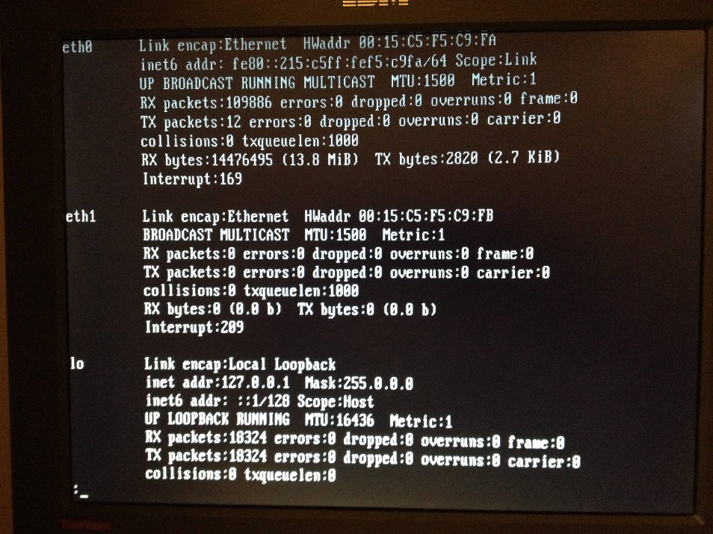
Obstacles (cont.)
Problem
Solution
Client name resolution
Assign static IP address to all nodes in the system
Setup DHCP to lease static IPs given a MAC address
Edit hosts file for each PC to allow easy naming convention nn1 = 10.100.1.2

Slide 7
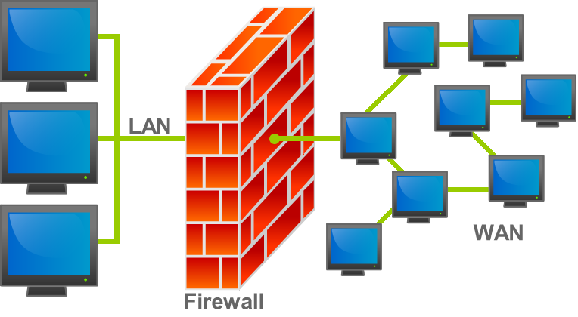
Obstacles (cont.)
More Problems & Solutions
Wireless Internet
Configure LAN connection
Firewall
Solution: Disable firewall for LAN nodes
Regional Time Sync
Install NAT package and sync time w/ internet
Hardware Restrictions
Swap memory modules/GPU between computers
Multiple tries to install Hadoop leave behind problem causing config files
Clean Re-Install of CentOs 6.6 on all PCs

Slide 8
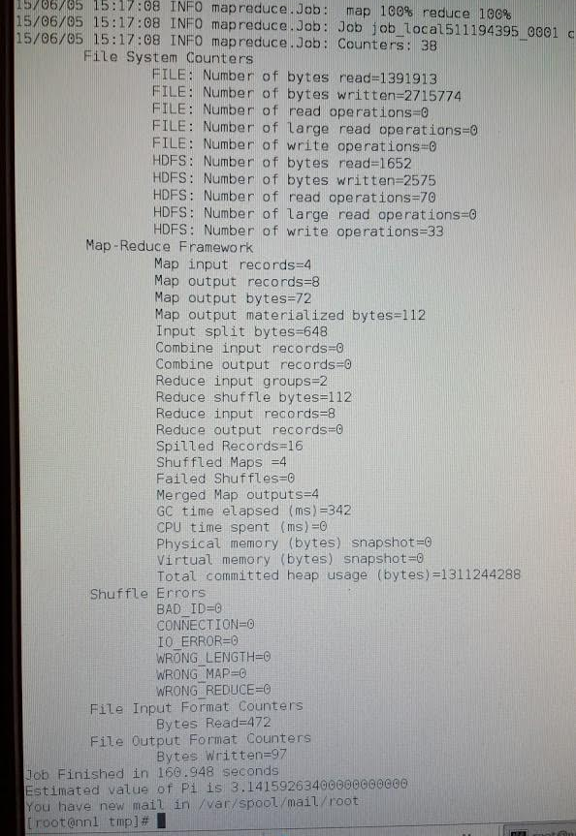
Accomplishments
I created ~200 line step-by-step guide for installing Hadoop using CentOS 6.6 (on Temple’s network)
Hadoop Cluster running with 1xNN, 1xJT, 3xDN with 1 Gateway
Ran first job on Hadoop server calculating PI with 1 billion samples

Slide 9
Accomplishments (cont.)
Report Status 2014/2015:
 | Session Count | Access | mModal | HC | Missing
Release_2014 | 3013 (2977 w/ Reports) | 1746 | 971 | 260 | 35
Release_2015 | 490 (458 w/ Reports) | 286 | 164 | 8 | 30
Overall Status 2014:
# | Function | Description | Status 1st Pass | Status 2nd Pass
1 | chck_mrns | Finds: No. Records Found, Duplicate MRNs, Multiple MRNs | Done 05/18/2015 | Done 05/26/2015
2 | check_fnames | Checks file_name syntax (Len(MRN)=8, Len(Date)=8, appendix) | Done 05/18/2015 | Done 05/26/2015
3 | check_dirs | Checks to ensure we have all necessary files in a directory | Done 05/19/2015 | Done 05/26/2015
4 | check_prerelease | outputs the files we need to exist in each directory | Done 05/25/2015 | Done 05/26/2015
5 | check_names | Compares names in NPA to reports | Done 05/25/2015 | Done 05/26/2015
6 | check_eg | Checks to see if de-identified = source | Done 05/25/2015 | Done 05/26/2015
7 | word_frequency | A tool to look for patient names, ect | N/A | Done 05/26/2015
8 | spell_check | Spell check the reports | N/A | In Progress
9 | check_special_words | Checks for special words that correlate to identifiable information | N/A | Done 05/27/2015

Slide 10
New Goals
Hadoop -> HPC
Switch to using Torque (w/ MAUI) as a job scheduler. As noted above, Torque is the open-source sister project of PBS which Temple uses.
For cluster monitoring we can use Ganglia and Nagios. They allow for monitoring of resources and handle node failure notification. For system deployment we can use experiment with one of the HPC deployment systems quoted above. For module handling we can use LMOD.
NEDC Data
Finalize 2014 for release
Proceed to prepare 2015 for spell check

