Slide 1
Weekly Presentation
Fabricio Teles Dutra Goncalves
06/15/2015

Slide 2
Goals
Combine parsing and channel processing code.
Correct error when the new channel is written to the file.
Check documentation.
Perform tests using the parameter file.

Slide 3
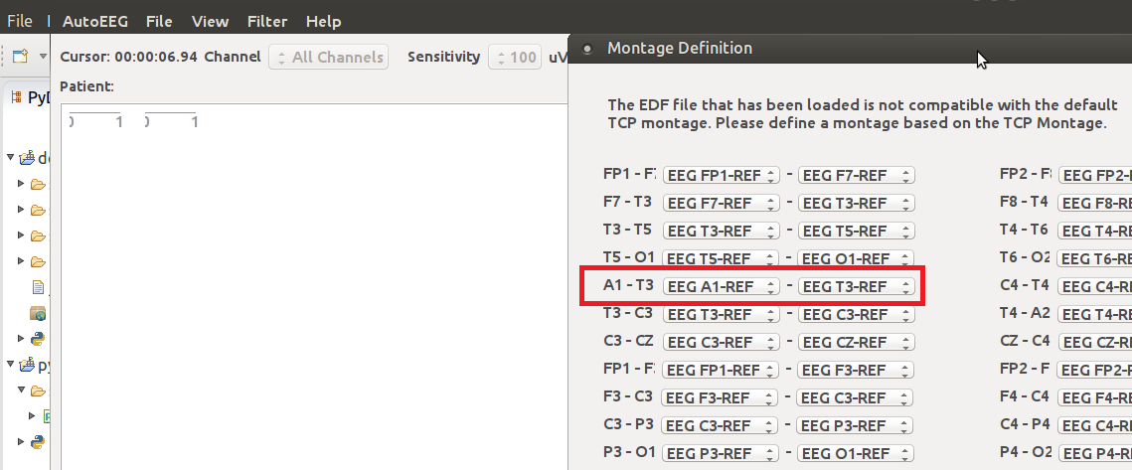
Accomplishments
Parsing and channel processing code partially combined.
Experiment performed adding a missing channel (A1).
Montage applied using EDFbrowser and demo software.

Slide 4
Next Week
Perform experiments interpolating multiple new channels using the new parameter file format.
Finish to integrate the code.
Design review.
Check documentation.

