Slide 1

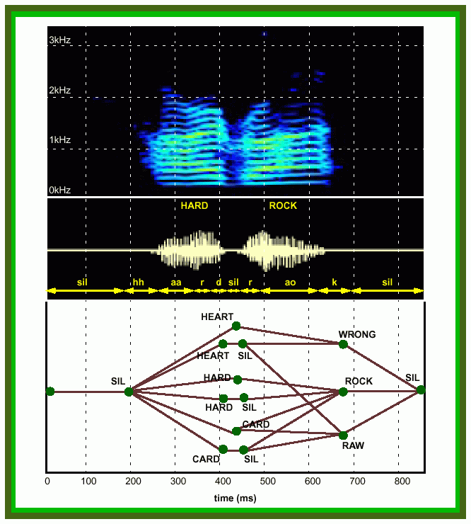

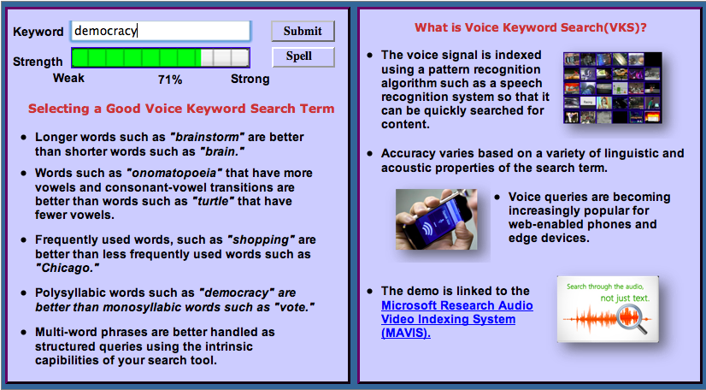
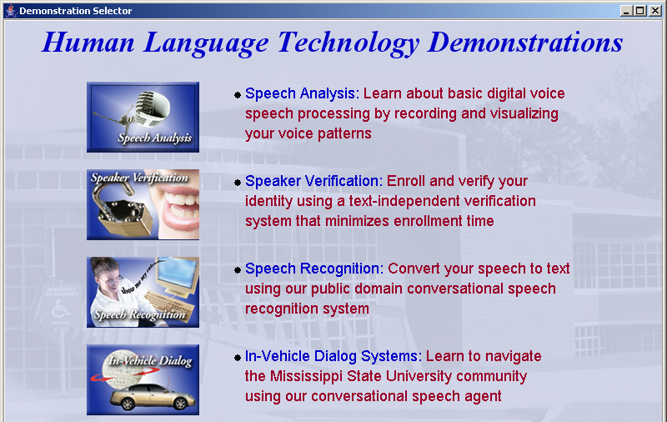
Institute for Signal and Information Processing
Mission: Automated extraction and organization of information using advanced statistical
models to fundamentally advance the level of integration, density, intelligence and performance
of electronic systems. Application areas include speech recognition, speech enhancement and biological systems.
Impact:
  Real-time information extraction from large audio resources such as the Internet
  Intelligence gathering and automated processing
  Next generation biometrics based on nonparametric statistical models
  Rapid generation of high performance systems in new domains involving untranscribed big data using models that self-organize information
Expertise:
  Statistical modeling of time-varying data sources in human language, imaging and bioinformatics
  Speech, speaker and language identification for defense and commercial applications
  Metadata extraction for enhanced understanding
  and improved semantic representations
  Intelligent systems and machine learning
  Data-driven and corpus-based methodologies utilizing big data resources have been proven to result in consistent incremental progress

Slide 2
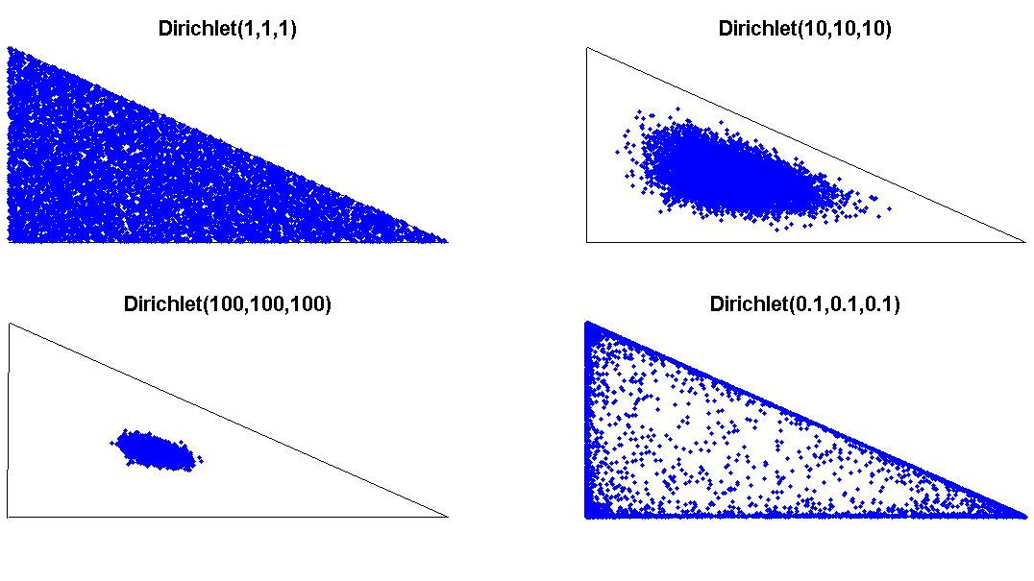
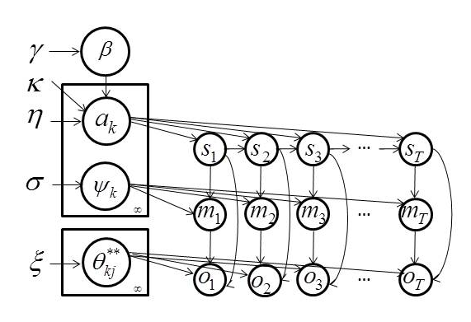
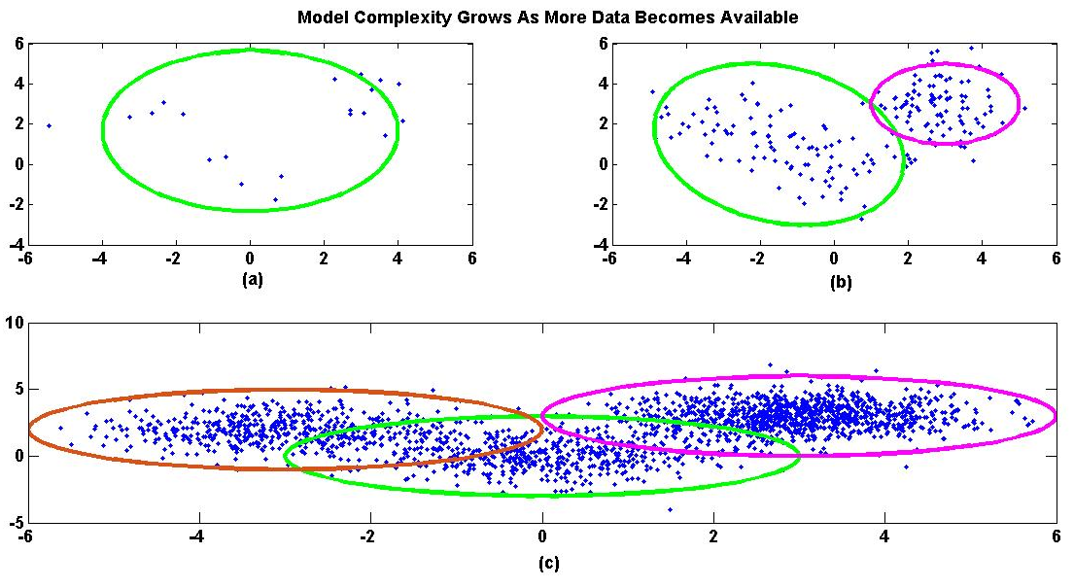
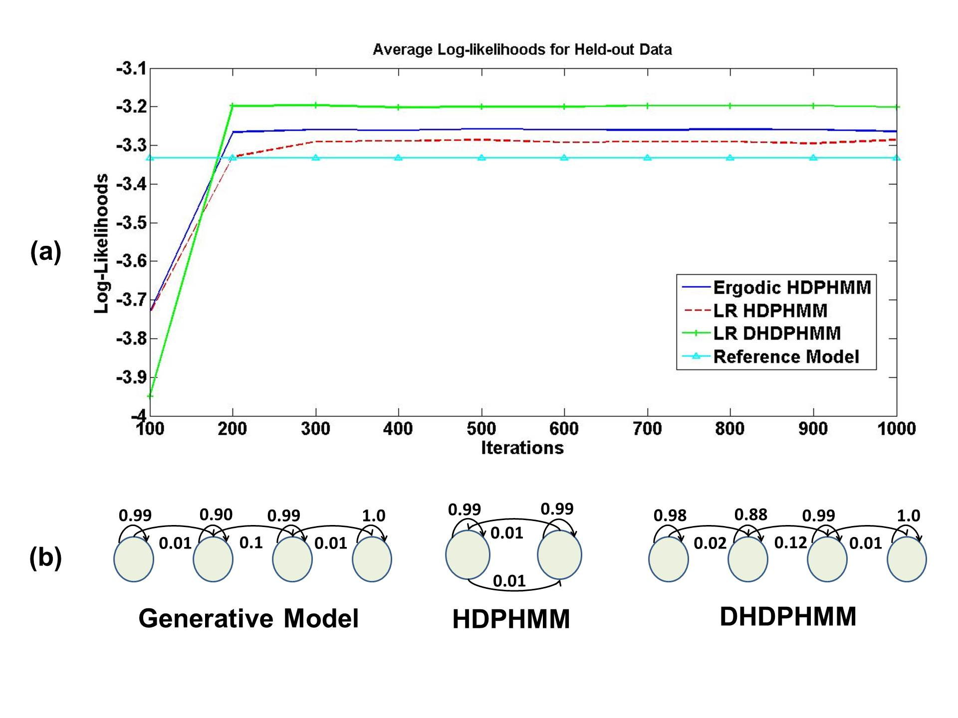
Big Data and Machine Learning
Goal: Self-organization of information using advanced statistical modeling algorithms so that
big data resources can be automatically ingested and mined for information. For example,
predictive maintenance models can be developed that exploit hidden dependencies between data sources.
Impact:
  Data from a variety of information sources, such as images, video, audio and text, can be ingested
  Powerful analytics can be derived based on data-driven nonparametric Bayesian models
  Complexity and discovery is learned automatically using big data resources
  Models can be acquired hyper-real time and rapidly adapted to new, previously unseen data
Relevant Expertise:
  Experimental design and instrumentation of transportation-related data collection
  Automatic ingestion of disparate data sources
  Blind deconvolution of signal and noise
  State of the art machine learning technology based on temporal modeling (hidden Markov models), long-term contextual modeling (deep learning) and advanced inference (nonparametric Bayesian)
  Decision support, resource optimization, predictive modeling and statistical inference

Slide 3
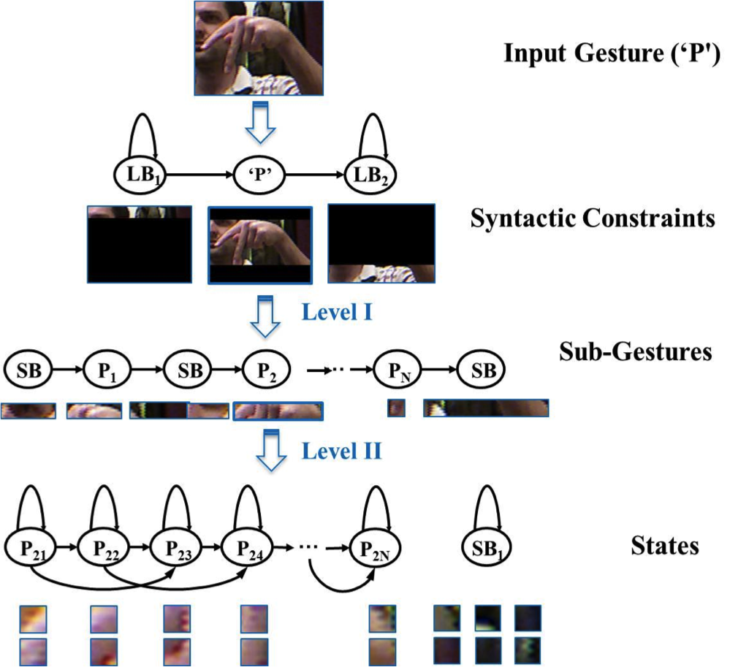
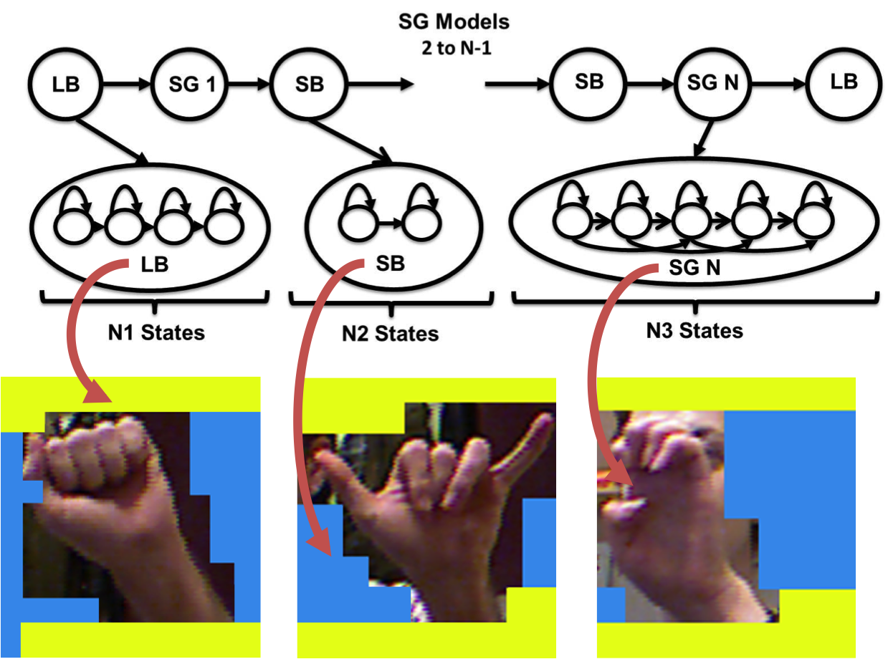
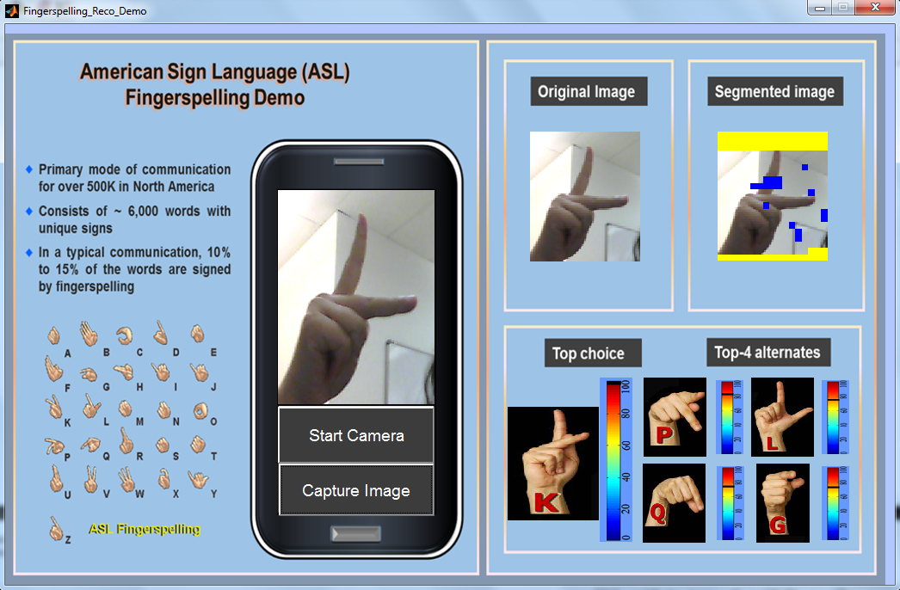
ASL Fingerspelling Recognition
Mission: (1) To fundamentally advance the performance of American Sign Language fingerspelling
recognition to enable more natural and efficient gesture-based human computer interfaces. (2) To deliver improved performance using standard, low-cost video cameras such as those in laptops and smartphones.
Impact:
  Best published results on the ASL-FS dataset (2% IER on an SD task and 46.7% on an SI task)
  Represents an 18% reduction over state of the art on the signer-independent (SI) task
  Integrated segmentation of images into background and image
  Image segmentation and background modeling remain the most significant challenges on this task
Overview:
  Apply a two-level hidden Markov model (HMM) based approach to simultaneously model spatial and color information in terms of sub-gestures
  Use Histogram of Gradient (HOG) features
  Frame-based analysis that processes the image in a sequential fashion with low latency
  Use unsupervised training to learn sub-gesture models and background models
  Short and long background models to better isolate hand segments and finger positions

Slide 4

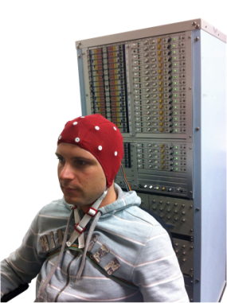
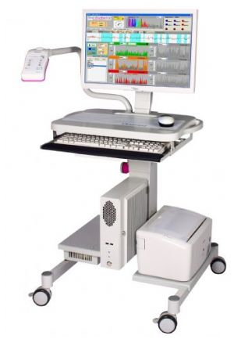
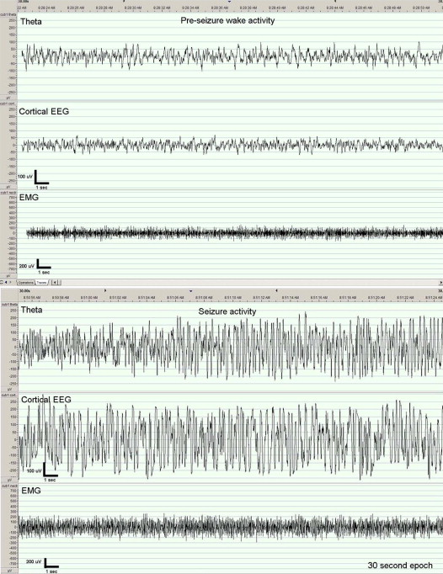
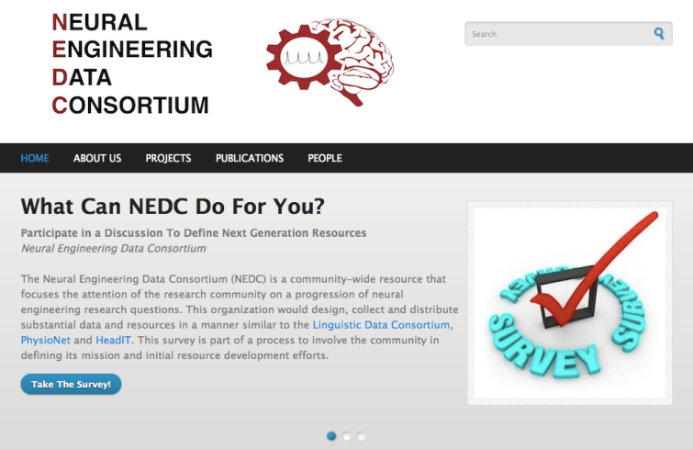
The Neural Engineering Data Consortium
Mission: To focus the research community on a progression of research questions and to
generate massive data sets used to address those questions. To broaden participation by making
data available to research groups who have significant expertise but lack capacity for data generation.
Impact:
  Big data resources enables application of state of the art machine-learning algorithms
  A common evaluation paradigm ensures consistent progress towards long-term research goals
  Publicly available data and performance baselines eliminate specious claims
  Technology can leverage advances in data collection to produce more robust solutions
Expertise:
  Experimental design and instrumentation of bioengineering-related data collection
  Signal processing and noise reduction
  Preprocessing and preparation of data for distribution and research experimentation
  Automatic labeling, alignment and sorting of data
  Metadata extraction for enhancing machine learning applications for the data
  Statistical modeling, mining and automated interpretation of big data
  To learn more, visit www.nedcdata.org

Slide 5
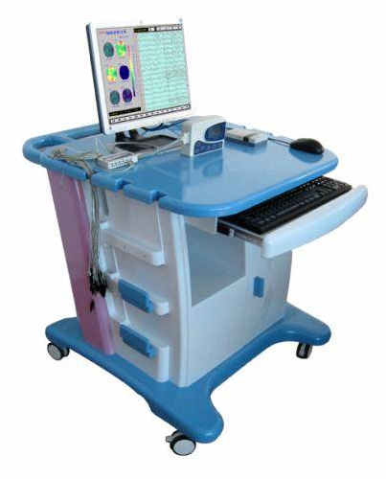
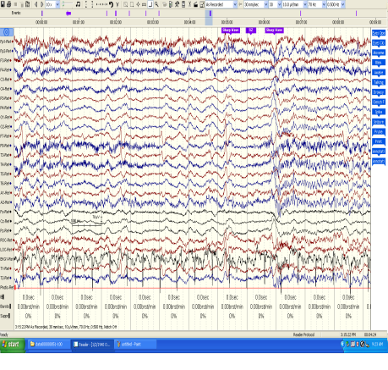
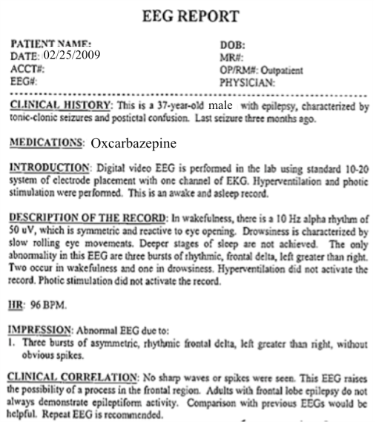
The Temple University Hospital EEG Corpus
Synopsis: The world’s largest publicly available EEG corpus consisting of 20,000+ EEGs collected
from 15,000 patients, collected over 12 years. Includes physician’s diagnoses and patient medical
histories. Number of channels varies from 24 to 36. Signal data distributed in an EDF format.
Impact:
  Sufficient data to support application of state of the art machine learning algorithms
  Patient medical histories, particularly drug treatments, supports statistical analysis of correlations between signals and treatments
  Historical archive also supports investigation of EEG changes over time for a given patient
  Enables the development of real-time monitoring
Database Overview:
  21,000+ EEGs collected at Temple University Hospital from 2002 to 2013 (an ongoing process)
  Recordings vary from 24 to 36 channels of signal data sampled at 250 Hz
  Patients range in age from 18 to 90 with an average of 1.4 EEGs per patient
  Data includes a test report generated by a technician, an impedance report and a physician’s report; data from 2009 forward inlcudes ICD-9 codes
  A total of 1.8 TBytes of data
  Personal information
  has been redacted
  Clinical history and medication history are included
  Physician notes are captured in three fields: description, impression and correlation fields.

Slide 6
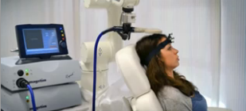
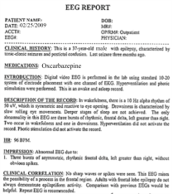
Automated Interpretation of EEGs
Goals: (1) To assist healthcare professionals in interpreting electroencephalography (EEG) tests,
thereby improving the quality and efficiency of a physician’s diagnostic capabilities; (2) Provide
a real-time alerting capability that addresses a critical gap in long-term monitoring technology.
Impact:
  Patients and technicians will receive immediate feedback rather than waiting days or weeks for results
  Physicians receive decision-making support that reduces their time spent interpreting EEGs
  Medical students can be trained with the system and use search tools make it easy to view patient histories and comparable conditions in other patients
  Uniform diagnostic techniques can be developed
Milestones:
  Baseline hidden Markov model-based system operating at 98% accuracy on research data (1Q’2014)
  TUH EEG Corpus baseline experiments (2Q’2014)
  Events labeled at 95% detection accuracy with a 5% false alarm rate on the TUH EEG Corpus (3Q’2014)
  Portable Python-based demonstration system with live input, montages and event search (4Q’2014)
  Analytics based on detected events (e.g., change detection of periodicity in PLEDs (1Q’2015)
  Enhanced feature extraction (2Q’2015)

Slide 7
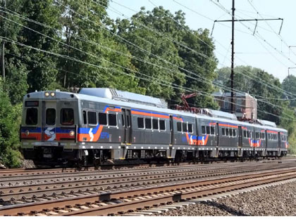

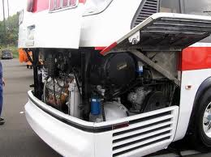
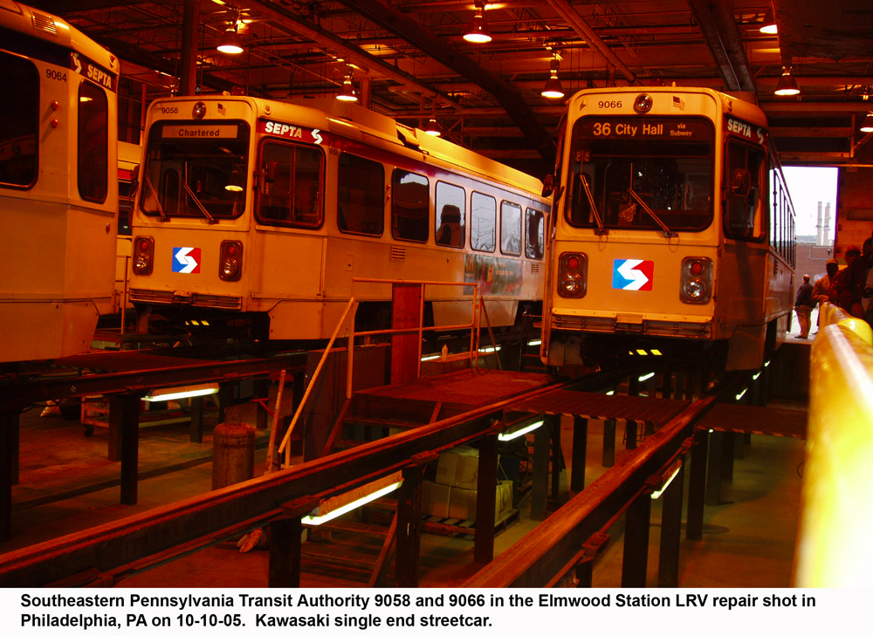
Transportation
Technology
Training
Center
Steve Shaffer
Shaffer Educational Associates, Inc.
David Thurston Joseph Picone
Parsons Transportation Group Temple University

Slide 8
Transportation is an Important National Challenge
Top 11 Priorities of the National Academies of Science’s Transit Technical Training Deliberations:
Electronics/Electrical
Heating, Ventilation, and Air Conditioning (HVAC)
Brakes (including ABS)
Diesel Engines
Preventative Maintenance (PM) Inspections
Drive Train and Transmissions
Suspension & Steering
L2 Engine Diagnostics
Body Systems
CNG and other Alternative Fuels
Hybrid-Electric Technology

Slide 9
Then and Now...
A Prospectus, prepared by Northrop Services, Inc. in 1980:
  “A New Approach to the Nation’s Transportation Problems: The physical infrastructure of the United States is in a state of dismal disrepair… Transit systems in particular are facing the challenges of delivering service in the 21st Century. Issues of recruitment and retention of employees coupled with the impacts of labor-market conditions and labor-management relations are of critical significance to the viability of public transit.”
Recently, the American Society of Civil Engineers (www.asce.org) issued a Report Card on the quality of our transit systems:
  “The Grade was a ‘D’. Transportation agencies face an unprecedented level of retirements of not only senior-level managers – but also maintenance-level technicians – over the next decade – nearly double the rate for the nation’s entire workforce. It is approaching sixty-percent.” (TRB Report, 275, p. 136).
Recommended that “Transportation agencies should partner with universities …. training institutes and the LTAP (Local Technical Assistance Programs) centers to meet agency training and workforce development needs.” (TRB Report, 275, p. 8).

Slide 10
Meeting the Needs of a Diverse, Nontraditional Workforce
Existing university-based research centers are delivering print-dominated, passive lecturing to large classes of 30 participants or more.
Training literature shows that this is the least effective – not to mention least efficient – delivery system. Plus, it costs too much.
According to a recent TCRP (Transportation Cooperative Research Program) Report #77, p. 12, “…Organizations are increasingly interested in bringing training in-house…Technology-driven training dropped slightly to 8.5%.”
Tutorial, one-on-one instruction appears to be substantially superior to classroom, one-on-many instruction. Interactive instructional technology based on computer technology may make tutorial instruction economically practical.
Tailoring instruction (education and training) to the needs of individual learners has been found to be an instructional imperative and an economic impossibility. Technology-based instruction can, in many cases, make this instructional imperative affordable.

Slide 11
Adaptation to Learner Style and Motivation is Critical
Gilbert’s Behavior Engineering Model:
Management’s Responsibility | Information | Resources | Incentives / Consequences
 | Expectations Standards Feedback Availability of Information | Tools Systems Procedures Time Reference Materials | Financial and Non-Financial Tangible and Intangible Rewards Recognition Promotions Punishments
Performer’s Responsibility | Skills and Knowledge | Capacity (Personal Ability) | Motivation
 | Training Development Educational Opportunities Work Assignments | Personal Characteristics Personal Traits Preferences Physical Mental Emotional | Value Confidence Mood
Notes:
,

Slide 12
Productivity and Return on Investment
Human Capital
Average
New Average
2σ
Greatly Improved
Productivity
Productivity
Economic
Gain
Distribution of Performance

Slide 13
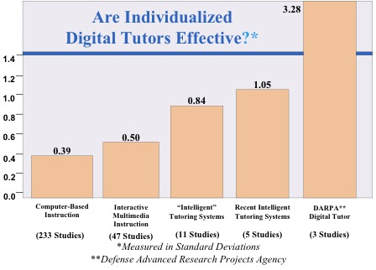
Are Individualized Tutors Effective?

Slide 14
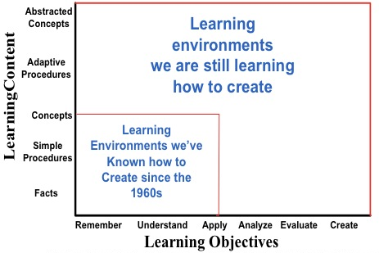
Innovation in Learning Environments is Critical

Slide 15
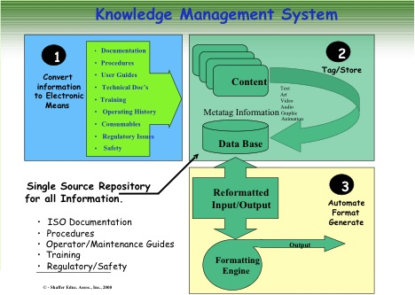
Flexible Content Delivery from a Single Knowledge Base

Slide 16
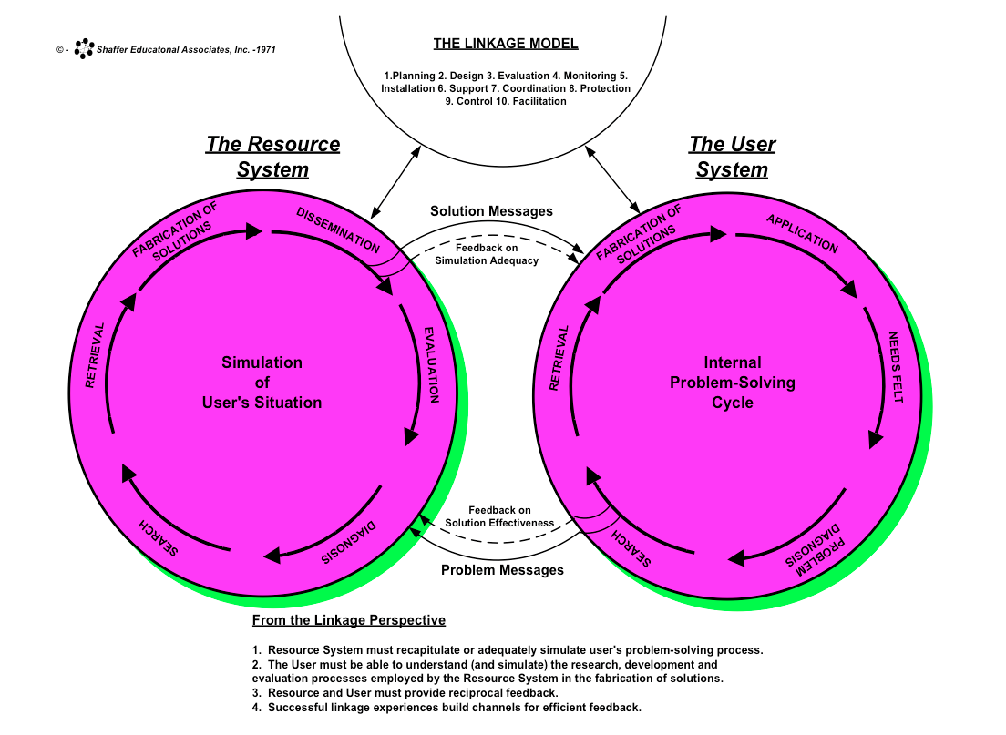
The Linkage Model

Slide 17
Proposal
Create a Transportation Technology Training Center as a University Affiliated Research Center (UARC) or equivalent once suitable funding is in place.
The center will provide a mix of distance learning, on-site workshops, hands-on training, CEU type activities and certificate programs.
Primary function is a service/extension organization; subcontracts with the university on research, technical content development and pedagogy.
Primary staffing will be full-time professionals with expertise in transportation technology, industrial training and state of the art content delivery technologies.
This interdisciplinary center will provide space to support on-site industry collaborations and partnerships.

Slide 18
TTTC is a Bridge Between Academia and Industry
Academia:
Continuing Education
Content Delivery
Technology Training
Research
Industry:
Operational Needs
Workforce Training
Workforce Development
Infrastructure Refresh
Technology Forecasting
Technology Upgrades
TTTC sits at the intersection of academia and industry. It serves the operational needs of the transportation industry.
It is an extension-like activity that develops state of the art content and delivers it using the latest in distance learning technology.

Slide 19
Why Establish the TTTC at Temple University?
Leverages existing relationships with key partners such as SEPTA, Amtrak and regional transportation organizations.
Temple’s Main Campus is strategically located in the Northeast Corridor, a major hub for transportation innovation in the U.S.
Relevant technical strengths include a research-intensive College of Engineering and an internationally-recognized Teaching and Learning Center.
Temple is committed to educating the underrepresented with a stellar reputation in diversity. The constituents for this training share a similar demographic.
A comprehensive university with a world-class colleges and professional schools representing the necessary disciplines (i.e., engineering, education, business and public policy).

Slide 20
TTTC Leverages Temple’s Breadth
Temple University:
Engineering (Technical Content)
School of Business (ROI)
School of Law (Public Policy)
Teaching and Learning Center (Pedagogy)
School of Education (Assessment)
Computer Services (Delivery)
Industry:
Operational Needs
Workforce Training
Infrastructure Refresh
Technology Upgrades
TTTC must integrate a wide range of expertise at Temple
Safety and public policy are examples of relevant non-technical issues that must be understood to deliver effective training.

Slide 21
The Start Up Phase
Identification of seed funding to develop a pilot program is crucial (ongoing discussions with SEPTA and APTA; pilot funding with DOL and center funding through DOT).
The center will need approximately 2,000 sqft (off campus) initially to house developers (4), administrative staff, prototype training facilities and meeting space.
The center will partner with SEPTA to define a suitable training module (discussions are underway).
Beyond the core technical mission, longer-term outreach activities to increase participation of underrepresented groups will include:
Summer internships for high school students (e.g., develop mobile apps explaining “how things work”).
Demonstrations and offsite visits to pre-high school students.
Connect Temple students with employers in the transportation fields.

Slide 22
Examples of Externally-Fundable Research Opportunities
Unsupervised assessment of individual learning styles and adaptation of content to optimize learning.
A unified knowledge management architecture that separates delivery from content and allows rapid creation of content for new technologies (i.e., alternative energy-based propulsion systems, hybrid powertrains).
Delivery of high-quality content on multiple platforms (e.g., desktops, tablets, smart phones) from a single software interface. Content must transparently adapt to the limitations of screen size and input devices.
Outreach to K-12 to stimulate interest by underrepresented groups in careers in the transportation industry (primary constituents for training are currently high school/GED and community college grads).

Slide 23
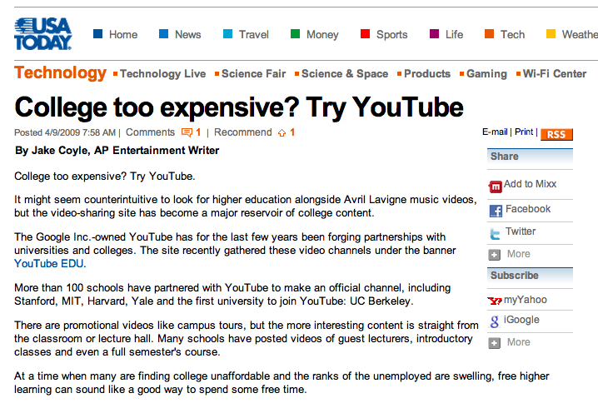
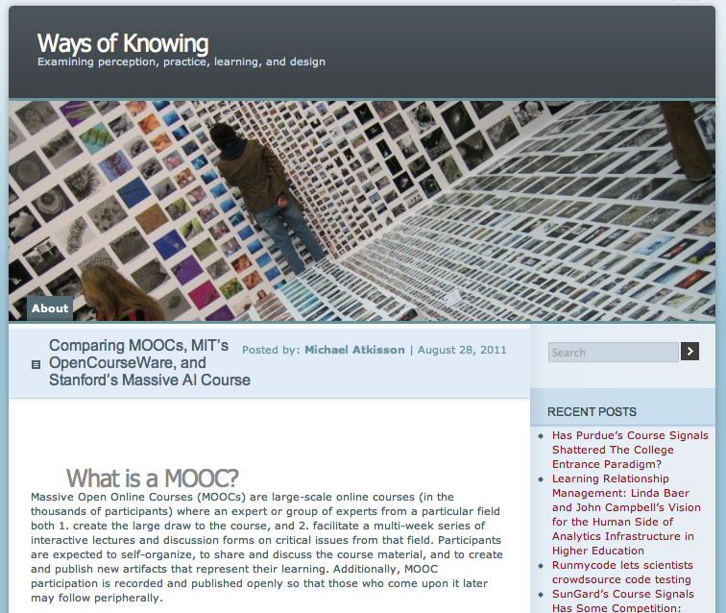
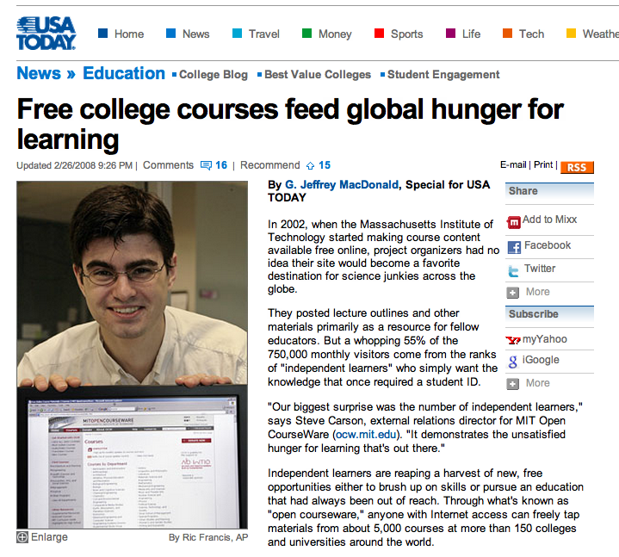


An Opportunity for Distance Learning at Temple
Emerging standards in software platforms for delivering online education are undergoing rapid change.
Web standards for content management are also evolving.
Temple has recently made a strategic investment in lynda.com for content delivery.

Slide 24
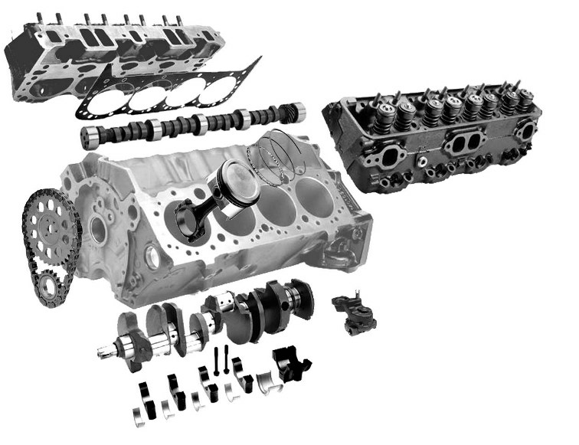
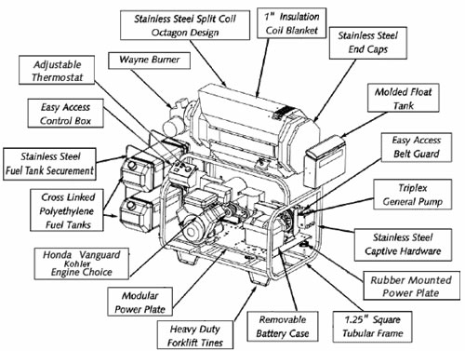
Pilot Program: Diesel Engine Maintenance (Tentative)
SEPTA will collaborate to jointly define a pilot training application (tentatively diesel engine maintenance).
Application relevant to many forms of transportation.
Hybrid powertrains involving both combustion and electric propulsion are common on buses.
Initial pilot will be a web-based interactive 3D application for desktops.
Theory of operation and routine maintenance will be initial topics.
Diagnosis and repair will follow.
Application relevant to many forms of transportation.

Slide 25
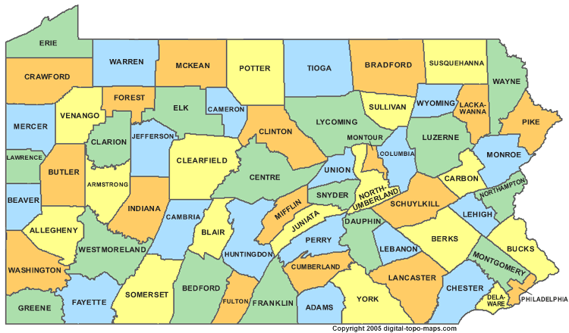
TTTC Provides Value to Local Constituents
Currently 60+ small transportation agencies in Pennsylvania alone.
Each has a need to train and refresh the skills of their workforce.
They lack internal expertise for such training.
Organizations such as SEPTA, which has this expertise, currently provides such training as a courtesy, but would like to offload this activity.
These smaller agencies can perhaps attend limited on-site training at Temple, but cannot really afford to send their workforce to training for extended periods of time.
Further, they often lack the local technical expertise to maintain equipment, and must outsource such maintenance.
Market in the U.S. and abroad is much larger.

Slide 26
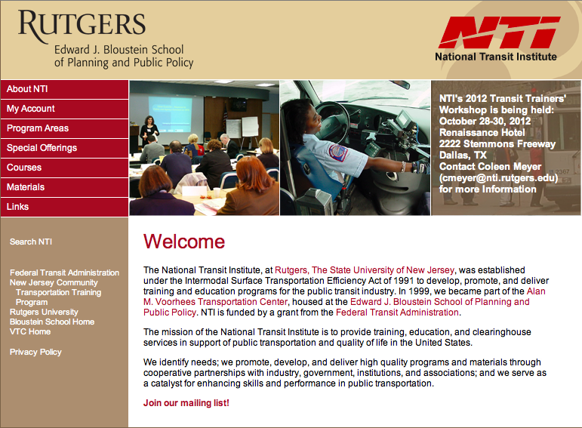
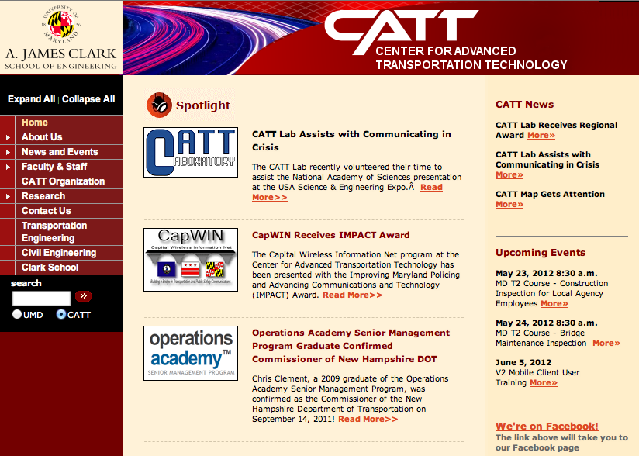
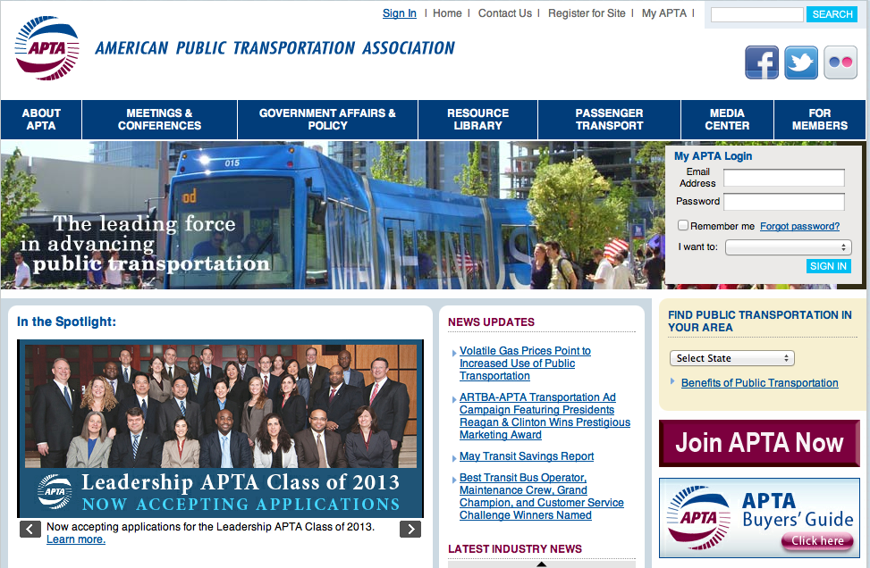
Competitive Analysis
The National Transit Institute at Rutgers University is focused on management training.
Established under the Intermodal Surface Transportation Efficiency Act of 1991 to deliver training and education programs for the public transit industry.
University of Maryland has several centers focused on research, technology and training.
Focus is not on distance learning and interactive training.
Does not meet the needs of service providers such as SEPTA and WAMA.
American Public Transportation Association (APTA) is focused on creating standards for training and certification (potential partner).

Slide 27
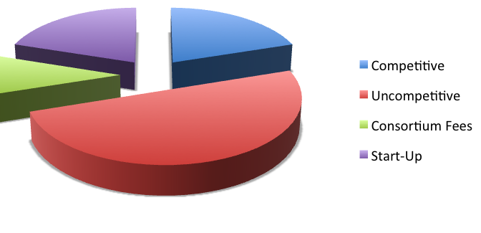
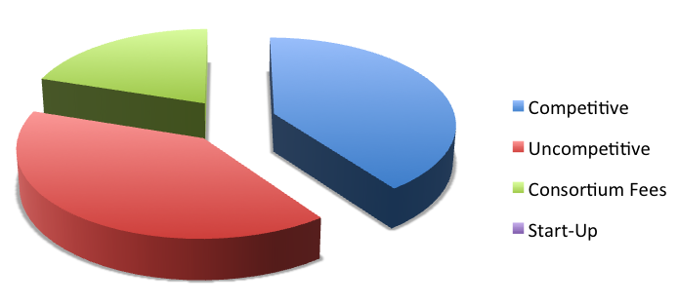
Funding Profile
Start up funding expected to come from a close collaboration with a single partner (e.g., SEPTA).
Competitive proposals will target APTA, DOT and NSF.
Early years: $400K/yr.
Sustainable level of funding will need to exceed $1M/yr. to support professional content development.
Three major revenue streams: competitive (e.g., DOT), uncompetitive (e.g., APTA) and fees (short courses, onsite training).

Slide 28
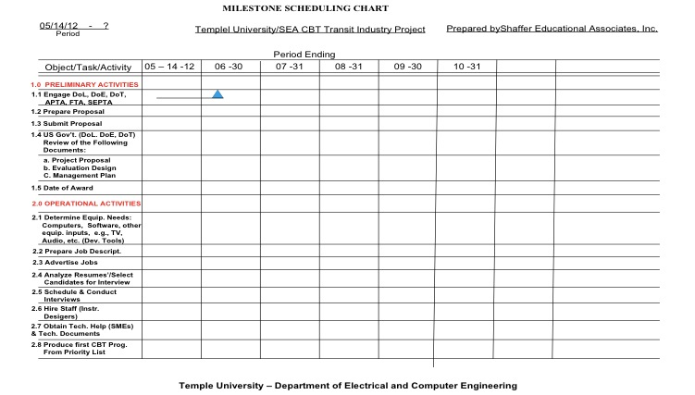
Proposed Timeline

Slide 29
Summary and Future Directions
Many engineering fields critical to our national infrastructure, an impending “silver tsunami” of retirements will cripple our infrastructure at a time when transportation and energy are critical grand challenges.
We propose the creation of a training center at Temple that will focus on the development of online education that will appeal to a nontraditional workforce with diverse learning styles.
Goal over the next 6 months is to identify one or two applications and to evaluate effectiveness.
Identification of seed funding sources will be critical to jumpstarting the process.
The long-term funding is expected to be a mix of federal funds and competitive awards. Directed funding sources, such as congressional funds, should be pursued.

Slide 30
Brief Bibliography of Related Research
[1] The Workforce Challenge. Transportation Research Board Special Report No. 275. (http://onlinepubs.trb.org/onlinepubs/sr/sr275.pdf).
[2] Managing Transit’s Workforce in the New Millennium. Transit Cooperative Research Program. (http://www.tcrponline.org/bin/doc-distr.cgi/TCRP_RPT_77.pdf?cat_id=23).
[3] Gilbert, T. (1978). The behavior engineering model. In T. Gilbert, Human competence: Engineering worthy performance (pp. 73-105). New York: McGraw-Hill.
[4] Dodds, P. and Fletcher, J.D. (2004). Opportunities for New “Smart” Learning Environments Enabled by Next Generation Web Capabilities. Institute for Defense Analysis Document No. D-2952.
[5] Anderson, L.W. (Ed.), Krathwohl, D.R. (Ed.), Airasian, P.W., Cruikshank, K.A., Mayer, R.E., Pintrich, P.R., Raths, J., & Wittrock, M.C. (2001). A taxonomy for learning, teaching, and assessing: A revision of Bloom's Taxonomy of Educational Objectives (Complete edition). New York: Longman.
[6] Hunter, L. (2012). Drupal Overview. The Drupal Open Source Project. (http://drupal.org/getting-started/before/overview).

Slide 31
Biography – J. Steve Shaffer
J.S. Shaffer received his M.A. in Communications from New York University in 1966, and completed two years of PhD studies at the Annenberg School of Communications of the University of Pennsylvania, where he was appointed to the graduate faculty in their experimental TV Laboratory.
In 1975 he founded Shaffer Educational Associates, Inc., whose client list includes such industry giants as GE, GM, Exxon/Mobil and Sylvan Learning System, Inc. SEA has conducted training programs in many foreign countries, including Saudi Arabia, The United Arab Emirates, Egypt, Pakistan, The Sudan, Thailand, Bolivia and Brazil. Their training technology is currently being taught to all of the USA’s major transit systems addressing all capital-intensive improvement programs to meet the demands of the 21st Century.
In 2004 Shaffer was appointed to a sub-group of The National Academy of Science’s Transportation Research Board which is in the process of examining the human resource development issues of the USA’s major public transit systems. Mr. Shaffer has served as a consultant to many government agencies, including the U.S Office of education, and commercial enterprises (e.g., CSX). He currently holds an appointment by the New Jersey Governor to his Advisory Council on Career Education. He has authored numerous papers on education and training for the transportation sector, and is internationally known for his work in this area.

Slide 32
Biography
Joseph Picone received his Ph.D. in Electrical Engineering in 1983 from the Illinois Institute of Technology. He is currently Professor and Chair of the Department of Electrical and Computer Engineering at Temple University. He recently completed a three-year sabbatical at the Department of Defense where he directed human language technology research and development.
His primary research interests are currently machine learning approaches to acoustic modeling in speech recognition. For over 25 years he has conducted research on many aspects of digital speech and signal processing. He has also been a long-term advocate of open source technology, delivering one of the first state-of-the-art open source speech recognition systems, and maintaining one of the more comprehensive web sites related to signal processing. His research group is known for producing many innovative educational materials that have increased access to the field.
Dr. Picone has previously been employed by Texas Instruments and AT&T Bell Laboratories, including a two-year assignment in Japan establishing Texas Instruments’ first international research center. He is a Senior Member of the IEEE, holds several patents in this area, and has been active in several professional societies related to human language technology.

