Slide 1
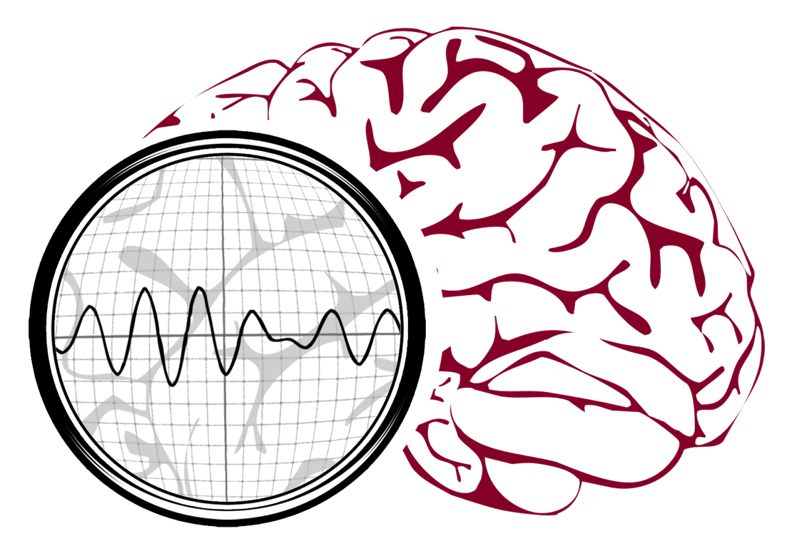
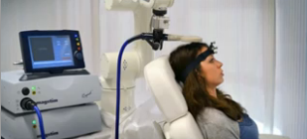
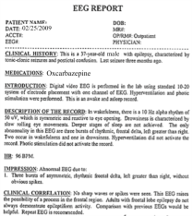
Automated Interpretation of EEGs
Goals: (1) To assist healthcare professionals in interpreting electroencephalography (EEG) tests,
thereby improving the quality and efficiency of a physician’s diagnostic capabilities; (2) Provide
a real-time alerting capability that addresses a critical gap in long-term monitoring technology.
Impact:
  Patients and technicians will receive immediate feedback rather than waiting days or weeks for results
  Physicians receive decision-making support that reduces their time spent interpreting EEGs
  Medical students can be trained with the system and use search tools make it easy to view patient histories and comparable conditions in other patients
  Uniform diagnostic techniques can be developed
Milestones:
  Baseline hidden Markov model-based system operating at 98% accuracy on research data (1Q’2014)
  Events labeled at 95% detection accuracy with a 5% false alarm rate on the TUH EEG Corpus (3Q’2014)
  Portable Python-based demonstration system with live input, montages and event search (4Q’2014)
  Enthusiastic feedback from TUH neurologists, fellows, interns and medical students (4Q’2014)
  NIH award for cohort retrieval (2Q’2015)
  Enhanced system architecture (3Q’2015)

