Slide 1
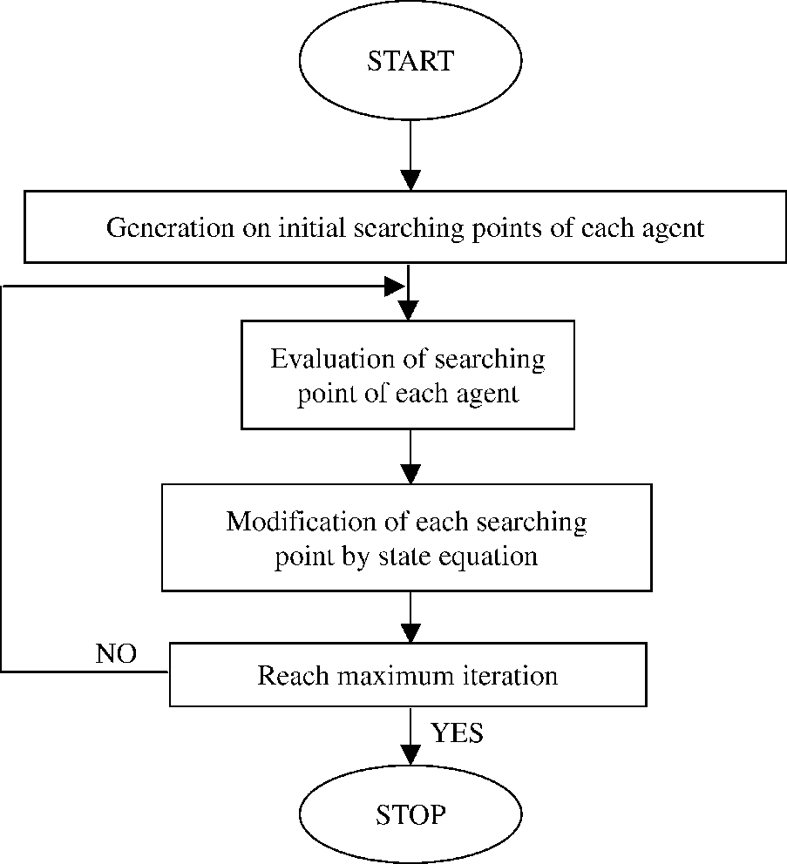
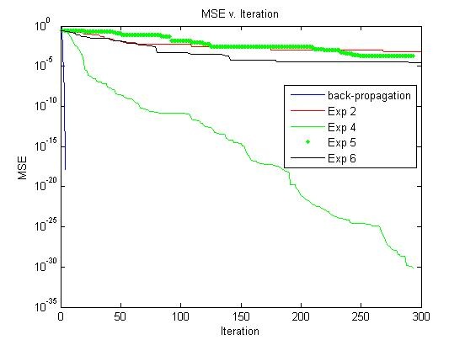
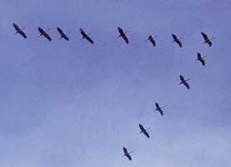
College of Engineering
Temple University
Application of Particle Swarm Optimization to Parameter Estimation for Hidden Markov Models
Amir H Harati Nejad Torbati, Joseph Picone Department of Electrical and Computer Engineering, Temple University, Philadelphia, Pennsylvania
Abstract
Optimization surfaces in large-scale machine learning problems are not simple, convex surfaces, and in many situations are not even differentiable. Classical optimization methods such as Expectation-Maximization (EM) and Gradient Descent can result in unacceptable solutions.
Our goal is to estimate parameters of typical graphical models such as hidden Markov models in a way that is robust to complex decision surfaces exhibiting significant local minima.
One approach is to use heuristic methods inspired by nature, such as Particle Swarm Optimization (PSO).
PSO has been shown to be effective in training Neural Networks, GMMs and HMMs.
In this work we apply PSO to several simple problems, but our final goal is to apply it in speech recognition. We also proposed several extensions to improve the algorithm.
PSO Algorithm
Results for Neural Networks
XOR function: Feedforward network ; hidden layer with 3 sigmoid nodes.
Results for Gaussian Mixtures
Table 2- Results on GMMs
Exp No | Parameters | Mean of error
0 | EM | 24.22%
1 | 18,3000,2,2,1,1,5 | 24.24%
2 | 18,3000,2,2,1,1,5+FEPSO | 23.78%
3 | 18,3000,2,2,.9,0,5 | 23.87%
4 | 18,3000,2,2,.9,0,5+FEPSO | 23.94%
5 | 18,300,2,2,.9,0,5 | 23.84%
Figure 3- MSE versus Iteration
Table 3- Results on HMMs
Pima Indian Diabetes [4]
Feedforward Network with one hidden layer of 5 sigmoid neuron.
Exp No | Parameters | Mean of Error on test | Time(sec)
0 | BW | 9.52% | -
1 | 18,300,2,2,1,1,5+FEPSO | 10.56% | 216.6
2 | 18,1000,2,2,1,1,5+FEPSO | 9.91% | 432.9853
3 | 18,300,2,2,.9-0,5+FEPSO | 10.03% | 357
4 | 18,300,2,2,.9-0,5+initilization method+FEPSO | 9.61% | 351.3
5 | 18,3000,2,2,.9-0,5+init+FEPSO | 9.16% | 1879
6 | 30,300,2,2,.7-.2,5+init+FEPSO | 9.90% | 640
7 | 18,300,3.39,-.34,-.27+init+FEPSO | 10.57% | 1106
8 | 18,300,2,2,.9-0,5+init+HPSO+FEPSO | 9.87% | 351.3
9 | 18,300,2,2,.9-0+init+RPSO+FEPSO | 9.31% | 254
10 | 36,300,2,2,.9-0+init+RPSO+FEPSO+MPPSO* | 8.86% | 489
11 | 36,300,2,2,.9-0+init+RPSO+FEPSO | 9.03% | 501.9675
Figure 2-PSO flowchart
Table 1- Results on Pima Indian Diabetes
Update Equation
Exp No | Parameters | Accuracy on Training data | Accuracy on test data
0 | Back-propagation | 0.7956 | 0.7539
1 | 18,1000,2,2,1,1,10 | 0.8037 | 0.7474
2 | 18,1000,2,2,1,0,10 | 0.8142 | 0.7606
3 | 18,3000,2,2,1,0,10 | 0.8102 | 0.7552
4 | 18,1000,2,2,0,0,10 | 0.805 | 0.7387
5 | 18,1000,2,2,.9,0,4 | 0.8141 | 0.7552
6 | 18,1000,2,2,.9,0,30 | 0.8226 | 0.7422
7 | 18,1000,2,2,.9,0,4+VPSO | 0.7999 | 0.7488
Particle Swarm Optimization
PSO was first introduced by Jammes Kennedy and Russell C. Eberhart in 1995.
Fundamental hypothesis: social sharing of information among species offers an evolutionary advantage.
Inspired from the way birds flock : Each bird is a particle. The objective is to find food supplies. Each bird adjust its position by considering its own historical best position and the best position of the whole flock. After many iterations, we expect that all birds converge toward the best position in the space.
PSO is a global optimization , population-based evolutionary algorithm for dealing with problems in which a best solution can be represented as a point or surface in an n-D space.
PSO Extensions
Hybrid PSO (HPSO) [3]: After each several iterations, the EM algorithm is run for each particle, combining the benefits of swarm optimization and EM.
Redistributing PSO (RPSO): All particles around the “best” particle are redistributed randomly.
Fast evaluation PSO (FEPSO): Since the evaluation time for each particle is a function of the data set size , the computational complexity is high for large data sets. Alternatively, we can randomly partition the data set into two separate sets and if the score for the first set was good enough calculate the score for the other set and hence the whole data set.
Multi-personality PSO (MPPSO): In the classical PSO, all particles have the same parameters (personalities). In MPPSO, we let some particles have randomly selected parameters.
PSO with validation (VPSO): In this version, we determine stopping time by using a separate validation set.
Results for Hidden Markov Models and Gaussian Mixture Models
Experiments with Gaussian mixtures and HMMs are based on artificially generated data.
For Gaussian mixtures, we have used models with one Gaussian per mixture. For HMMs, we have used 4 states models, each state has a one dimensional Gaussian mixture.
PSO and its derivatives show performance comparable to EM and, in some cases, somewhat better than HMM.
FEPSO works as good as PSO and at the same time is eight times faster.
MPPSO shows up to a 10% improvement. (It is important to know that the result for MPPSO in this report is as a proof of the concept. The condition and properties of MPPSO need additional investigation.)
Our experiments do not show any improvement for HPSO, despite claims in [3] of its effectiveness.
Uniform initialization seems to give the best results because it reduce the possibility of falling in a local optimum in early iterations.
RPSO is also an effective and low cost approach.
It is evident that we can use a combination of these methods to further improve the results.
Conclusion
It has been shown that PSO and its extensions can exceed the performance of classical methods such as EM and back propagation.
FEPSO is shown to work well and increase speed considerably.
RPSO and MPPSO appear to could lead to some improvement but their gain is marginal.
Reference
[1] Kennedy, J. and Eberhart, R. C, “Particle swarm optimization,” Proc. IEEE int'l conf. on neural networks, vol. IV, pp. 1942-1948.
[2] Eberhart, R. C. and Kennedy. J, “A new optimizer using particle swarm theory,” Proc. Sixth int'l international symposium on micro machine and human science, pp. 39-43, 1995.
[3] Fengqin Yang; Changhai Zhang, An Effective Hybrid Optimization Algorithm for HMM, ICNC '08. Fourth International Conf on Natural Computation, 18-20 Oct 2008.
[4] Xue, L.; Yin, J.; Ji, Z.; Jiang, L, A Particle Swarm Optimization for Hidden Markov Model Training, 8th International Conference on Signal Processing, Nov 16-20 2006
[4] http://archive.ics.uci.edu/ml
Figure 1-Swarm of birds [1] [2]
Notes:
This poster template is from http://www.swarthmore.edu/NatSci/cpurrin1/posteradvice.htm. It is free, free, free for non-commercial use. But if you really like it, I’m always thrilled to get postcards from wherever you happen to be presenting your poster. Or, send me cookies! My kids made me put that last sentence in. Have fun. Sincerely, Colin Purrington, Department of Biology, Swarthmore College, Swarthmore, PA 19081, USA. Email: cpurrin1@swarthmore.edu

