Slide 1
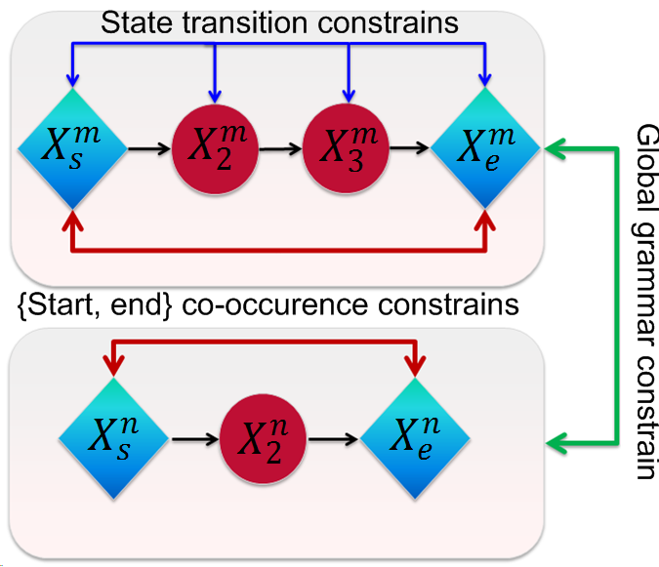
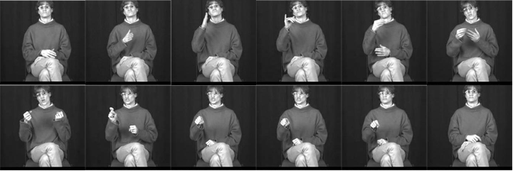
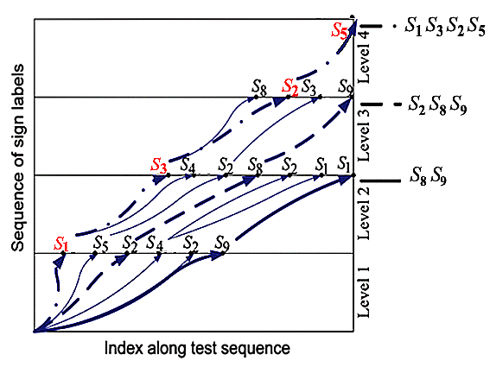
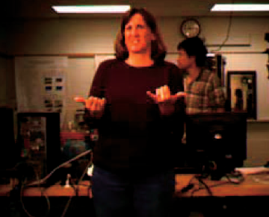
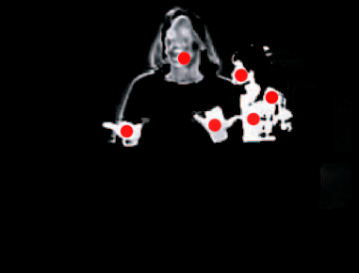
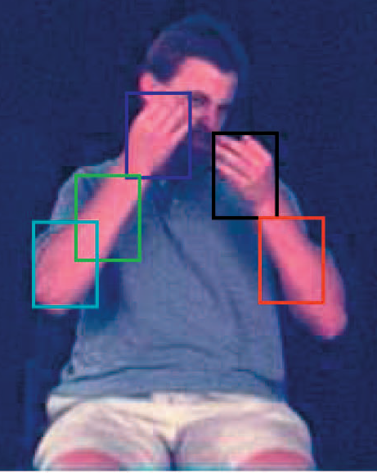
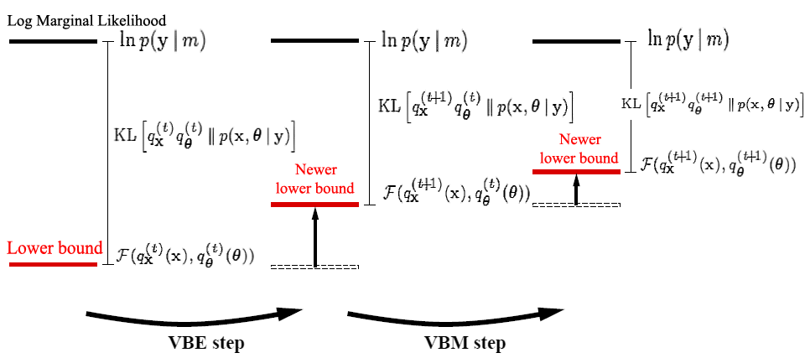
College of Engineering
Temple University
A Review of American Sign Language (ASL) Recognition
Shuang Lu Advisor: Joseph Picone
Abstract
Developing sign language applications for deaf people is extremely important, since it is difficult to communicate with people that are unfamiliar with sign language. Ideally, a translation system would improve communication by utilizing common and easy to use signs that can be applied to human computer interaction. Continuous stream sign recognition is a major challenge since both spatial (hand position) and temporal (when gesture starts/ends) segmentation are needed.
This poster will discuss:
State of the art ASL recognition system structure
Constraints for sign language recognition
Introduction to algorithms commonly used in ASL recognition
Benchmark results and databases
Multiple Constraints
Grammar constraint:
Whether two gestures can
be connected
State transition constraint:
Probability of one state of a
sign change to another state Figure 2. Multiple constrains
{start, end} co-occurrence constraint:
Probability of two gestures can be the start and end states for a sign
Level-Building Dynamic Programming
DP: Given an optimal task, we need to solve many sub-problems, and then combine these solutions to reach an overall solution.
Results
The best results are obtained from the VB-EM algorithm. For hand shape the rate of correct retrieval at rank 1 and top-5 are only 32.1% and 61.5%.
The best recognition result for simple background continuous sign gesture recognition is about 83%, using level-building DP. However, the results become significantly worse when using complex backgrounds or when test sequences are from different signers.
Error rate
20 test sequences
Error rate
5 test sequences 10 test sequences
With Bigram grammar constraint
If can not be a predecessor of
Figure 8. Error rate for complex background test
Figure 9. Error rate for cross signer test
Figure 4. Level-building Dynamic programming
VB-HMM-EM for single sign recognition
General HMM structure:
Initial state;
Hidden variables;
Observed variables.
Figure 3. ASL example: John should buy a car
Figure 10. Left: Original image; Middle: Hand candidate (red) detection (USF) Right: Hand candidate detection (Boston)
ASL Recognition System
This process is typically implemented with Dynamic programming since HMM’s require large sets of training data.
Conclusion
As can be seen from the above results, these commonly used algorithms which have shown to produce good results for speech recognition (i.e. HMM, DP) were tested for sign language. However, they do not yield satisfactory results in continuous sign recognition. Lacking spatial information is one major reason because these models typically ignore hand shapes. Moreover, multiple constraints should be considered to either speed up the process or improve accuracy. Future work will focus on how to use shape information without slowing down the overall recognition system.
Figure 5. HMM structure
Gaussian mixture model
Global features (Distance histogram)
Dynamic Programming
Face detection based
Local features
(Location and motion)
Hidden Markov Model
Figure 6. VB-EM hand shape matching
Motion information
Hand shape features
(HOG)
Bayesian Network
VBE step: maximize lower bound w.r.t.
VBM step: maximize lower bound w.r.t.
Figure 7. VB-HMM
References
[1] J. Alon, V. Athitsos, Q. Yuan, and S. Sclaroff. A unified framework for gesture recognition and spatiotemporal gesture segmentation. PAMI, 31(9):1685–1699, 2009.
[2] R. Yang, S. Sarkar, and B. Loeding. Handling movement epenthesis and hand segmentation ambiguities in continuous sign language recognition using nested dynamic programming. PAMI, 32,no.3:462–477, 2010.
[3] A. Thangali, J. P. Nash, and S. Sclaroff. Exploiting Phonological Constraints for Hand Shape Inference in ASL Video. In CVPR, 2008.
Benchmark Databases:
Hand Candidate Detection
Feature Extraction
Calculate Match Cost
Research Institute | Year | Short Sleeves | Background | Number of Signer | Data Size | Data Type
Purdue University | 2002 | No | Simple | Three | Medium | Letter spelling
Boston University | 2001 | Yes | Multiple | Three | Large | Lexicon/continuous
RWTH-Boston | 2004 | Some | Multiple | Three | Large | Sentence/Lexicon/ Continuous
University of South Florida | 2006 | Yes | Complex | One | Small | Sentence
One Sign Process within DP recognition
Figure 1. ASL recognition system
Notes:
This poster template is from http://www.swarthmore.edu/NatSci/cpurrin1/posteradvice.htm. It is free, free, free for non-commercial use. But if you really like it, I’m always thrilled to get postcards from wherever you happen to be presenting your poster. Or, send me cookies! My kids made me put that last sentence in. Have fun. Sincerely, Colin Purrington, Department of Biology, Swarthmore College, Swarthmore, PA 19081, USA. Email: cpurrin1@swarthmore.edu

