Slide 1
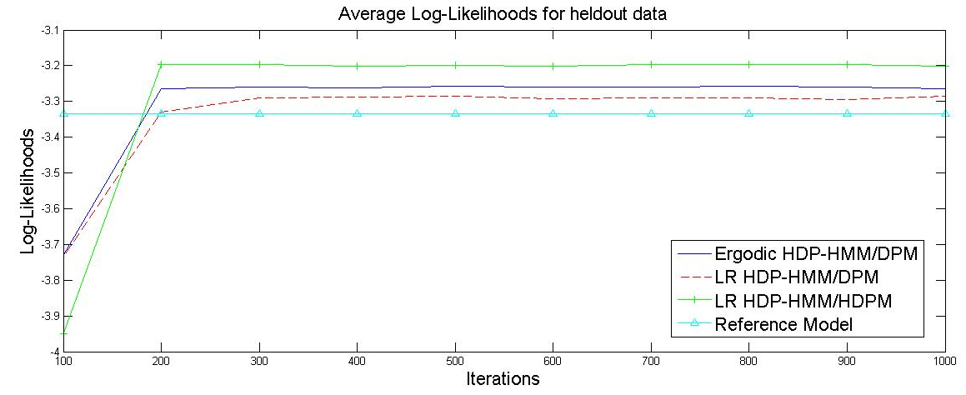
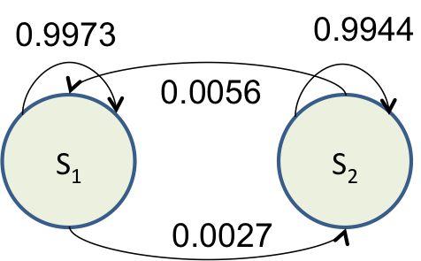
(a)
(b)
Reference Model
Ergodic HDP-HMM/DPM
LR HDP-HMM/HDPM

Slide 2
0.99
0.90
0.996
1
0.01
0.1
0.004
S₁
S₂
S₃
S₄

Slide 3
0.9973
0.9944
0.0056
S₁
S₂
0.0027

Slide 4
0.9848
0.8800
0.9945
1
0.0152
0.12
0.0055
S₁
S₂
S₃
S₄

Slide 5
