Slide 1
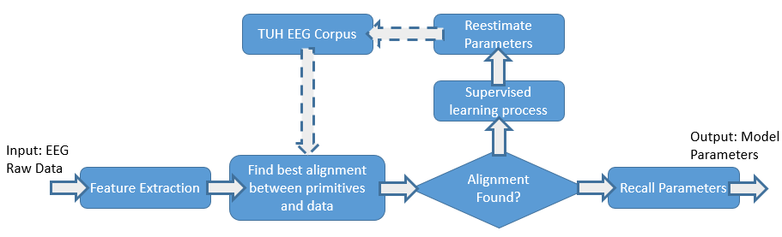
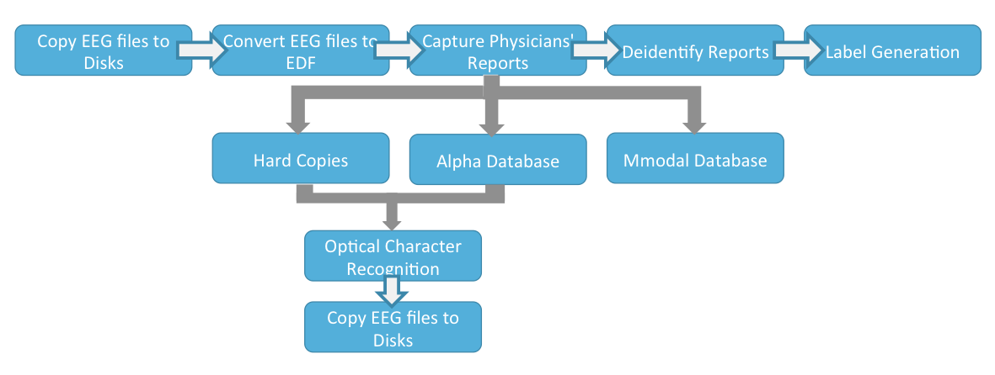
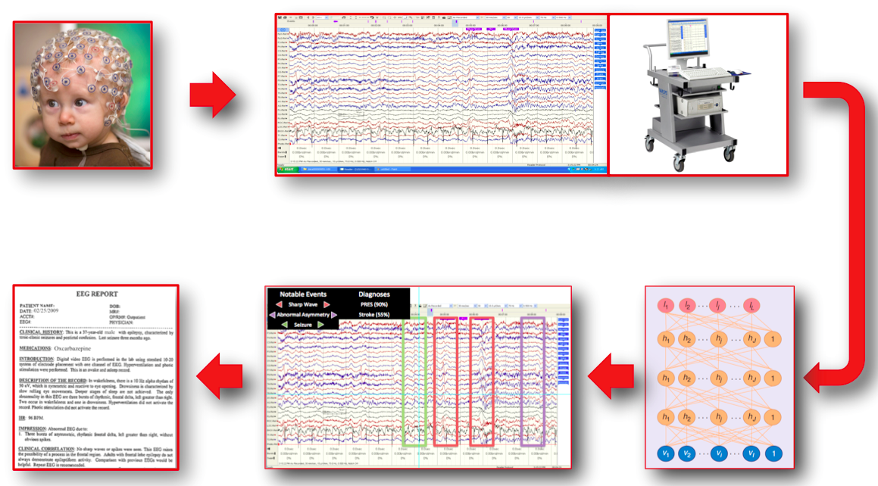
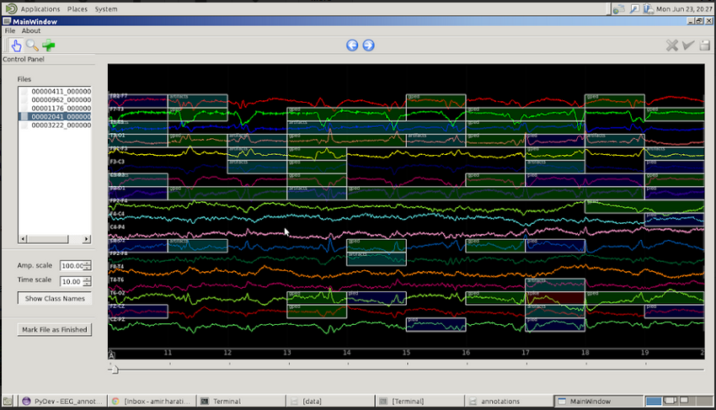
Automatic Interpretation of EEGs Using BIG DATA
Silvia Lopez, Amir Harati, Iyad Obeid and Joseph Picone
The Neural Engineering Data Consortium, Temple University
www.nedcdata.org
Abstract
The emergence of big data and deep learning is enabling the ability to automatically learn how to interpret EEGs from a big data archive.
The TUH EEG Corpus is the largest and most comprehensive publicly-released corpus representing 11 years of clinical data collected at Temple Hospital. It includes over 15,000 patients, 20,000+ sessions, 50,000+ EEGs and deidentified clinical information.
We are developing a system, AutoEEG, that generates time aligned markers indicating points of interest in the signal, and then produces a summarization if its findings based on a statistical analysis of this markers.
Physicians can view the report from any portable computing device and can interactively query the data using standard query tools. Clinical consequences include real-time feedback and decision making support.
Machine Learning Algorithm
Machine learning algorithms based on hidden Markov models and deep learning are used to learn mappings of EEG events to diagnoses.
The system accepts multichannel EEG raw data files as input. Desired output is a transcribed signal and a probability vector with various probable diagnoses.
A simple filter bank-based cepstral analysis is used to convert EEG signals to features.
The signal is analyzed in 1 sec epochs using 100 msec frames. HMMs are used to map frames to epochs and classify epochs.
Corpus Statistics
Preliminary Experiments
Hidden Markov models (baseline) perform comparably to best previously published results on similar tasks.
Error confusion matrix:
The use of annotated data significantly reduces the false alarm rate.
Field | Description | Example
1 | Version Number | 0
2 | Patient ID | TUH123456789
3 | Gender | M
4 | Date of Birth | 57
8 | Firstname_Lastname | TUH123456789
11 | Startdate | 01-MAY-2010
13 | Study Number/ Tech. ID | TUH123456789/TAS X
14 | Start Date | 01.05.10
15 | Start Time | 11.39.35
16 | Number of Bytes in Header | 6400
17 | Type of Signal | EDF+C
19 | Number of Data Records | 207
20 | Dur. of a Data Record (Secs) | 1
21 | No. of Signals in a Record | 24
27 | Signal[1] Prefiltering | HP:1.000 Hz LP:70.0 Hz N:60.0
28 | Signal[1] No. Samples/Rec. | 250
No. Gaussian Mixtures | Error Rate
1 | 90.1%
2 | 57.4%
2/4 (bckg) | 53.0%
4 | 56.5%
 | SPSW | PLED | GPED | ARTF | EYBL | BCKG
SPSW | 38% | 19% | 24% | 13% | 6% | 1%
PLED | 15% | 27% | 39% | 9% | 2% | 9%
GPED | 12% | 17% | 61% | 6% | 2% | 3%
ARTF | 3% | 19% | 24% | 43% | 3% | 8%
EYBL | 14% | 2% | 6% | 8% | 68% | 2%
BCKG | 6% | 24% | 18% | 7% | 2% | 42%
Description | Example
Gender | M (46%), F (54%)
Age (Derived from DOB) | Min (20), Max (94) Avg (53), Stdev (19)
Duration | 42 hours (17 mins./study)
Number of Channels | 28 (2%), 33 (15%), 34 (23%) 37 (11%), 42 (29%), 129 (3%)
Prefiltering | HP:0.000 Hz LP:0.0 Hz N:0.0
Sample Frequency | 250 Hz (100), 256 Hz (43)
Introduction
Electroencephalography is increasingly being used for preventive diagnostic procedures.
A board certified EEG specialist currently interprets an EEG. It takes several year of training to learn this art.
Interpreting an EEG is time-consuming and there is only moderate inter-observer agreement.
Corpus Development
EEG signal files and reports had to be manually paired, de-identified and annotated:
Summary
Current event detection technology for EEGs is not used in clinical applications due to a high false alarm rate.
Big data and machine learning offer the potential to deliver much higher performance solutions.
The TUH EEG Corpus will become the premier machine learning corpus for EEG R&D.
The 2010–2013 data will be released in August 2014, with the remainder of the data following by the end of 2014. See http://www.nedcdata.org for more details.
Acknowledgements
Portions of this work were sponsored by the Defense Advanced Research Projects Agency (DARPA) MTO under the auspices of Dr. Doug Weber through the Contract No. D13AP00065, Temple University’s College of Engineering and Office of the Senior Vice-Provost for Research.
Marker | Frequency
Eyes Open | 38%
Eyes Closed | 28%
Movement | 17%
Swallow | 7%
Awake | 4%
Drowsy / Sleeping | 3%
Hyperventilation | 2%
Talking | 1%
Numeric Label | Name
1 | Hyperventilation
2 | Movement
3 | Sleeping
4 | Cough
5 | Drowsy
6 | Talking
7 | Chew
8 | Seizure
9 | Swallow
10 | Spike
11 | Dizzy
12 | Twitch

