Slide 1
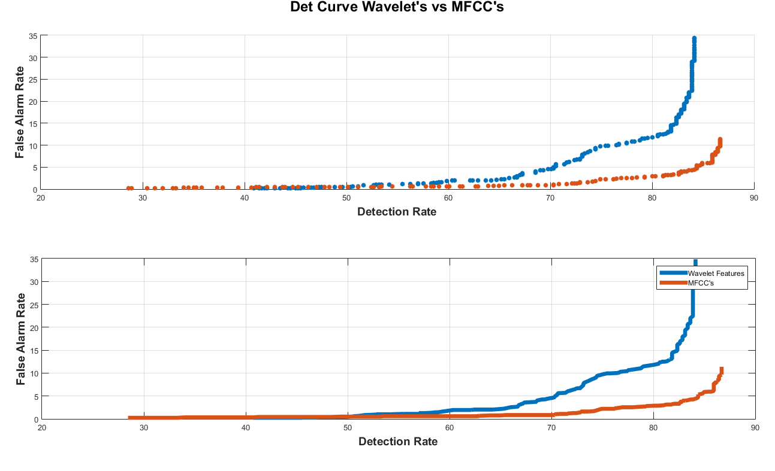
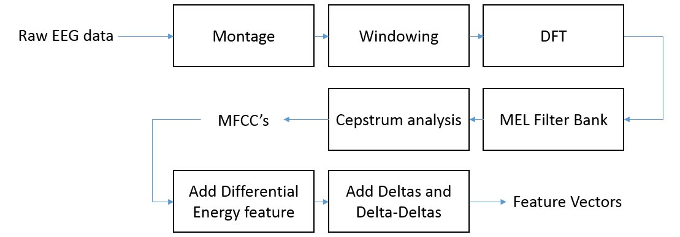
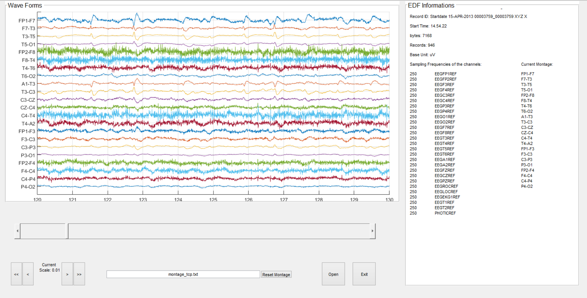
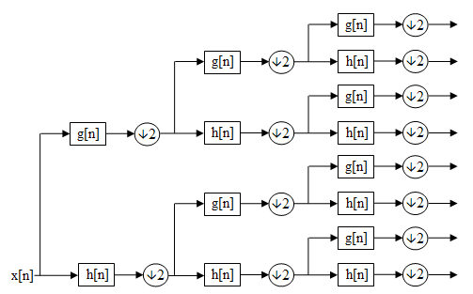
Wavelet Analysis for Feature Extraction on EEG Signals
Pedro H. R. Garrit, Anderson G. Moura, Dr. Iyad Obeid and Dr. Joseph Picone
The Neural Engineering Data Consortium, Temple University
College of Engineering
Temple University
www.isip.piconepress.com
Abstract
The emergence of big data and deep learning is enabling the ability to automatically learn how to interpret EEGs from a big data archive.
The AutoEEGTM is a system that automatically recognizes specific events in EEG data and generates annotations.
The system detects three events of clinical interest (PLED, GPLE and SPSW) and three events used to model background noise (ARTF, EYEM and BCKG).
The current system uses a standard feature extraction approach based on Mel Frequency Cepstral Coefficients (MFCCs) that are popular in other disciplines (e.g., speech recognition).
In this study, we evaluated the use of wavelet transform for feature extraction.
In contrast to the classical Fourier transform, the wavelet transform gives a multi-time scale analysis that is better for analysis of non-stationary signals.
Preliminary results showed that wavelet features deliver performance similar to MFCCs, but with a slightly higher false alarm rate.
Mel Frequency Cepstral Coefficients
AutoEEGTM is a machine learning-based system that uses hidden Markov models and deep learning to learn mappings of EEG events to diagnoses.
The system accepts multichannel EEG raw data files as input. The desired output is a transcribed signal and a probability vector for each one second epoch that contains signal event probabilities.
Currently a filter bank-based cepstral analysis (MFCC), popular in other signal analysis applications such as speech recognition, is used to convert EEG signals to vectors of features.
The signal is analyzed in 1 sec epochs using 100 msec frames. HMMs are used to map frames to epochs and classify epochs.
A differential energy feature is defined as the difference between the maximum and minimum energy in a window (typically 9 secs in duration).
The delta features are calculated using the adjacent frames to give the “trajectories” over time of the MFCC coefficients.
The delta-delta features (acceleration) are calculated in the same way as the delta coefficients, but over the delta coefficients instead of over the static coefficients.
Wavelets
Wavelets are a family of basis functions that are isolated with respect to time and frequency.
It is a representation of a function as a linear combination of the chosen wavelet basis.
Currently we are using a five level decomposition tree followed by a coefficient selection process to cover the frequency band of 0-20 Hz.
Each level of the tree contains $2^{n}$ coefficient vectors that represents the anterior level coefficients passed by a quadrature mirror filter followed by a downsampling process.
After the coefficients are selected a simple RMS analysis is made to generate the feature vectors.
Experimental Design
A pilot study was conducted on a small data set of 12 EEG sessions for training and an independent set of 12 EEGs for evaluation. This data contains a rich variety of signal events.
This small set was chosen so that parameter tuning experiments could be conducted quickly.
The data was sampled at 250 Hz and analyzed using a frame duration of 0.1 secs and an analysis window duration of 1.024 secs (256 samples).
Preliminary Results
An error confusion matrix for the HMM-based system (MFCC’s):
An error confusion matrix for the HMM-based system using wavelet features:
Collapsing the background noise classes into a single class gives this confusion matrix:
The associated error rates are:
A detection error tradeoff (DET) curve can be generated by penalizing the background scores
Detection Error Tradeoff (DET)
The DET curve represents tradeoff curve off the detection rate against the false alarm over a range of detection thresholds (-50 to 50 ). The DET curve is used to calculate the optimal operating point for the system.
Wavelet features perform better in comparison to MFCC’s for the negative penalties (e.g., -50 ), but that advantage rapidly diminishes as the penalty is increased. Fortunately, high positive values of the penalty are not desired operating points for clinical applications.
The DET curve shows that wavelet features result in a higher false alarm rate than MFCC’s features.
For clinical analysis a lower false alarm rate is desired over a higher detection rate since high false alarms decrease a clinician’s productivity.
Wavelet features show a higher group error in comparison to the MFCC’s, causing the higher false alarm rate.
 | SPSW | PLED | GPED | EYEM | ARTF | BCKG
SPSW | 5.30% | 23.48% | 13.64% | 32.58% | 3.79% | 21.21%
PLED | 11.19% | 53.73% | 23.88% | 2.99% | 0.75% | 7.46%
GPED | 2.40% | 28.80% | 68.80% | 0.00% | 0.00% | 0.00%
EYEM | 0.00% | 18.87% | 9.43% | 64.15% | 7.55% | 0.00%
ARTF | 0.00% | 0.00% | 0.00% | 0.48% | 83.09% | 16.43%
BCKG | 4.47% | 6.22% | 0.76% | 0.11% | 14.83% | 73.61%
Introduction
An electroencephalogram (EEG) is an exam that measures electrical activity in the brain.
A typical EEG exam following the 10-20 system consists of 21 electrodes distributed over the patients scalp in a way that distances between adjacent electrodes are either 10% or 20% of the total front–back or right–left distance of the skull.
The most critical event we detect is a spike/sharp wave (SPSW), which is used to diagnose seizures, epilepsy and strokes:
Periodic Lateralized Epileptiform Discharges (PLED) are also important, especially with respect to changes in their fundamental frequency:
 | SPSW | PLED | GPED | EYEM | ARTF | BCKG
SPSW | 0.76% | 22.73% | 40.91% | 11.36% | 11.36% | 12.88%
PLED | 4.48% | 65.67% | 18.66% | 5.22% | 5.22% | 0.75%
GPED | 1.60% | 40.80% | 53.60% | 2.40% | 0.80% | 0.80%
EYEM | 0.00% | 5.66% | 3.77% | 84.91% | 5.66% | 0.00%
ARTF | 0.33% | 1.42% | 2.51% | 0.00% | 17.45% | 78.30%
BCKG | 0.00% | 0.00% | 0.00% | 0.00% | 61.84% | 38.16%
Summary
We have presented the results of a pilot study of the use of wavelet features for EEG signal classification. A small pilot corpus that is designed to give rapid turnaround on experiments.
The wavelet features currently use only 7 coefficients covering the frequency range from 0 to 20 Hz. This is comparable to MFCCs but not necessarily optimal.
Our preliminary results show a higher false alarm rate for the wavelet features.
Experiments designed to reduce the false alarm rate and optimize the structure of the wavelet are underway.
Once positive results have been established on the pilot corpus, additional experiments will be run on the entire TUH EEG Corpus (25,000+ EEGs).
Acknowledgements
This research was also supported by the Brazil Scientific Mobility Program (BSMP) and the Institute of International Education (IIE).
MFCCs | BCKG | SPSW | GPED | PLED | Wavelet | BCKG | SPSW | GPED | PLED
BCKG | 96.26% | 0.25% | 2.12% | 1.36% | BCKG | 89.80% | 3.48% | 1.02% | 5.69%
SPSW | 35.61% | 0.76% | 40.91% | 22.73% | SPSW | 57.58% | 5.30% | 13.64% | 23.48%
GPED | 4.00% | 1.60% | 53.60% | 40.80% | GPED | 0.00% | 2.40% | 68.80% | 28.80%
PLED | 11.19% | 4.48% | 18.66% | 65.67% | PLED | 11.19% | 11.19% | 23.88% | 53.73%
6 Classes |  | 4 Classes
Wavelets | 33.3% | Wavelets | 22.1%
MFCC's | 33.2% | MFCC's | 17.8%

