Slide 1
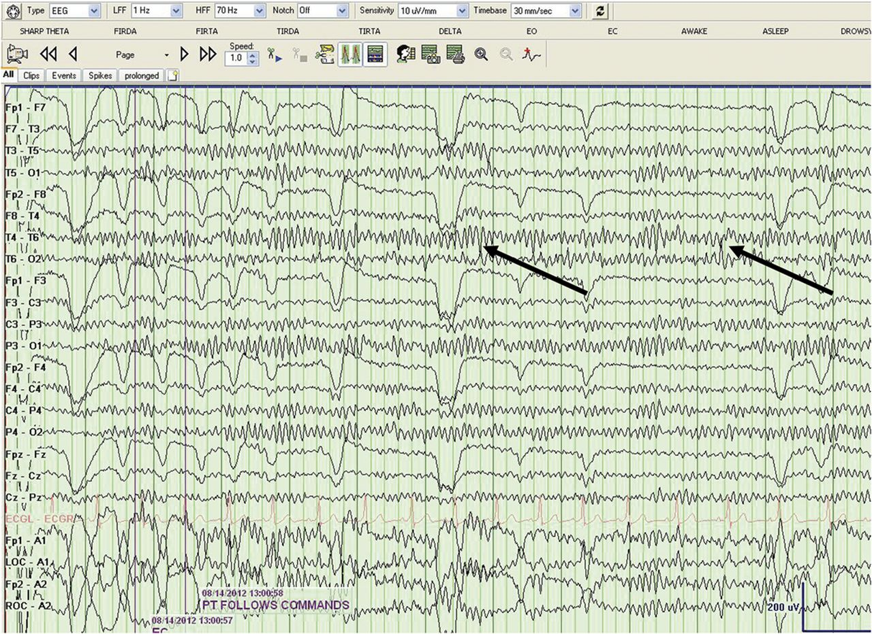
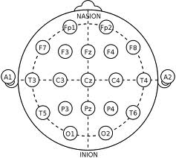
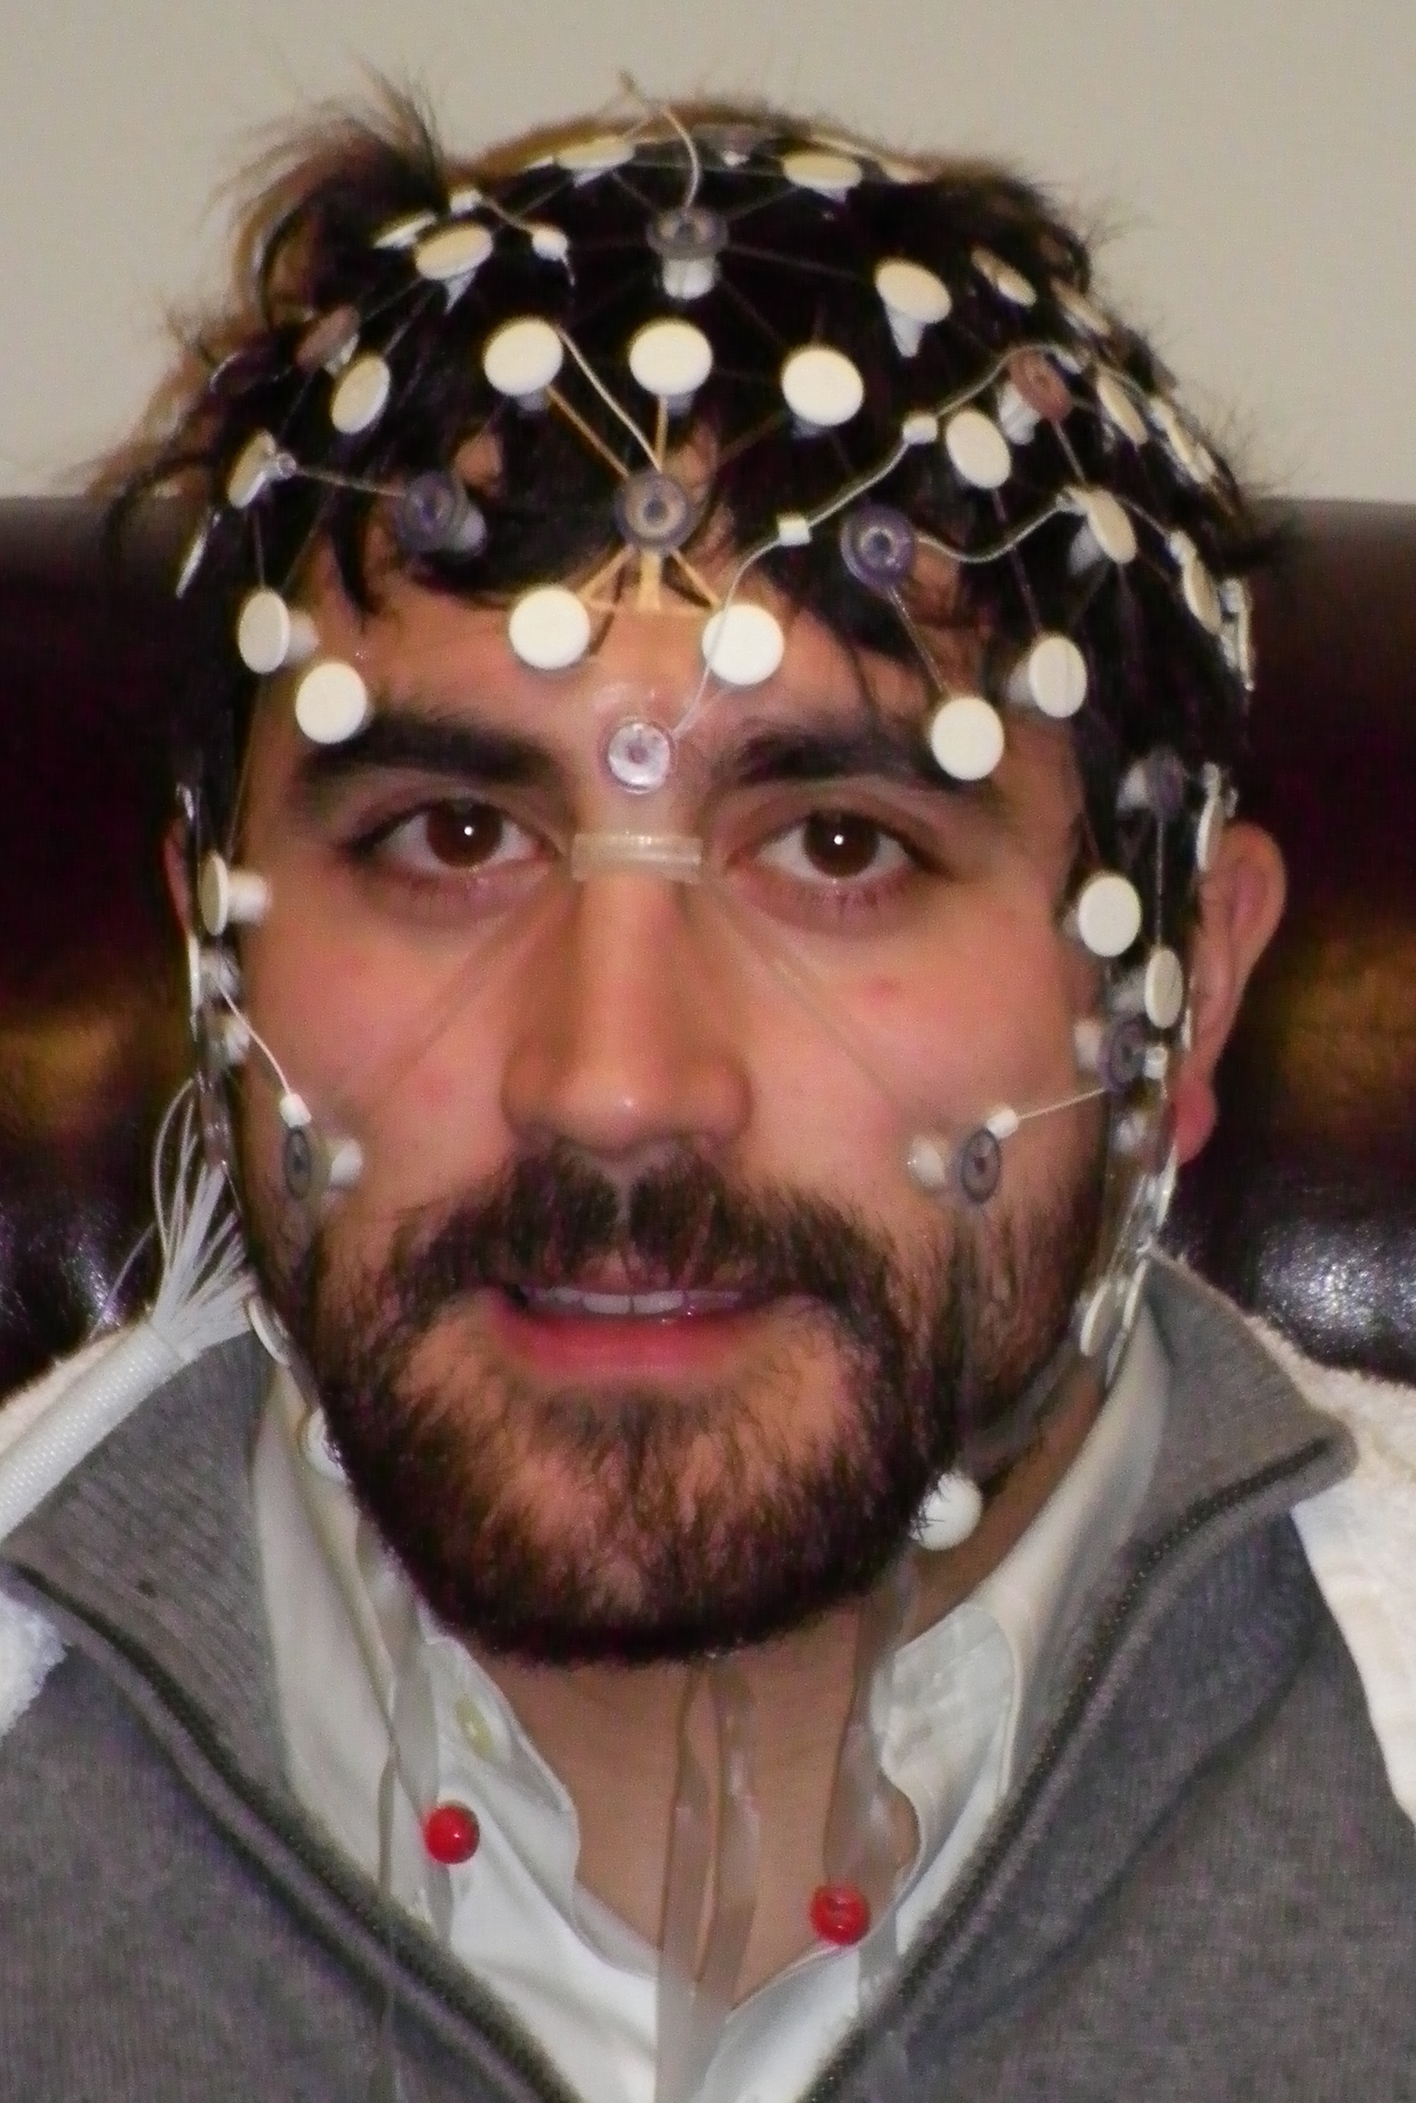
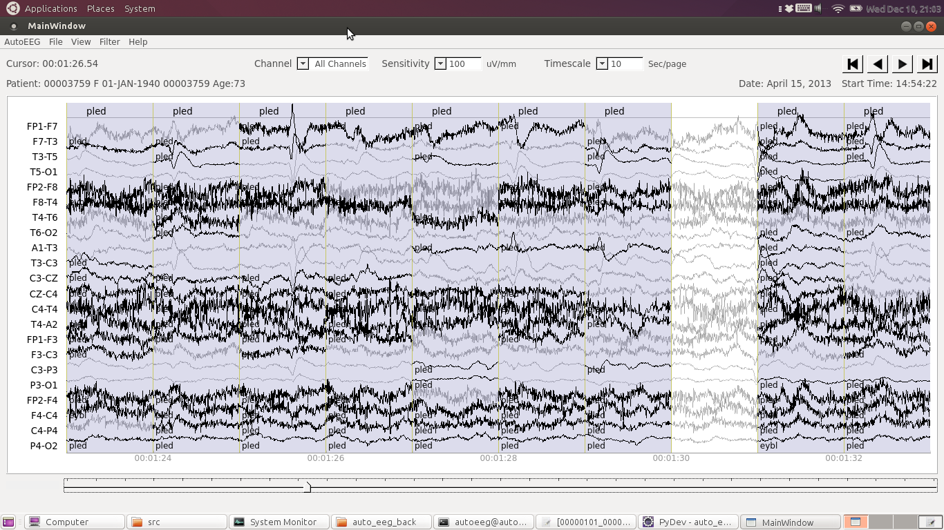
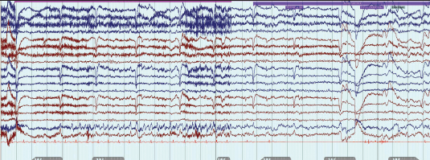
College of Engineering
Temple University
Computer Detection of Abnormal Electroencephalography
www.nedcdata.org
D. Jungreis and M. Jacobson I. Obeid and J. Picone
Department of Neurology College of Engineering
Temple University School of Medicine Temple University
Abstract
The electroencephalogram (EEG) is the standard tool used by neurologists for diagnosing epilepsy. Automated detection by computers has met with limited success. Our goal is to develop a tool that can aid the neurologist in real-time diagnosis of epilepsy, first by detecting isolated anomalies and then moving to detection of global properties of the EEG. Bilateral comparisons and assessment across multiple channels will be crucial.
Preliminary experiments are being conducted on the TUH EEG Corpus, which contains over 17,000 patient records.
The Problem
Electroencephalogram (EEG) is used to measure brain electrophysiology. EEG interpretation is subjective. Inter-annotator agreement is low, even for expert neurologists.
EEGs can also be long (e.g., 24 hours) and require human review to spot pathologies.
The Goal
Use computers to aid physicians in diagnosis of neurological diseases, particularly epilepsy
Detect pathological events in real time
Currently, attempting detection of three local pathologies:
No reactivity of posterior channels upon eye closure
Phase reversal of brain waves
Changes in periodic lateralized epileptiform discharge (PLED) frequency
Fig. 1 Black arrows point to examples of phase reversal spikes seen amid the apparent chaos.
The Obstacles
Detection of global events
Noise and artifact
Amplitude changes
Variability in human interpretation
Lack of success by previous teams
The Strategy
Gold standard approach (from Simon Warby) to establish “correct” interpretation of EEG
Develop programs to detect local abnormalities
Test on TUH EEG Corpus that contains 17,000+ EEGs
Detection techniques
Comparison of hemispheres
Evolution of waves across the brain
Future Work
Analysis of global pathology
Refining and expanding analysis of local abnormalities
Conclusions
Automatic interpretation of EEGs has the potential to be valuable for a neurologist, improving patient outcomes
Future analysis of global abnormalities and refinement of local analysis should yield exciting and useful results
References
Warby S.C., et al. Sleep-spindle detection: crowdsourcing and evaluating performance of experts, non-experts and automated methods. Nat. Methods. 2014;11:385–392.
Notes:
This is my poster. Many are like it, but this one is MINE!
All pictures are from Google.

