Slide 1
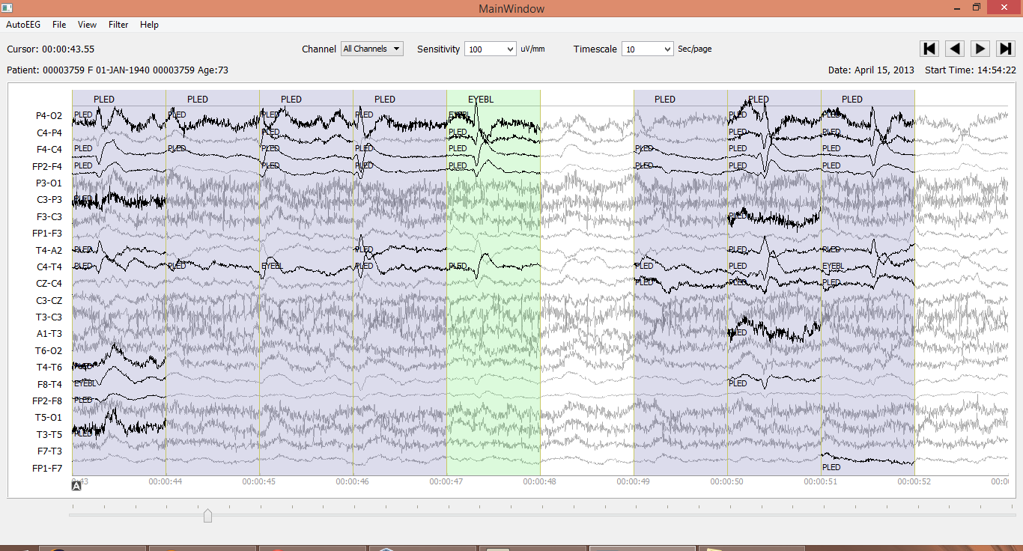
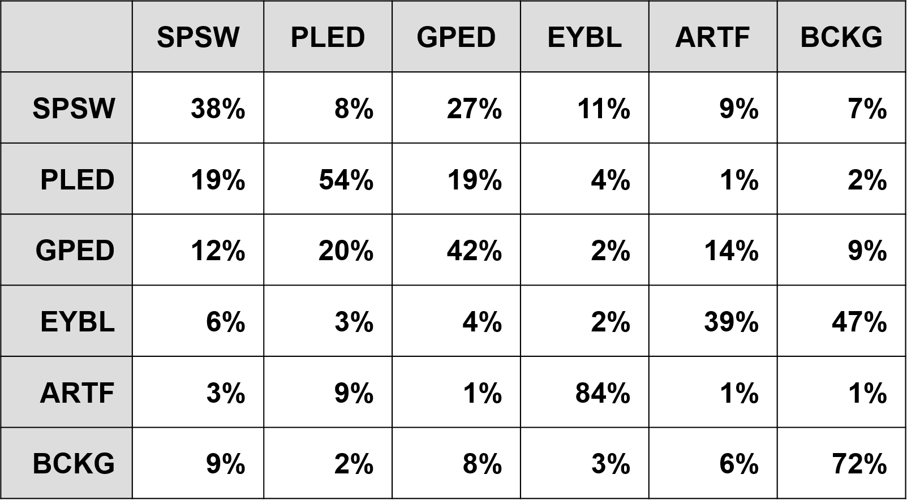
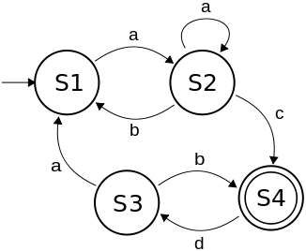
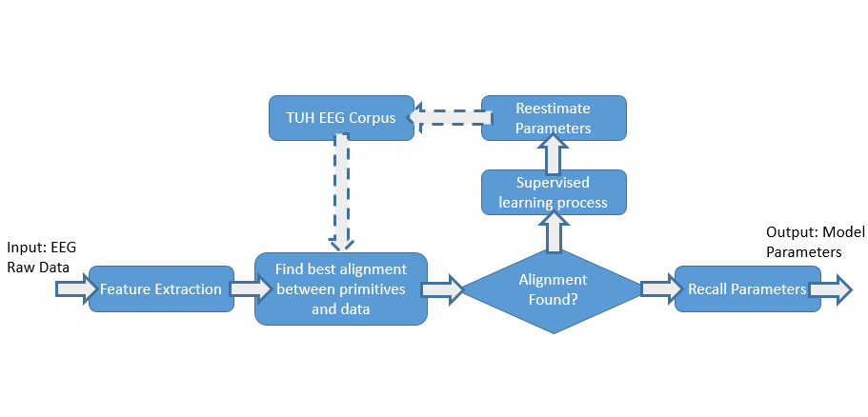
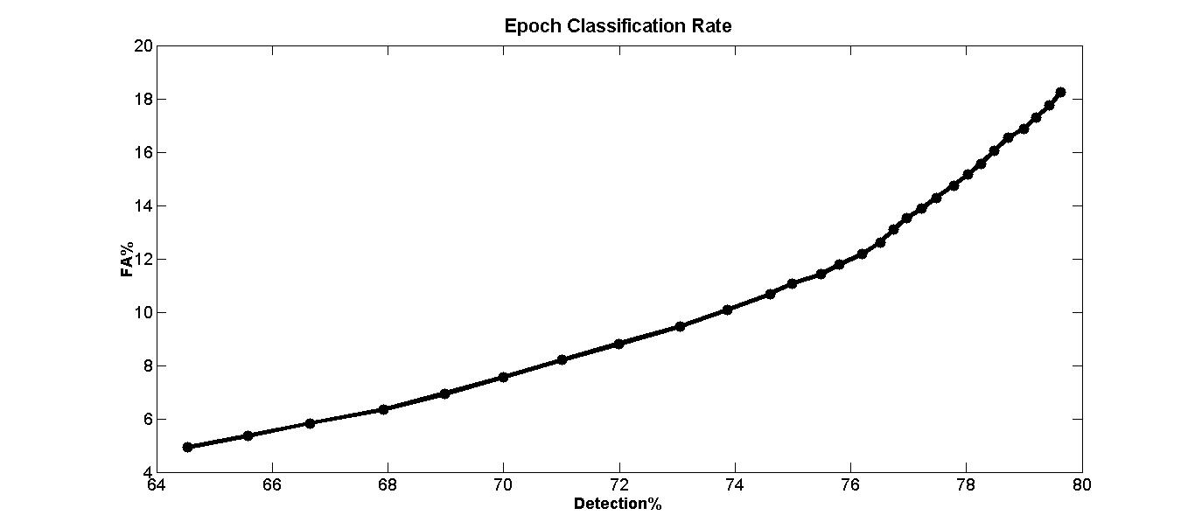
College of Engineering
Temple University
AutoEEG: Automatic Interpretation of EEGs Using Big Data
www.nedcdata.org
Meysam Golmohammadi, Amir Harati, Iyad Obeid and Joseph Picone
Abstract
EEGs, which record electrical activity on the scalp using an array of electrodes, are routinely used in clinical settings to assess brain injury or brain disease. Currently, a board certified EEG specialist is required to interpret an EEG.
The emergence of big data and deep learning is enabling the ability to automatically learn how to interpret EEGs from a large archive of untranscribed EEG data.
We are developing a system, AutoEEG, that generates time aligned markers indicating points of interest in the signal, and then produces a summarization based on a statistical analysis of this markers.
Results
An error confusion matrix for the HMM-based system (event mode):
An error confusion matrix after deep learning:
The overall false alarm rate for the three primary event classes (SPSW, PLED, and GPED) is under 5% and misrecognition rate is under 10%.
Detections and false alarms can be adjusted using confidence measures:
High performance system can run hyper real-time (e.g., 100 times faster than real-time).
Demonstration
A Python-based user interface:
Summary
Using AutoEEG, physicians can view the report and can interactively query the data from any portable computing device.
Clinical consequences include real-time feedback and decision making support.
Patients and technicians will receive immediate feedback rather than waiting days or weeks for results.
Medical students can be trained with the system and use search tools make it easy to view patient histories and comparable conditions in other patients.
The same baseline technology provides state of the art results on epileptic seizure detection (CHB-MIT). However, that technology performs extremely poorly on TUH EEG.
More sophisticated systems are under development and delivering much higher performance, approaching the performance needed to be clinically relevant.
Two-Level Machine Learning Architecture
Feature Extraction
Temporal and Spatial Context
Sequential Modeler
Post Processor
Epoch
Label
Epoch
Methods
Machine learning algorithms based on hidden Markov models and deep learning are used to learn mappings of EEG events to diagnoses.
A simple filter bank-based cepstral analysis is used to convert an EEG signal into features.
The system accepts multichannel EEG data in EDF format as input. The signal is analyzed in 1 sec epochs using 100 msec frames.
HMMs are used to map frames to epochs and classify epochs.
The desired output is a time-aligned transcription.
Hidden Markov Models
Finite State Machine
Active Learning
Seed models with a small amount of transcribed data using reports that clearly indicate the existence of the desired events.
Classify the data.
Train models based on hypothesized labels.
Select high confidence data.
References
D. Wulsin, J. Blanco, R. Mani, and B. Litt, “Semi-Supervised Anomaly Detection for EEG Waveforms Using Deep Belief Nets,” in International Conference on Machine Learning and Applications (ICMLA), 2010, pp. 436–441.
J. Picone, “Continuous speech recognition using hidden Markov models,” IEEE ASSP Magazine, vol. 7, no. 3, pp. 26–41, Jul. 1990.
D. Wulsin, Bayesian Nonparametric Modeling of Epileptic Events, University of Pennsylvania, 2013.

