Slide 1
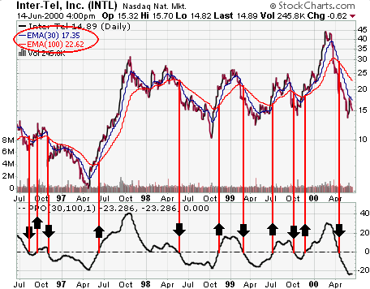
LECTURE 01: CONTINUOUS AND DISCRETE-TIME SIGNALS
Objectives: Examples of Signals Functional Forms Continuous vs. Discrete Symmetry and Periodicity Basic Characteristics
Resources: MIT 6.003: Lecture 1 Wiki: Continuous Signals Wiki: Discrete Signals JF: MATLAB Resources ISIP: Signal Processing Demonstrations JHU: Java Applets
• URL: .../publications/courses/ece_3163/lectures/current/lecture_01.ppt
• MP3: .../publications/courses/ece_3163/lectures/current/lecture_01.mp3
Notes:
MS Equation 3.0 was used with settings of: 18, 12, 8, 18, 12.

Slide 2
Introduction
Signals and Systems is a cornerstone of an electrical or computer engineering education and relevant to most engineering disciplines.
The concepts described in this class (e.g., Fourier analysis) have roots in applied mathematics, and have impacted virtually all engineering disciplines. In fact, many non-engineering disciplines, such as business and finance, exploit these concepts today.
Popular software tools such as Excel and Photoshop now include extensive signal processing capabilities.
Virtually all engineers will use some aspect of this course in their work, since even hardware design begins with computer modeling.
This course is actually an introduction to the design, simulation, and testing of systems. One often overlooked benefit of this course is to help you better appreciate some of that free software you download from the Internet.
We will focus on basic mathematical concepts, such as linearity, and common transformations (e.g., Laplace). More advanced courses deal with how you can combine such concepts into algorithms, and how to implement these concepts efficiently in hardware.
Though the analog portion of this course focuses on linear systems, digital systems are most often nonlinear in nature due to the ease with which the linearity assumption can be violated in software.

Slide 3
Multimedia Signal Processing At A Glance…
Some of the specifications of this MP3 player are:
❑ 1” x 2.5” package  2 Gbytes memory
❑ music, video, photo  audio recording
❑ FM radio  USB interface
Advances in integrated circuits and digital signal processing technology enabled the creation of this device.
Low power and large inexpensive memories were crucial to the commercial viability of the device.
The signals stored in this device are digital signals, because they consist of discrete-time signals whose amplitudes are represented as a finite set of numbers.
The signals are compressed to save space using software-based compression (MP3).
An FM radio demodulates an electromagnetic wave and converts it to a digital audio signal.
The audio recorder uses a microphone to convert a sound pressure wave into an electrical signal, which is then converted to an MP3 digital signal.
A lot of signal processing technology for $30!

Slide 4
Examples of Signals
Electrical signals (e.g., voltages and currents in a circuit)
Acoustic signals (e.g., audio or speech signals)
Video signals (e.g., intensity variations in an image)
Biological signals (e.g., sequence of bases in a gene)
The Internet is introducing many new forms of “signals” as information streams (e.g., multimedia news broadcasts).
Noise: unwanted components in your signals that are often random.
Video signals are interesting because they are discrete in several dimensions:
The image has a particular horizontal and vertical resolution (e.g., 320 x 240 pixels).
The image also is sampled in the temporal dimension (e.g., 30 frames per second).
Each pixel is represented by 8 to 24 bits of color (e.g., 8 bits for Red, Green and Blue).
The audio and video are compressed.

Slide 5
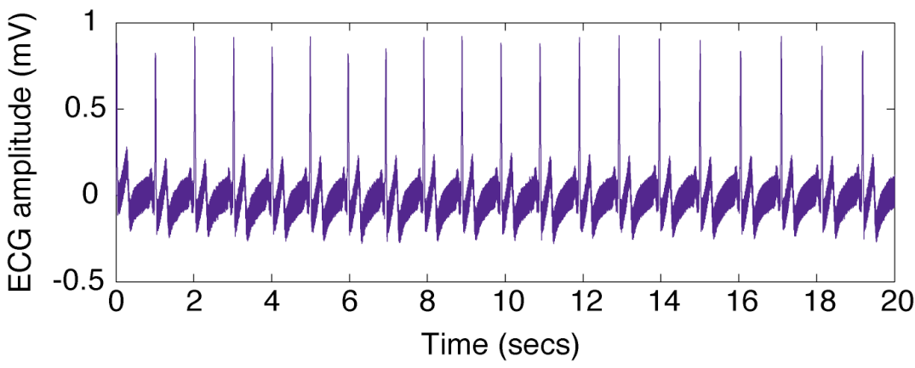
Independent Variables
Time is often the independent variable for a signal. x(t) will be used to represent a signal that is a function of time, t.
A temporal signal is defined by the relationship of its amplitude (the dependent variable) to time (the independent variable).
An independent variable can be 1D (time), 2D (space), 3D (space) or even something more complicated.
The signal is described as a function of this variable.
There are many types of functions that can be used to describe signals (continuous, discrete, random are just a few of the concepts we will encounter this semester).

Slide 6
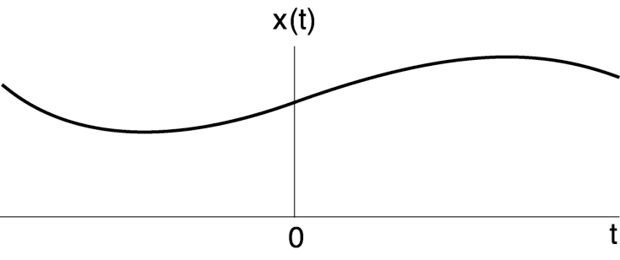
Continuous Time (CT) Signals
Most of the signals in the physical world are CT signals, since the time scale is infinitesimally fine (e.g., voltage, pressure, temperature, velocity).
Often, the only way we can view these signals is through a transducer, a device that converts a CT signal to an electrical signal.
Common transducers are the ears, the eyes, the nose… but these are a little complicated.
Simpler transducers are voltmeters, microphones, and pressure sensors.

Slide 7
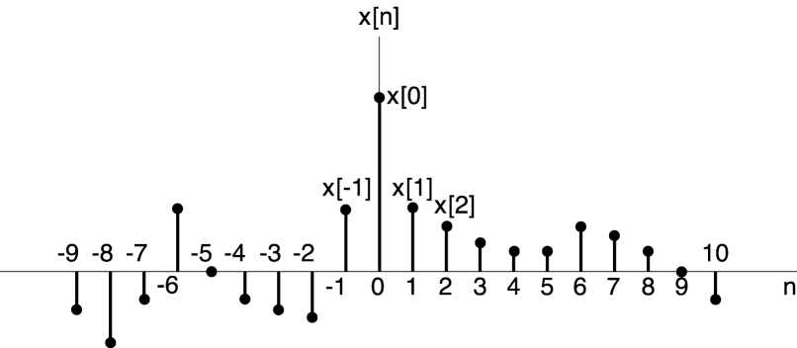
Discrete-Time (DT) Signals
We can write a collection of numbers (1, -3, 7, 9) representing a signal as a function of a discrete variable, n. x[n] represents the amplitude, or value of the signal as a function of n, which takes on integer values.
Many human-generated signals are discrete (e.g., MIDI codes, stock market prices, digital images).
In this course, we will show that most of the properties that apply to CT signals apply in a similar manner to DT signals.

Slide 8
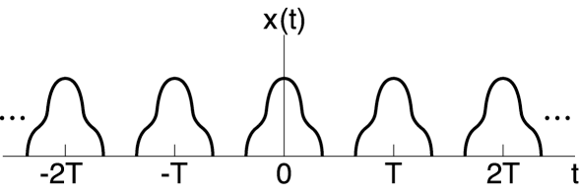
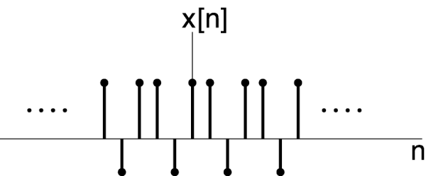
Signals With Symmetry: Periodic
CT Periodic signals:
DT Periodic signals:
Note: The sum of two CT signals is periodic only if the ratio of their periods can be written as the ratio of two integers. We will exploit this fact when building signals out of sums of periodic signals (e.g., Fourier series).

Slide 9
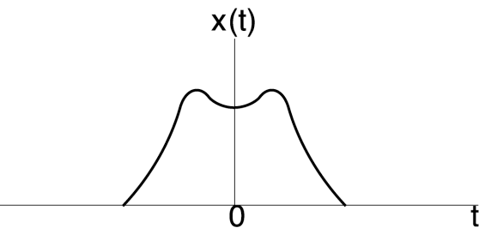
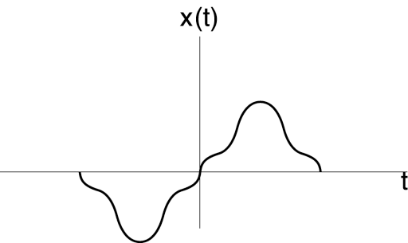
Signals With Symmetry: Even/Odd
Even: CT:
DT:
Odd: CT:
DT:

Slide 10
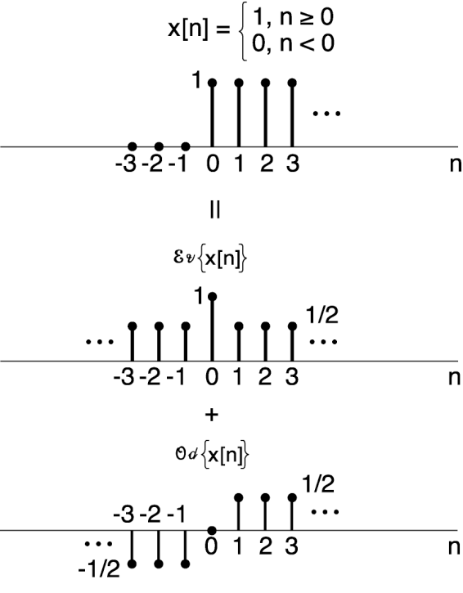
Properties of Even/Odd Signals
Any signals can be expressed as a sum of even and odd signals. That is:
This is demonstrated to the right for a signal referred to as a unit step.

Slide 11
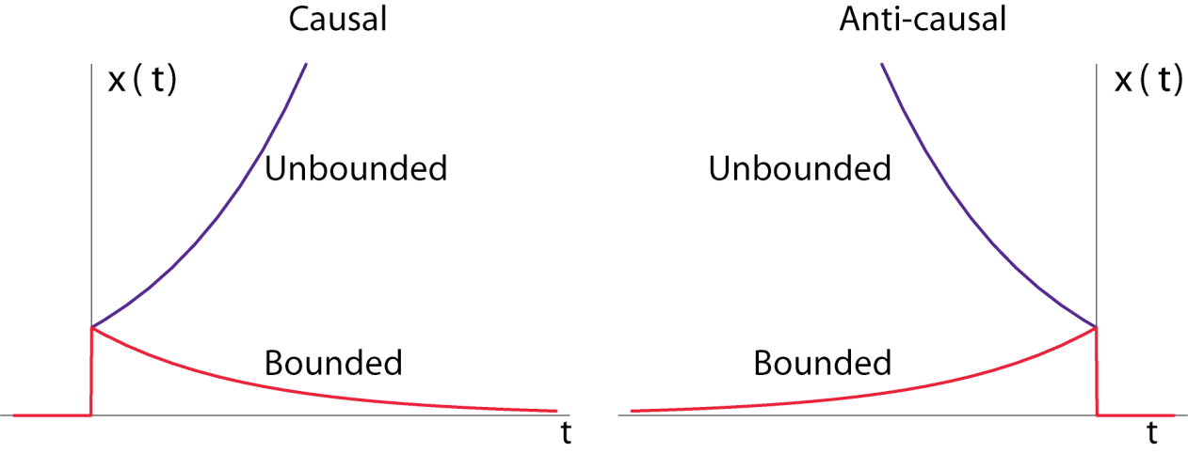
Other Types Of Symmetry
A right-sided signal is zero for t < T and a left-sided signal is zero for t > T, where T can be positive or negative.
A signal can be bounded or unbounded depending on the stability of the system.

Slide 12
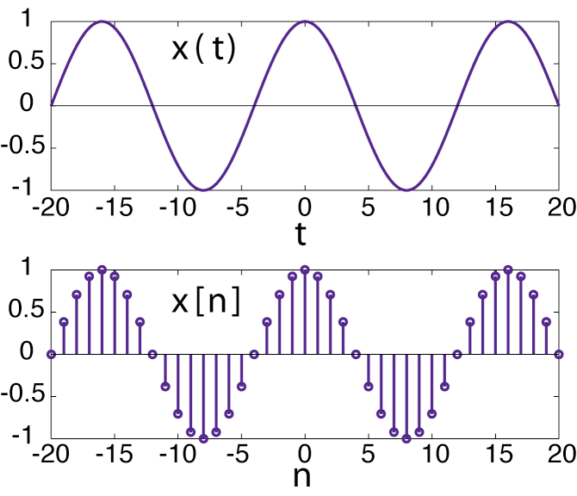
Real and Complex Signals
Complex signals are an important abstraction in many disciplines such as communications and multidimensional signal processing.
In general, x is a complex quantity and has:
a real and imaginary part, or equivalently
a magnitude and a phase angle.
A very important class of signals is complex exponentials:
CT signals of the form x(t) = e^{st}
DT signals of the form x[n] = z^{n}
where z and s are complex numbers.
For example, suppose s = jπt/8 and z = e ^{jπ/8}, the exponentials are purely imaginary, then the real parts are:

Slide 13
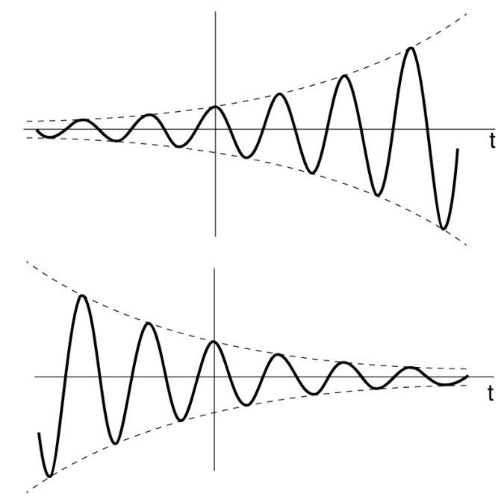
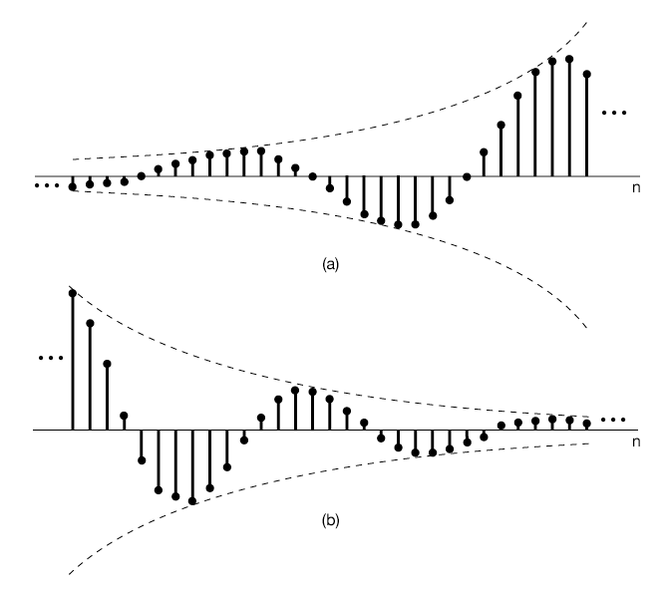
Real and Complex Signals (Cont.)
For example, suppose s = σ + jω for a CT signal:
σ>0:
σ<0:
σ>0:
For example, suppose z = e^{(σ + jω)} for a DT signal:
σ<0:

Slide 14
Summary
With the advent of the Internet and personal electronics, signals and systems have become an integral part of the human experience.
Signals can be continuous or discrete; time-varying, spatially varying, or both.
Signals can be one-dimensional (amplitude vs. time) or multidimensional (a 2D or 3D image vs. time).
However, all these signals and systems can be characterized by a common set of mathematical abstractions such as the Fourier transform.
The more symmetry a signal has, the easier it is to represent, analyze and understand.
Hence, understanding the properties of signals and systems will be important.
In this course, we will focus mainly on one-dimensional continuous and discrete signals.

