Slide 1
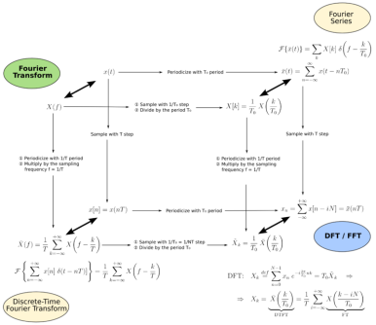
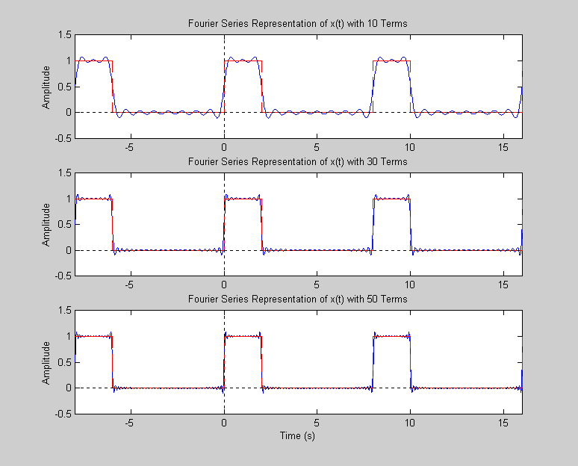
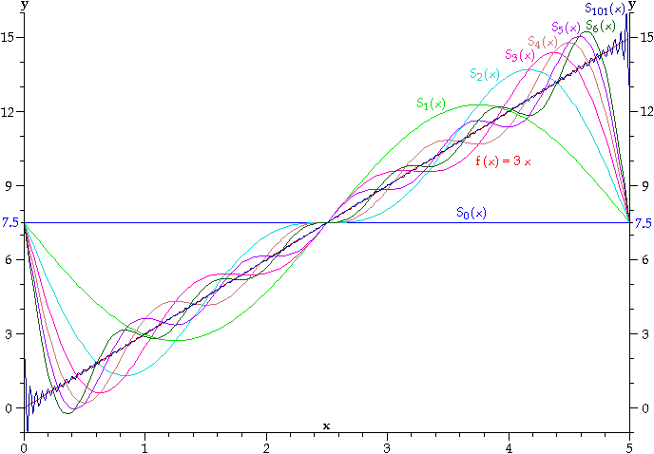
LECTURE 09: THE TRIGONOMETRIC FOURIER SERIES
Objectives: The Trigonometric Fourier Series Pulse Train Example Symmetry (Even and Odd Functions) Line Spectra Power Spectra More Properties More Examples
Resources: CNX: Fourier Series Properties CNX: Symmetry AM: Fourier Series and the FFT DSPG: Fourier Series Examples DR: Fourier Series Demo
• URL: .../publications/courses/ece_3163/lectures/current/lecture_09.ppt
• MP3: .../publications/courses/ece_3163/lectures/current/lecture_09.mp3
Notes:
MS Equation 3.0 was used with settings of: 18, 12, 8, 18, 12.

Slide 2
The Trigonometric Fourier Series Representations
For real, periodic signals:
The analysis equations for a_{k} and b_{k} are:
Note that a₀ represents the average, or DC, value of the signal.
We can convert the trigonometric form to the complex form:

Slide 3
Example: Periodic Pulse Train (Complex Fourier Series)

Slide 4
Example: Periodic Pulse Train (Trig Fourier Series)
This is not surprising because a₀ is the average value (2T₁/T).
Also,

Slide 5
Example: Periodic Pulse Train (Cont.)
Check this with our result for the complex Fourier series (k > 0):

Slide 6
Even and Odd Functions
Was this result surprising? Note: x(t) is an even function: x(t) = x(-t)
If x(t) is an odd function: x(t) = –x(-t)

Slide 7
Line Spectra
Recall:
From this we can show:

Slide 8
Energy and Power Spectra
The energy of a CT signal is:
The power of a signal is defined as:
Think of this as the power of a voltage across a 1-ohm resistor.
Recall our expression for the signal:
We can derive an expression for the power in terms of the Fourier series coefficients:
Hence we can also think of the line spectrum as a power spectral density:

Slide 9
Properties of the Fourier Series

Slide 10
Properties of the Fourier Series

Slide 11
Properties of the Fourier Series

Slide 12
Summary
Reviewed the Trigonometric Fourier Series.
Worked an example for a periodic pulse train.
Analyzed the impact of symmetry on the Fourier series.
Introduced the concept of a line spectrum.
Discussed the relationship of the Fourier series coefficients to power.
Introduced our first table of transform properties.
Next: what do we do about non-periodic signals?

