Slide 1
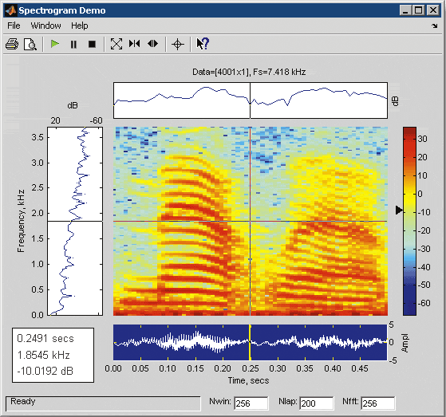
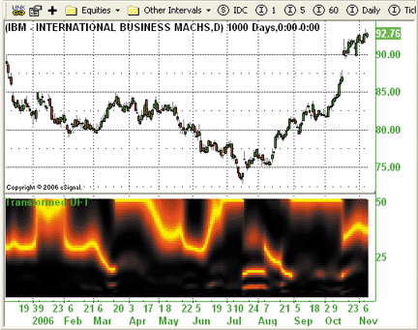
LECTURE 16: DISCRETE FOURIER TRANSFORM
Objectives: Introduction to the IEEE Derivation of the DFT Relationship to DTFT DFT of Truncated Signals Time Domain Windowing
Resources: Wiki: Discrete Fourier Transform Wolfram: Discrete Fourier Transform DSPG: The Discrete Fourier Transform Wiki: Time Domain Windows ISIP: Java Applet
• URL: .../publications/courses/ece_3163/lectures/current/lecture_16.ppt
• MP3: .../publications/courses/ece_3163/lectures/current/lecture_16.mp3
Notes:
MS Equation 3.0 was used with settings of: 18, 12, 8, 18, 12.

Slide 2
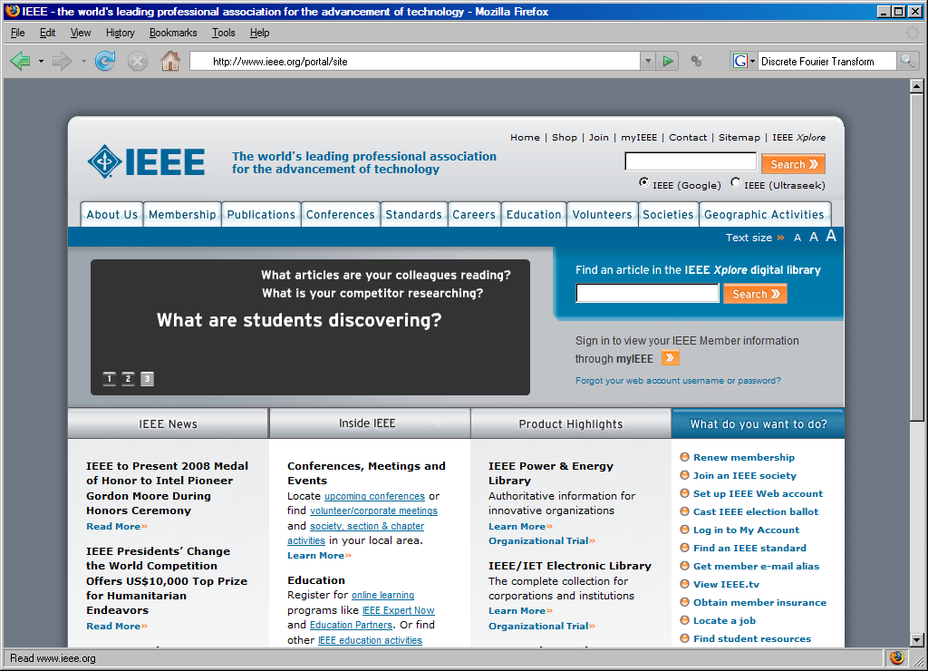
Introduction to the IEEE
Notes:
]i=k,

Slide 3
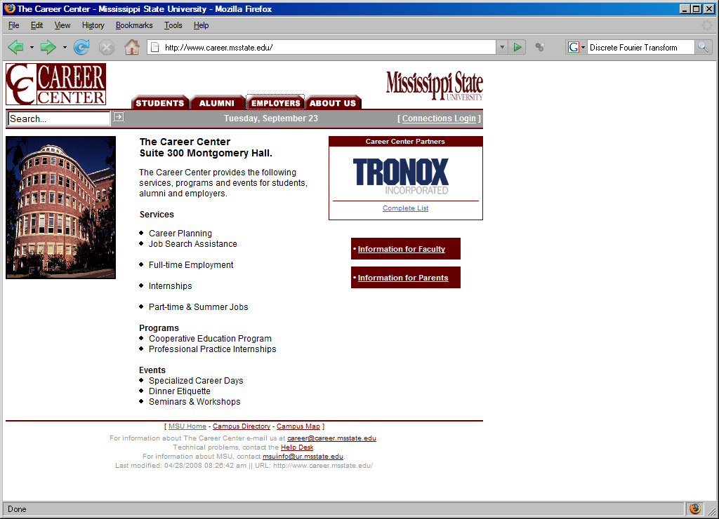
Career Day
Notes:
]i=k,

Slide 4
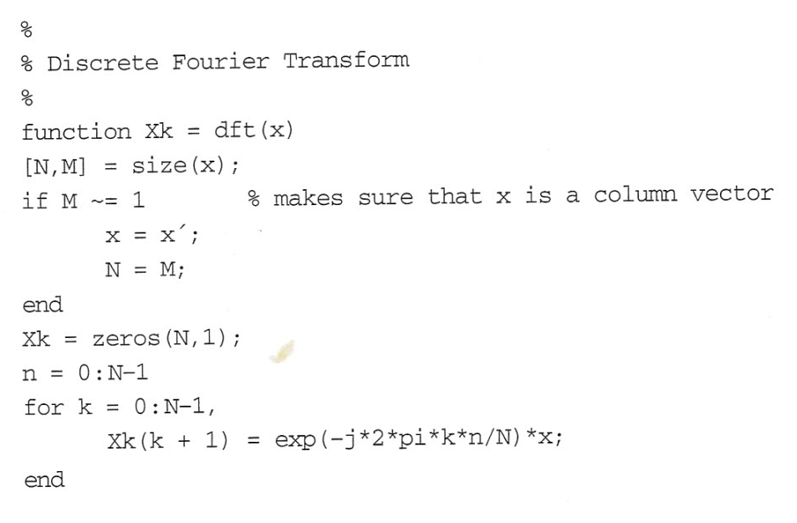
The Discrete-Time Fourier Transform
The Discrete-Time Fourier Transform:
Not practical for (real-time) computation on a digital computer.
Solution: limit the extent of the summation to N points and evaluate the continuous function of frequency at N equispaced points:
MATLAB code for the DFT:
The exponentials can be precomputed so that the DFT can be computed as a vector-matrix multiplication.
Later we will exploit the symmetry properties of the exponential to speed up the computation (e.g., fft()).

Slide 5
Computation of the DFT
Given the signal:

Slide 6
Symmetry
The magnitude and phase functions are even and odd respectively.
The DFT also has “circular” symmetry:
When N is even, |X_{k}| is symmetric about N/2.
The phase, ∠ X_{k}, has odd symmetry about N/2.

Slide 7
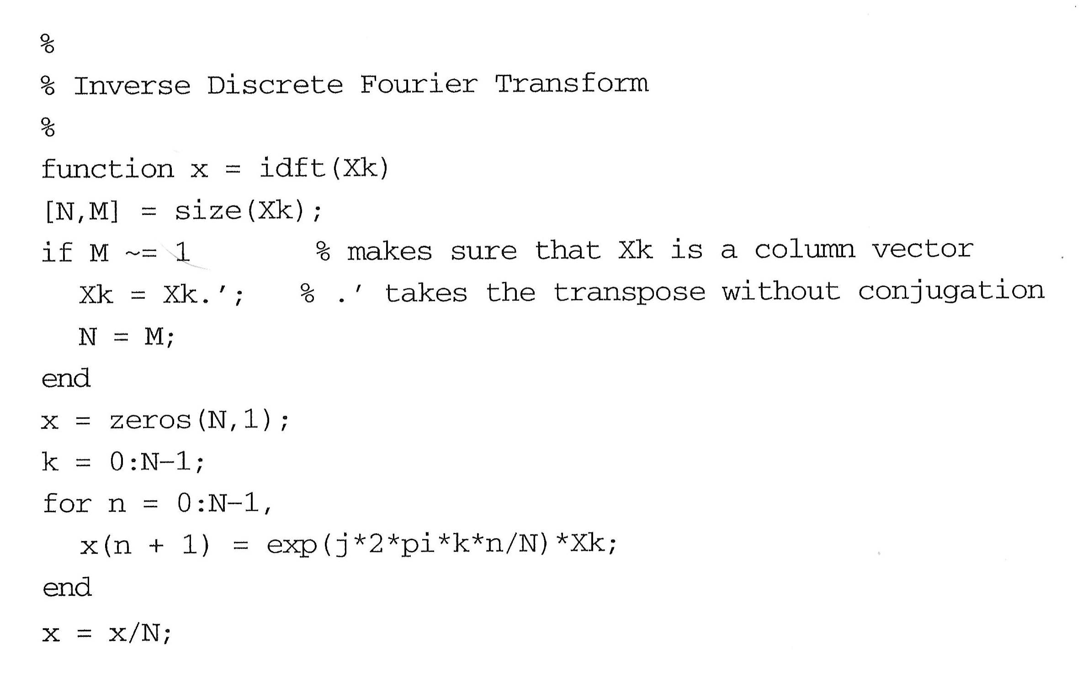
Inverse DFT
The inverse transform follows from the DT Fourier Series:

Slide 8
Computation of the Inverse DFT

Slide 9
Relationship to the DTFT
q = 5
The DFT and the DFT are related by:
If we define a pulse as:
The DFT is simply a sampling of the DTFT at equispaced points along the frequency axis.
As N increases, the sampling becomes finer. Note that this is true even when q is constant ⇒ increasing N is a way of interpolating the spectrum.
q=5, N = 22
q = 5, N = 88

Slide 10
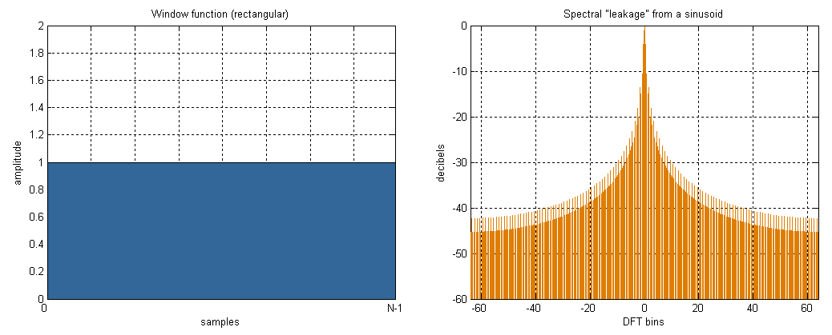
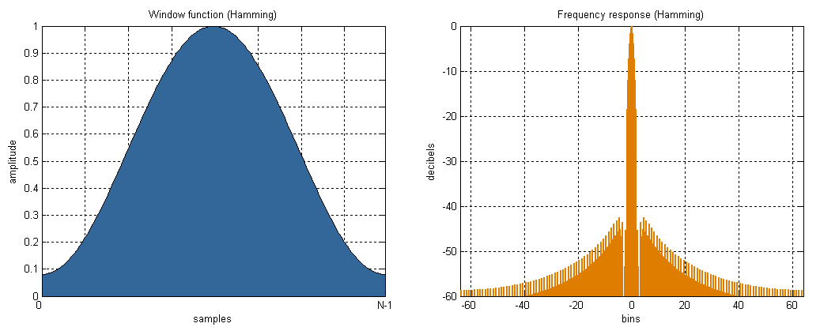
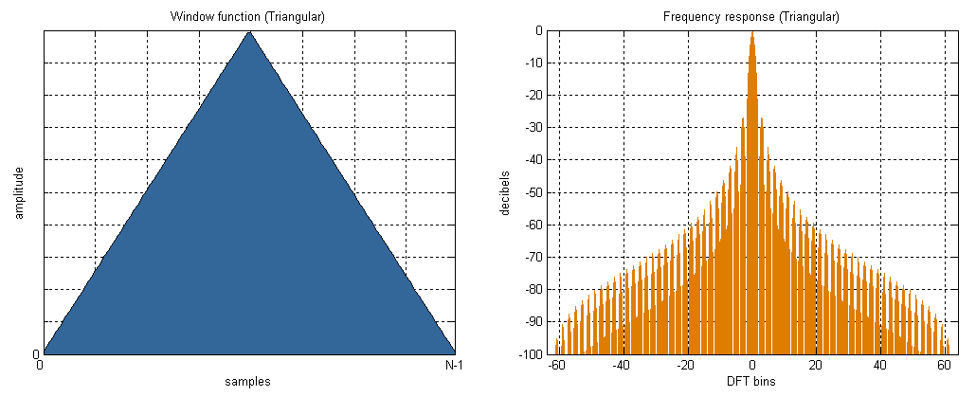
DFT of Truncated Signals
What if the signal is not time-limited? We can think of limiting the sum to N points as a truncation of the signal:
What are the implications of this in the frequency domain? (Hint: convolution)
Popular Windows:
Rectangular:
Generalized Hanning:
Triangular:
Rectangular
Generalized Hanning
Triangular

Slide 11
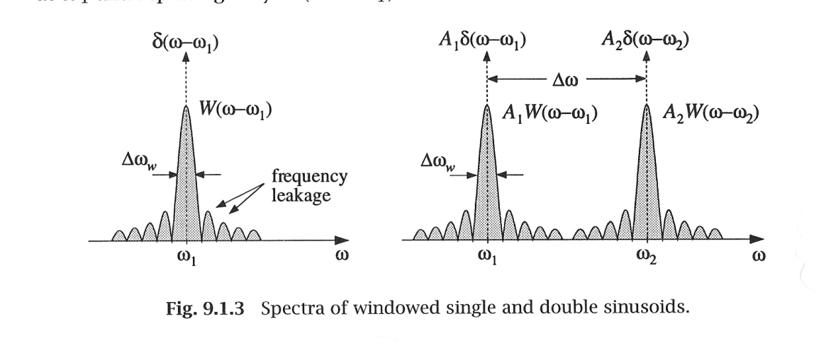
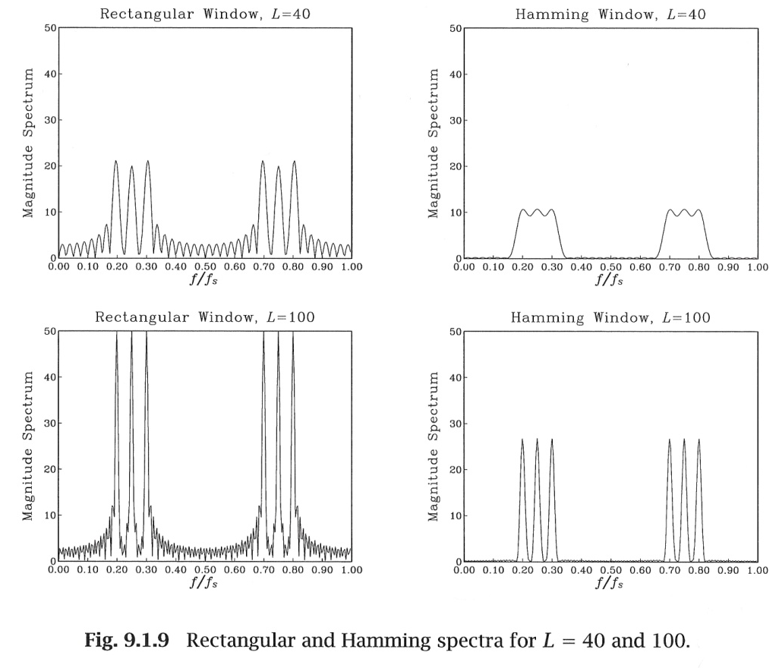
Impact on Spectral Estimation
The spectrum of a windowed sinewave is the convolution of two impulse functions with the frequency response of the window.
For two closely spaced sinewaves, there is “leakage” between each sinewave’s spectrum.
The impact of this leakage can be mitigated by using a window function with a narrower main lobe.
For example, consider the spectrum of three sinewaves computed using a rectangular and a Hamming window.
We see that for the same number of points, the spectrum produced by te Hamming window separates the sinewaves.
What is the computational cost?

Slide 12
Summary
Join the IEEE as a student member!
Visit the Career Fair.
Introduced the Discrete Fourier Transform as a truncated version of the Discrete-Time Fourier Transform.
Demonstrated both the forward and inverse transforms.
Explored the relationship to the DTFT.
Compared the spectrum of a pulse.
Discussed the effects of truncation on the spectrum.
Introduced the concept of time domain windowing and discussed the impact of windows in the frequency domain.

