Slide 1
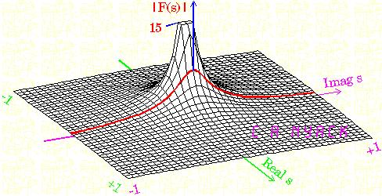
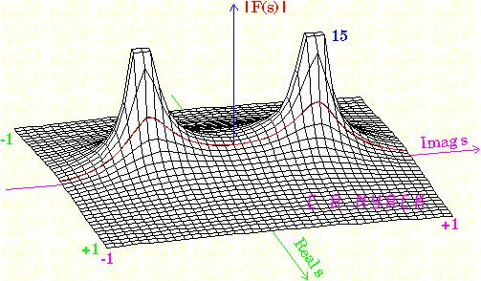
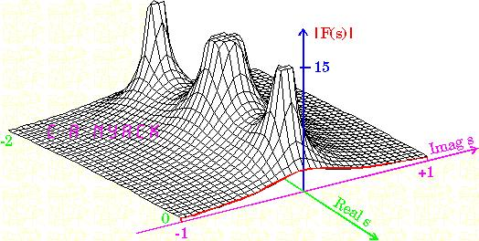
LECTURE 21: THE LAPLACE TRANSFORM
Objectives: Motivation The Bilateral Transform Region of Convergence (ROC) Properties of the ROC Rational Transforms
Resources: MIT 6.003: Lecture 17 Wiki: Laplace Transform Wiki: Bilateral Transform Wolfram: Laplace Transform IntMath: Laplace Transform CNX: Region of Convergence
• URL: .../publications/courses/ece_3163/lectures/current/lecture_21.ppt
• MP3: .../publications/courses/ece_3163/lectures/current/lecture_21.mp3
Notes:
MS Equation 3.0 was used with settings of: 18, 12, 8, 18, 12.

Slide 2
Motivation for the Laplace Transform
The CT Fourier transform enables us to:
Solve linear constant coefficient differential equations (LCCDE);
Analyze the frequency response of LTI systems;
Analyze and understand the implications of sampling;
Develop communications systems based on modulation principles.
Why do we need another transform?
The Fourier transform cannot handle unstable signals:
(Recall this is related to the fact that the eigenfunction, e^{jωt}, has unit amplitude, |e^{jωt}| = 1.
There are many problems in which we desire to analyze and control unstable systems (e.g., the space shuttle, oscillators, lasers).
Consider the simple unstable system:
This is an unstable causal system.
We cannot analyze its behavior using:
Note however we can use time domain techniques such as convolution and differential equations.
CT LTI
Notes:
]i=k,

Slide 3
The Bilateral (Two-sided) Laplace Transform
Recall the eigenfunction property of an LTI system:
e^{st} is an eigenfunction of ANY LTI system.
s can be complex:
We can define the bilateral, or two-sided, Laplace transform:
Several important observations are:
Can be viewed as a generalization of the Fourier transform:
X(s) generally exists for a certain range of values of s. We refer to this as the region of convergence (ROC). Note that this only depends on σ and not ω.
If s = jω is in the ROC (i.e., σ = 0), then:
and there is a clear relationship between the Laplace and Fourier transforms.
CT LTI

Slide 4
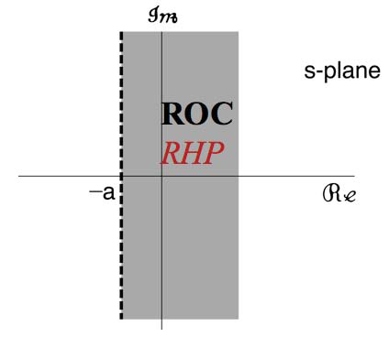
Example: A Right-Sided Signal
Example: where a is an arbitrary real or complex number.
Solution:
This converges only if:
and we can write:
ROC
The ROC can be visualized using s-plane plot shown above. The shaded region defines the values of s for which the Laplace transform exists. The ROC is a very importance property of a two-sided Laplace transform.

Slide 5
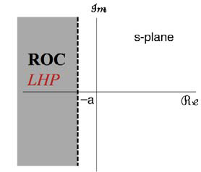
Example: A Left-Sided Signal
Example:
Solution:
This converges only if:
and we can write:
ROC
The transform is the same but the ROC is different. This is a major difference from the Fourier transform – we need both the transform and the ROC to uniquely specify the signal. The FT does not have an ROC issue.

Slide 6
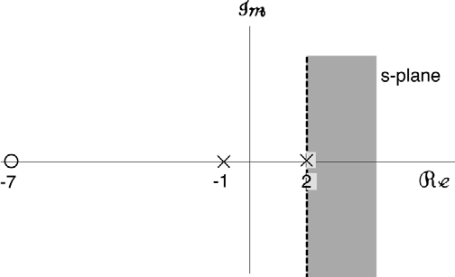
Rational Transforms
Many transforms of interest to us will be ratios of polynomials in s, which we refer to as a rational transform:
The zeroes of the polynomial, N(s), are called zeroes of H(s).
The zeroes of the polynomial, D(s), are called poles of H(s).
Any signal that is a sum of (complex) one-sided exponentials can be expressed as a rational transform. Examples include circuit analysis.
Example:
zero poles
Does this signal have a Fourier transform?

Slide 7
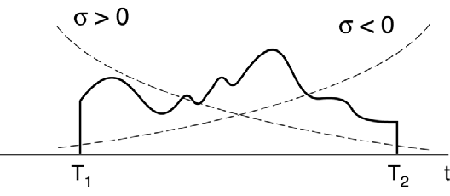
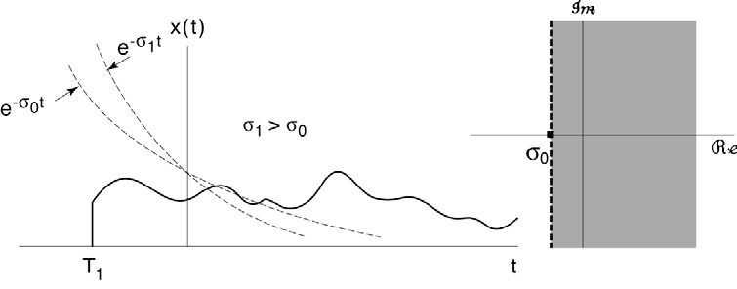
Properties of the ROC
There are some signals, particularly two-sided signals such as and that do not have Laplace transforms.
The ROC typically assumes a few simple shapes. It is usually the intersection of lines parallel to the imaginary axis. Why?
For rational transforms, the ROC does not include any poles. Why?
If is of finite duration and absolutely integrable, its ROC is the complete s-plane.
If is right-sided, and if σ₀ is in the ROC, all points to the right of σ₀ are in the ROC.
If is left-sided, points to the left of σ₀ are in the ROC.

Slide 8
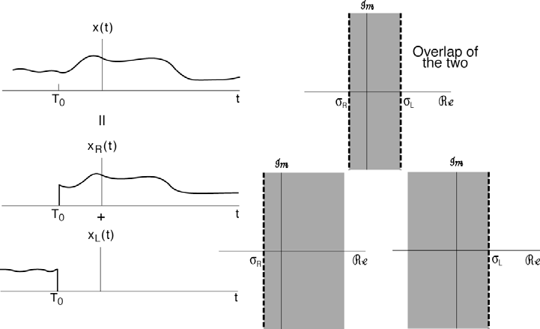
More Properties of the ROC
If is two-sided, then the ROC consists of the intersection of a left-sided and right-sided version of , which is a strip in the s-plane:

Slide 9
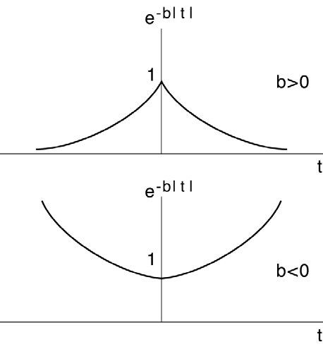
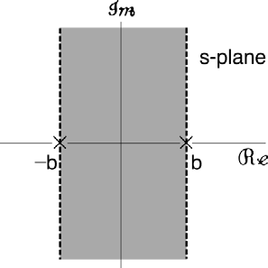
Example of a Two-sided Signal
If b < 0, the Laplace transform does not exist.
Hence, the ROC plays an integral role in the Laplace transform.

Slide 10
ROC for Rational Transforms
Since the ROC cannot include poles, the ROC is bounded by the poles for a rational transform.
If x(t) is right-sided, the ROC begins to the right of the rightmost pole. If x(t) is left-sided, the ROC begins to the left of the leftmost pole. If x(t) is double-sided, the ROC will be the intersection of these two regions.
If the ROC includes the jω-axis, then the Fourier transform of x(t) exists. Hence, the Fourier transform can be considered to be the evaluation of the Laplace transform along the jω-axis.

Slide 11
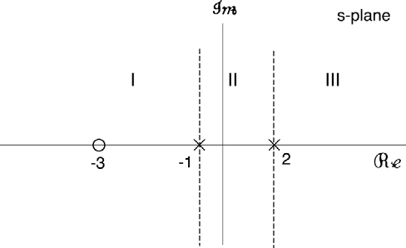
Example
Consider the Laplace transform:
Can we uniquely determine the original signal, x(t)?
There are three possible ROCs:
ROC III: only if x(t) is right-sided.
ROC I: only if x(t) is left-sided.
ROC II: only if x(t) has a Fourier transform.

Slide 12
Summary
Introduced the bilateral Laplace transform and discussed its merits relative to the Fourier transform.
Demonstrated calculation of the double-sided transform for simple exponential signals.
Discussed the important role that the Region of Convergence (ROC) plays in this transform.
Introduced the concept of a rational transform as a ratio of two polynomials.
Explored how some basic properties of a signal influence the ROC.
Next:
The Inverse Laplace Transform
Properties of the Laplace Transform

