Slide 1
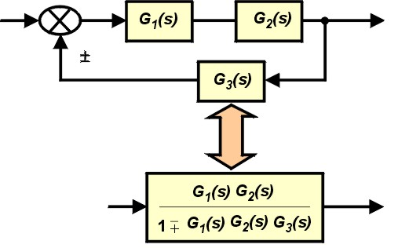
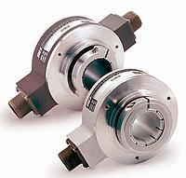
LECTURE 25: TRANSFER FUNCTIONS
Objectives: Parallel Interconnection Series Connection Feedback Connection Review
Resources: Wiki: Signal Flow Graphs KPhang: Signal Flow Graphs Wiki: Control Systems JKP: Block Diagram Reductions
• URL: .../publications/courses/ece_3163/lectures/current/lecture_25.ppt
• MP3: .../publications/courses/ece_3163/lectures/current/lecture_25.mp3
Notes:
MS Equation 3.0 was used with settings of: 18, 12, 8, 18, 12.

Slide 2
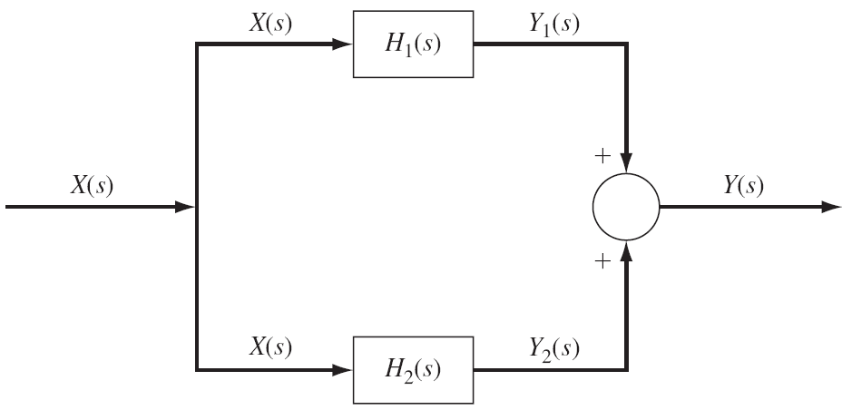
Interconnections
Blocks can be thought of as subsystems that make up a system described by a signal flow graph.
We can reduce such graphs to a transfer function.
Consider a parallel connection:
Consider a series connection:
Notes:
]i=k,

Slide 3
Feedback
Feedback plays a major role in signals and systems. For example, it is one way to stabilize an unstable system.
Assuming interconnection does not load the other systems:
How does the addition of feedback influence the stability of the system?
What if connection of the feedback system changes the properties of the systems? How can we mitigate this?
Notes:
]i=k,

Slide 4
Circuit Analysis Example
Assume R = 1, C = 2, and:
Also assume
Can we predict the form of the output signal? Or solve using Laplace:
Class assignment: find y(t) using:
Analytic/PPT – Laplace transform (last name begins with A-M)
Numerical – MATLAB code + plot (last name begins with N-P)
Email me the results by 8 AM Monday for 1 point extra credit (maximum)
Notes:
]i=k,

Slide 5
Exam No. 2 Review – Major Concepts
Modulation and Demodulation
Generalized Fourier Transform
Amplitude Modulation
Frequency and Phase Modulation
Synchronous Demodulation of an AM Signal
Asynchronous Demodulation
DSB and SSB Modulation
Frequency Domain Multiplexing
Superheterodyne Receivers
Demultiplexing and Demodulation
The Superheterodyne Receiver
Review
Exam No. 1
Discrete-Time Fourier Transform
Derivation and Properties of the DTFT
Transforms of Common Signals
Lowpass and Highpass Filters
Discrete Fourier Transform
Introduction to the IEEE
Derivation of the DFT
Relationship to DTFT
DFT of Truncated Signals
Time Domain Windowing
Fast Fourier Transform
Discrete Fourier Transform
Computational Complexity
Decimation in Time
Butterfly Diagrams
Convolution Application
Waterfall Plots and Spectrograms
Fourier Analysis of CT Systems
Response to a Sinusoidal Input
Frequency Analysis of an RC Circuit
Response to Periodic Inputs
Response to Nonperiodic Inputs
Analysis of Ideal Filters
The Sampling Theorem
Representation Using Impulses
FT of a Sampled Signal
Signal Reconstruction
Signal Interpolation
Aliasing
Multirate Signal Processing

Slide 6
Exam No. 1 Review – Major Concepts (Cont.)
Fourier Analysis of DT Systems
Frequency Response
Response of a Sinusoid
DT MA Filter
Filter Design
DT WMA Filter
The Laplace Transform
Motivation
The Bilateral Transform
Region of Convergence (ROC)
Properties of the ROC
Rational Transforms
Properties of the Laplace Transf.
Properties
Initial and Final Value Theorems
Unilateral Laplace Transform
Inverse Laplace Transform
Inverse Laplace Transform
Rational Transforms
Partial Fractions Expansion
Distinct Roots, Complex and Repeated Roots
Transforms With Exponentials
Differential Equations
First-Order
Second-Order
N^{th}-Order
Computation of the Output Signal
Transfer Functions
Transfer Functions
Parallel Interconnection
Series Connection
Feedback Connection
Review
The z-Transform
Properties of the z-Transform
Exam No. 2

Slide 7
Exam No. 2 Review – But What Did We Really Learn?
Major Themes?
…
… and you made it through two-thirds of the course ☺

Slide 8
Summary
Introduced series, parallel and feedback interconnections of systems.
Derived the overall transfer functions.
Discussed the important role feedback has in stability. This is a major topic addressed in Control Theory.
Noted that these interconnection models only work when the properties of the system does not change when the interconnection is made.
This is known as loading and is a practical issue that can be mitigated through the use of buffer amplifiers.
Reviewed major concepts for exam no. 2.

