Slide 1
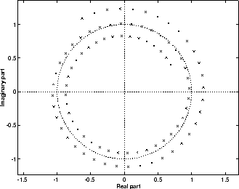
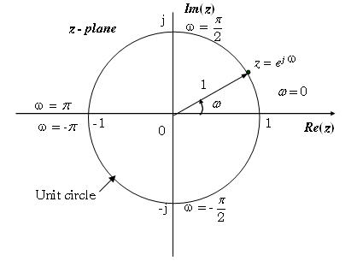
LECTURE 27: PROPERTIES OF THE Z-TRANSFORM AND THE INVERSE Z-TRANSFORM
Objectives: Modulation Summation Convolution Initial Value and Final Value Theorems Inverse z-Transform by Long Division Inverse z-Transform by Partial Fractions
Resources: MIT 6.003: Lecture 23 Wiki: Inverse Z-Transform CNX: Inverse Z-Transform Arslan: The Inverse Z-Transform CNX: Properties ISIP: Pole/Zero Demo
• URL: .../publications/courses/ece_3163/lectures/current/lecture_27.ppt
• MP3: .../publications/courses/ece_3163/lectures/current/lecture_27.mp3
Notes:
MS Equation 3.0 was used with settings of: 18, 12, 8, 18, 12.

Slide 2
Properties of the z-Transform
Linearity:
Time-shift:
Multiplication by n:
Proof:
Multiplication by a^{n}:
Proof:
Multiplication by e^{jωn}:
Multiplication by cosωn:
Multiplication by sinωn:
Summation:
Notes:
]i=k,

Slide 3
Convolution
Convolution:
Proof:
Change of index on the second sum:
The ROC is at least the intersection of the ROCs of x[n] and h[n], but can be a larger region if there is pole/zero cancellation.
The system transfer function is completely analogous to the CT case:
Causality:
Implies the ROC must be the exterior of a circle and include z = ∞.
Notes:
]i=k,

Slide 4
Initial-Value and Final-Value Theorems (One-Sided ZT)
Initial Value Theorem:
Proof:
Final Value Theorem:
Example:
Tables 7.2 and 7.3 in the textbook contain a summary of the z-Transform properties and common transform pairs.
Notes:
]i=k,

Slide 5
Inverse Laplace Transform
Recall the definition of the inverse Laplace transform via contour integration:
The inverse z-transform follows from this:
Evaluation of this integral is beyond the scope of this course. Instead, as with the Laplace transform, we will restrict our interest in the inverse transform to rational forms (ratio of polynomials). We will see shortly that this is convenient since linear constant-coefficient difference equations can be converted to polynomials using the z-transform.
As with the Laplace transform, there are two common approaches:
Long Division
Partial Fractions Expansion
Expansion by long division Is also known as the power series expansion approach and can be easily demonstrated by an example.
Notes:
]i=k,

Slide 6
Long Division
Consider:
Solution:
Implications of stability?
Notes:
]i=k,

Slide 7
Inverse z-Transform Using MATLAB
Consider:
MATLAB:
Syms X x z
X = (8*z^3+2*z^2-5*z)/(z^3-1.75*z+.75);
x = iztrans(X)
x = 2*(1/2)^n+2*(-3/2)^n+4
Evaluate numerically:
num = [8 2 -5 0];
den = [1 0 -1.75 .75];
x = filter(num, den, [1 zeros(1,9)])
Output:
8 2 9 -2.5 14.25 -11.125 26.8125 -30.1563 55.2656
Notes:
]i=k,

Slide 8
Inverse z-Transform Using Partial Fractions
Rational transforms can be factored using the same partial fractions approach we used for the Laplace transforms.
The partial fractions approach is preferred if we want a closed-form solution rather than the numerical solution long division provides.
Example:
In this example, the order of the numerator and denominator are the same. For this case, we can use a trick of factoring X(z)/z:
Notes:
]i=k,

Slide 9
Inverse z-Transform (Cont.)
We can compute the inverse using our table of common transforms:
The exponential terms can be converted to a single cosine using a magnitude/phase conversion:
Notes:
]i=k,

Slide 10
Inverse z-Transform (Cont.)
This can be verified using MATLAB:
num = [1 0 0 1];
den = [1 -1 -1 -2 0];
[r, p] = residue(num, den)
r = p=
0.6429 2.0000
0.4286 – 0.825i -0.5000 + 0.8660i
0.4286 + 0.825i -0.5000 – 0.8660i
-0.5000 0
The first 20 samples of the output can be computed numerically using:
num = [1 0 0 1];
den = [1 -1 -1 -2 0];
x = filter(num, den, [1 zeros(1,19)]);
Using MATLAB as a resource for solving homework problems can greatly reduce the time you spend doing busywork.
Notes:
]i=k,

Slide 11
Summary
Introduced additional properties of the z-transform.
Derived the convolution property for DT LTI systems.
Introduced two practical ways to compute the inverse z-transform: long division and partial fractions expansion.
Worked examples of each and demonstrated how to solve these problems using MATLAB.
Demonstration: Frequency response using a Java applet that allows you to visualize poles and zeros in the complex plane.
Next: Using the z-transform to solve first and second-order difference equations.

