Slide 1
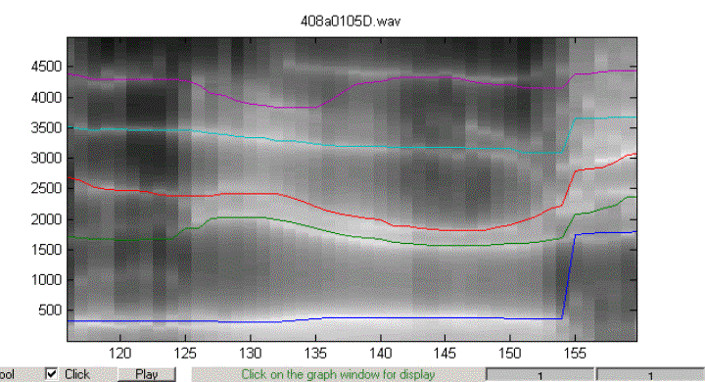
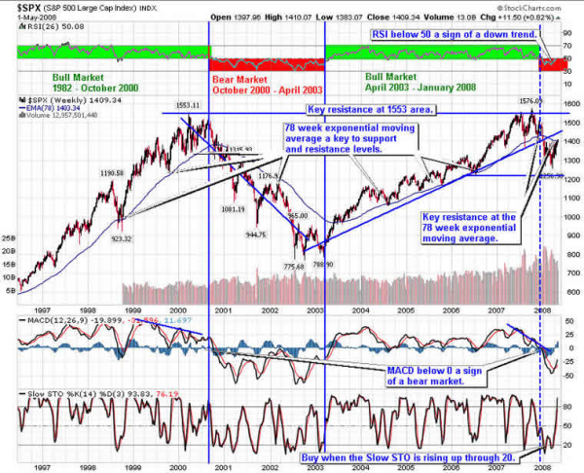
LECTURE 30: SYSTEM ANALYSIS USING THE TRANSFER FUNCTION
Objectives: Stability Response to a Sinusoid Filtering White Noise Autocorrelation Power Spectral Density
Resources: JOS: Transfer Function Analysis RAKL: z-Transform Analysis RWang: Analysis of LTI Systems SST: Stock Market Trading
• URL: .../publications/courses/ece_3163/lectures/current/lecture_30.ppt
• MP3: .../publications/courses/ece_3163/lectures/current/lecture_30.mp3
Notes:
MS Equation 3.0 was used with settings of: 18, 12, 8, 18, 12.

Slide 2
Transfer Functions and Stability
Consider a causal, linear time-invariant system described by:
We have previously described how to factor this into a product of its poles:
We note that both p_{k} and A_{k} can, in general, be complex.
Applying the inverse z-Transform:
From this we observe that the system can be stable if and only if .
This implies the poles all lie within a circle of radius 1 in the z-plane.
Stability also implies: . This also implies that if input signal is
bounded, the output will also be bounded. We refer to this as Bounded-Input Bounded-Output (BIBO) stability.
Notes:
]i=k,

Slide 3
Response to a Sinusoid
Consider the signal:
Recall that a sinewave is a signal that is marginally stable, meaning its poles like on the unit circle.
We can compute the output of an LTI system modeled by a rational transform:
We can express the z-transform in terms of these poles using a PFE:
Notes:
]i=k,

Slide 4
Response to a Sinusoid (Cont.)
We can solve for Y(z):
The first term of this expression is a transient response that decays to zero if the system is stable.
The second two terms can be rewritten as a phase-shifted cosine:
Once again we see that the output of a linear system to a sinewave is an amplitude and phase-shifted version of the input (reminiscent of phasor analysis in circuits).
This result can be generalized to all periodic signals because a periodic signal can be represented as a sum of sinewaves via the Fourier series.
We also see the importance of poles of the system as resonant frequencies. What happens if the input signal is at the same frequency as a pole of the transfer function?
What implications does this have for physical structures such as bridges or skyscrapers? circuits?
Notes:
]i=k,

Slide 5
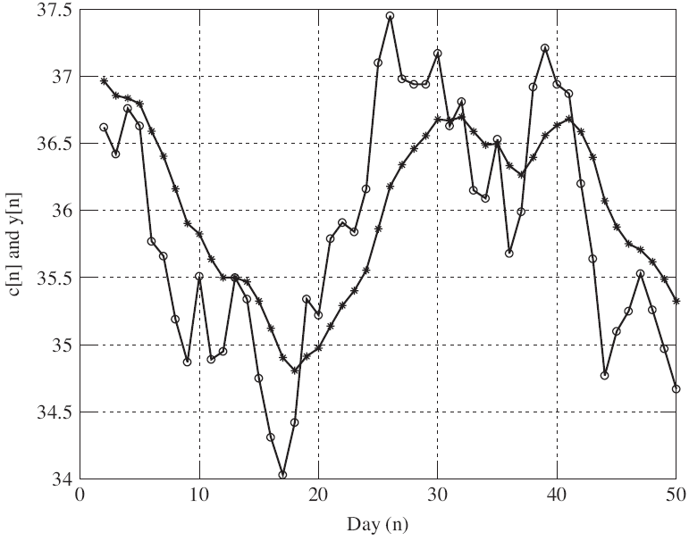
Applications: Noise Reduction
Consider a signal corrupted by noise:
Suppose we have reason to believe the underlying signal, s[n], is smooth, and that the noise corrupts our measurements.
How can we recover the smooth signal?
One option is to use the averager we explored earlier:
Another type of filter we might use is a recursive, or infinite impulse response (IIR) filter:
Notes:
]i=k,

Slide 6
Correlation-Based Processing (Advanced / Statistics)
Consider operating on the correlation of the signal:
Assume the noise is statistically uncorrelated with the signal:
Also, assume the noise is “white,” meaning it has a flat frequency spectrum:
Our correlation operator simplifies to:
Hence, the effects of additive white noise can be removed through the use of a correlation function. What is the significance of this result?
Notes:
]i=k,

Slide 7
Correlation and the Power Spectrum
Consider the discrete Fourier transform of the correlation function:
This relationship is known as the Wiener-Khintchine Theorem:
Hence, the spectrum of the correlation function is just the power spectral density. Two important observations:
The autocorrelation function is “blind” to phase.
The spectrum of the autocorrelation function of our noisy signal is:
Notes:
]i=k,

Slide 8
Summary
Discussed stability of a linear, time-invariant system: poles must be inside the unit circle.
Demonstrated that the response to a sinusoid is a amplitude and phase-shifted sinusoid at steady state.
Introduced an application of filtering to reduce the effects of additive noise.
Introduce the concept of an autocorrelation function and demonstrated its relationship to the power spectrum.

