Slide 1
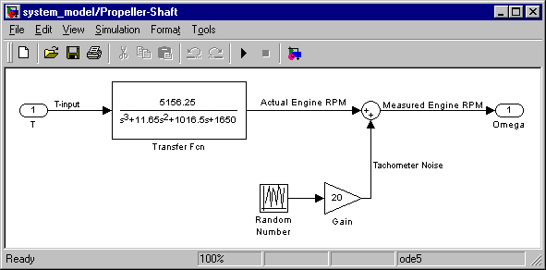
LECTURE 31: STABILITY OF CT SYSTEMS
Objectives: Stability and the s-Plane Stability of an RC Circuit Routh-Hurwitz Stability Test Step Response of 1st-Order Systems
Resources: MH: Control Theory and Stability Wiki: Routh-Hurwitz Stability Test TBCO: Routh-Hurwitz Tutorial EC: Step Response
• URL: .../publications/courses/ece_3163/lectures/current/lecture_31.ppt
• MP3: .../publications/courses/ece_3163/lectures/current/lecture_31.mp3
Notes:
MS Equation 3.0 was used with settings of: 18, 12, 8, 18, 12.

Slide 2
Stability of CT Systems in the s-Plane
Recall our stability condition for the Laplace transform of the impulse response of a CT linear time-invariant system:
This implies the poles are in the left-half plane. This also implies:
A system is said to be marginally stable if its impulse response is bounded:
In this case, at least one pole of the system lies on the jω-axis.
Recall periodic signals also have poles on the jω-axis because they are marginally stable.
Also recall that the left-half plane maps to the inside of the unit circle in the z-plane for discrete-time (sampled) signals.
We can show that circuits built from passive components (RLC) are always stable if there is some resistance in the circuit.
LHP
Notes:
]i=k,

Slide 3
Stability of CT Systems in the s-Plane
Example: Series RLC Circuit
Using the quadratic formula:
The RLC circuit is always stable. Why?
Notes:
]i=k,

Slide 4
The Routh-Hurwitz Stability Test
The procedures for determining stability do not require finding the roots of the denominator polynomial, which can be a daunting task for a high-order system (e.g., 32 poles).
The Routh-Hurwitz stability test is a method of determining stability using simple algebraic operations on the polynomial coefficients. It is best demonstrated through an example.
Consider:
Construct the Routh array:
Number of sign changes in 1st column = number of poles in the RHPRLC circuit is always stable
Notes:
]i=k,

Slide 5
Routh-Hurwitz Examples
Example:
Example:
Notes:
]i=k,

Slide 6
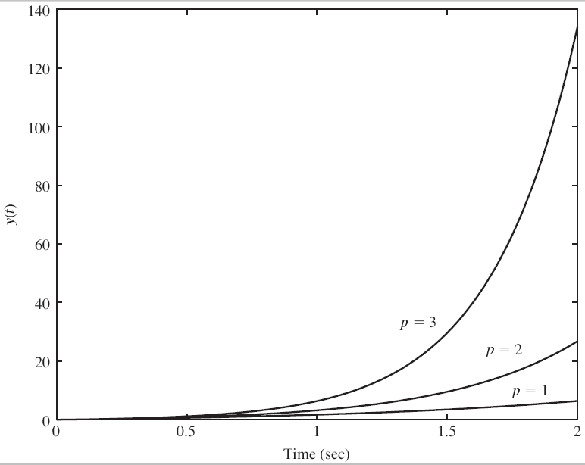
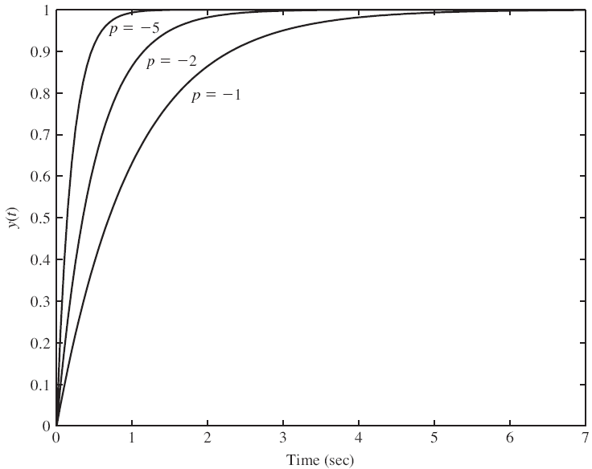
Analysis of the Step Response For A 1st-Order System
Recall the transfer function for a 1st-order differential equation:
num = 1; den = [1 –p];
t = 0:0.05:10;
y = step(num, den, t);
Define a time constant as the time it takes for the response to reach 1/e (37%) of its value.
The time constant in this case is equal to -1/p. Hence, the real part of the pole, which is the distance of the pole from the jω-axis, and is the bandwidth of the pole, is directly related to the time constant.
Notes:
]i=k,

Slide 7
Summary
Reviewed stability of CT systems in terms of the location of the poles in the s-plane.
Demonstrated that an RLC circuit is unconditionally stable.
Introduced the Routh-Hurwitz technique for determining the stability of a system: does not require finding the roots of a polynomial.
Analyzed the properties of the impulse response of a first-order differential equation.
Next: analyze the properties of a second-order differential equation.

