Slide 1
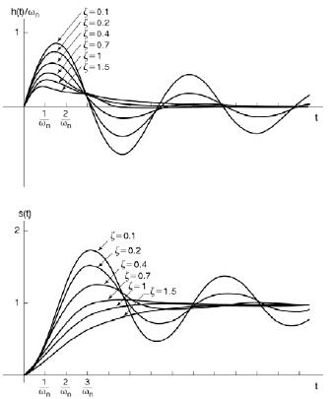
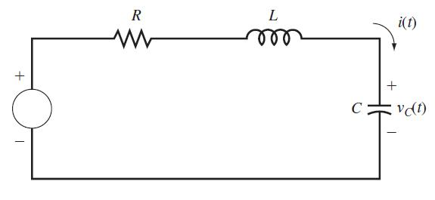
LECTURE 32: SECOND-ORDER SYSTEMS
Objectives: Second-Order Transfer Function Real Poles Complex Poles Effect of Damping Circuit Example
Resources: MIT 6.003: Lecture 18 GW: Underdamped 2nd-Order Systems CRB: System Response RVJ: RLC Circuits
• URL: .../publications/courses/ece_3163/lectures/current/lecture_32.ppt
• MP3: .../publications/courses/ece_3163/lectures/current/lecture_32.mp3
Notes:
MS Equation 3.0 was used with settings of: 18, 12, 8, 18, 12.

Slide 2
Second-Order Transfer Function
Recall our expression for a simple, 2nd-order differential equation:
Write this in terms of two parameters, ζ and ω_{n}, related to the poles:
From the quadratic equation:
There are three types of interesting behavior of this system:
Impulse Response
Step Response
Notes:
]i=k,

Slide 3
Step Response For Two Real Poles
When ζ > 1, both poles are real and distinct:
When ζ = 1, both poles are real (s = ω_{n}) and repeated:
There are two components to this response:
Notes:
]i=k,

Slide 4
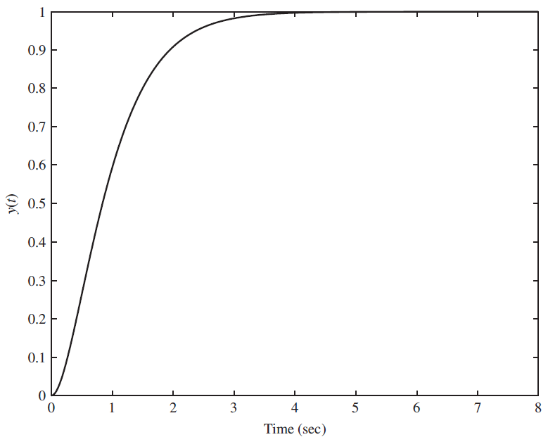
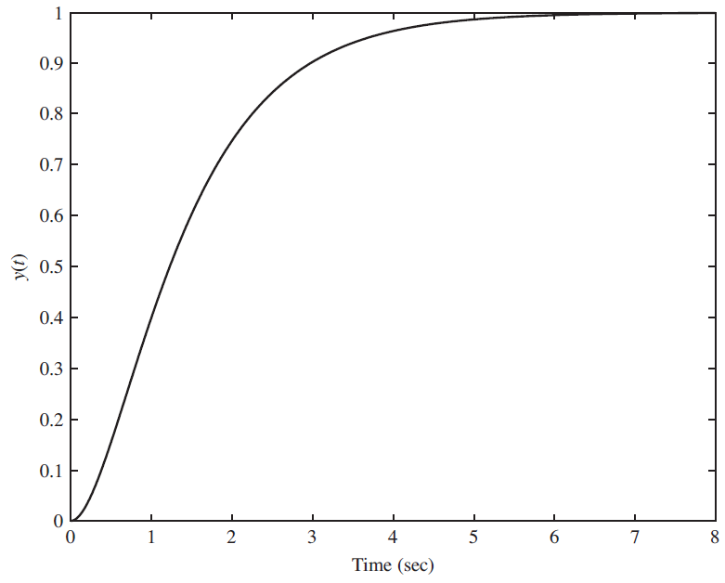
Step Response For Two Real Poles (Cont.)
Both Real and Repeated
Two Real Poles
ζ is referred to as the damping ratio because it controls the time constant of the impulse response (and the time to reach steady state);
ω_{n} is the natural frequency and controls the frequency of oscillation (which we will see next for the case of two complex poles).
ζ > 1: The system is considered overdamped because it does not achieve oscillation and simply directly approaches its steady-state value.
ζ = 1: The system is considered critically damped because it is on the verge of oscillation.
Notes:
]i=k,

Slide 5
Step Response For Two Complex Poles
When 0 < ζ < 1, we have two complex conjugate poles:
The transfer function can be rewritten as:
The step response, after some simplification, can be written as:
Hence, the response of this system eventually settles to a steady-state value of 1. However, the response can overshoot the steady-state value and will oscillate around it, eventually settling in to its final value.
Notes:
]i=k,

Slide 6
Analysis of the Step Response For Two Complex Poles
Impulse Response
ζ > 1: the overdamped system experiences an exponential rise and decay. Its asymptotic behavior is a decaying exponential.
ζ = 1: the critically damped system has a fast rise time, and converges to the steady-state value in an exponetial fashion.
0 < ζ > 1: the underdamped system oscillates about the steady-state behavior at a frequency of ω_{d}.
Note that you cannot control the rise time and the oscillation behavior independently!
What can we conclude about the frequency response of this system?
Step Response
Notes:
]i=k,

Slide 7
Implications in the s-Plane
Several important observations:
The pole locations are:
Since the frequency response is computed along the jω-axis, we can see that the pole is located at ±ω_{d}.
The bandwidth of the pole is proportional to the distance from the jω-axis, and is given by ζω_{n}.
For a fixed ω_{n}, the range 0 < ζ < 1 describes a circle. We will make use of this concept in the next chapter when we discuss control systems.
What happens if ζ is negative?
Notes:
]i=k,

Slide 8
RC Circuit
Example: Find the response to a sinewave:.
Solution:
Again we see the solution is the superposition of a transient and steady-state response.
The steady-state response could have been found by simply evaluating the Fourier transform at ω₀ and applying the magnitude scaling and phase shift to the input signal. Why?
The Fourier transform is given by:
Notes:
]i=k,

Slide 9
Summary
Analyzed the behavior of stable 2nd-order systems.
Characterized these systems in terms of three possible behaviors: overdamped, critically-damped, or overdamped.
Discussed the implications of this in the time and frequency domains.
Analyzed the response of an RC circuit to a sinewave.
Next: Frequency response and Bode plots.

