Slide 1
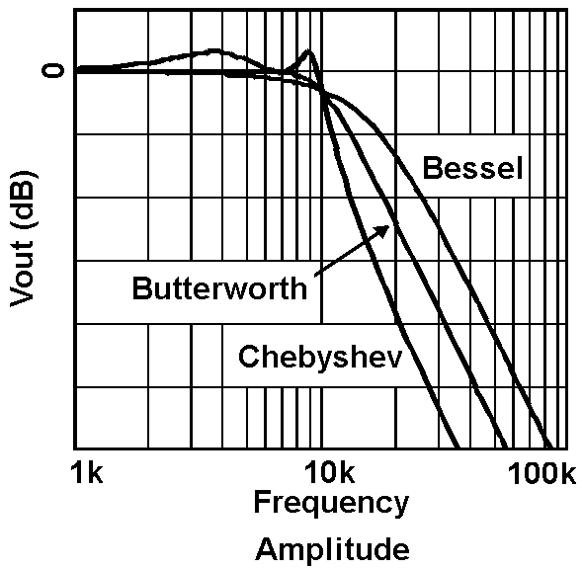
LECTURE 33: BODE PLOTS AND FILTERS
Objectives: First-Order System Second-Order System Poles and Zeros Butterworth Filters Chebyshev Filters Frequency Transformations
Resources: MIT 6.003: Lecture 18 Wiki: Bode Plots EC: Bode Plots Wiki: Butterworth Filters Wiki: Chebyshev Filters
• URL: .../publications/courses/ece_3163/lectures/current/lecture_33.ppt
• MP3: .../publications/courses/ece_3163/lectures/current/lecture_33.mp3
Notes:
MS Equation 3.0 was used with settings of: 18, 12, 8, 18, 12.

Slide 2
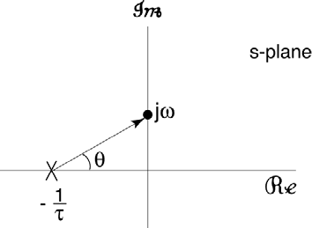
First-Order System Revisited
Recall the transfer function for a 1st-order system:
The frequency response of this system is:
Notes:
]i=k,

Slide 3
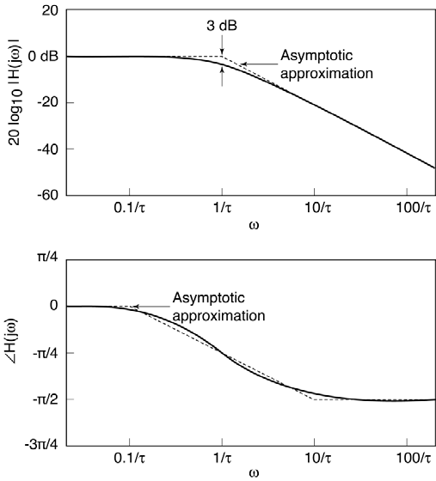
Bode Plot
Asymptotic approximation to the actual frequency response.
Plotted on a log-log scale.
Allows approximation of the frequency response using straight lines:
Note that:
20 dB/decade
Changes by π/2
Notes:
]i=k,

Slide 4
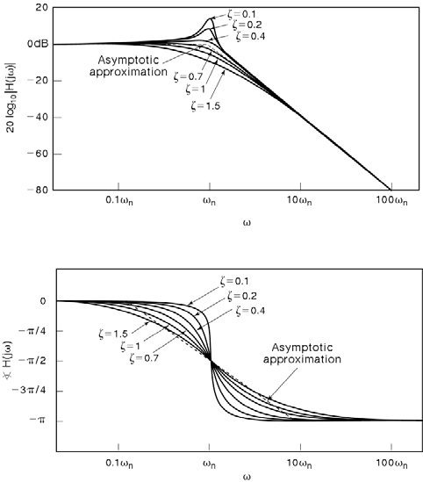
Second-Order System
The transfer function of a 2nd-order system:
The frequency response of this system can be modeled as:
When :
40 dB/decade
Changes by π
Notes:
]i=k,

Slide 5
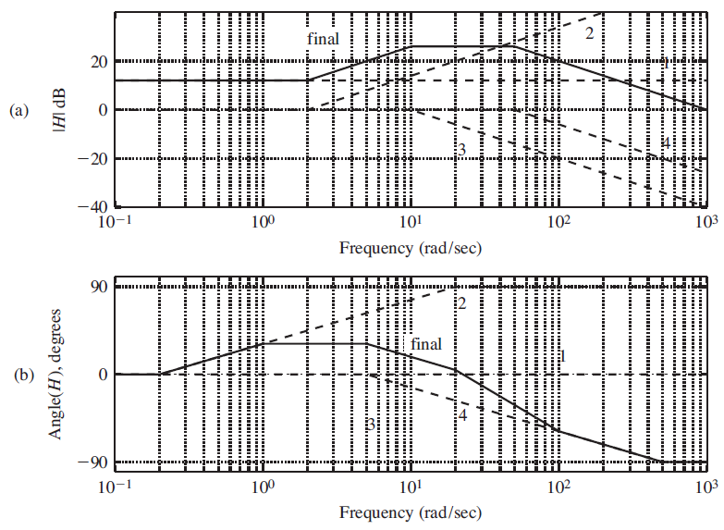
Example: Poles and Zeroes
Transfer function:
The critical frequencies are ω = 2 (zero), 10 (pole), and 50 (pole).
MATLAB (exact resp.):
w = logspace(-1,3,300);
s = j*w;
H = 1000*(s+2)./(s+10)./(s+50);
magdB = 20*log10(abs(H));
phase = angle(H)*180/pi;
MATLAB (Bode):
num = [1000 2000];
den = conv([1 1o], [1 50]);
bode(num, den);
Bode plots are useful as an analytic tool.
Notes:
]i=k,

Slide 6
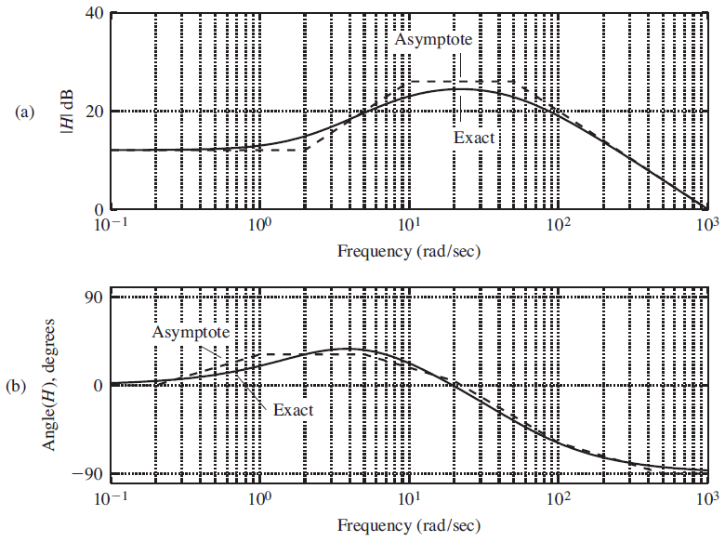
Example: Comparison of Exact and Bode Plots
Notes:
]i=k,

Slide 7
Causal Filters
Recall that the ideal lowpass filter is a noncausal filter and hence unrealizable.
The filter design problem then becomes an optimization problem in which we try to best meet the user’s requirements with a filter that can be implemented with the least number of components.
This is equivalent to trying to minimize the number of coefficients in the (Laplace transform) transfer function. It is also comparable to minimizing the order of the filter.
Typically the numerator order is less than or equal to the denominator order, so, building on the concept of a Bode plot, we can relate the maximum amount of attenuation desired to the order of the denominator.
There are often no “perfect” solutions. Users must tradeoff design constraints such as passband smoothness, stopband attenuation and linearity in phase.
Computer-aided design programs, including MATLAB, are able to design filters once the user adequately specifies the constraints. We will explore two interesting analytic solutions: Butterworth and Chebyshev filters.
Notes:
]i=k,

Slide 8
Butterworth Filters
Butterworth filters are maximally flat in the passband. Their distinguishing characteristic is that the poles are arranged on a semi-circle of radius ω_{c} in the left-half plane.
The filter function is an all-pole filter that exploits the properties of Butterworth polynomials.
Examples:
Frequency Response:
Design strategy: select the cutoff frequency and the amount of stopband attenuation, then compute the order of the filter.
Notes:
]i=k,

Slide 9
Chebyshev Filters
Chebyshev filter, based on Chebyshev polynomials, allows ripple in the passband to achieve greater attenuation. This implies a lower filter order at the expense of smoothness of the frequency response in the passband.
Prototype:
where:
and ε is chosen based on the amount of passband ripple that can be tolerated.
Filter design theory is based largely on the mathematical properties of polynomials.
An third type of filter, the elliptical filter, attempts to allow ripple in both bands.
Notes:
]i=k,

Slide 10
Frequency Transformations
There are two general approaches to filter design:
Direct optimization of the desired frequency response, typically using software like MATLAB.
Design a “normalized” lowpass filter and then transform it to another lowpass, highpass or bandpass filter.
The latter approach can be achieved by using these simple frequency transformations:
This latter approach is popular because it leverages our knowledge of the properties of lowpass filters.
Notes:
]i=k,

Slide 11
Summary
Analyzed the frequency response of a first and second-order system.
Demonstrated how this can be approximated using Bode plots.
Demonstrated that the Bode plot can be used to construct the frequency and phase responses of complex systems.
Introduced Butterworth and Chebyshev lowpass filters.
Described how lowpass filters can be converted to bandpass and highpass filters using a frequency transformation.

