Slide 1
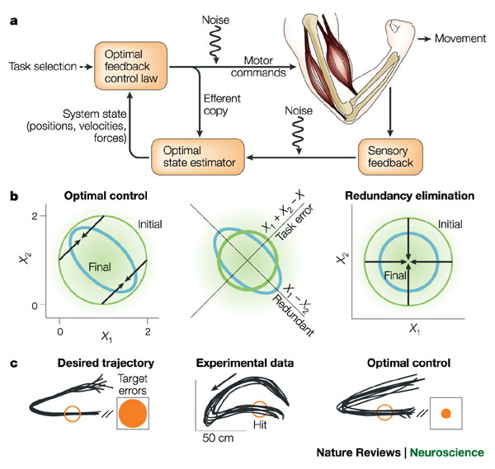
LECTURE 34: FEEDBACK CONTROL
Objectives: Typical Feedback System Feedback Example Black’s Formula Feedback as Compensation Proportional Feedback Damping
Resources: MIT 6.003: Lecture 20 Wiki: Control Systems Brit: Feedback Control FLL: History JC: Crash Course
• URL: .../publications/courses/ece_3163/lectures/current/lecture_34.ppt
• MP3: .../publications/courses/ece_3163/lectures/current/lecture_34.mp3
Notes:
MS Equation 3.0 was used with settings of: 18, 12, 8, 18, 12.

Slide 2
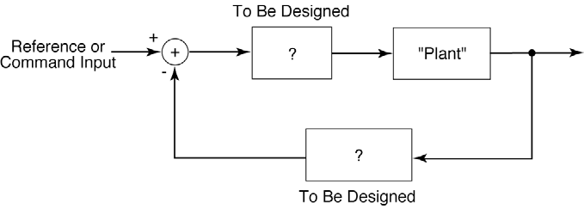
A Typical Feedback System
Feed Forward
Feedback
Why use feedback?
Reducing Nonlinearities
Reducing Sensitivity to Uncertainties and Variability
Stabilizing Unstable Systems
Reducing Effects of Disturbances
Tracking
Shaping System Response Characteristics (bandwidth/speed)
Notes:
]i=k,

Slide 3
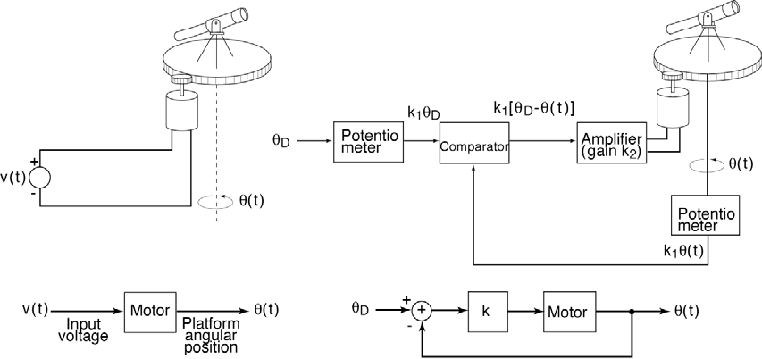
Motivating Example
Open loop system: aim and shoot.
What happens if you miss?
Can you automate the correction process?
Closed-loop system: automatically adjusts until the proper coordinates are achieved.
Issues: speed of adjustment, inertia, momentum, stability, …
Notes:
]i=k,

Slide 4
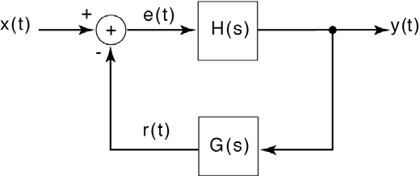
System Function For A Closed-Loop System
The transfer function of this system can be derived using principles we learned in Chapter 6:
Black’s Formula: Closed-loop transfer function is given by:
Forward Gain: total gain of the forward path from the input to the output, where the gain of a summer is 1.
Loop Gain: total gain along the closed loop shared by all systems.
Loop
Notes:
]i=k,

Slide 5
The Use Of Feedback As Compensation
Assume the open loop gain is very large (e.g., op amp):
⋅ Independent of P(s)
The closed-loop gain depends only on the passive components (R₁ and R₂) and is independent of the open-loop gain of the op amp.
Notes:
]i=k,

Slide 6
Stabilization of an Unstable System
If P(s) is unstable, can we stabilize the system by inserting controllers?
Design C(s) and G(s) so that the poles of Q(s) are in the LHP:
Example: Proportional Feedback (C(s) = K)
The overall system gain is:
The transfer function is stable for K > 2.
Hence, we can adjust K until the system is stable.
Notes:
]i=k,

Slide 7
Second-Order Unstable System
Try proportional feedback:
One of the poles is at
Unstable for all values of K.
Try damping, a term proportional to :
This system is stable as long as:
K₂ > 0: sufficient damping force
K₁ > 4: sufficient gain
Using damping and feedback, we have stabilized a second-order unstable system.
Notes:
]i=k,

Slide 8
Summary
Introduced the concept of system control using feedback.
Introduced a method of calculating the system gain known as Black’s formula.
Demonstrated how we can stabilize first-order systems using simple proportional feedback, and second-order systems using damping (derivative proportional feedback).
Why did we not simply cancel the poles?
In real systems we never know the exact locations of the poles. Slight errors in predicting these values can be fatal.
Disturbances between the two systems can cause instability.
There are many ways we can use feedback to control systems including feedback that adapts over time to changes in the system or environment.

