Slide 1
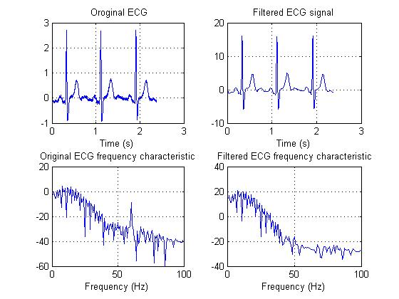
LECTURE 37: DESIGN OF FIR FILTERS AND CONTROLLERS
Objectives:
FIR Filters Design of Ideal Lowpass Filters Filter Design Example Digital Controller Design Step-Response Matching
Resources: ISIP: Filter Transformations Wiki: Finite Impulse Response CNX: FIR Filters Wiki: Window Function EAW: Window Functions
• URL: .../publications/courses/ece_3163/lectures/current/lecture_37.ppt
• MP3: .../publications/courses/ece_3163/lectures/current/lecture_37.mp3
Notes:
MS Equation 3.0 was used with settings of: 18, 12, 8, 18, 12.

Slide 2
Finite Impulse Response Filters
Consider a filter with only feedforward components:
The transfer function is:
Since the impulse response of this filter, h[n], has a finite number of nonzero terms, this filter is referred to as a finite impulse response (FIR) filter.
Observe that this filter only has zeroes (the roots of H(z)).
Notes:
]i=k,

Slide 3
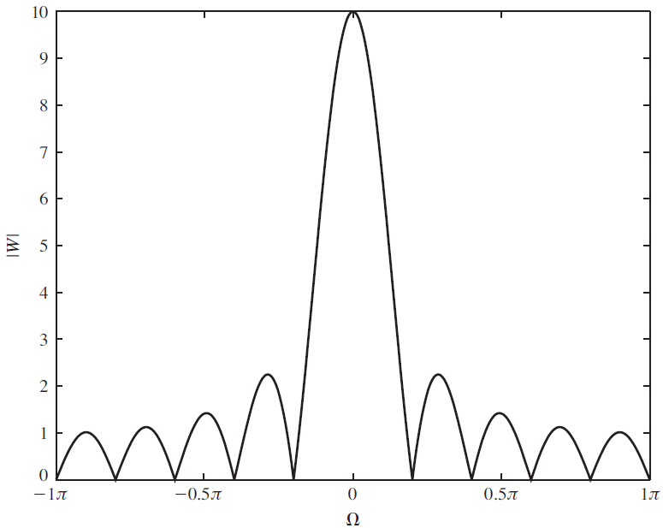
Design of FIR Filters
The simplest method for designing an FIR filter is to construct an ideal frequency response, perform an inverse Fourier transform to obtain the impulse response, and then truncate the impulse response:
As we discussed previously, we can view this truncation operation as multiplication of a signal by a window:
Since multiplication in the time domain implies convolution in the frequency domain, the spectrum of the windowed signal is given by:
In the case of the rectangular window:
Notes:
]i=k,

Slide 4
FIR Design Example
Consider the design of an ideal lowpass filter. The ideal filter is noncausal for the response shown.
Introduce a phase delay which will help us create a causal approximation:
We can truncate the impulse response to obtain our FIR filter:
Examples of the frequency response:
N = 21
N = 21
N = 41
Wc = 0.4; N = 21; m = (N-1)/2; n = 0:2*m + 10; h = Wc/pi*sinc(Wc*(n-m)/pi);
w = [ones(1,N) zeros(1,length(n)-N)];
hd = h.*w;
Notes:
]i=k,

Slide 5
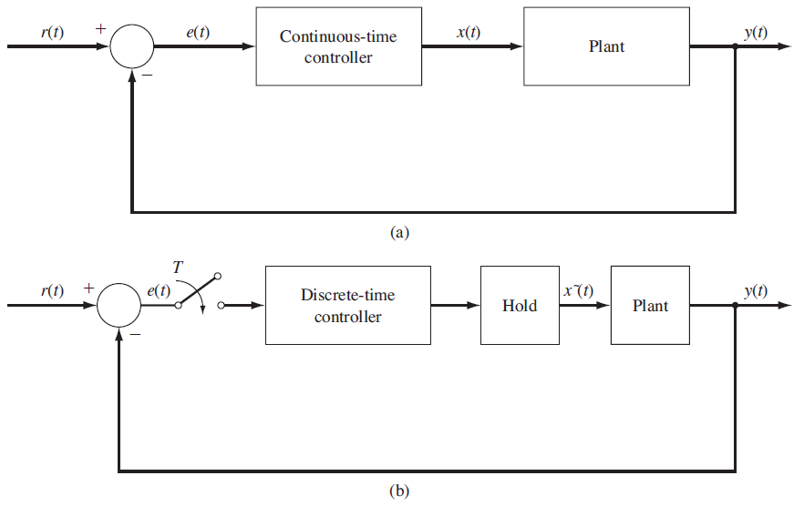
Digital Controllers
There are many strategies for approximating an analog controller with a digital controller.
This is analogous to the filter design problem, and many of the same techniques (e.g., bilinear transform) can be applied.
This process is referred to as analog emulation.
In this section, we will explore a technique known as step-response matching in which we design the digital system to approximate the step response of the analog system.
The approach involves taking the inverse Laplace transform of the output, y(t), corresponding to the response of the system to a step function:
We will need to make sure the sampling interval is chosen to be small enough that the discrete system matches the analog system.
Notes:
]i=k,

Slide 6
Design Example
Consider a CT system with transfer function:
The transform of the step response is:
The inverse Laplace transform is:
The discrete version is:
We can work backwards to derive the equivalent transfer function:
We can compare the frequency response of the discrete system to the analog system, and also compare impulse responses.
Notes:
]i=k,

Slide 7
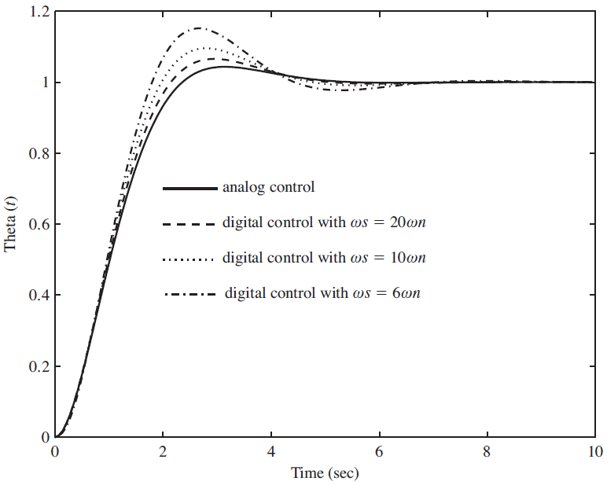
Design of a Feedback Controller
Consider a feedback system:
The overall transfer function is:
Using our step-response design method, with , we have:
The step response of this system can be plotted using MATLAB.
Note how the overshoot varies as a function of the sample interval.
There are a variety of ways we can approximate an analog control system using a digital controller. For example, we can match the impulse response rather than the step response.
Notes:
]i=k,

Slide 8
Summary
Reviewed FIR filters.
Introduced a design methodology based on truncating the impulse response of an ideal lowpass filter.
Demonstrated an application of this design approach.
Introduced a methodology for design digital controllers that can approximate an equivalent analog controller.
Demonstrated an approach involving matching the step response.
Applied this to two control examples.

