Slide 1
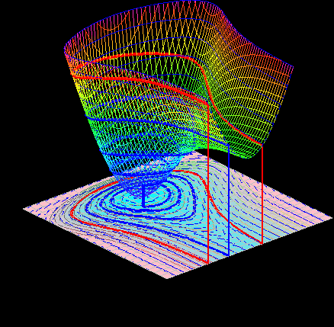
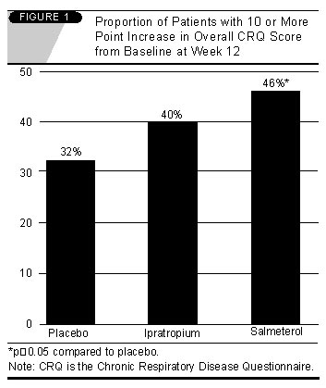
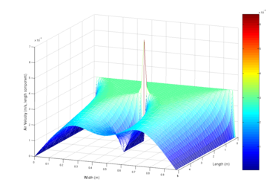
LECTURE 06: DIFFERENCE AND DIFFERENTIAL EQUATIONS AND THEIR SOLUTIONS
Objectives: Difference Equations Recursive Solutions Differential Equations Numerical Solutions Representation of CT SIgnals
Resources: Wiki Difference Equations DS: Diff. To. Differential TK: Diff. Eq. Tutorial MIT 6.003: Lecture 4
URL:
Audio:
Notes:
MS Equation 3.0 was used with settings of: 18, 12, 8, 18, 12.

Slide 2
Linear Constant-Coefficient Difference Equations
We can model the input/output behavior of a DT LTI systems using an Nth-order input/output difference equation (also called a digital filter):
DT LTI
Solution of such equations can be easily computed by solving for y[n]:
Let us consider a simple example:
Let us assume: (the latter are referred to as initial conditions). The output can be computed using a table:
n | x[n] | x[n-1] | x[n-2] | y[n] | y[n-1] | y[n-2]
0 | 1 | 0 | 0 | 0 | 0 | 0
1 | 0 | 1 | 0 | 0 | 0 | 0
2 | 0 | 0 | 1 | 2 | 0 | 0
3 | 0 | 0 | 0 | 3 | 2 | 0
4 | 0 | 0 | 0 | 2.5 | 3 | 2

Slide 3
Difference Equations in MATLAB
The solutions to these equations can be easily programmed in MATLAB.
Note that the key step is actually a dot product between the equation’s coefficients and the previous samples of the output and input (often referred to as the filter memory).
The response to a unit step function can also be computed using the function recur.
The unit step function is created by assigning values of “1” to x, followed by the invocation of the recur function that performs the difference equation computations.

Slide 4
Complete Response of a First-Order Equation
Consider the first-order linear difference equation:
Let us assume that:
The first part of the response is due to the initial condition being nonzero. The second part of the response is due to the forcing function, x[n].
Together, they comprise the complete response of the system.
We will see that closed-form solutions of these equations can be easily computed using the z-transform, which is very similar to the Laplace transform. The z-transform converts the difference equation to an algebraic equation.
Closed-form solutions can also be found using summation tables.

Slide 5
Differential Equations
For CT systems, such as circuits, our principal tool is the differential equation.
For the circuit shown, we can easily compute the input/output differential equation using Kirchoff’s Law.
What is the nature of the impulse response for this circuit?

Slide 6
Numerical Solutions to Differential Equations
Consider our 1st-order diff. eq.:
We can solve this numerically by setting t = nT:
The derivative can be approximated:
Substituting into our diff. eq.:
Let and :
We can replace n by n-1 to obtain:
This is called the Euler approximation to the differential equation.
With and initial condition, , the solution is:
The CT solution is:
Later, we will see that using the Laplace transform, we can obtain:
But we can approximate this:
Which tells us our 1st-order approximation is accurate!

Slide 7
Higher-Order Derivatives
We can use the same approach for the second-order derivative:
Higher-order derivatives can be similarly approximated.
Arbitrary differential equations can be converted to difference equations using this technique.
There are many ways to approximate derivatives and to numerically solve differential equations. MATLAB supports both symbolic and numerical solutions.
Derivatives are quite tricky to compute for discrete-time signals. However, in addition to the differences method shown above, there are powerful methods for approximating them using statistical regression.
Later in the course we will consider the implications of differentiation in the frequency domain.

Slide 8
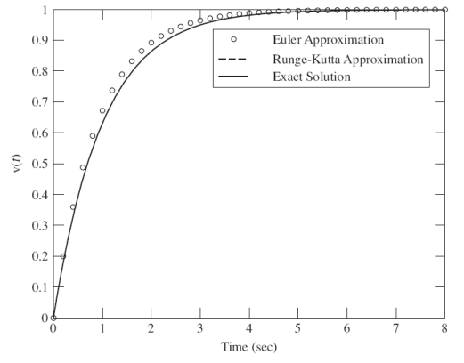
Series RC Circuit Example
Difference Equation:
R=1;C=1;T=0.2;
a=-(1-T/R/C);b=[0 T/R/C];
y0=0; x0=1;
n=1:40;
x=ones(1,length(n));
y1=recur(a, b, n, x, x0, y0);
Analytic Solution:
t=0:0.04:8;
y2=1-exp(-t);
y1=[y0 y1];
n=0:40;
plot(n*T, y1, ’o’, t, y2, ’-’);

Slide 9
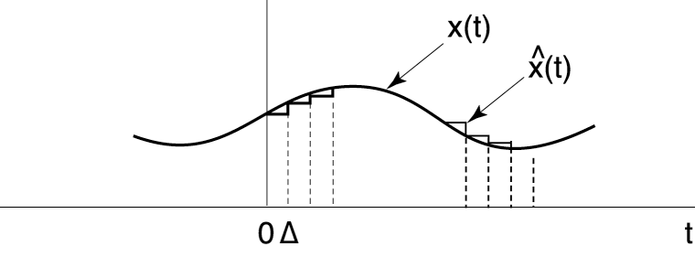
Representation of CT Signals
Recall from calculus how we approximated a function by a sum of time-shifted, scaled pulse functions:
We approximate the signal’s amplitude value as a constant over the interval :
The signal changes discontinuously at the next step.
What happens as ? Recall our representation of a CT impulse function:

Slide 10
Representation of CT Signals Using Impulse Functions
We approximate a CT signal as a weighted pulse function.
The signal can be written as a sum of these pulses:
In the limit, as :
Mathematical definition of an impulse function (the equivalent of the unit pulse for DT signals and systems):
Unit pulses can be constructed from many functional shapes (e.g., triangular or Gaussian) as long as they have a vanishingly small width. The rectangular pulse is popular because it is easy to integrate ☺

Slide 11
Summary
We introduced a linear constant coefficient difference equation.
We demonstrated how to solve such equations numerically.
We demonstrated how these difference equations can be used to approximate differential equations.
We discussed how to convert derivatives to differences.
We compared the accuracy of the analytic and approximate solutions for a series RC circuit.
We introduced a method for representing CT signals as a combination of impulse functions. We will use this representation to derive the convolution integral for CT signals.

