Slide 1
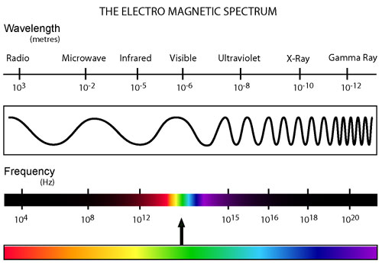
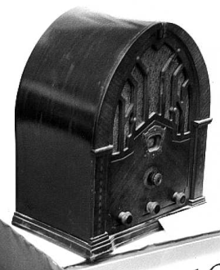
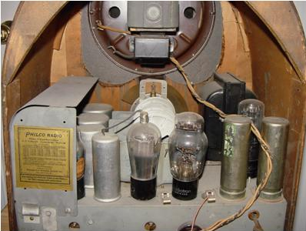
LECTURE 13: DEMODULATION AND SUPERHETERODYNE RECEIVERS
Objectives: Demultiplexing and Demodulation Superheterodyne Receivers Review
Resources: Wiki: Superheterodyne Receivers RE: Superheterodyne Receivers MIT 6.003: Lecture 15 NASA: Electromagnetic Spectrum
URL:
Audio:
Notes:
MS Equation 3.0 was used with settings of: 18, 12, 8, 18, 12.

Slide 2
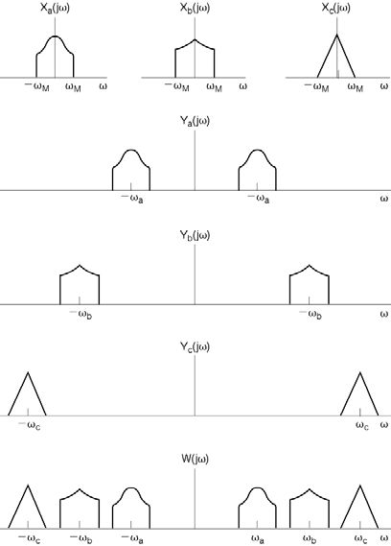
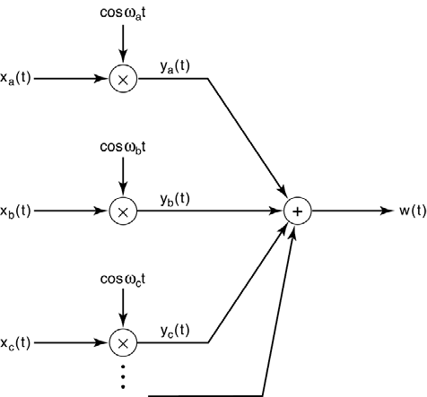
Frequency Division Multiplexing (Review)
Used in many communications systems including broadcast radio and cell phones.
Notes:
]i=k,

Slide 3
Demultiplexing and Demodulation
Recall to recover one channel (e.g., radio station) from a multiplexed signal, we must first bandpass filter the multiplexed signal, and then demodulate it:
However, the channels must not overlap for this to work. Fortunately, this is an important role played by the FCC (in the U.S.) – management of the electromagnetic spectrum.
It is difficult to design a highly selective bandpass filter with a tunable center frequency.
A better solution is the superheterodyne receiver: downconvert all channels to a common intermediate frequency. “The advantage to this method is that most of the radio's signal path has to be sensitive to only a narrow range of frequencies. Only the front end (the part before the frequency converter stage) needs to be sensitive to a wide frequency range.” (Wiki)

Slide 4
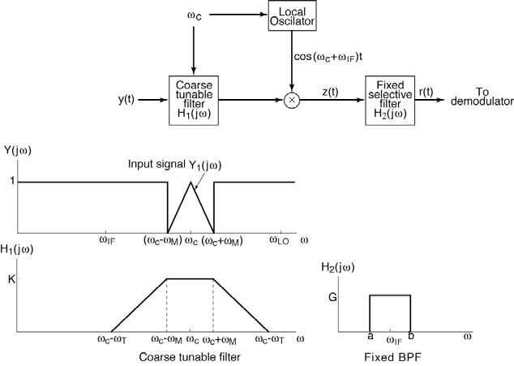
The Superheterodyne Receiver
AM Band: 535 – 1605 kHz
FCC-mandated IF Frequency: 455 kHz
Principle: Down convert the received signal from ω_{c} to ω_{IF} using a coarse tunable bandpass filter. Use a sharp, fixed bandpass filter at ω_{IF} to demodulate the remaining signal and remove remnants of the other channels that pass through the initial coarse filter.

Slide 5
Exam No. 1 Review – Major Concepts
Basic Properties of Signals
Continuous Signals
Discrete-Time Signals
Digital Signals
Real/Complex Signals
Properties: Periodic, Even/Odd
More Properties of Signals
Types: Impulse, Unit Step, Ramp, Sinewaves
Time-Shift
Continuous, Piecewise-Continuous
Derivatives of a CT Signal
Sampling
Basic System Properties
Causality
Linearity
Time-Invariance
Basic Statistical Models
Digital Signals
Mean, Standard Deviation, Variance
Covariance, Correlation
Noise, Gaussian Noise, White Noise
Discrete-Time Convolution
Representation of DT Signals
Response of an LTI System (Convolution)
Impulse Response
Graphical Convolution
Analytic Convolution
Properties of Convolution:
Commutative
Distributive
Associative
Properties of DT LTI Systems
Difference and Differential Eqs.
Linear Constant-Coefficient
Response of 1st-Order Systems
Differential Equations
Numerical Solutions
Representation of CT Signals Using Pulses
Continuous-Time Convolution
Response of a CT LTI System
Graphical Convolution
Analytic Convolution
Properties of Convolution
Sifting
Commutative, Distributive, Associative
Useful Properties of CT LTI Systems

Slide 6
Exam No. 1 Review – Major Concepts (Cont.)
Fourier Series
Complex Fourier Series
Trigonometric Fourier Series
Convergence
Gibbs Phenomena
Trigonometric Fourier Series
Analysis Equations
Even/Odd Symmetry
Line Spectra
Power Spectra
Properties
The Fourier Transform
Analysis/Synthesis Equations
Frequency Response of an LTI System
Existence
Fourier Transforms of Periodic Signals
Fourier Transform Properties
Linearity
Time Shift and Time Reversal
Multiplication, Integration
Convolution
Parseval’s Theorem
Duality
Modulation and Demodulation
Generalized Fourier Transform
Amplitude Modulation
Frequency and Phase Modulation
Synchronous Demodulation of an AM Signal
Asynchronous Demodulation
DSB and SSB Modulation
Frequency Domain Multiplexing
Superheterodyne Receivers
Demultiplexing and Demodulation
The Superheterodyne Receiver
Review
Exam No. 1

Slide 7
Exam No. 1 Review – But What Did We Really Learn?
How to model the input and output behavior of a linear time-invariant system:
Time Domain vs. Frequency Domain
Discrete-Time vs. Continuous Time
for a wide range of signals including:
Impulse
Unit Step
Ramp
Sinewaves and Other Periodic Signals
Time-limited Signals (e.g., Unit Pulse)
Infinite Duration Signals (e.g., exponential)
… and this is just the first 1/3 of the course ☺

Slide 8
Summary
Introduced a two-stage process for demodulating broadcast signals known as the Superheterodyne receiver.
Reviewed the material covered on the first exam: Sects. 1.0 – 3.6.

