Slide 1
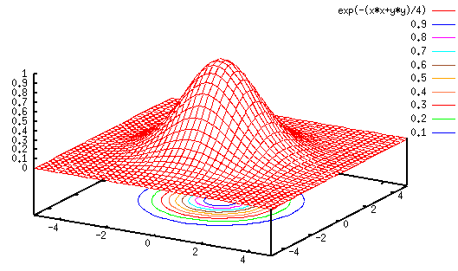
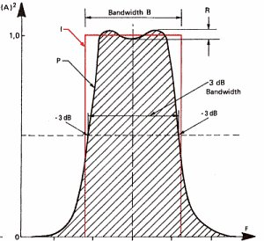
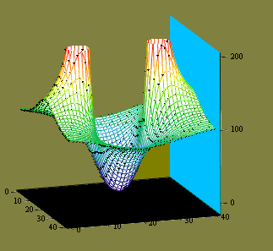

LECTURE 18: FOURIER ANALYSIS OF CT SYSTEMS
Objectives:
Response to a Sinusoidal Input
Frequency Analysis of an RC Circuit
Response to Periodic Inputs
Response to Nonperiodic Inputs
Analysis of Ideal Filters
Resources:
Wiki: The RC Circuit
CN: Response of an RC Circuit
CNX: Ideal Filters
URL:
Audio:
Notes:
MS Equation 3.0 was used with settings of: 18, 12, 8, 18, 12.

Slide 2
Response of an LTI System to a Sinusoid
Consider an LTI CT system with impulse response h(t):
We will assume that the Fourier transform of h(t) exists:
The output can be computed using our Fourier transform properties:
Suppose the input is a sinusoid:
Using properties of the Fourier transform, we can compute the output:
Notes:
]i=k,

Slide 3
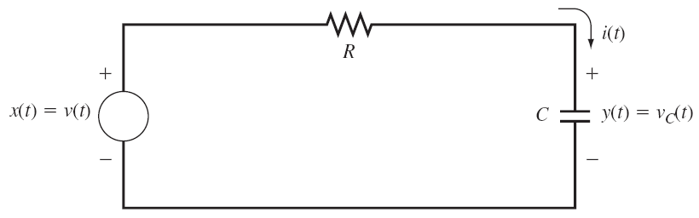
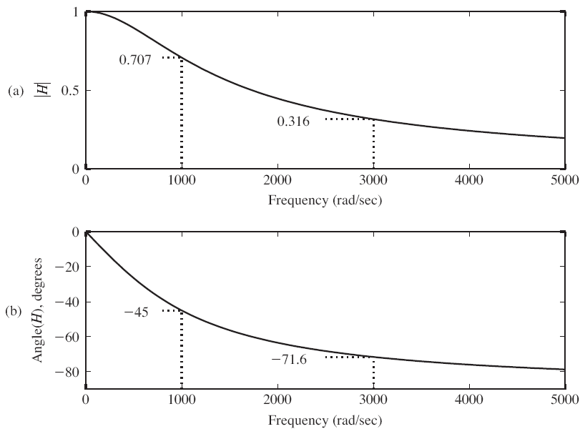
Example: RC Circuit
Using our FT properties:
Compute the frequency response:
RC = 0.001;
W=0:50:5000;
H=(1/RC)./(j*w+1/RC);
magH=abs(H);
angH=180*angle(H)/pi;

Slide 4
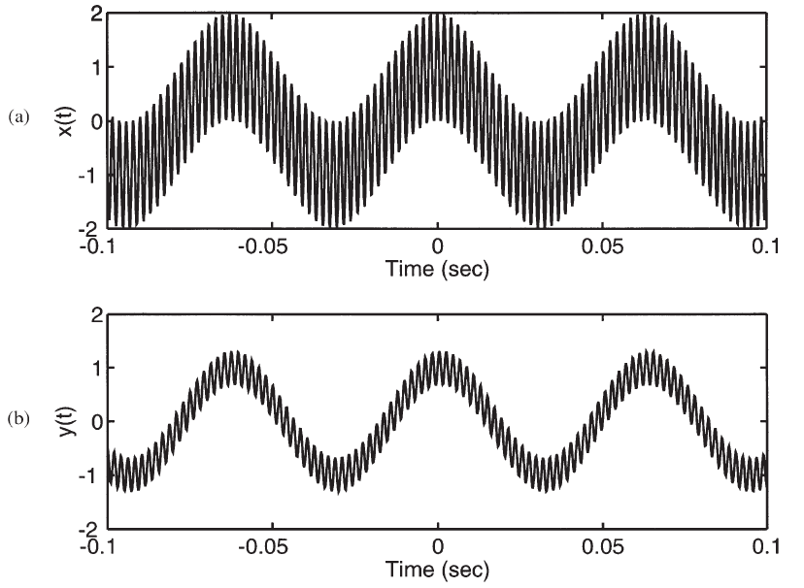
Example: RC Circuit (Cont.)
We can compute the output for RC=0.001 and ω₀=1000 rad/sec:
We can compute the output for RC=0.001 and ω₀=3000 rad/sec:
Hence the circuit acts as a lowpass filter. Note the phase is not linear.
If the input was the sum of two sinewaves:
describe the output.

Slide 5
Response To Periodic Inputs
We can extend our example to all periodic signals using the Fourier series:
The output of an LTI system is:
We can write the Fourier series for the output as:
It is important to observe that since the spectrum of a periodic signal is a line spectrum, the output spectrum is simply a weighted version of the input, where the weights are found by sampling of the frequency response of the LTI system at multiples of the fundamental frequency, ω₀.

Slide 6
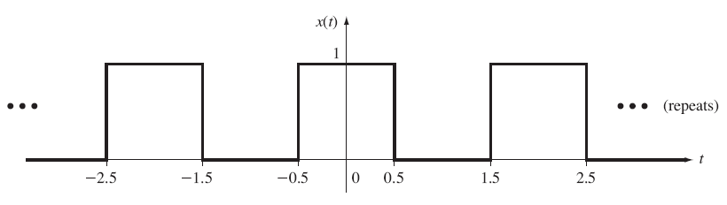
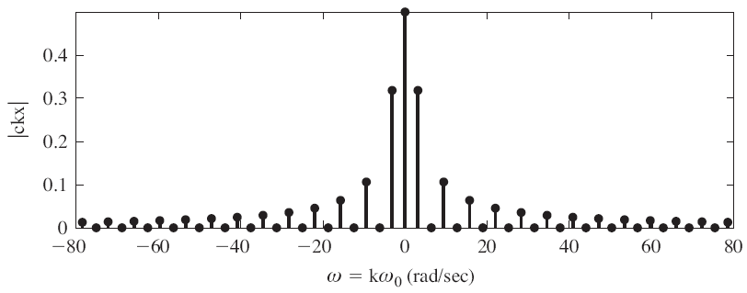
Example: Rectangular Pulse Train and an RC Circuit
Recall the Fourier series for
a periodic rectangular pulse:
Also recall the system response was:
The output can be easily written as:

Slide 7
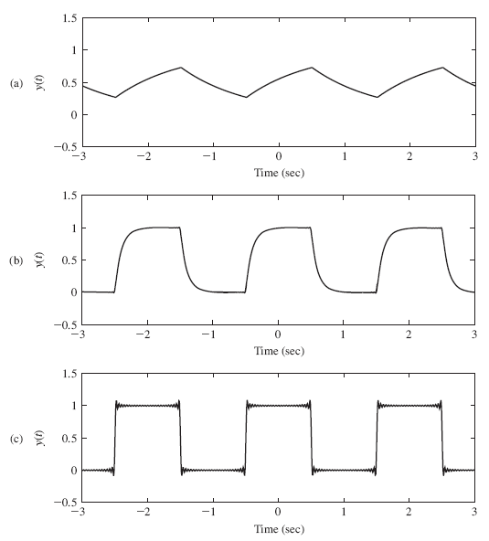
Example: Rectangular Pulse Train (Cont.)
We can write a similar expression for the output:
1/RC = 1
We can observe the implications of lowpass filtering this signal.
What aspects of the input signal give rise to high frequency components?
What are the implications of increasing 1/RC in the circuit?
Why are the pulses increasingly rounded for lower values of 1/RC?
What causes the oscillations in the signal as 1/RC is increased?
1/RC = 10
1/RC = 100

Slide 8
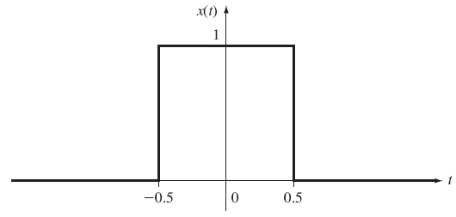
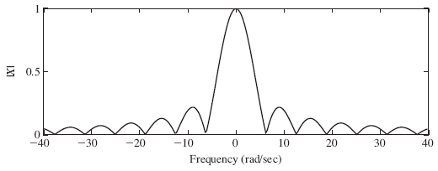
Response to Nonperiodic Inputs
We can recover the output in the time domain using the inverse transform:
These integrals are often hard to compute, so we try to circumvent them using transform tables and combinations of transform properties.
Consider the response of our RC circuit to a single pulse:
MATLAB code for the frequency response:
RC=1;
w=-40:.3:40;
X=2*sin(w/2)./w;
H=(1/RC)./(j*w+1/RC);
Y=X.*H;
magY=abs(Y);

Slide 9
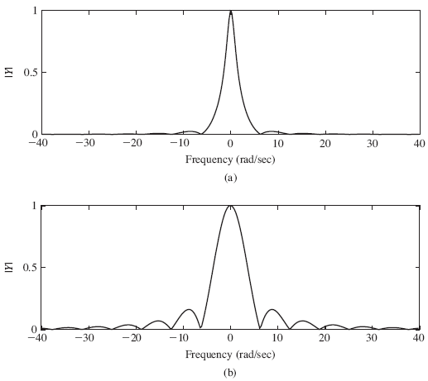
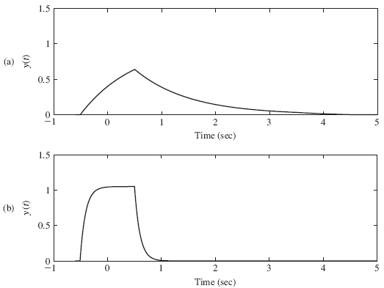
Response to Nonperiodic Inputs (Cont.)
We can recover the output using the inverse Fourier transform:
syms X H Y y w
X = 2*sin(w/2)./w;
H=(1/RC)./(j*w+1/RC);
Y=X.*H;
Y=ifourier(Y);
ezplot(y,[-1 5]);
axis([-1 5 0 1.5])
1/RC = 1
1/RC = 1
1/RC = 10
1/RC = 10

Slide 10
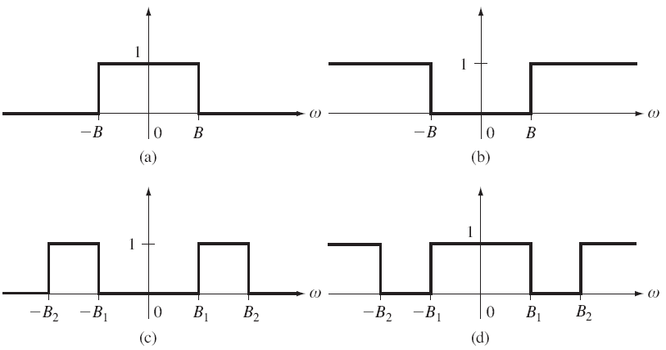
Ideal Filters
The process of rejecting particular frequencies or a range of frequencies is called filtering. A system that has this characteristic is called a filter.
An ideal filter is a filter whose frequency response goes exactly to zero for some frequencies and whose magnitude response is exactly one for other ranges of frequencies.
To avoid phase distortion in the filtering process, an ideal filter should have a linear phase characteristic. Why?
We will see this “ideal” response has some important implications for the impulse response of the filter.
Lowpass
Highpass
Bandpass
Bandstop

Slide 11
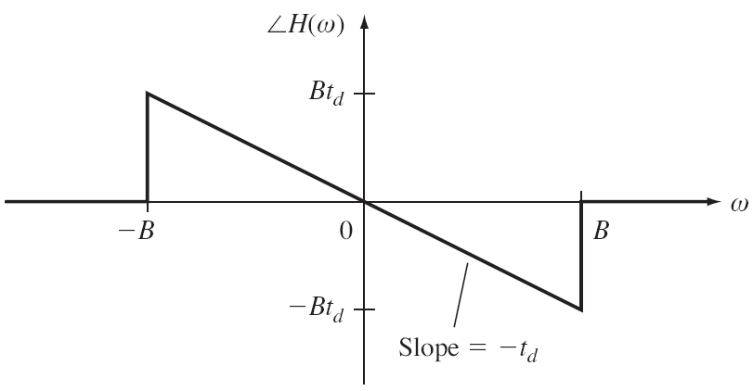
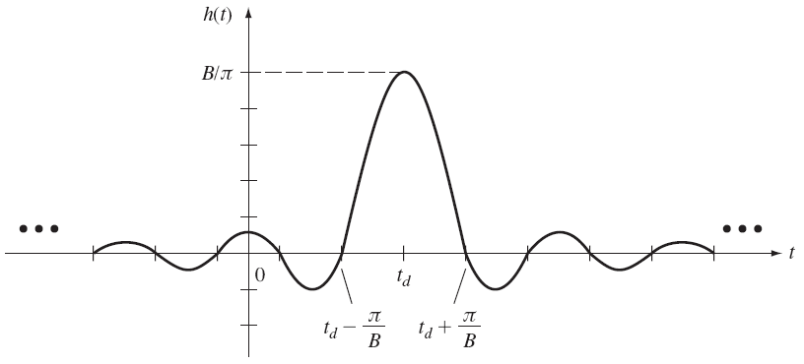
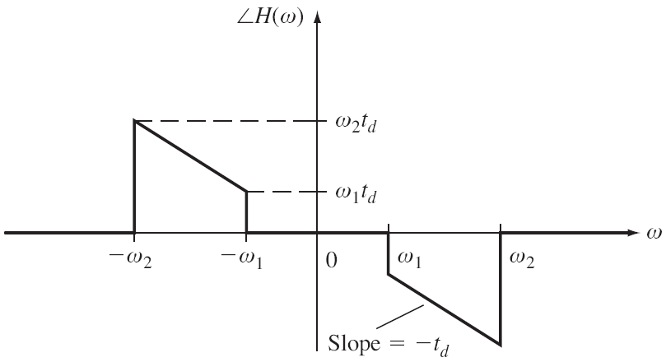
Ideal Linear Phase Lowpass Filter
Consider the ideal lowpass filter
with frequency response:
Using the Fourier transform pair
for a rectangular pulse, and applying
the time-shift property:
Is this filter causal?
The frequency response of an ideal
bandpass filter can be similarly defined:
Will this filter be physically realizable?
Why?
Phase
Response
Impulse
Response

Slide 12
Summary
Showed that the response of a linear LTI system to a sinusoid is a sinusoid at the same frequency with a different amplitude and phase.
Demonstrated how to compute the change in amplitude and phase using the system’s Fourier transform.
Demonstrated this for a simple RC circuit.
Generalized this to periodic and nonperiodic signals.
Worked examples involving a periodic pulse train and a single pulse.
Introduced the concept of an ideal filter and discussed several types of ideal filters.
Noted that the ideal filter is a noncausal system and is not physically realizable. However, there are many ways to approximate ideal filters, and that is a topic known as filter design.

