Slide 1
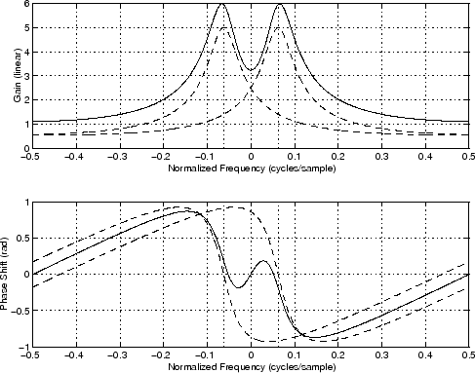
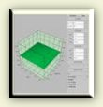
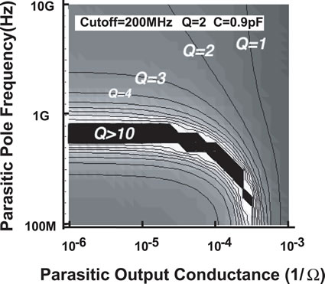
LECTURE 23: INVERSE LAPLACE TRANSFORM
Objectives: Rational Transforms Partial Fractions Expansion Distinct Roots Complex Poles Repeated Roots Transforms With Exponentials
Resources: MIT 6.003: Lecture 18 Wiki: Inverse Laplace Transform Wiki: Partial Fractions DM: Partial Fractions DK: Integration By Partial Fractions OSU: Application to Laplace Transforms
URL:
Audio:
Notes:
MS Equation 3.0 was used with settings of: 18, 12, 8, 18, 12.

Slide 2
Rational Transforms
Consider the problem of finding the inverse Laplace transform for:
where {a_{i}} and {b_{i}} are real numbers, and M and N are positive integers.
One straightforward approach is to factor B(s) into a sum of simpler terms whose Laplace transforms can be easily computed (or located in a table of transform pairs). The method of Partial Fractions is one approach:
The details of the expansion depends on the properties of A(s). For example, the presence of repeated roots slightly complicates things.
Fortunately, MATLAB can be used to find the roots of the polynomial:
A = [1 4 6 4]
p = roots(A)
p =
-2
-1.0000 + 1.0000i
-1.0000 – 1.0000i
Notes:
]i=k,

Slide 3
Distinct Roots: Method of Residues
Suppose there are distinct or non-repeated roots: p_{i} ≠ p_{j} when i ≠ j.
The constants, c_{i}, are called residues, and this method of computation is called the residue method.
The constant c_{i} is real if the corresponding pole is real. If two poles appear as complex conjugate pairs, the c_{i} must also appear in complex conjugate pairs.
Once the partial fractions expansion is completed, the inverse Laplace transform can be easily found as:
MATLAB can be used to find poles as residues:
num = [b_{M} b_{M-1} … b₁ b₀]
den = [a_{N} a_{N-1} … a₁ a₀]
[r,p] = residue(num, den)
Example:
Notes:
]i=k,

Slide 4
Distinct Roots (Cont.)
Example:
This can be checked with MATLAB:
num = [1 2]
den = [1 4 3 0]
[r,p] = residue(num, den)
r = p =
-0.1667 -3
-0.5000 -1
0.6667 0
Notes:
]i=k,

Slide 5
Distinct Complex Poles
Recall if all coefficients of the denominator are real, then the polynomial must have a combination of real and/or complex conjugate poles.
We can factor this polynomial into the following form:
The inverse transform is given by:
How can this be visualized in the s-plane? (Hint: frequency and bandwidth)
Example:

Slide 6
Repeated Poles
If the denominator has repeated poles, the expansion is of the form:
The residues for the nonrepeated poles are calculated the same as before:
The residues for the repeated poles are calculated by:
If the poles are all real, the inverse can be compactly written using:
Repeated complex poles and complex conjugate poles can also be dealt with by combining the complex conjugate poles into one quadratic term, and solving for the residues by equating terms of a polynomial:

Slide 7
Repeated Poles (Cont.)
Example:
Compute the inverse of each term individually and sum them:
This can be easily checked using MATLAB.

Slide 8
Numerator Has A Larger Order (M ≥ N)
What if the numerator has a degree larger than the denominator?
The polynomials can be decomposed using long division:
The inverse transform of Q(s) is computing using the transform pair:
Example:
The long division can be performed using the MATLAB command deconv:
num = [1 0 2 -4]
den = [1 4 -2]
[Q,R] = deconv(num, den)

Slide 9
Pole Locations Determine the Behavior of a Signal
We have seen that the structure of the poles in the denominator polynomial play a significant role in the determining the structure of the signal:
As a result, the signal can be determined directly from the poles. Modifying the numerator does not change the signal significantly, it just changes the values of the constants associated with the above terms.
We can observe that x(t) converges to zero as t  ∞ if and only if the poles of the signal all have real parts strictly less than zero:
Hence, the poles play a critical role in the stability of a signal. The field of Control Systems deals with stability issues in signals and systems.
If X(s) has a single pole at s = 0, the limiting value of x(t) is equal to the residue corresponding to that pole:

Slide 10
Transforms Containing Exponentials
One last case we want to consider:
The function is not rational in s. Such functions are referred to as transcendental functions of s.
Our approach is to use the methods previously described to compute the inverse of the rational transforms, and then to apply the time shift property:
Such functions arise when the Laplace transform is applied to a piecewise-continuous function, such as a pulse:
Example:

Slide 11
Summary
Introduced a method for funding the inverse Laplace transform using partial fractions expansion:
Factor the denominator.
Assess the complexity of the poles (e.g., distinct vs. repeated, real vs. complex conjugate pairs).
Compute the coefficients of the expansion using the method of residues.
Write the inverse Laplace transform by inspection.
Discussed the influence poles have on the resulting signal. We will study this more carefully later in the course.
Note that the MATLAB Symbolic Toolbox can be used to find the inverse transforms:
syms X s x
X = (s+2)/(s^3+4*s^2+3*s);
x = ilaplace(X);
x =
-1/6*exp(-3*t)-1/2*exp(-t)+2/3
ezplot(x,[0,10])

