Slide 1
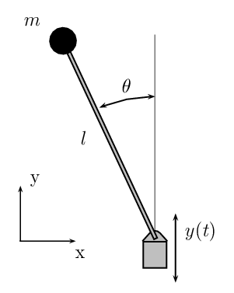
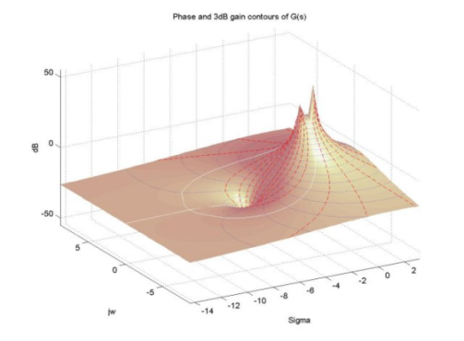
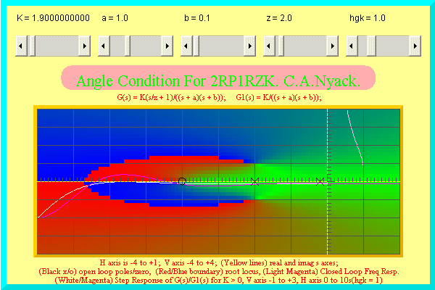

LECTURE 35: ROOT LOCUS
Objectives:
Conceptual View
Classical Formulation
Second-Order Example
Application
Resources:
MIT 6.003: Lecture 21
Wiki: Root Locus
EJM: Root Locus
Wiki: Inverted Pendulum
CJC: Inverted Pendulum
URL:
Audio:
Notes:
MS Equation 3.0 was used with settings of: 18, 12, 8, 18, 12.

Slide 2
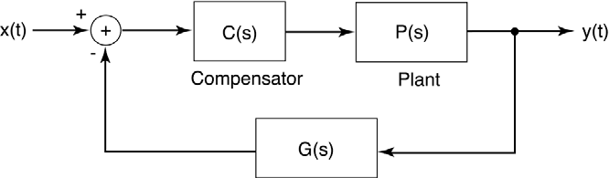
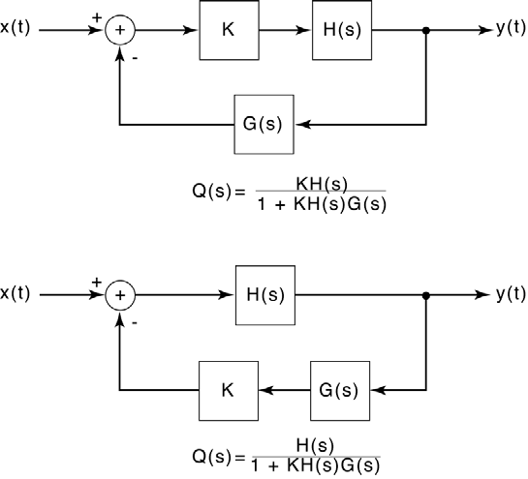
The Concept of a Root Locus
Recall our simple control system
with transfer function:
The controllers C(s) and G(s) can be
designed to stabilize the system, but that
could involve a multidimensional optimization. Instead, we would like a simpler, more intuitive approach to understand the behavior of this system.
Recall the stability of the system depends on the poles of 1 + C(s)G(s)P(s).
A root locus, in its most general form, is simply a plot of how the poles of our transfer function vary as the parameters of C(s) and G(s) are varied.
The classic root locus problem involves a simplified system:
Closed-loop poles are the same.
Notes:
]i=k,

Slide 3
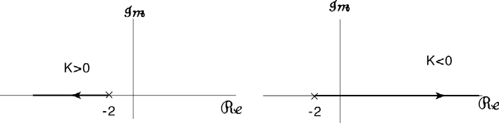
Example: First-Order System
Consider a simple first-order system:
The pole is at s₀ = -(2+K). Vary K from 0 to ± ∞:
Observation: improper adjustment of the gain can cause the overall system to become unstable.
Becomes more stable
Becomes less stable
Notes:
]i=k,

Slide 4
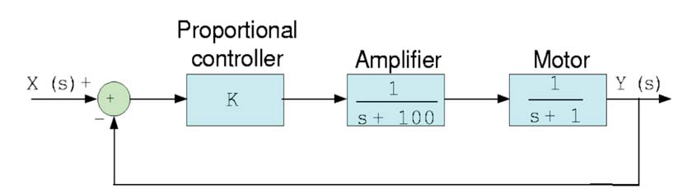
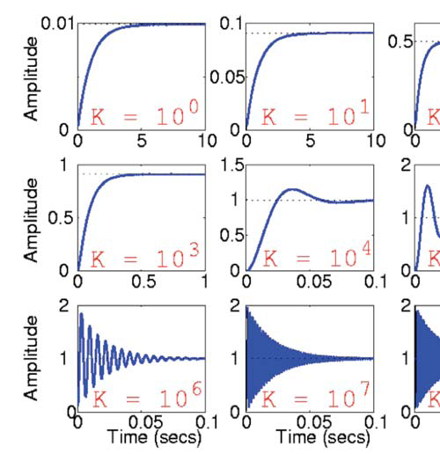
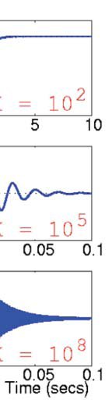
Example: Second-Order System With Proportional Control
Using Black’s Formula:
How does the step response
vary as a function of the gain, K?
Note that as K increases, the
system goes from too little gain
to too much gain.
Notes:
]i=k,

Slide 5
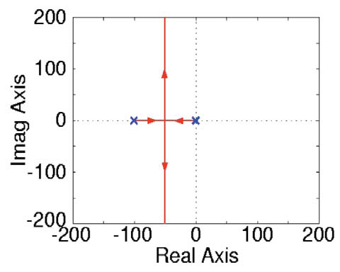
How Do The Poles Move?
Desired Response
Can we generalize this analysis to systems of arbitrary complexity?
Fortunately, MATLAB has support for generation of the root locus:
num = [1];
den = [1 101 101]; (assuming K = 1)
P = tf(num, den);
rlocus(P);
Notes:
]i=k,

Slide 6
More General Case
Assume no pole/zero cancellation in G(s)H(s):
Closed-loop poles are the roots of:
It is much easier to plot the root locus for high-order polynomials because we can usually determine critical points of the plot from limiting cases
(e.g., K = 0, ±∞), and then connect the critical points using some simple rules.
The root locus is defined as traces of s for unity gain:
Some general rules:
At K = 0, G(s₀)H(s₀) = ∞ ⇒ s₀ are the poles of G(s)H(s).
At K = ∞, G(s₀)H(s₀) = 0 ⇒ s₀ are the zeroes of G(s)H(s).
Rule #1: start at a pole at K = 0 and end at a zero at K = ∞.
Rule #2: (K ≥ 0) number of zeroes and poles to the right of the locus point must be odd.
Notes:
]i=k,

Slide 7
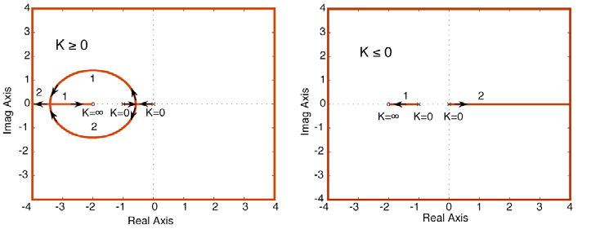
Example
Notes:
]i=k,

Slide 8
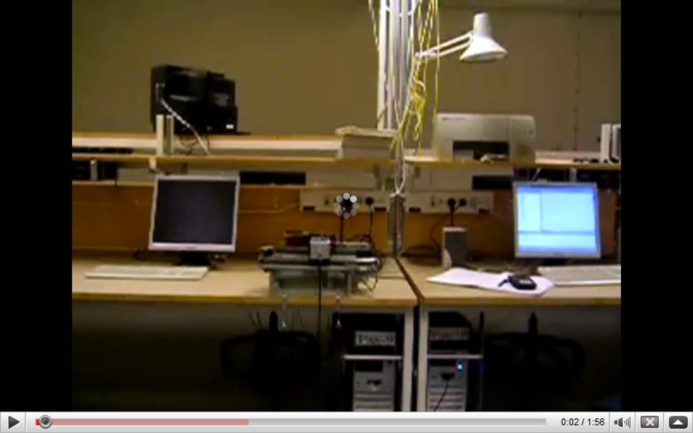
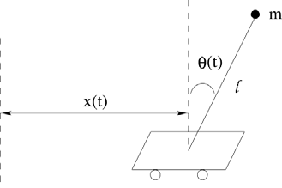
Inverted Pendulum
Pendulum which has its mass above its pivot point.
It is often implemented with the pivot point mounted on a cart that can move horizontally.
A normal pendulum is stable when hanging downwards, an inverted pendulum is inherently unstable.
Must be actively balanced in order to remain upright, either by applying a torque at the pivot point or by moving the pivot point horizontally (Wiki).
Notes:
]i=k,

Slide 9
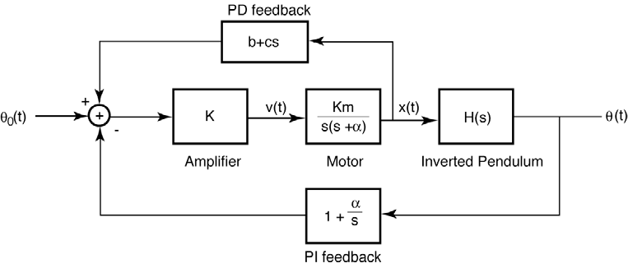
Feedback System – Use Proportional Derivative Control
Equations describing the physics:
The poles of the system are inherently
unstable.
Feedback control can be used to
stabilize both the angle and position.
Other approaches involve oscillating
the support up and down.
Notes:
]i=k,

Slide 10
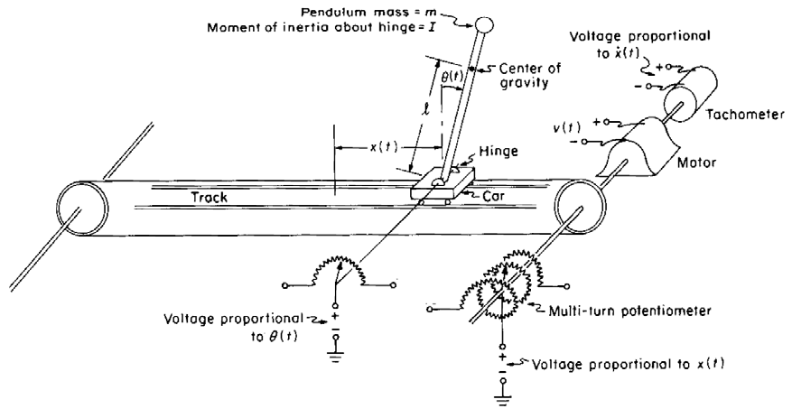

Feedback System – Implementation
Notes:
]i=k,

Slide 11
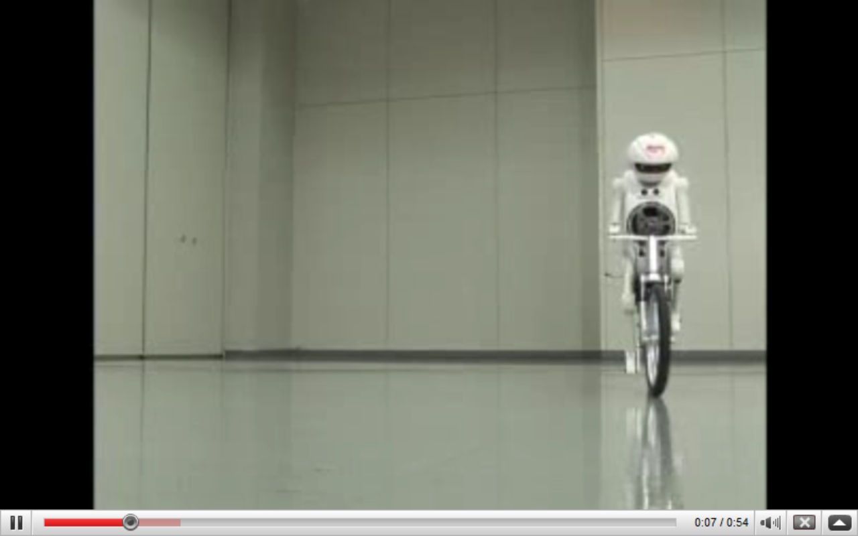
Summary
Reviewed how stability is a function of gain for a simple feedback control circuit.
Introduced the root locus diagram as an analysis tool to understand stability.
Demonstrated its calculation for some simple first and second-order systems.
Discussed an application of feedback control involving stabilization of an inverted pendulum.

