Slide 1
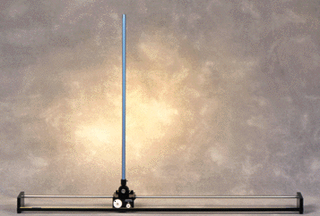
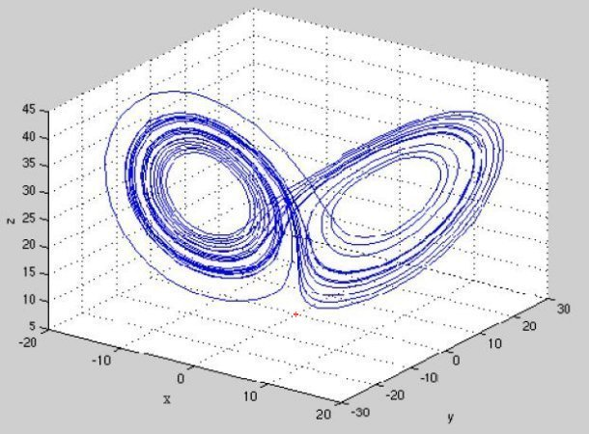
LECTURE 39: SOLUTIONS OF THE STATE EQUATIONS
Objectives:
Useful Matrix Properties Time-Domain Solutions Relationship to Convolution Laplace Transform Solution
Resources: SHS: State Equation Solutions MIT: State Equation Solutions
URL:
Audio:
Notes:
MS Equation 3.0 was used with settings of: 18, 12, 8, 18, 12.

Slide 2
Preliminaries
Recall our state equations:
To solve these equations, we will need a few mathematical tools. First:
where I is an NxN identity matrix. A^{k} is simply AxAx…A.
For any real numbers t and λ:
Further, setting λ = -t:
Next:
We can use these results to show that the solution to is:
Notes:
]i=k,

Slide 3
Solutions to the Forced Equation
If:
is referred to as the state-transition matrix.
We can apply these results to the state equations:
Note that:
Integrating both sides:
Generalization of our convolution integral
Notes:
]i=k,

Slide 4
Solution to the Output Equation
Recall:
Using the definition of the unit impulse:
Recall our convolution integral for a single-input single-output system:
Equating terms:
The impulse response can be computed directly from the coefficient matrices.
Notes:
]i=k,

Slide 5
Solution via the Laplace Transform
Recall our state equations:
Using the Laplace transform on the first equation:
Comparing this to:
reveals that:
Continuing with the output equation:
For zero initial conditions:
The transfer function can be computed directly from the system parameters.
Notes:
]i=k,

Slide 6
Discrete-Time Systems
The discrete-time equivalents of the state equations are:
The process is completely analogous to CT systems, with one exception: these equations are easy to implement and solve using difference equations ☺
For example, note that if v[n] = 0 for n ≥ 0,
and A^{n} is the state-transition matrix for the discrete-time case.
The output equation can be derived following the procedure for the CT case:
The impulse response is given by:
Notes:
]i=k,

Slide 7
Solutions Using the z-Transform
Just as we solved the CT equations with the Laplace transform, we can solve the DT case with the z-transform:
Note that historically the CT state equations were solved numerically using a discrete-time approximation for the derivatives (see Section 11.6), and this provided a bridge between the CT and DT solutions.
Example:
Notes:
]i=k,

Slide 8
Summary
Introduced some useful properties of matrices that allowed us to solve the state equations.
Demonstrated a solution to the forced equation.
Discussed how this is a generalization of the single-input single-output analysis approach previously studied (e.g., convolution).
Applied the Laplace transform to solve the state equations using algebra. Derived an expression for the transfer function.
Extended the state equations to the discrete-time case.
Demonstrated a DT signal flow graph implementation of the DT solution.
Next: We will work some examples involving circuit analysis using the state variable approach.

