Slide 1
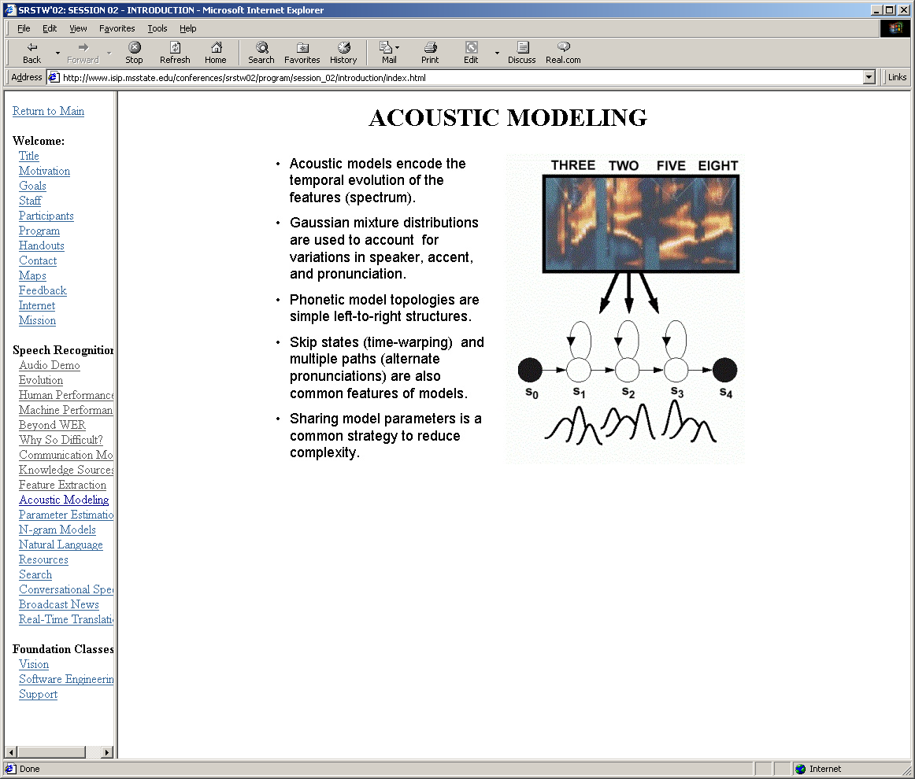

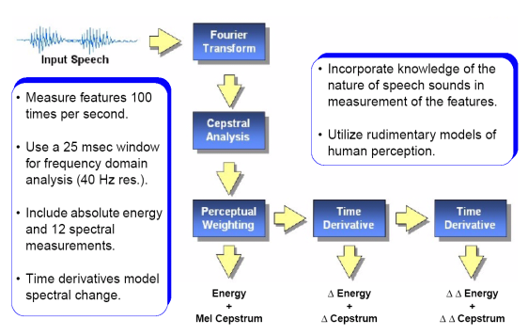

LECTURE 42: SELECTED APPLICATIONS
Objectives:
Pattern Recognition
Feature Generation
Linear Prediction
Gaussian Mixture Models
Emerging Applications
Resources:
Introduction to DSP
Fundamentals of ASR
Pattern Recognition
Information Theory
URL:
Audio:
Notes:
MS Equation 3.0 was used with settings of: 18, 12, 8, 18, 12.

Slide 2
Pattern Recognition
Pattern Recognition: “the act of taking raw data and taking an action based on the category of the pattern.”
Common Applications: speech recognition, fingerprint identification (biometrics), DNA sequence identification
Related Terminology:
  Machine Learning: The ability of a machine to improve its performance based on previous results.
  Machine Understanding: acting on the intentions of the user generating the data.
Related Fields: artificial intelligence, signal processing and discipline-specific research (e.g., speech and image recognition, biometrics, DNA sequencing).
Classification is typically performed using advanced statistical methods (e.g., maximum likelihood, Gaussian models, Bayes’ Rule).
Feature extraction is the process of converting a signal to a set of vectors that contain relevant information.
Decision
Post-Processing
Classification
Feature Extraction
Segmentation
Sensing
Input
Notes:
]i=k,

Slide 3
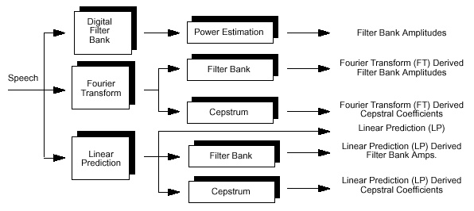
Common Frequency Domain Representations
Salient information in the signal is often manifests itself in both the time and frequency domain.
There are many ways to derive a frequency domain representation of a signal:
The (fast) Fourier transform (or Discrete Cosine Transform) are often used in audio and image processing because of their linear properties and computationally efficient structure.
Notes:
]i=k,

Slide 4
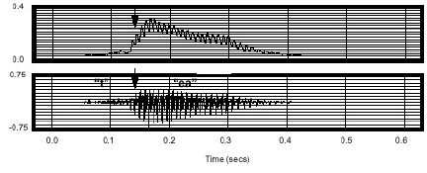
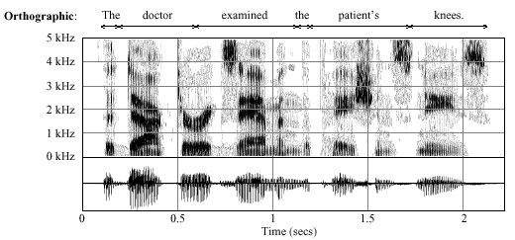
Example: Modeling Energy in a Speech Signal
Salient information in the
speech signal is often
manifests itself in both
the time-domain (e.g.,
energy as a function of
time):
and the frequency
domain (e.g., spectral
magnitude as a function
of time):
Modeling the change in energy as a function of time and frequency (and even space) forms the basis of most pattern recognition systems.
Notes:
]i=k,

Slide 5

Example: Feature Extraction in Speech Recognition
A popular approach for capturing these dynamics is the Mel-Frequency Cepstral Coefficients (MFCC) “front-end:”
Notes:
]i=k,

Slide 6
Linear Prediction
Another popular approach for capturing
information in a signal integrates concepts
of signal processing and statistics, and is
known as linear prediction.
In this approach, we attempt to model the
signal as a linear combination of its
previous samples. Why?
Consider a p^{th}-order linear prediction model:
This model is based on notions of regression and
minimum mean-squared error (MMSE):
We can adjust the coefficients to minimize the mean-squared error:
–
+
Regression or
MMSE estimate

Slide 7
Linear Prediction and Filtering
The solution to this optimization problem has a familiar look:
where:
Using the z-Transform, we can show that the error equation can be computed using a linear filter:

Slide 8
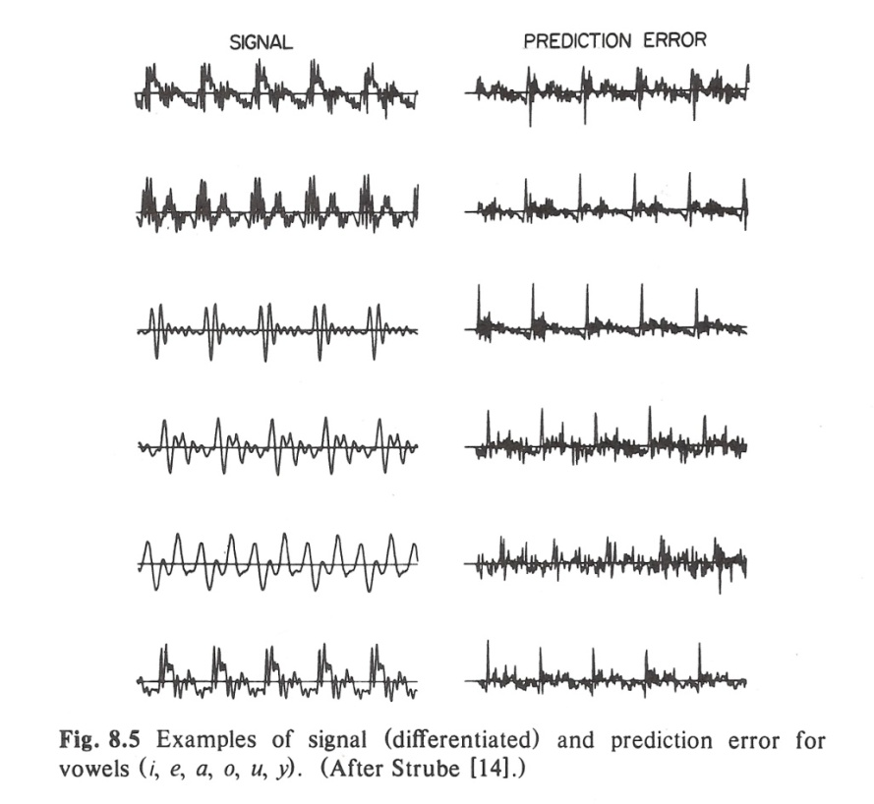
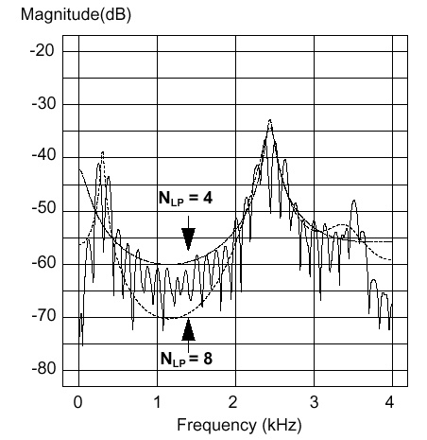
Linear Prediction and the Spectrum
To the left are some examples of the linear prediction error for voiced speech signals.
The points where the prediction error peaks are points in the signal where the signal is least predictable by a linear prediction model. In the case of voiced speech, this relates to the manner in which the signal is produced.
The LP filter becomes increasingly more accurate if you increase the order of the model.
We can interpret this as a spectral matching process, as shown to the right. As the order increases, the LP model better models the envelope of the spectrum of the original signal.
The LP parameters can be used to recognize patterns in a signal.

Slide 9
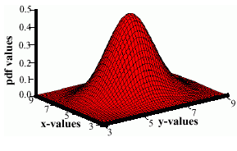
Multivariate Normal Distributions
A multivariate normal, or Gaussian, distribution is defined as:
where the vector, μ, represents the mean and the matrix, ∑, represents the covariance.
Note the exponent term is really a dot product or weighted Euclidean distance.
The covariance is always symmetric
and positive semidefinite.
How does the shape vary as a
function of the covariance?
It is common in many signal
processing system to model the
statistics of a feature vector as a
weighted sum of Gaussian distributions:
This is known as a Gaussian mixture model.

Slide 10
Capturing the Time-Frequency Evolution

Slide 11
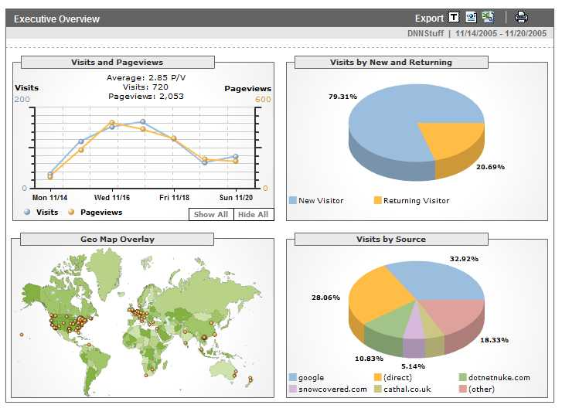
Analytics
Definition: A tool or process that allows an entity (i.e., business) arrive at an optimal or realistic decision based on existing data. (Wiki).
Google is building a highly
profitable business around
analytics derived from people
using its search engine.
Any time you access a web page,
you are leaving a footprint of
yourself, particularly with respect
to what you like to look at.
This has allows advertisers to tailor
their ads to your personal interests
by adapting web pages to your
habits.
Web sites such as amazon.com, netflix.com and pandora.com have taken this concept of personalization to the next level.
As people do more browsing from their telephones, which are now GPS enabled, an entirely new class of applications is emerging that can track your location, your interests and your network of “friends.”

Slide 12

Social Networking
Sites such as Facebook, MySpace, and Linkedin.com are building a business based on your desire to network with other people.
By monitoring what sites/people you visit
and how frequently you visit them, a graph
can be built describing your social network.
These graphs can be aggregated,
or averaged, over groups to better
understand group dynamics.
The intersection of these graphs with other
people’s graphs can help determine
who or what is at the center of an activity.
These graphs can often be clustered into three levels: immediate, near and distant contacts. Graph theory plays a prominent role in the analysis of your “connectedness.”
Other types of information, such as the time of day and the physical location of your edge device, coupled with who/what you are viewing, can be useful in constructing a timeline of an event and understanding your habitual behavior.
Deviation from this behavior can set off alerts (e.g., credit cards).

Slide 13

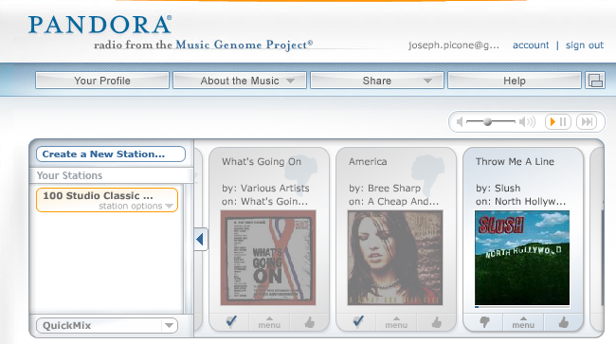
Predicting User Preferences
These models can be used to generate alternatives for you that are consistent with your previous choices (or the choices of people like you).
Such models are referred to as generative models because they can generate new data spontaneously that is statistically consistent with previously collected data.
Alternately, you can build graphs in which movies are nodes and links represent connections between movies judged to be similar.
Some sites, such as Pandora, allow you to continuously rate choices, and adapt the mathematical models of your preferences in real time.
This area of science is known as adaptive systems, dealing with algorithms for rapidly adjusting to new data.

Slide 14
Summary
Introduced the concept of a pattern recognition system. Discussed how it integrates signal processing and statistics.
Introduced conventional techniques for converting a discrete-time signal to a sequence of feature vectors.
Discussed linear prediction as a statistically-based method for modeling a signal as an all-pole or autoregressive process.
Introduced Gaussian mixture models as a statistical technique for modeling systematic variations in parameters, such as linear prediction coefficients.
Discussed several emerging applications that attempt to model and predict human behavior using statistics.
Signal processing remains a vital and growing field. In upper-level and graduate studies, you can investigate more powerful statistical methods for modeling and controlling signals that might appear to be random.

