Slide 1
LECTURE 07: CONVOLUTION FOR CT SYSTEMS
Objectives: Convolution Definition Graphical Convolution Examples Properties
Resources: Wiki: Convolution MIT 6.003: Lecture 4 JHU: Convolution Tutorial ISIP: Java Applet
URL:
Audio:
Notes:
MS Equation 3.0 was used with settings of: 18, 12, 8, 18, 12.

Slide 2
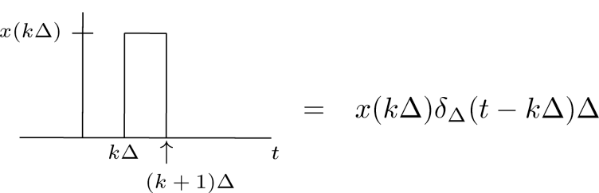
Representation of CT Signals (Review)
We approximate a CT signal as a weighted pulse function.
The signal can be written as a sum of these pulses:
In the limit, as :
Mathematical definition of an impulse function (the equivalent of the unit pulse for DT signals and systems):
Unit pulses can be constructed from many functional shapes (e.g., triangular or Gaussian) as long as they have a vanishingly small width. The rectangular pulse is popular because it is easy to integrate ☺

Slide 3
Response of a CT LTI System
CT LTI
Denote the system impulse response, h(t), as the output produced when the input is a unit impulse function, δ(t).
From time-invariance:
From linearity:
This is referred to as the convolution integral for CT signals and systems.
Its computation is completely analogous to the DT version:

Slide 4
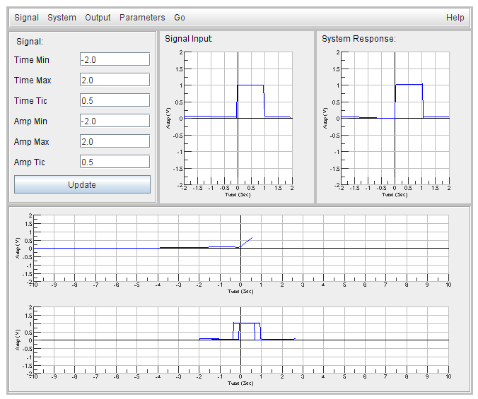
Example: Unit Pulse Functions
t < 0: y(t) = 0
t > 2: y(t) = 0
0 ≤ t ≤ 1: y(t) = t
1 ≤ t ≤ 2: y(t) = 2-t

Slide 5
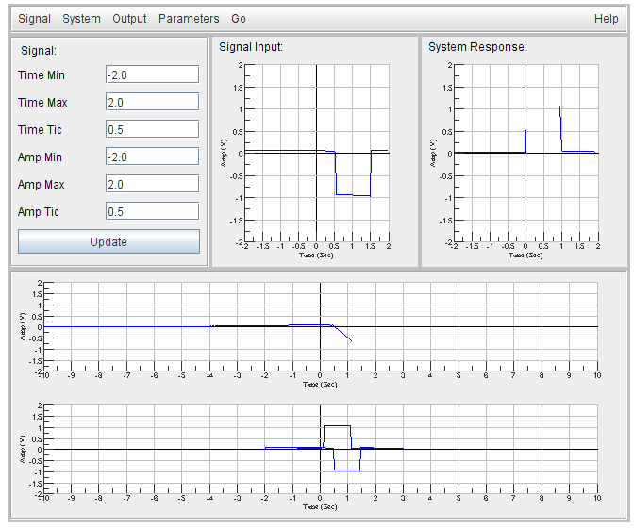
Example: Negative Unit Pulse
t < 0.5: y(t) = 0
t > 2.5: y(t) = 0
0.5 ≤ t ≤ 1.5: y(t) = 0.5-t
1 ≤ t ≤ 2: y(t) = -2.5+t

Slide 6
Example: Combination Pulse
p(t) = 1 0 ≤ t ≤ 1
x(t) = p(t) - p(t-1)
y(t) = ???

Slide 7
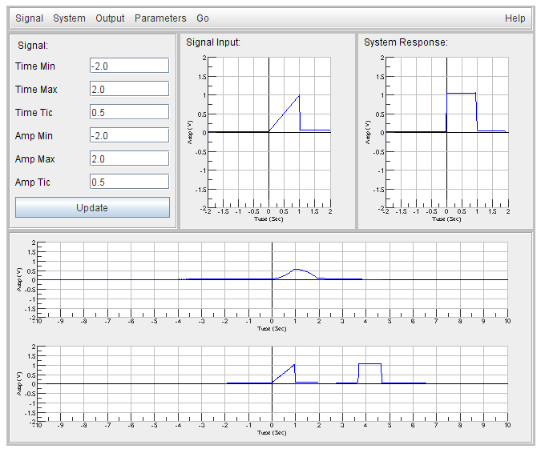
Example: Unit Ramp
p(t) = 1 0 ≤ t ≤ 1
x(t) = r(t) p(t)
y(t) = ???

Slide 8
Properties of Convolution
Sifting Property:
Proof:
Integration:
Proof:
Step Response (follows from the integration property):
Comments:
Requires proof of the commutative property.
In practice, measuring the step response of a system is much easier than measuring the impulse response directly. How can we obtain the impulse response from the step response?

Slide 9
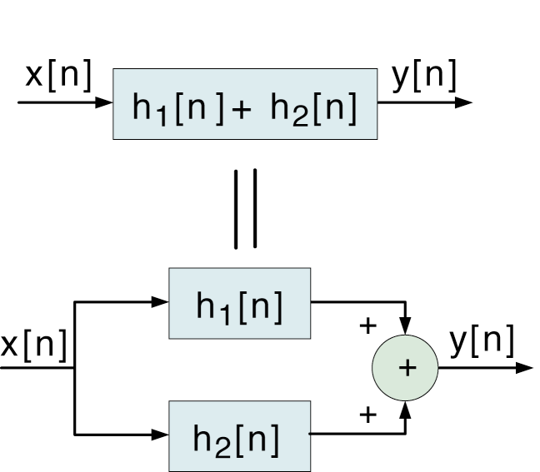
Properties of Convolution (Cont.)
Commutative Property:
Proof:
Implications (from DT lecture):
Distributive Property:
Proof:

Slide 10
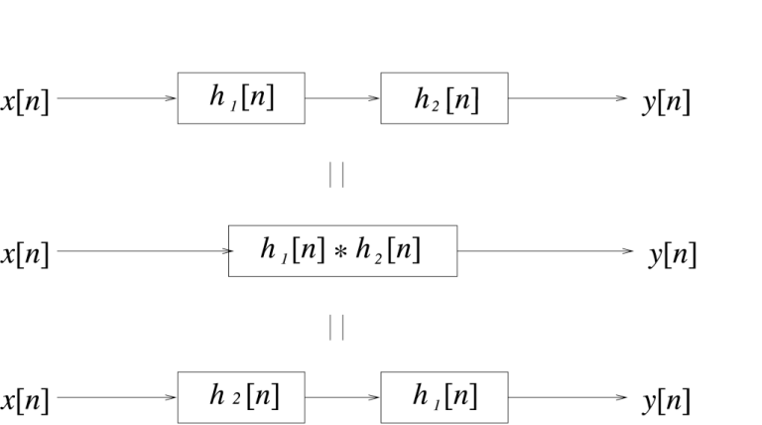
Properties of Convolution (Cont.)
Associative Property:
Proof:
Implications (from DT lecture):

Slide 11
Useful Properties of CT LTI Systems
Causality: which implies:
This means y(t) only depends on x(τ < t).
Stability:
Bounded Input ↔ Bounded Output
Sufficient Condition:
Necessary Condition:

Slide 12
Summary
We introduced CT convolution.
We worked some analytic examples.
We also demonstrated graphical convolution.
We discussed some general properties of convolution.
We also discussed constraints on the impulse response for bounded input / bounded output (stability).

