Slide 1
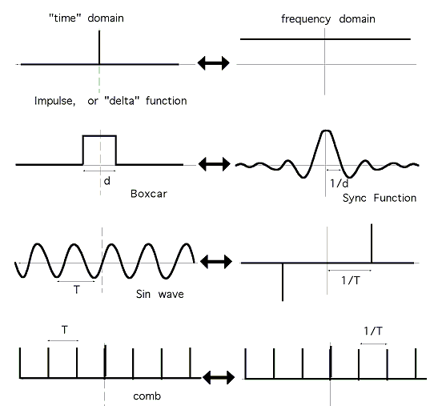
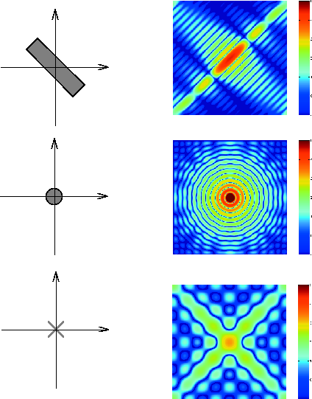

LECTURE 10: THE FOURIER TRANSFORM
Objectives:
Derivation
Transform Pairs
Response of LTI Systems
Transforms of Periodic Signals
Examples
Resources:
Wiki: The Fourier Transform
CNX: Derivation
MIT 6.003: Lecture 8
Wikibooks: Fourier Transform Tables
RBF: Image Transforms (Advanced)
URL:
Audio:
Notes:
MS Equation 3.0 was used with settings of: 18, 12, 8, 18, 12.

Slide 2
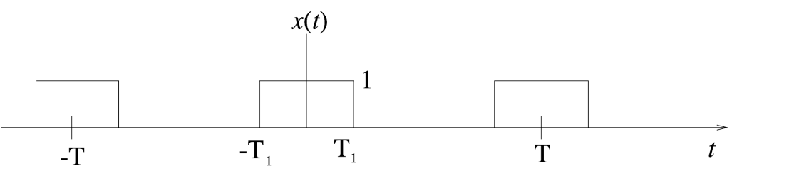
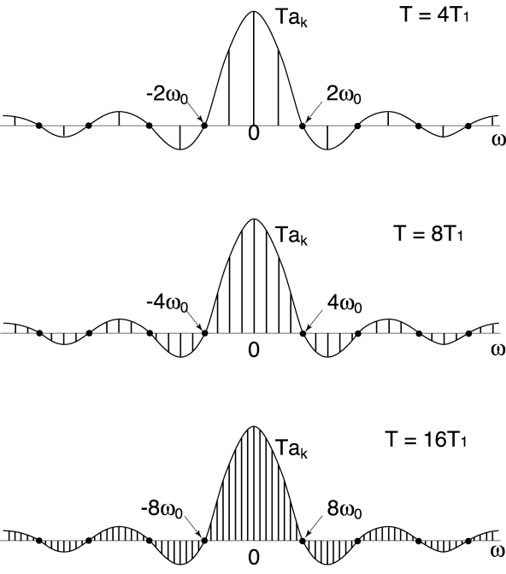
Motivation
We have introduced a Fourier Series for analyzing periodic signals. What about aperiodic signals? (e.g., a pulse instead of a pulse train)
We can view an aperiodic signal as the limit of a periodic signal as T  ∞.
The harmonic components are spaced apart.
As T  ∞, ω₀  0, then kω₀ becomes continuous.
The Fourier Series becomes the Fourier Transform.

Slide 3
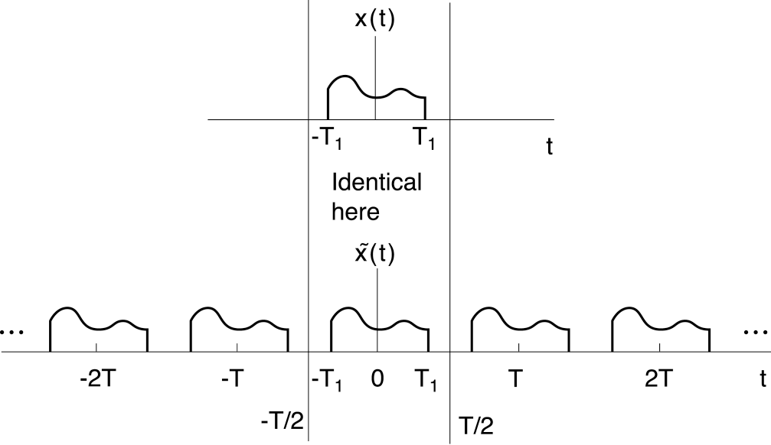
Derivation of Analysis Equation
Assume x(t) has a finite duration.
Define as a periodic extension
of x(t):
As
Recall our Fourier series pair:
Since x(t) and are identical over this interval:
As

Slide 4
Derivation of the Synthesis Equation
Recall:
We can substitute for c_{k} the sampled value of :
As
and we arrive at our Fourier Transform pair:
Note the presence of the eigenfunction:
Also note the symmetry of these equations (e.g., integrals over time and frequency, change in the sign of the exponential, difference in scale factors).
(synthesis)
(analysis)

Slide 5
Frequency Response of a CT LTI System
Recall that the impulse response of
a CT system, h(t), defines the
properties of that system.
We apply the Fourier Transform to
obtain the system’s frequency response:
except that now this is valid for finite duration (energy) signals as well as periodic signals!
How does this relate to what you have learned in circuit theory?
CT LTI
CT LTI

Slide 6
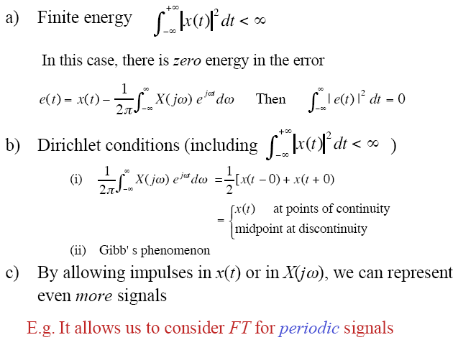
Existence of the Fourier Transform
Under what conditions does this transform exist?
x(t) can be infinite duration but must satisfy these conditions:

Slide 7
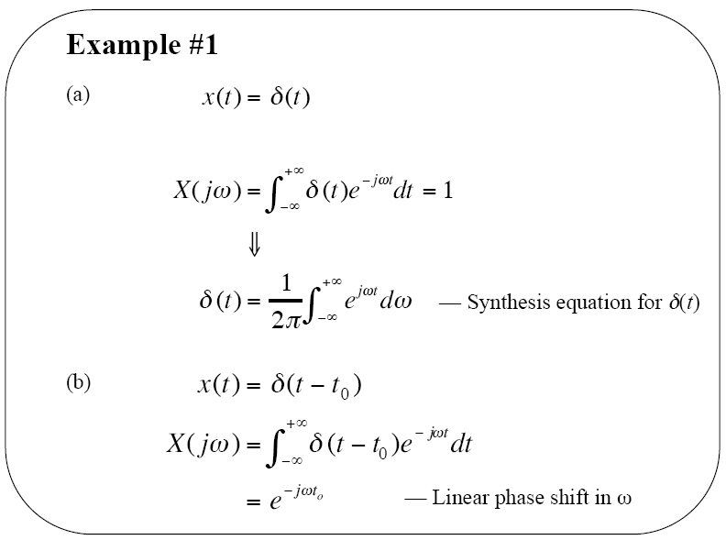
Example: Impulse Function

Slide 8
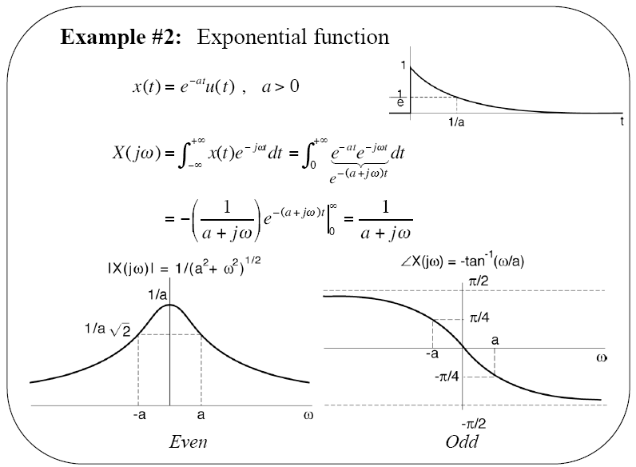
Example: Exponential Function

Slide 9
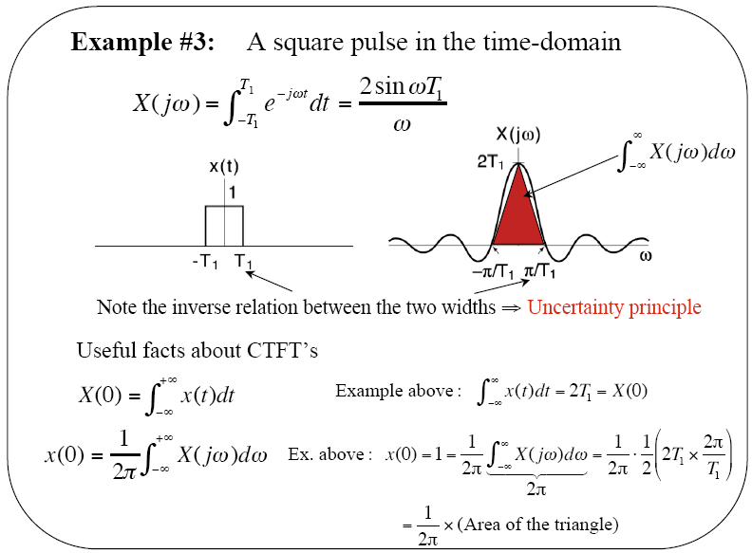
Example: Square Pulse

Slide 10
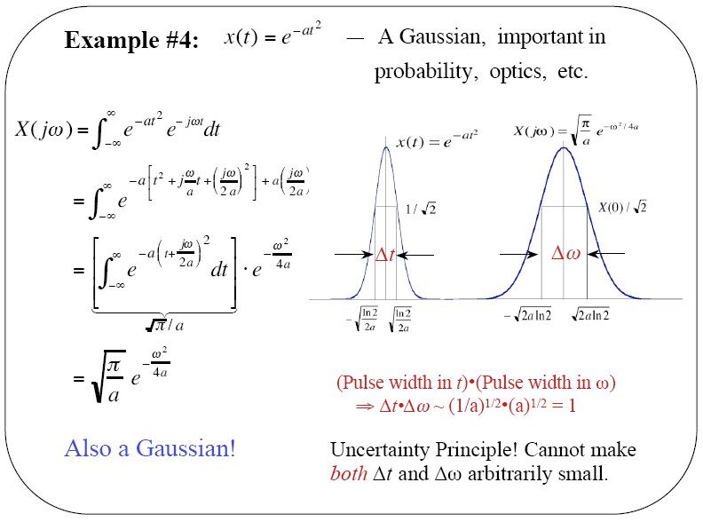
Example: Gaussian Pulse

Slide 11
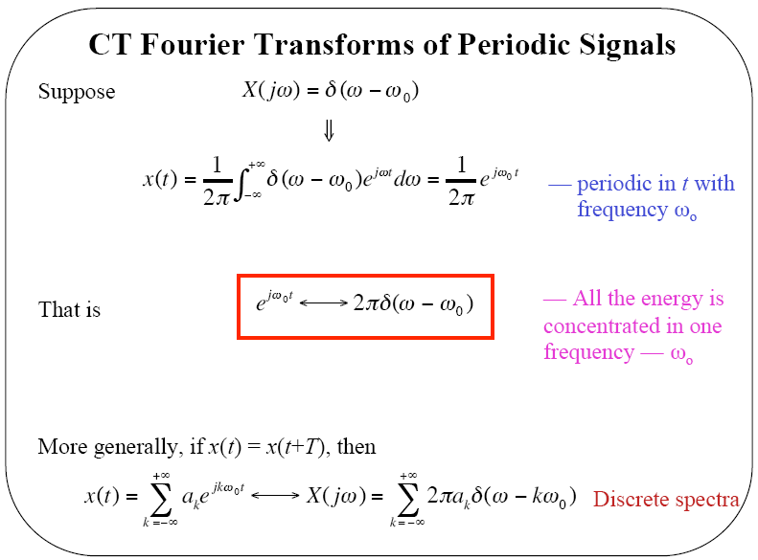
CT Fourier Transforms of Periodic Signals

Slide 12
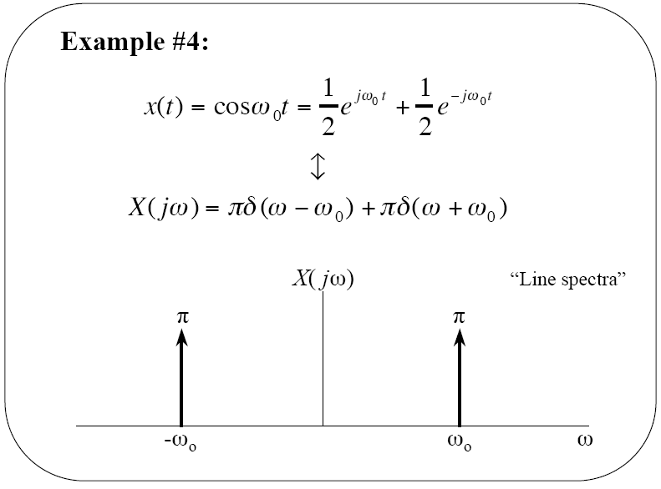
Example: Cosine Function

Slide 13
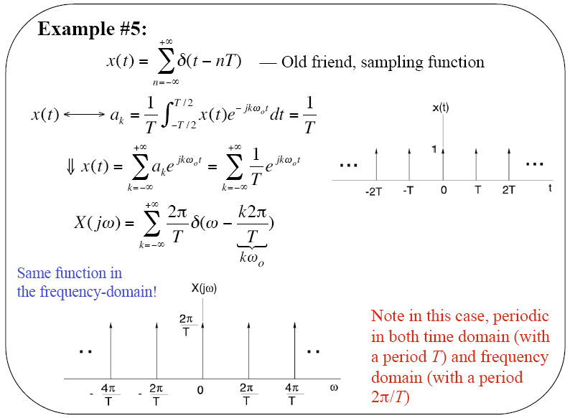
Example: Periodic Pulse Train

Slide 14
Summary
Motivated the derivation of the CT Fourier Transform by starting with the Fourier Series and increasing the period: T  ∞
Derived the analysis and synthesis equations (Fourier Transform pairs).
Applied the Fourier Transform to CT LTI systems and showed that we can obtain the frequency response of an LTI system by taking the Fourier Transform of its impulse response.
Discussed the conditions under which the Fourier Transform exists. Demonstrated that it can be applied to periodic signals and infinite duration signals as well as finite duration signals.
Worked several examples of important finite duration signals.
Introduced the Fourier Transform of a periodic signal.
Applied this to a cosinewave and a pulse train.

