Slide 1
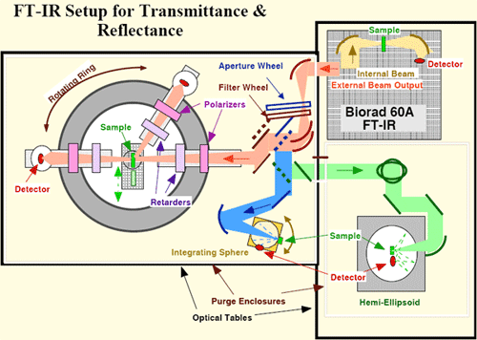
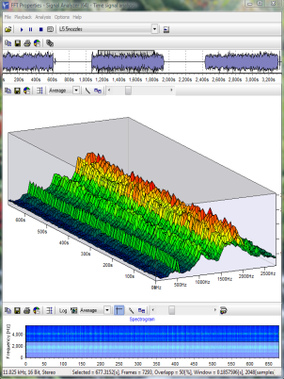
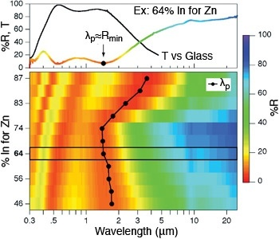

LECTURE 11: FOURIER TRANSFORM PROPERTIES
Objectives:
Linearity
Time Shift and Time Reversal
Multiplication
Integration
Convolution
Parseval’s Theorem
Duality
Resources:
BEvans: Fourier Transform Properties
MIT 6.003: Lecture 8
DSPGuide: Fourier Transform Properties
Wiki: Audio Timescale Modification
ISIP: Spectrum Analysis
URL:
Audio:
Notes:
MS Equation 3.0 was used with settings of: 18, 12, 8, 18, 12.

Slide 2
Linearity
Recall our expressions for the Fourier Transform and its inverse:
The property of linearity:
Proof:
(synthesis)
(analysis)

Slide 3
Time Shift
Time Shift:
Proof:
Note that this means time delay is equivalent to a linear phase shift in the frequency domain (the phase shift is proportional to frequency).
We refer to a system as an all-pass filter if:
Phase shift is an important concept in the development of surround sound.

Slide 4
Time Scaling
Time Scaling:
Proof:
Generalization for a < 0 , the negative value is offset by the change in the limits of integration.
What is the implication of a < 1 on the time-domain waveform? On the frequency response? What about a > 1?
Any real-world applications of this property? Hint: sampled signals.78
Notes:
]i=k,

Slide 5
Time Reversal
Time Reversal:
Proof:
We can also note that for real-valued signals:
Time reversal is equivalent to conjugation in the frequency domain.
Can we time reverse a signal? If not, why is this property useful?
Notes:
]i=k,

Slide 6
Multiplication by a Power of t
Multiplication by a power of t:
Proof:
We can repeat the process for higher powers of t.
Notes:
]i=k,

Slide 7
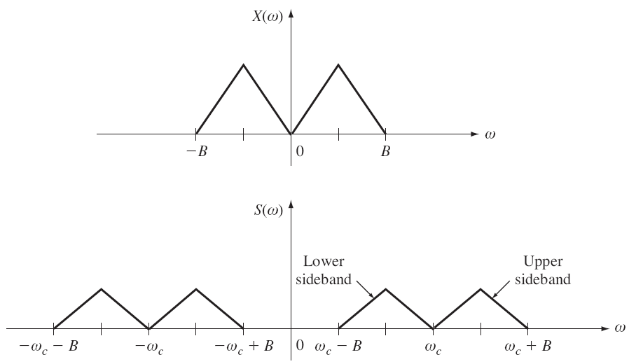
Multiplication by a Complex Exponential (Modulation)
Multiplication by a complex exponential:
Proof:
Why is this property useful?
First, another property:
This produces a translation in the frequency
domain. How might this be useful in a
communication system?
Notes:
]i=k,

Slide 8
Differentiation / Integration
Differentiation in the Time Domain:
Integration in the Time Domain:
What are the implications of time-domain differentiation in the frequency domain?
Why might this be a problem? Hint: additive noise.
How can we apply these properties? Hint: unit impulse, unit step, …
Notes:
]i=k,

Slide 9
Convolution in the Time Domain
Convolution in the time domain:
Proof:
Notes:
]i=k,

Slide 10
Other Important Properties
Multiplication in the time domain:
Parseval’s Theorem:
Duality:
Note: please read the textbook carefully for the derivations and interpretation of these results.
Notes:
]i=k,

Slide 11
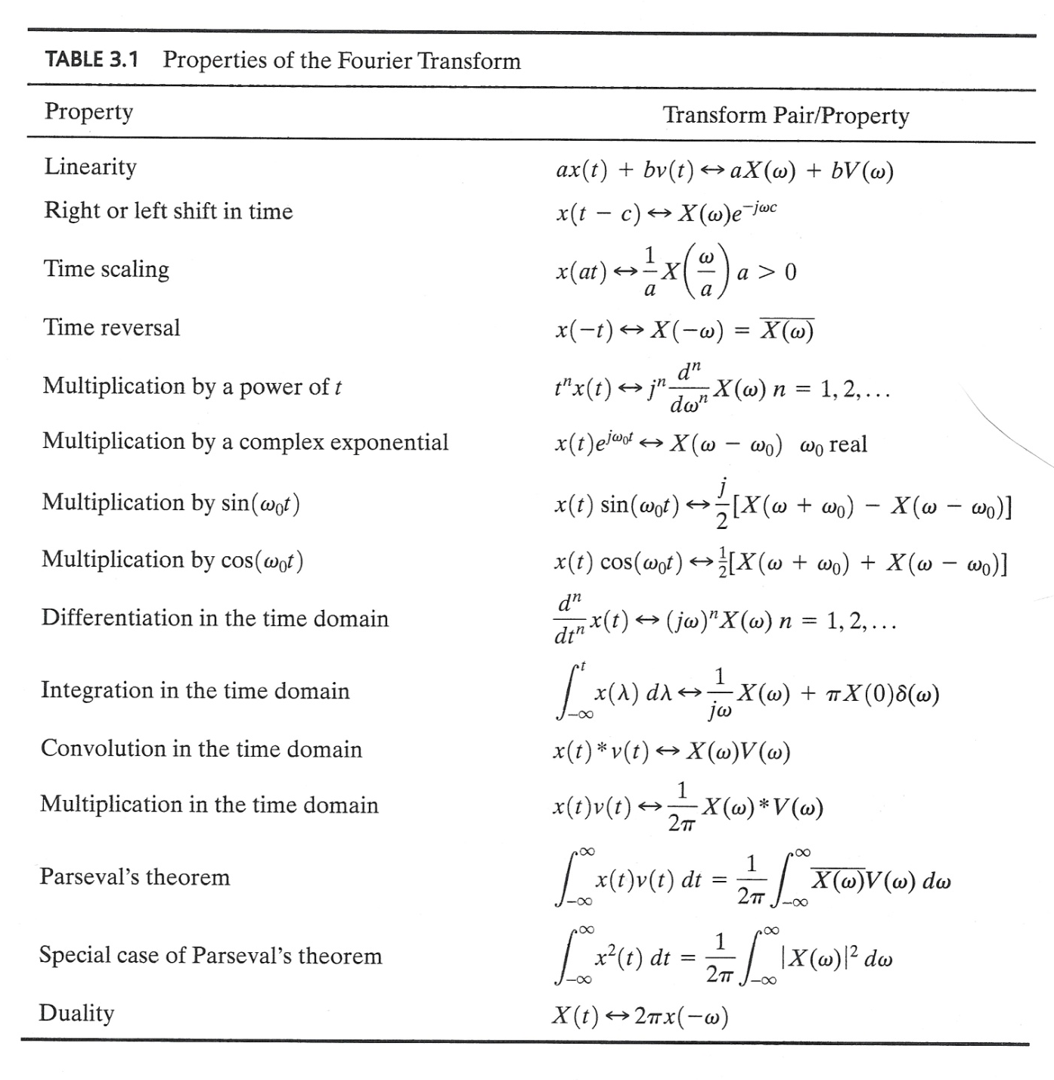
Summary

Slide 12
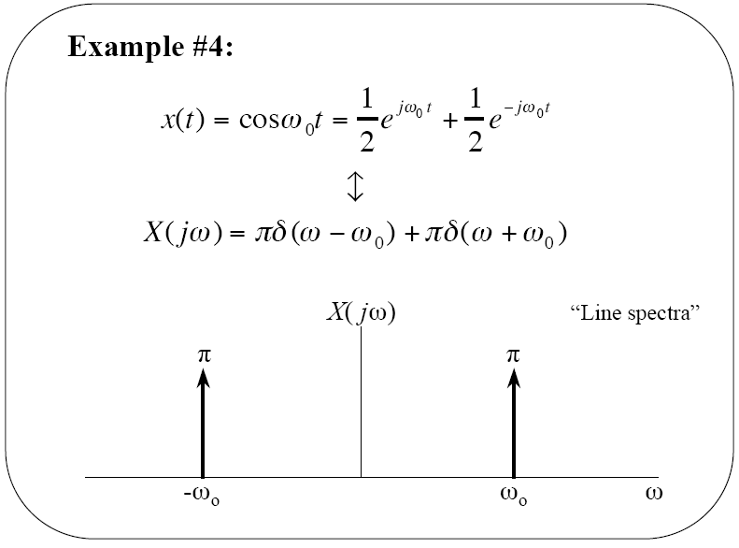
Example: Cosine Function

Slide 13
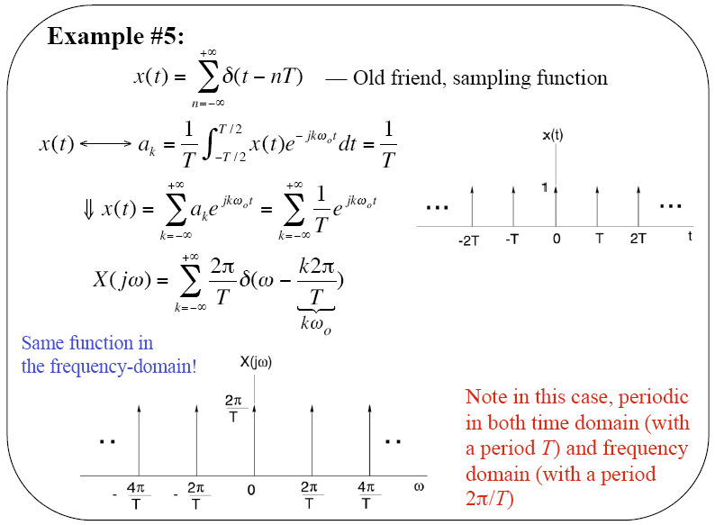
Example: Periodic Pulse Train

Slide 14
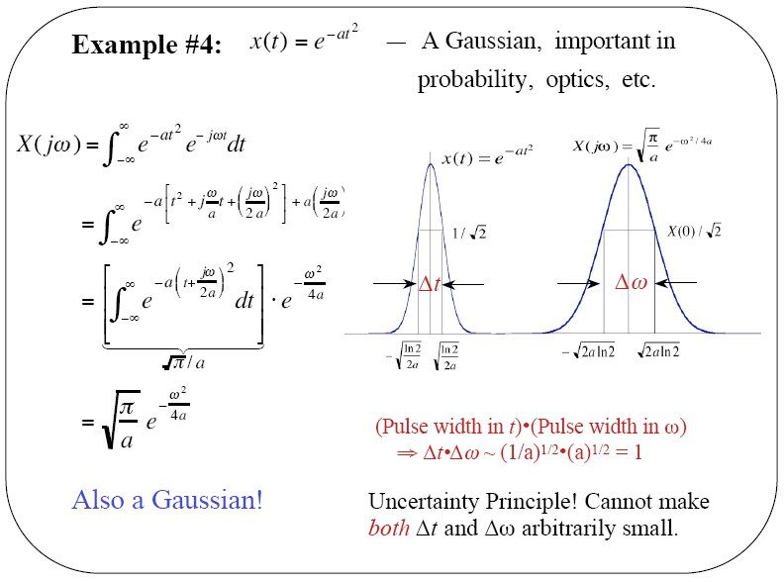
Example: Gaussian Pulse

