Slide 1
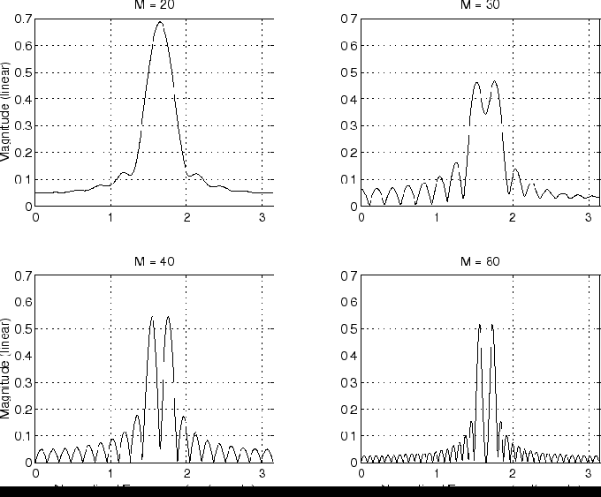
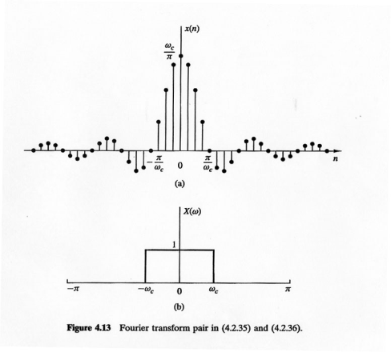
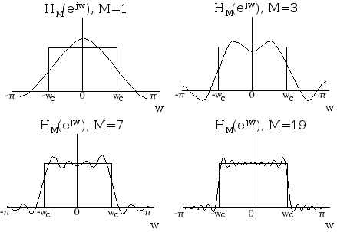

LECTURE 15: DISCRETE-TIME FOURIER TRANSFORM
Objectives:
Derivation of the DTFT
Transforms of Common Signals
Properties of the DTFT
Lowpass and Highpass Filters
Resources:
Wiki: Discete-Time Fourier Transform
JOS: DTFT Derivation
MIT 6.003: Lecture 9
CNX: DTFT Properties
SKM: DTFT Properties
URL:
Audio:
Notes:
MS Equation 3.0 was used with settings of: 18, 12, 8, 18, 12.

Slide 2
Discrete-Time Fourier Series
Assume x[n] is a discrete-time periodic signal. We want to represent it as a weighted-sum of complex exponentials:
Note that the notation <N> refers to performing the summation over an N samples which constitute exactly one period.
We can derive an expression for the coefficients by using a property of orthogonal functions (which applies to the complex exponential above):
Multiplying both sides by and summing over N terms:
Interchanging the order of summation on the right side:
We can show that the second sum on the right equals N if k = r and 0 if k ≠ r:
Notes:
]i=k,

Slide 3
Discrete-Time Fourier Series (Cont.)
This provides a closed-form expression for the Discrete-Time Fourier Series:
Note that the DT Fourier Series coefficients can be interpreted as in the CT case – they can be plotted as a function of frequency (kω₀) and demonstrate the a periodic signal has a line spectrum.
As expected, this DT Fourier Series (DTFS) obeys the same properties we have seen for the CTFS and CTFT.
Next, we will apply the DTFS to nonperiodic signals to produce the Discrete-Time Fourier Transform (DTFT).
Notes:
]i=k,

Slide 4
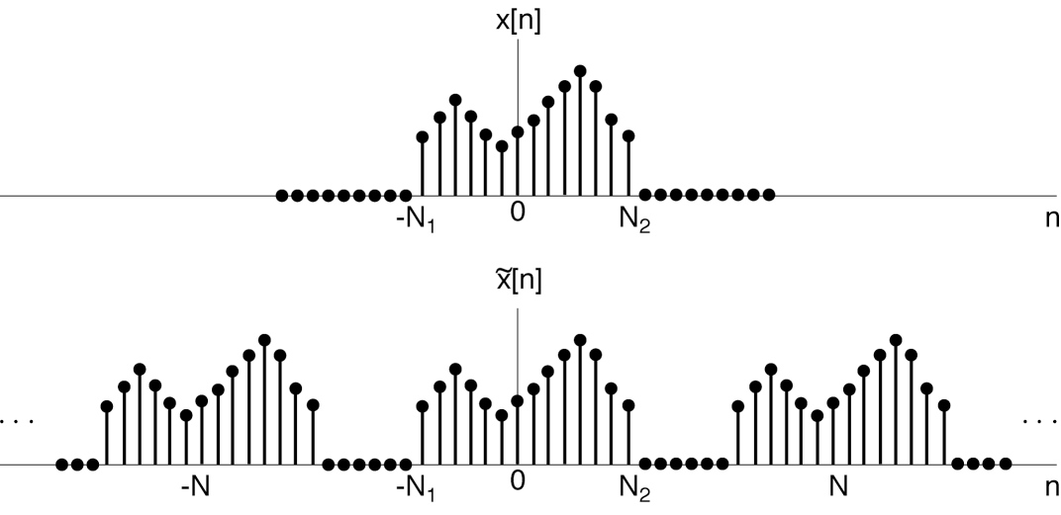
Periodic Extension
Assume x[n] is an aperiodic,
finite duration signal.
Define a periodic extension of x[n]:
Note that:
We can apply the complex Fourier series:
Define: . Note this is periodic in ω with period 2π.
This implies: . Note that these are evenly spaced samples of our definition for .
Notes:
]i=k,

Slide 5
The Discrete-Time Fourier Transform
Derive an inverse transform:
As
This results in our Discrete-Time Fourier Transform:
Notes:
The DTFT and inverse DTFT are not symmetric. One is integration over a finite interval (2π), and the other is summation over infinite terms.
The signal, x[n] is aperiodic, and hence, the transform is a continuous function of frequency. (Recall, periodic signals have a line spectrum.)
The DTFT is periodic with period 2π. Later we will exploit this property to develop a faster way to compute this transform.

Slide 6
Example: Unit Pulse and Unit Step
Unit Pulse:
The spectrum is a constant (and periodic over the range [-π,π].
Shifted Unit Pulse:
Time delay produces a phase shift linearly proportional to ω. Note that these functions are also periodic over the range [-π,π].
Unit Step:
Since this is not a time-limited function, it has
no DTFT in the ordinary sense. However, it can
be shown that the inverse of this function is
a unit step:

Slide 7
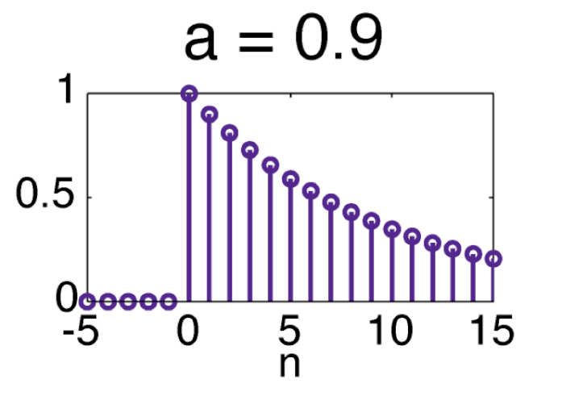
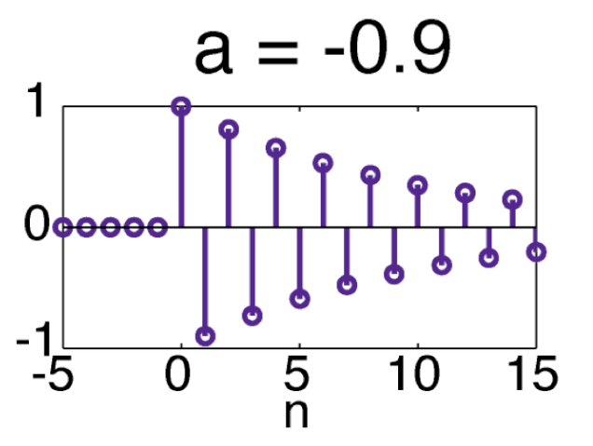
Example: Exponential Decay
Consider an exponentially decaying signal:

Slide 8
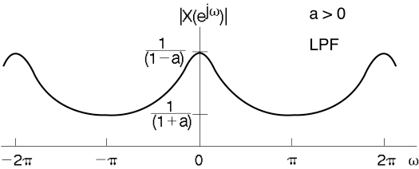
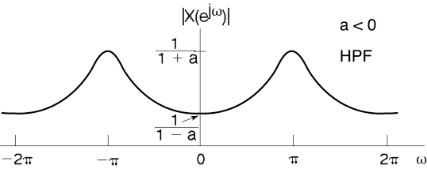
The Spectrum of an Exponentially Decaying Signal
Lowpass Filter:
Highpass Filter:

Slide 9
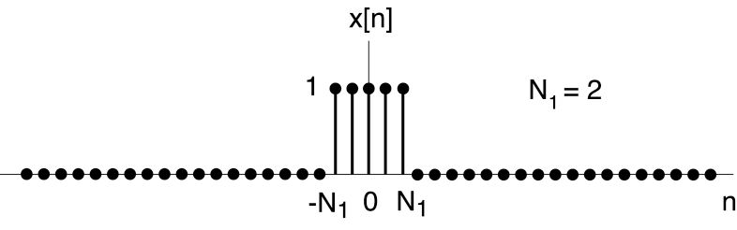
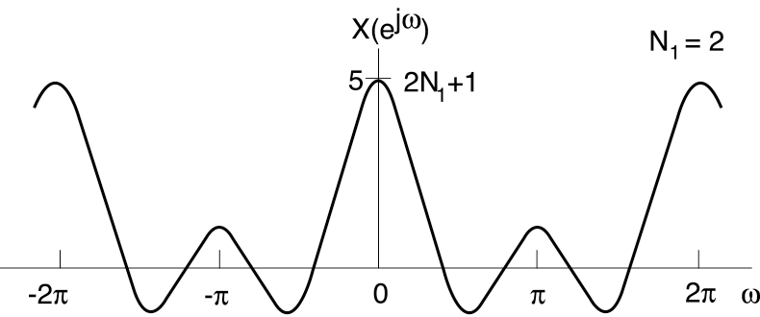
Finite Impulse Response Lowpass Filter
The frequency response of
a time-limited pulse is a
lowpass filter.
We refer to this type of
filter as a finite impulse
response (FIR) filter.
In the CT case, we obtained
a sinc function (sin(x)/x) for the frequency response. This is close to a sinc function, and is periodic with period 2π.

Slide 10
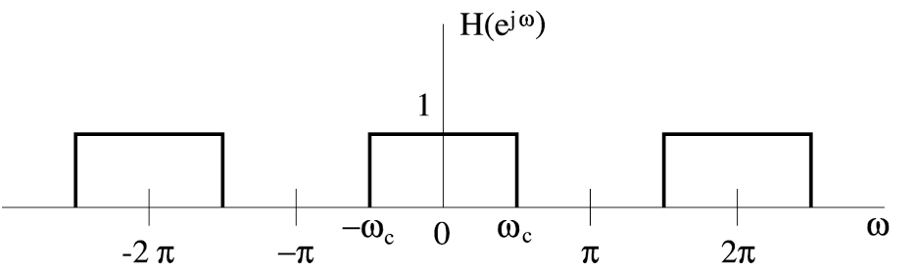
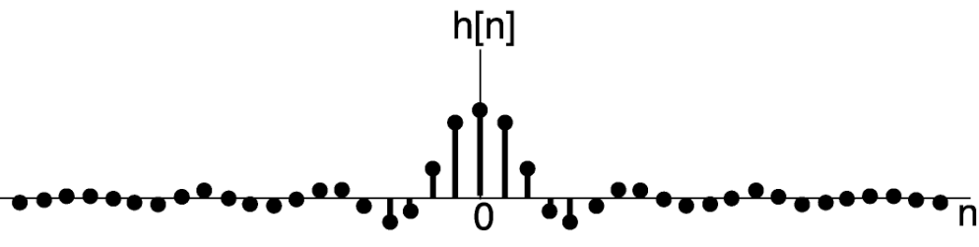
Example: Ideal Lowpass Filter (Inverse)
The Ideal Lowpass Filter Is Noncausal!

Slide 11
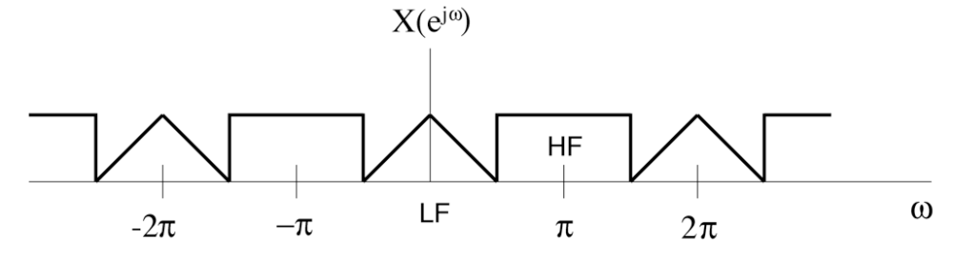
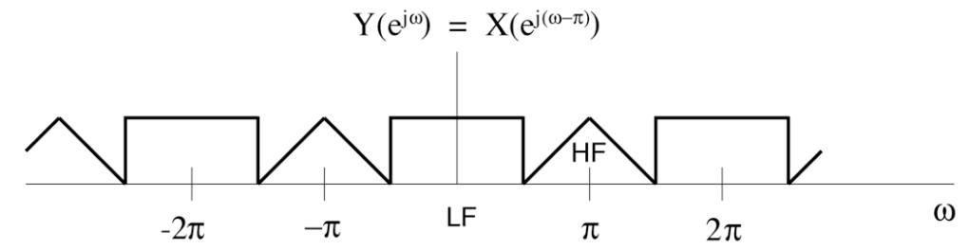
Properties of the DTFT
Periodicity:
Linearity:
Time Shifting:
Frequency Shifting:
Example:
Note the role
periodicity
plays in the
result.

Slide 12
Properties of the DTFT (Cont.)
Time Reversal:
Conjugate Symmetry:
Also:
Differentiation in
Frequency:
Parseval’s Relation:
Convolution:

Slide 13
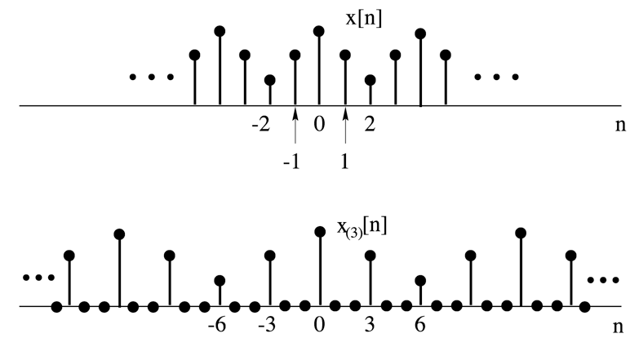
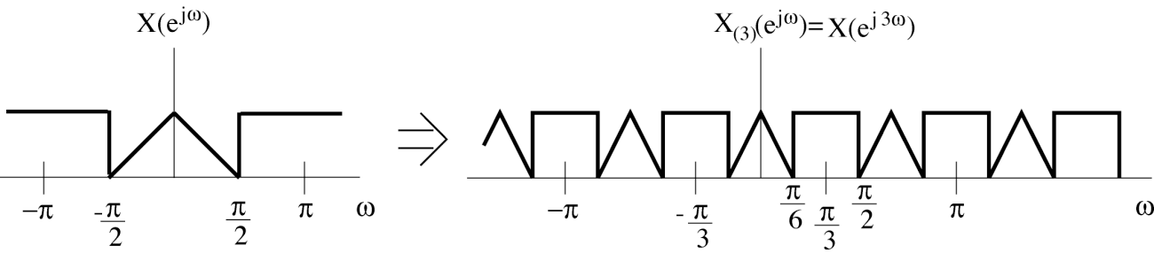
Properties of the DTFT (Cont.)
Time-Scaling:

Slide 14
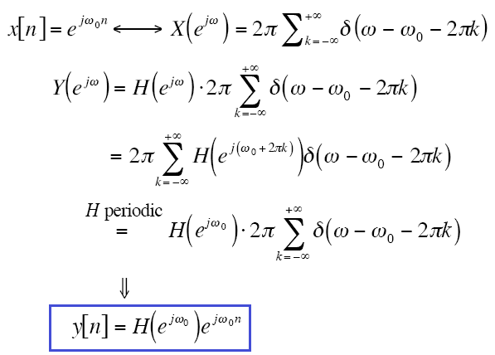
Example: Convolution For A Sinewave

Slide 15
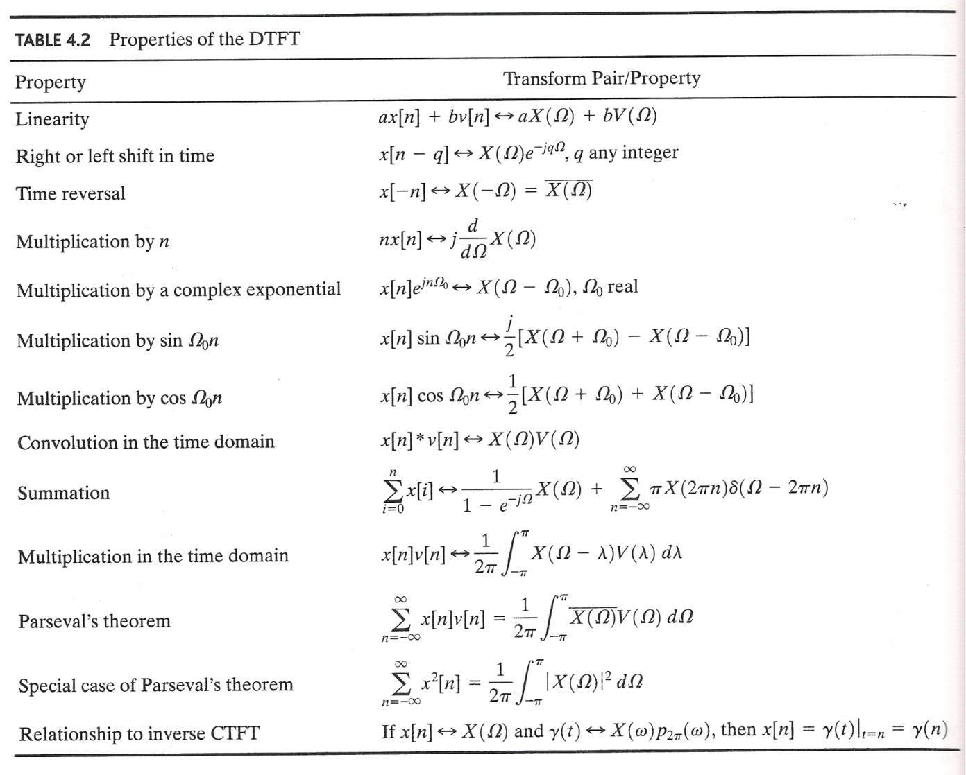
Summary
Introduced the Discrete-Time Fourier Transform (DTFT) that is the analog of the Continuous-Time Fourier Transform.
Worked several examples.
Discussed properties:

