Slide 1
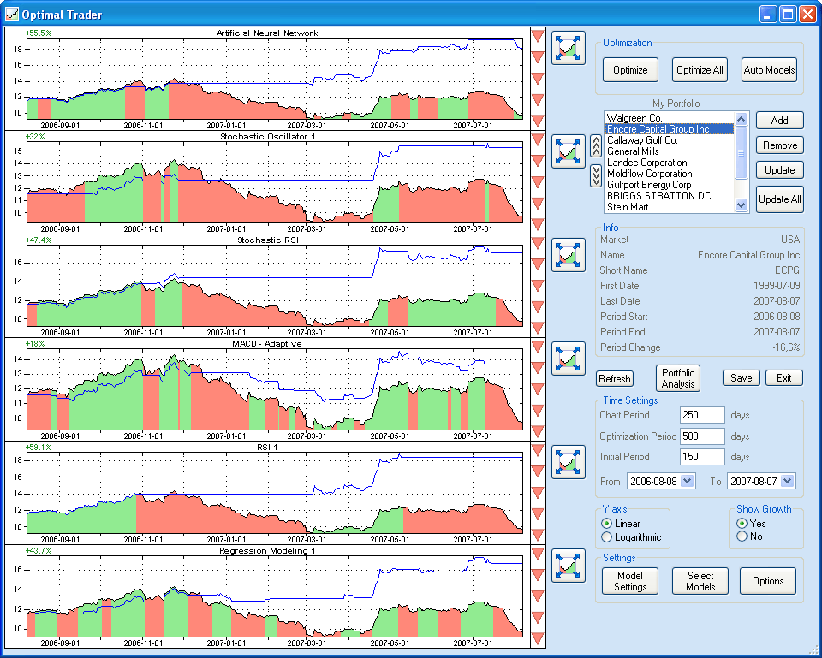
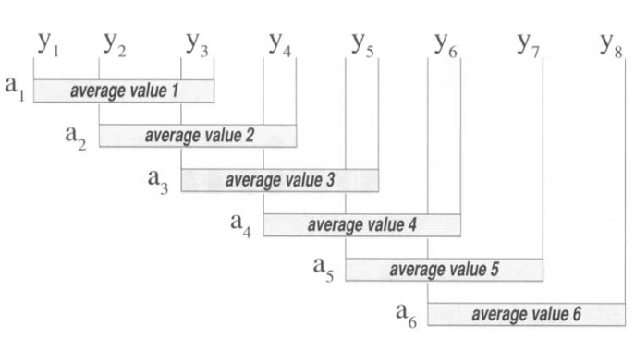
LECTURE 20: FOURIER ANALYSIS OF DT SYSTEMS
Objectives: Frequency Response Response of a Sinusoid DT MA Filter Filter Design DT WMA Filter
Resources: Wiki: Fourier Analysis Wiki: Moving Average USU: The Discrete-Time FT DSPGuide: Moving Average Filters Logix4u: MA Demo
URL:
Audio:
Notes:
MS Equation 3.0 was used with settings of: 18, 12, 8, 18, 12.

Slide 2
Fourier Analysis of Discrete-Time Systems
Recall our convolution sum for DT systems:
Assume the ordinary DTFT of h[n] exists (absolute summability):
The DTFT of h[n] is:
We can also write our input/output relations:
Note also (applying the time shift property):
DT LTI
Notes:
]i=k,

Slide 3
Response to a Sinusoid
Paralleling our derivation for CT systems:
Note that the H(e^{jω}) is periodic with period 2π. Also, since h[n] is real-valued, |H(ejj)| is an even function:
Taking the inverse DTFT:
As we saw with CT LTI systems, when the input is a sinusoid, the output is a sinusoid at the same frequency with a modified amplitude and phase.
If the system were nonlinear, what differences might we see in the output?

Slide 4
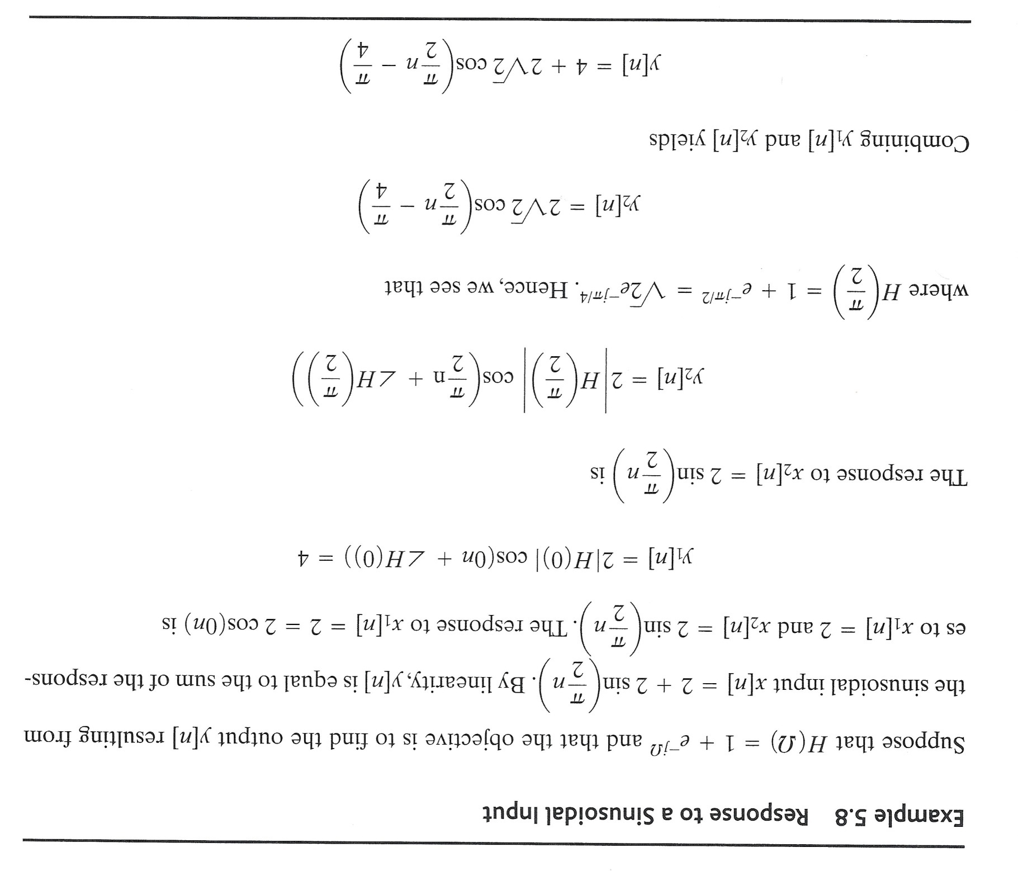
Example: Response to a Sinusoid

Slide 5
Example: Moving Average (MA) Filter
In this example, we will demonstrate that the process of averaging is essentially a lowpass filter. Therefore, many different types of filters, or difference equations, can be used to average. In this example, we analyze what is known as a “moving average” filter:
MATLAB CODE:
W=0:.01:1;
H=(1/2).*(1-exp(-j*2*pi*W))/.(1-exp(-j*pi*W));
magH=abs(H);
angH=180*angle(H)/pi;

Slide 6
Example: Filter Design
The magnitude of the frequency response of a 3rd-order MA filter:
is shown to the right. What is wrong?
Can we do better?
Optimization of the coefficients, c, d, and e, is a topic known as filter design.
We will use three constraints:
This generates three equations:

Slide 7
Example: Filter Design (Cont.)
Solution of these equations results in:
The magnitude response is shown to the right.
Suppose we cascade two of these filters. What is the impact?
Both of these filters can be shown to have linear phase responses. Both compute “weighted” averages. Which is better? Which is more costly? Can we do better?

Slide 8
Summary
Introduced the use of the DTFT to compute the output of a DT LTI system.
Demonstrated that the output of a DT LTI system to a sinusoidal input is also sinusoidal.
Introduced the concept of filter design and demonstrated the design of moving average filters.
Next: Laplace Transforms
What properties will hold for this transform?
Why do we need another transform? Where you have applied this?

