Slide 1
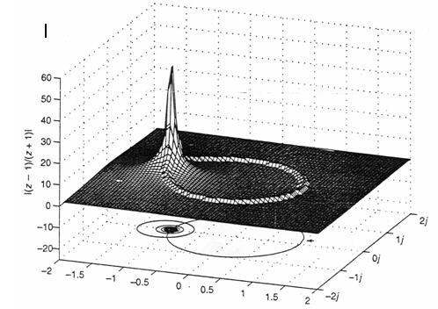
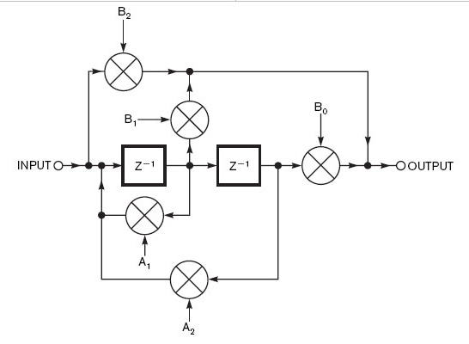
LECTURE 26: THE Z-TRANSFORM AND ITS ROC PROPERTIES
Objectives: Relationship to the Laplace Transform Relationship to the DTFT Stability and the ROC ROC Properties Transform Properties
Resources: MIT 6.003: Lecture 22 Wiki: Z-Transform CNX: Definition of the Z-Transform CNX: Properties RW: Properties MKim: Applications of the Z-Transform
URL:
Audio:
Notes:
MS Equation 3.0 was used with settings of: 18, 12, 8, 18, 12.

Slide 2
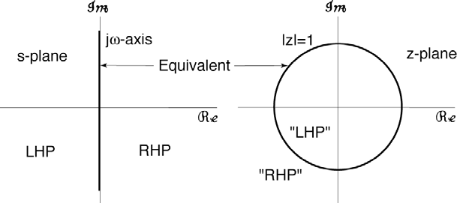
Definition Based on the Laplace Transform
The z-Transform is a special case of the Laplace transform and results from applying the Laplace transform to a discrete-time signal:
Let us consider how this transformation maps the s-plane into the z-plane:
s = jω:
s = σ + jω:
Recall, if a CT system is stable, its poles lie in the left-half plane.
Hence, a DT system is stable if its poles are inside the unit circle.
The z-Transform behaves much like the Laplace transform and can be applied to difference equations to produce frequency and time domain responses.
Notes:
]i=k,

Slide 3
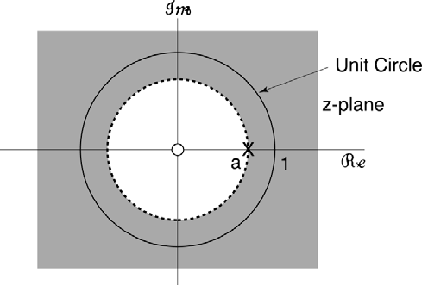
ROC and the Relationship to the DTFT
We can derive the DTFT by setting z = re^{jω}:
The ROC is the region for which:
Depends only on r = |z| just like the ROC in the s-plane for the Laplace transform depended only on Re{σ}.
If the unit circle is in the ROC, then the DTFT, X(e^{jω}), exists.
Example: (a right-sided signal)
If :
The ROC is outside a circle of radius a, and includes the unit circle, which means its DTFT exists. Note also there is a zero at z = 0.
Notes:
]i=k,

Slide 4
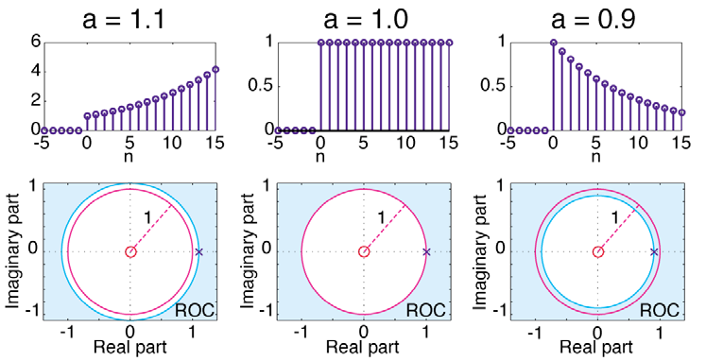
Stability and the ROC
For a > 0:
If the ROC is outside the unit circle, the signal is unstable.
If the ROC includes the unit circle, the signal is stable.
Notes:
]i=k,

Slide 5
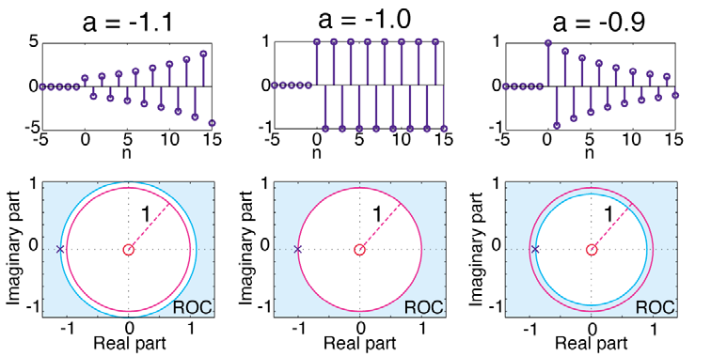
Stability and the ROC (Cont.)
For a < 0:
If the ROC is outside the unit circle, the signal is unstable.
If the ROC includes the unit circle, the signal is stable.
Notes:
]i=k,

Slide 6
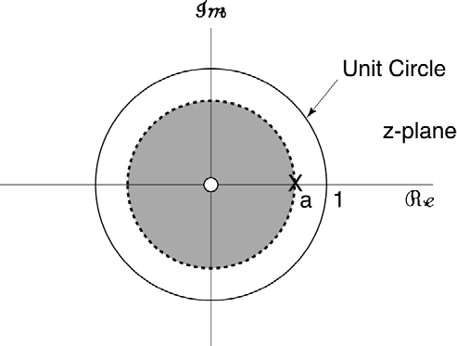
More on ROC
Example:
If:
The z-Transform is the same, but the region of convergence is different.
Notes:
]i=k,

Slide 7
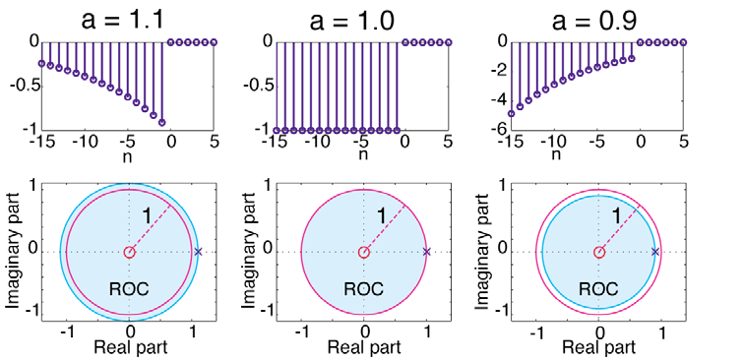
Stability and the ROC
For:
If the ROC includes the unit circle, the signal is stable.
If the ROC includes the unit circle, the signal is unstable.
Notes:
]i=k,

Slide 8
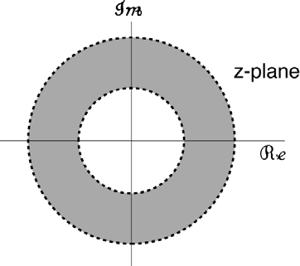
Properties of the ROC
The ROC is an annular ring in the z-plane centered about the origin (which is equivalent to a vertical strip in the s-plane).
The ROC does not contain any poles (similar to the Laplace transform).
If x[n] is of finite duration, then the ROC is the entire z-plane except possibly z = 0 and/or z = ∞:
If x[n] is a right-sided sequence, and if |z| = r₀ is in the ROC, then all finite values of z for which |z| > r₀ are also in the ROC.
If x[n] is a left-sided sequence, and if |z| = r₀ is in the ROC, then all finite values of z for which |z| < r₀ are also in the ROC.
Notes:
]i=k,

Slide 9
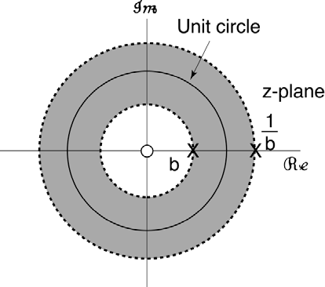
Properties of the ROC (Cont.)
If x[n] is a two-sided sequence, and if |z| = r₀ is in the ROC, then the ROC consists of a ring in the z-plane including |z| = r₀.
Example:
right-sided
left-sided
two-sided
Notes:
]i=k,

Slide 10
Properties of the Z-Transform
Linearity:
Proof:
Time-shift:
Proof:
What was the analog for CT signals and the Laplace transform?
Multiplication by n:
Proof:
Notes:
]i=k,

Slide 11
Summary
Definition of the z-Transform:
Explanation of the Region of Convergence and its relationship to the existence of the DTFT and stability.
Properties of the z-Transform:
Linearity:
Time-shift:
Multiplication by n:
Basic transforms (see Table 7.1) in the textbook.

