Slide 1
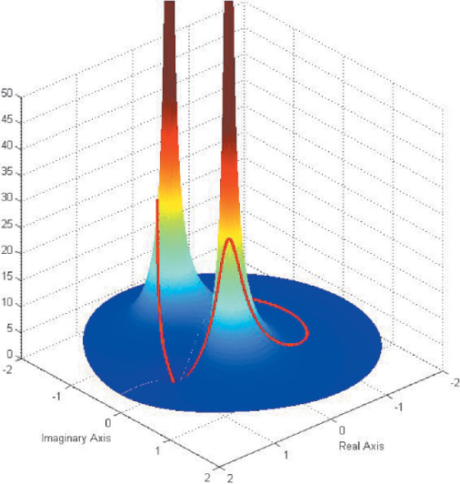
LECTURE 29: TRANSFER FUNCTION REPRESENTATION
Objectives: First-Order Difference Equations Second-Order Difference Equations N^{th}-Order Difference Equations Poles, Zeroes and Transfer Functions Signal Flow Graphs Basic Interconnections of Systems
Resources: JOS: Transfer Function Analysis CNX: z-Transform Transfer Function CNX: Difference Equation JWen: Difference Equation
URL:
Audio:
Notes:
MS Equation 3.0 was used with settings of: 18, 12, 8, 18, 12.

Slide 2
First-Order Difference Equations
Consider a first-order difference equation:
We can apply the time-shift property:
We can solve for Y(z):
The response is again a function of two things: the response due to the initial condition and the response due to the input.
If the initial condition is zero:
Applying the inverse z-Transform:
Is this system causal? Why?
Is this system stable? Why?
Suppose the input was a sinusoid. How would you compute the output?
Notes:
]i=k,

Slide 3
Example of a First-Order System
Consider the unit-step response of this system:
Use the (1/z) approach for the inverse transform:
The output consists of a DC term, an exponential term due to the I.C., and an exponential term due to the input. Under what conditions is the output stable?
Notes:
]i=k,

Slide 4
Second-Order Difference Equations
Consider a second-order difference equation:
We can apply the time-shift property:
Assume x[-1] = 0 and solve for Y(z):
Multiplying z²/z²:
Assuming the initial conditions are zero:
Note that the impulse response is of the form:
This can be visualized as a complex pole pair with a center frequency and bandwidth (see Java applet).
Notes:
]i=k,

Slide 5
Example of a Second-Order System
Consider the unit-step response of this system:
We can further simplify this:
The inverse z-transform gives:
MATLAB:
num = [1 -1 0];
den = [1 1.5 .5];
n = 0:20;
x = ones(1, length(n));
zi = [-1.5*2-0.5*1, -0.5*2];
y = filter(num, den, x, zi);
Notes:
]i=k,

Slide 6
Nth-Order Difference Equations
Consider a general difference equation:
We can apply the time-shift property once again:
We can again see the important of poles in the stability and overall frequency response of the system. (See Java applet).
Since the coefficients of the denominator are most often real, the transfer function can be factored into a product of complex conjugate poles, which in turn means the impulse response can be computed as the sum of damped sinusoids. Why?
The frequency response of the system can be found by setting z = e^{jω}.
Notes:
]i=k,

Slide 7
Transfer Functions
In addition to our normal transfer function components, such as summation and multiplication, we use one important additional component: delay.
This is often denoted by its z-transform equivalent.
We can illustrate this with an example (assume initial conditions are zero):
D
z⁻¹
Notes:
]i=k,

Slide 8
Transfer Function Example
Redraw using z-transform:
Write equations for the behavior at each of the summation nodes:
Three equations and three unknowns: solve the first for Q₁(z) and substitute into the other two equations.
Notes:
]i=k,

Slide 9
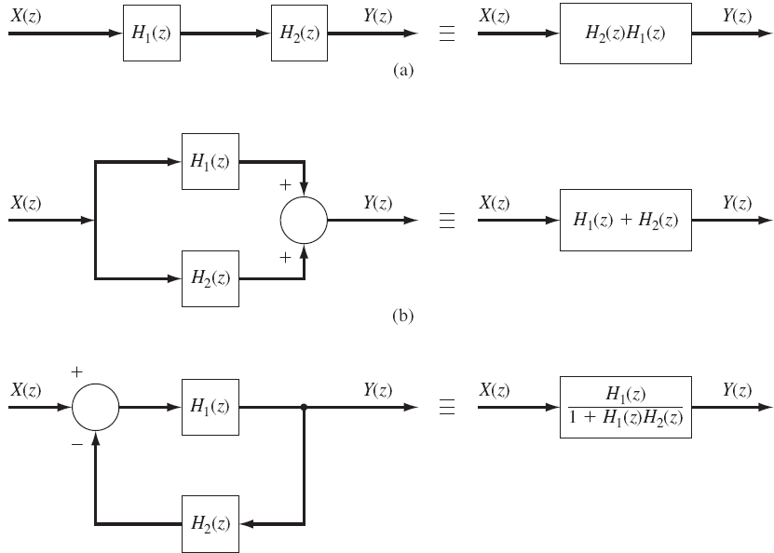
Basic Interconnections of Transfer Functions
Notes:
]i=k,

Slide 10
Summary
Demonstrated the solution of 1st-order difference equations using the z-transform: general response is an exponential.
Demonstrated the solution of 2nd-order difference equations using the z-transform: general response is a damped sinusoid (complex pole or two real poles).
Discussed the general solution to an N^{th}-order difference equation: transfer function is a ratio of two polynomials.
Demonstrated how to develop and decompose signal flow graphs using the z-transform: introduced a component, the delay, which is equivalent to differentiation in the s-plane.

