Slide 1
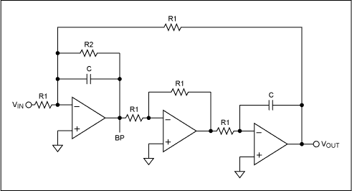
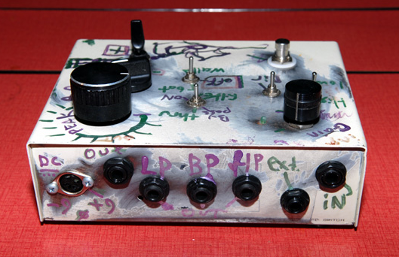

LECTURE 40: APPLICATIONS OF STATE VARIABLES
Objectives:
Review of State Equations
Example – Two-Car Motion
Time-Domain Response
Transfer Function
Course Evaluations
Resources:
WikiBooks: State Variables
WC: State Variables
URL:
Audio:
Notes:
MS Equation 3.0 was used with settings of: 18, 12, 8, 18, 12.

Slide 2
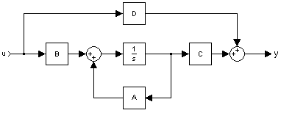
State Variable Equations and Solutions – CT Systems
Recall our state equations for CT systems:
the time-domain solutions:
and the frequency domain solutions:
An equivalent formulation
exists for discrete-time
(DT) systems.
Notes:
]i=k,

Slide 3
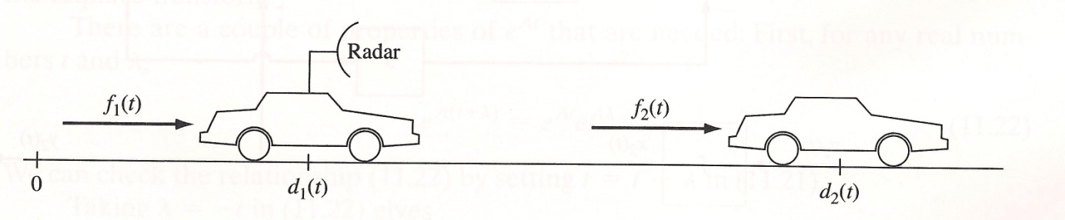
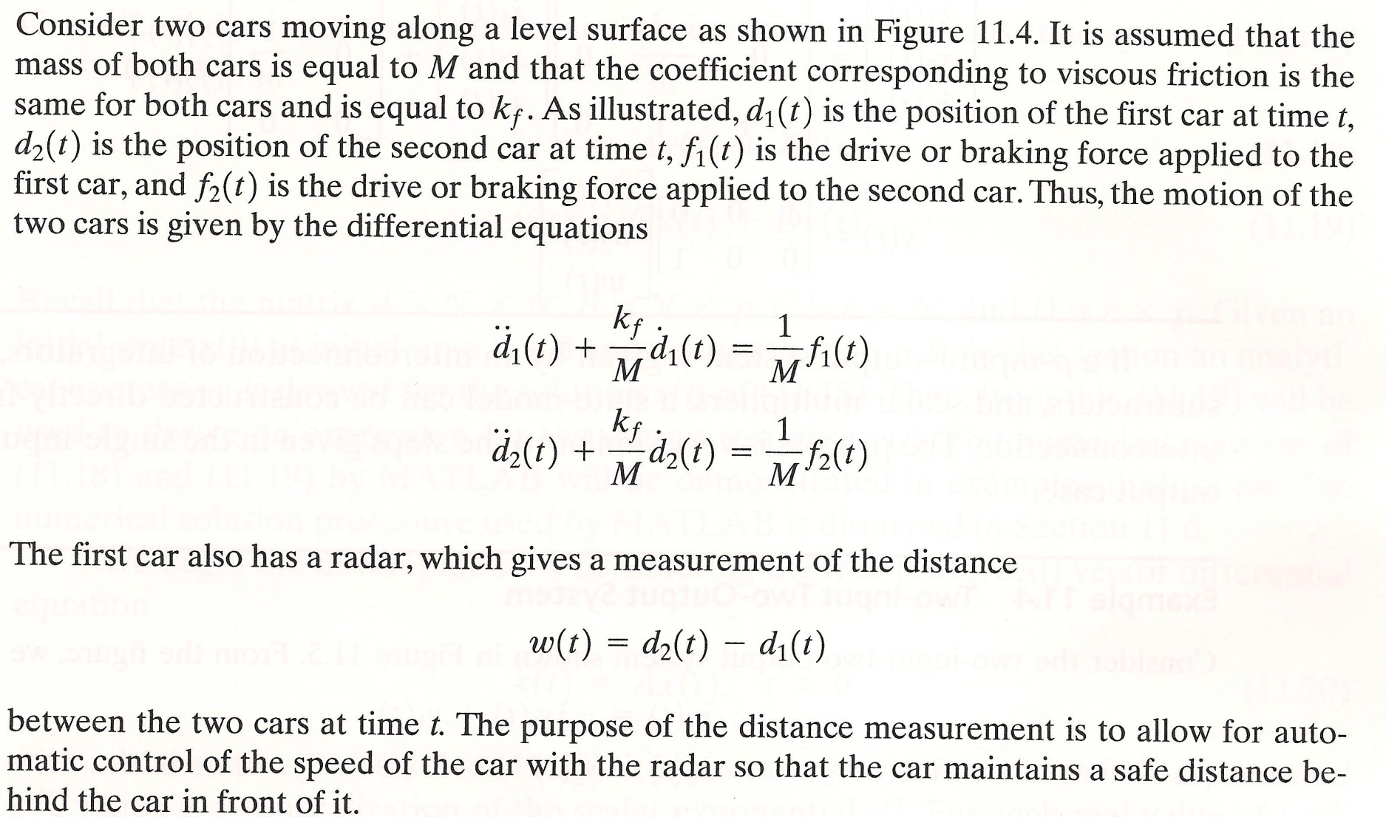
Example – Coupled Two-Car System

Slide 4
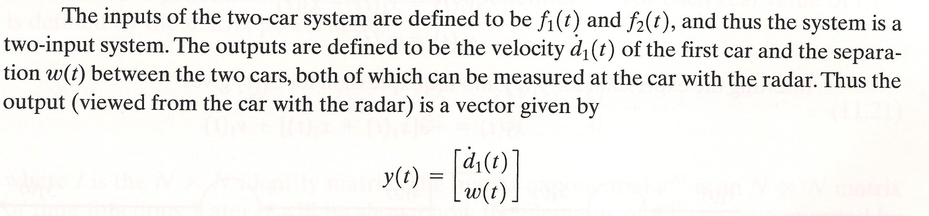
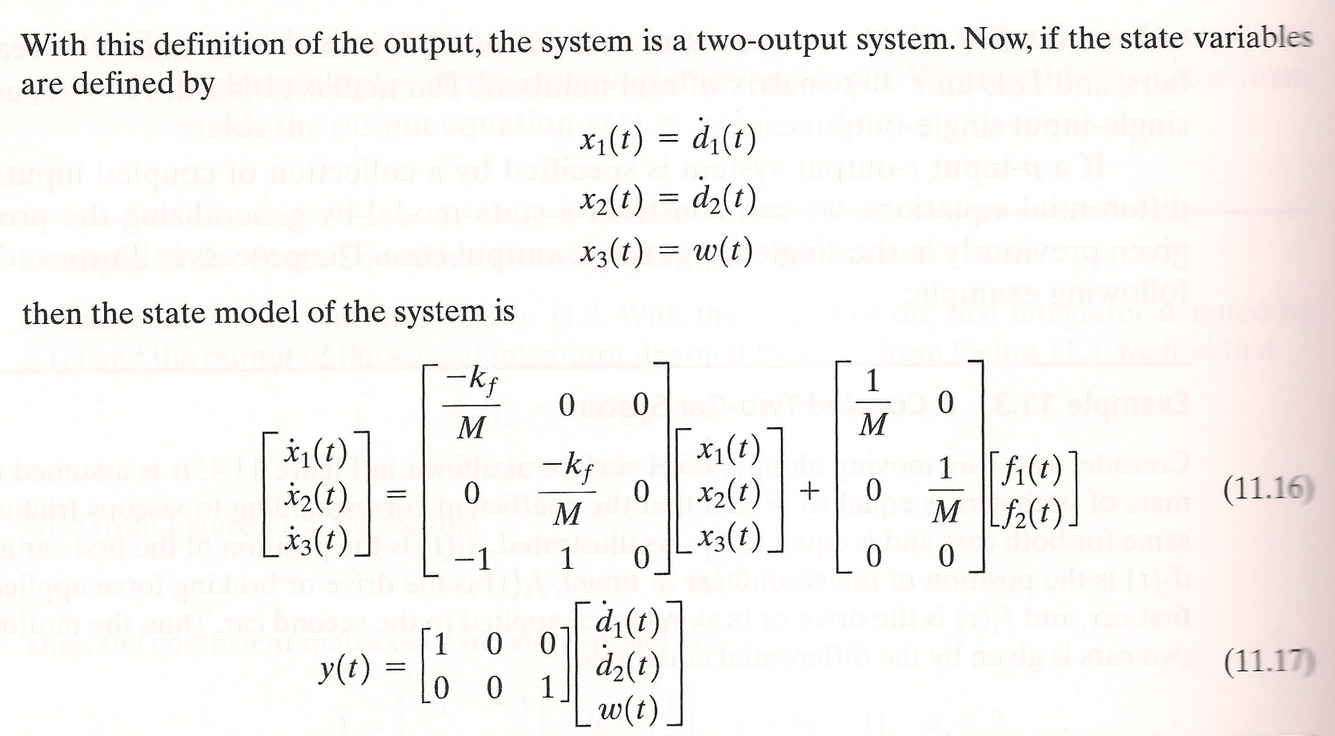
Example (Cont.)

Slide 5
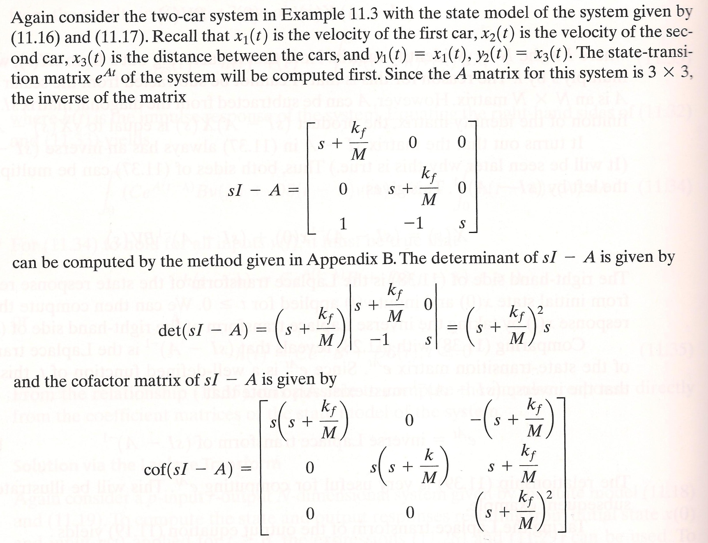
Example (Cont.)

Slide 6
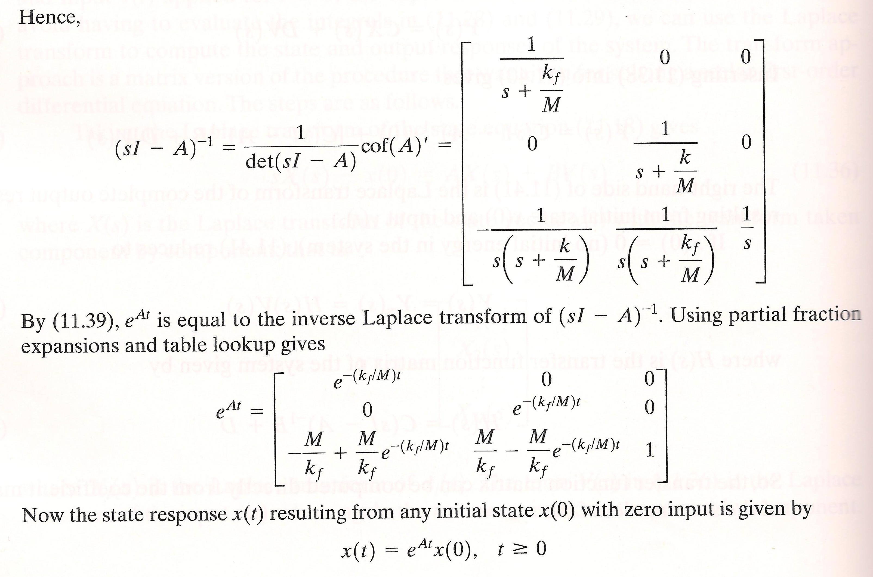
Example (Cont.)

Slide 7
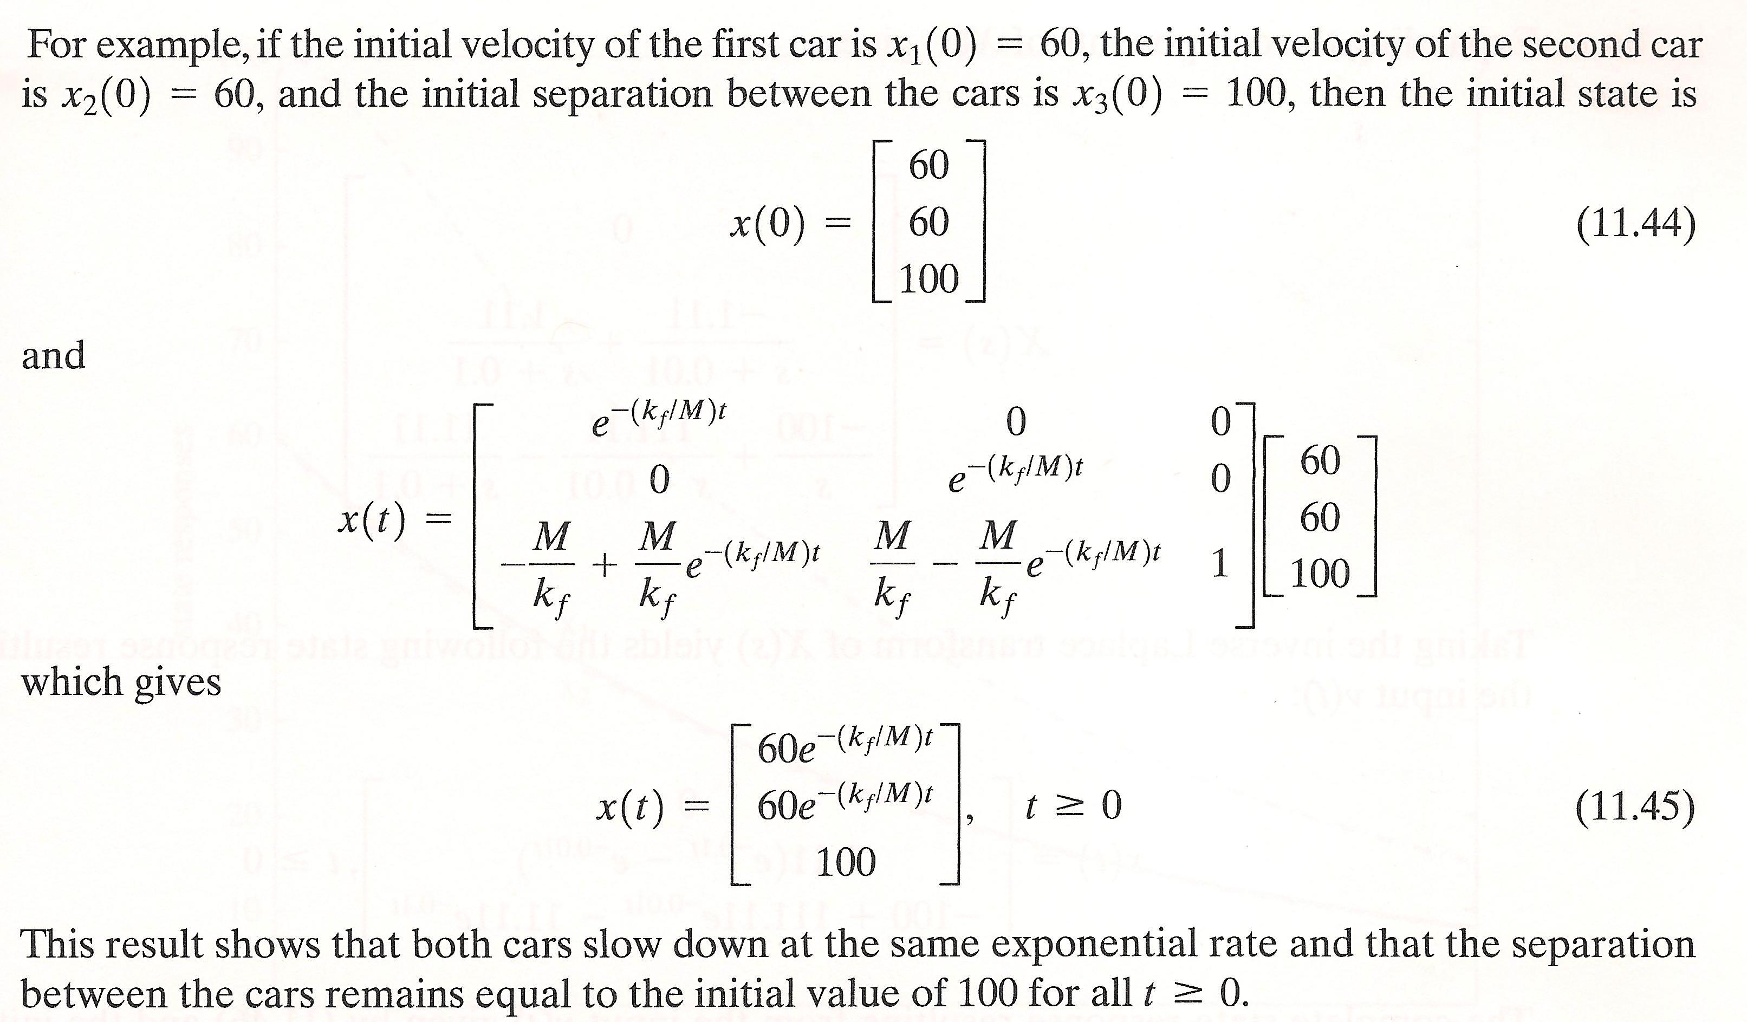
Example (Cont.)

Slide 8

Example (Cont.)

Slide 9
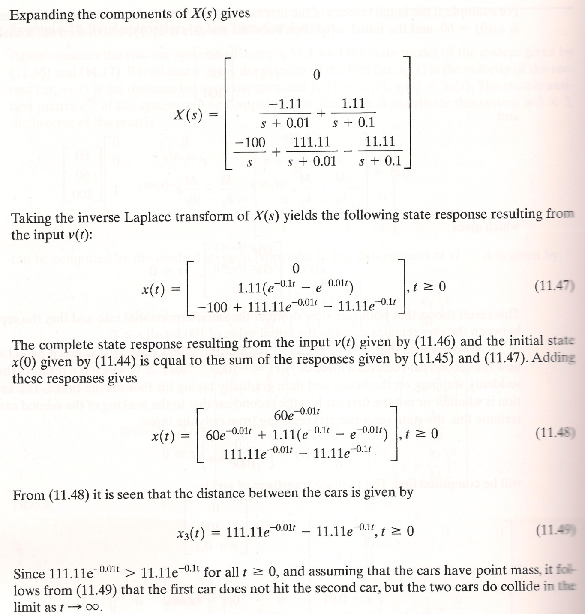
Example (Cont.)

Slide 10
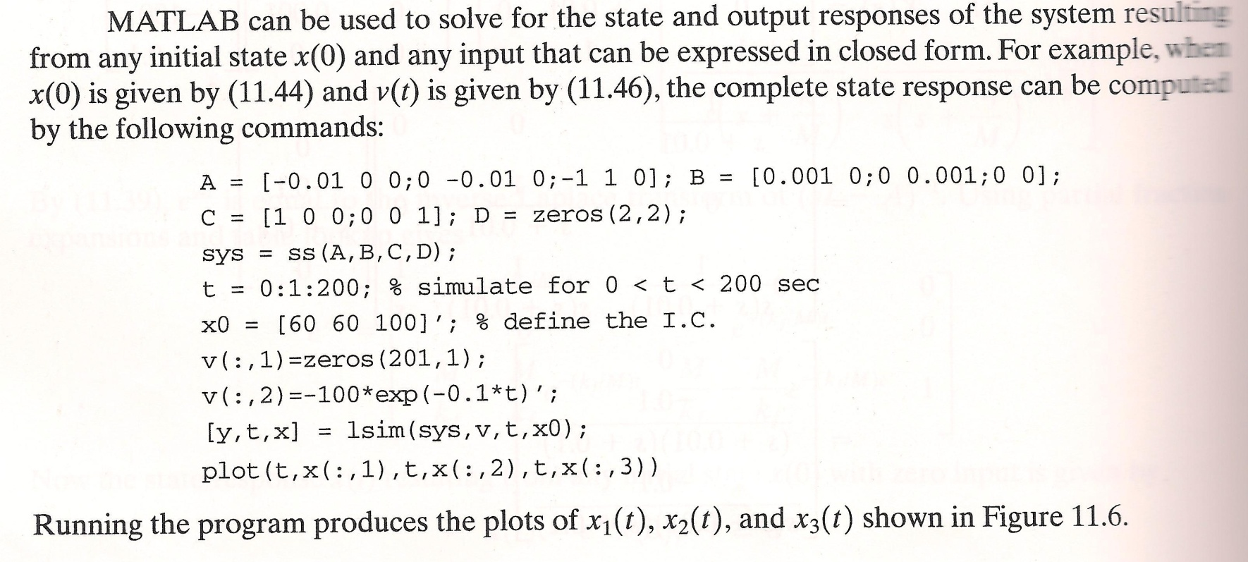
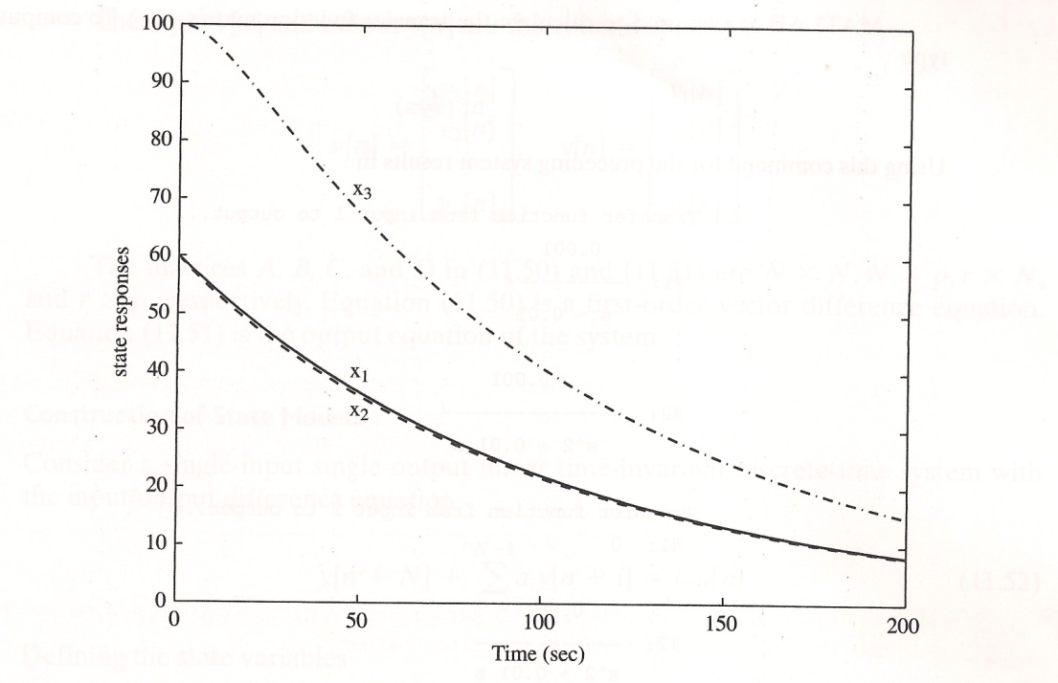
Example (Cont.)

Slide 11
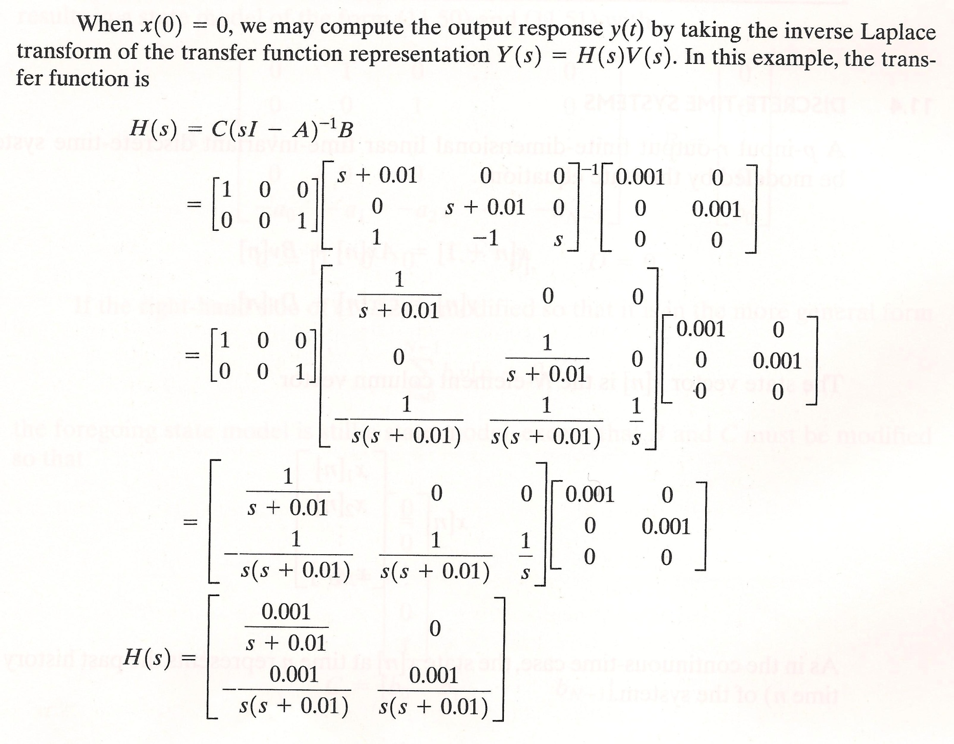
Example (Cont.)

Slide 12
Summary
Reviewed an example in the textbook demonstrating the use of state variables on a real application.
Derived the state equations, the time-domain form of the output, and the transfer function.
Demonstrated how to solve this system in MATLAB.
Course evaluations…

