Slide 1
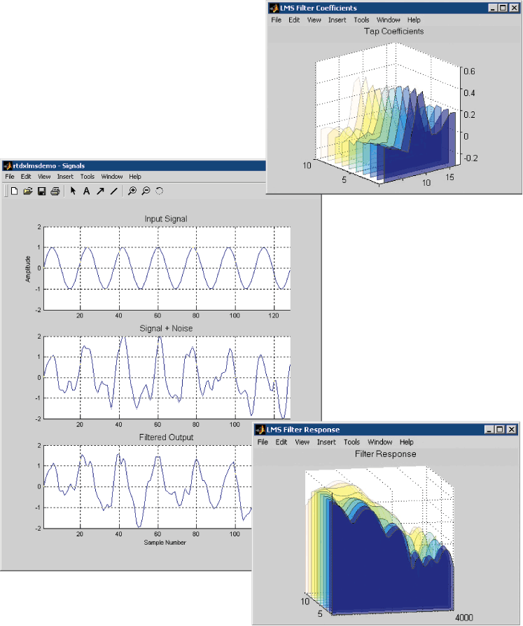
LECTURE 05: LMS ADAPTIVE FILTERS
Objectives: The FIR Adaptive Filter The LMS Adaptive Filter Stability and Convergence Covariance Matrix Diagonalization
Resources: PP: LMS Tutorial CNX: LMS Adaptive Filter DM: DSP Echo Cancellation WIKI: Echo Cancellation ISIP: Echo Cancellation
• URL: .../publications/courses/ece_8423/lectures/current/lecture_05.ppt
• MP3: .../publications/courses/ece_8423/lectures/current/lecture_05.mp3

Slide 2
The Basic Adaptive Filter
Apply our fixed, finite length LMS filter to the problem of a continuously adaptive filter that can track changes in a signal.
Specification of the filter involves three essential elements: the structure of the filter, the overall system configuration, and the performance criterion for adaptation.
+
–
Definitions: Data vector:
Filter coefficients:
Convolution:
Error Signal:
To optimize the filter coefficients sample by sample, we need an iterative solution to the normal equations.
Alternately, we could compute a batch solution for every new sample, but this wastes computational resources.

Slide 3
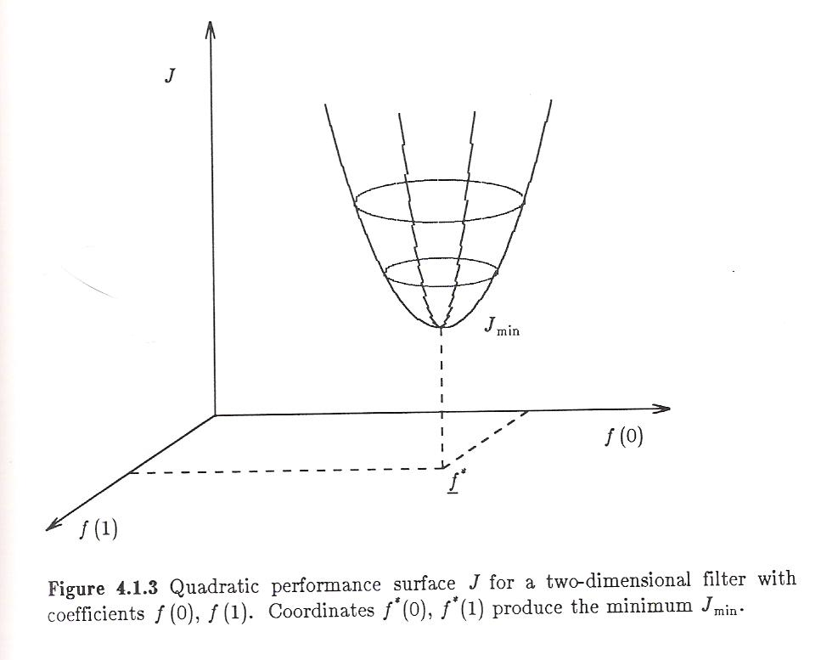
Iterative Solutions to the Normal Equations
Recall our objective function:
This is a quadratic performance surface for which a global minimum can be found using a gradient descent approach (following the derivative from an initial guess, f₀.
Recall our optimal solution was:
A general iterative solution is given by:
The constant, α_{n}, is a step-size parameter and p_{n} defines the search direction.
A general class of iterative algorithms are those which iterate based on the gradient of the mean-squared error:
and D_{n} is an (LxL) weighting matrix. A large number of possible algorithms exist based on the selection of D_{n} and α_{n} .

Slide 4
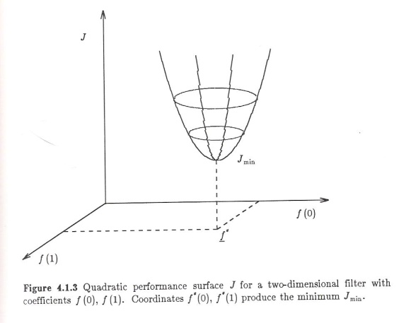
The Method of Steepest Descent
Principle: move in a direction opposite to the gradient of the performance index, J, and by a distance proportional to the magnitude of that gradient:
If we differentiate J with respect to f:
Combining expressions, we can write our update equation:
The term steepest descent arises from the fact that the gradient is normal to lines of equal cost. For a parabolic surface, this is the direction of steepest descent.
The following property can be proven:
where λ_{max} is the largest eigenvalue of the autocorrelation matrix.

Slide 5
The LMS Adaptive Filter
To design a filter which is responsive to changes in the signal, we need an iterative structure that is dependent on the (local properties) of the signal.
We could use:
where the autocorrelation and cross-correlations are computed with respect to the nth sample. But this is not computationally efficient.
Instead, we can estimate the gradient from the instantaneous error:
We can write this in terms of the error signal and the input signal:

Slide 6
Observations
This is known as the LMS adaptive filter update. The filter impulse response at each sample is equal to its previous value plus a term proportional to the dot product of the error and the signal (recall the orthogonality principle).
This approach is widely used (e.g., modems, acoustic echo cancellers).
A group delay can be applied to the filter for applications where there is a known fixed delay.
It is a computationally simple update: approx. L multiplications and additions per step. This is significant since the filter sometimes has to be long (e.g., echo cancellation applications).
The filter tracks instantaneous variations in the signal, which can be good (channel switching) and bad (nonstationary noise). Hence, control of the adaptation speed becomes critical.
The filter is often initialized to a value of zero, which is safe (why?).
For an excellent treatment on an echo cancellation application, including discussion of many important DSP issues, see DM: DSP Echo Cancellation.

Slide 7
Performance Considerations
Two major concerns about the performance of filter: (1) stability and convergence; (2) the mean-squared error.
One approach to analyzing the performance of filter is to compare its performance on a stationary signal.
Recall we can analyze the long-term solution of the normal equations in terms of the Fourier transform:
Convergence of the filter can be obtained by applying the so-called independence assumption:
This condition is stronger than requiring the input to be white noise.
We begin with our expression for the filter coefficients:
We can take the expectation:

Slide 8
Convergence of the Mean
We can define an error vector:
Subtracting f* from both sides of our update equation:
We can prove convergence in the mean if we can prove that:
We can decouple the update equation using eigenvalue analysis:
We can define a rotated error vector:
Multiple both sides by Q^{t} and note Q^{t}Q=I:
Since Λ is diagonal:

Slide 9
Convergence of the Mean (Cont.)
This equation:
is a first-order difference equation, whose solution in terms of is:
Consequently:
The eigenvalues of R are all real and positive since R is symmetric. Therefore:
This must be satisfied for all j and all eigenvalues λ_{j}:
In practice, this bound is too high and too difficult to estimate online. A stronger condition can be derived:
But: so:
This is a very important result because it tells us how to set the adaptation speed in terms of something we can measure.

Slide 10
Diagonalization of a Correlation Matrix
Consider a correlation matrix, R, with eigenvalues .
Define a matrix where q_{i} form a set of real eiqenvectors satisfying or .
Define a spectral matrix, Λ:
We can write the following relations:
The first two equations follow from the definition of an eigenvalue.
The third equation summarizes the second equation in matrix form.
The last equation follows by postmultiplying by Q^{t} and noting that Q Q^{t} = I.

Slide 11
Summary
We introduced the FIR adaptive filter and the LMS adaptive filter.
We derived its update equations.
We also derived its stability and convergence properties for stationary signals, which led to a simple method for setting the adaptation speed in terms of a quantity we can easily measure.
Things we did not discuss but are treated extensively in the textbook:
The eigenvalue disparity problem: convergence is not uniform and depends on the spread of the eigenvalues of the autocorrelation matrix.
Time-constants for convergence: the speed of convergence creates an overshoot/undershoot type problem.
Estimation of time-delay or group-delay of the filter: often set a priori in practice based on application knowledge or constraints.
Steady-state mean squared error value of the error: related to the power of the input signal and the adaptation speed.
Transfer function analysis for deterministic signals: of historical significance but not of great practical value since we are most concerned about stochastic signals.

Slide 12
Echo Cancellation for Analog Telephony

