Slide 1
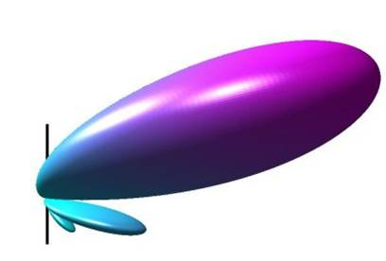
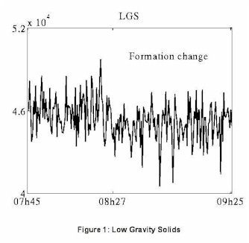
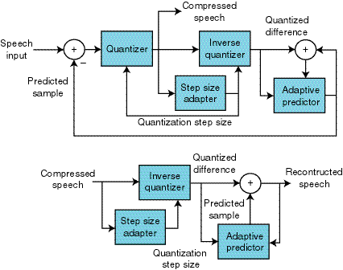
LECTURE 07: TIME-DELAY ESTIMATION AND ADPCM
Objectives: Time-Delay Estimation The LMS Time-Delay Estimator Adaptive Differential PCM
Resources: CNX: Time-Delay Estimation CNX: Beamforming Wiki: Pulse Code Modulation Kurssit: Differential Coding of Images
• URL: .../publications/courses/ece_8423/lectures/current/lecture_07.ppt
• MP3: .../publications/courses/ece_8423/lectures/current/lecture_07.mp3

Slide 2
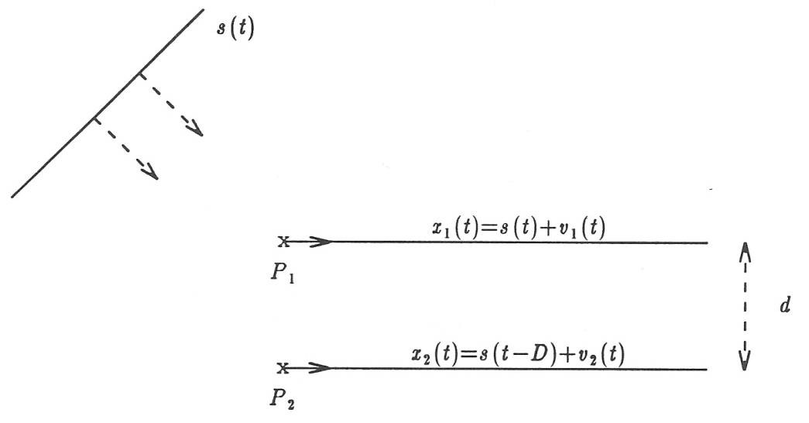
Time-Delay Estimation
Our challenge is to estimate the time-delay between two signals.
Applications include radar, sonar, geophysics, biomedical, and audio.
Two measurements are made at sensors P₁ and P₂ separated by a distance d.
A simple model for the received signals is:
s(t) is the signal which is derived from some distant source, and modeled as traveling at a constant speed.
v₁(t) and v₂(t) are additive noise terms measured at the receiver and D is the delay. v₁(t) and v₂(t) are assumed to be zero-mean, stationary, mutually uncorrelated.
We also assume that these measurement noises are uncorrelated with the signal, s(t). (We will relax these assumptions later.)

Slide 3
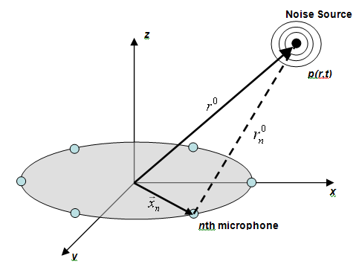
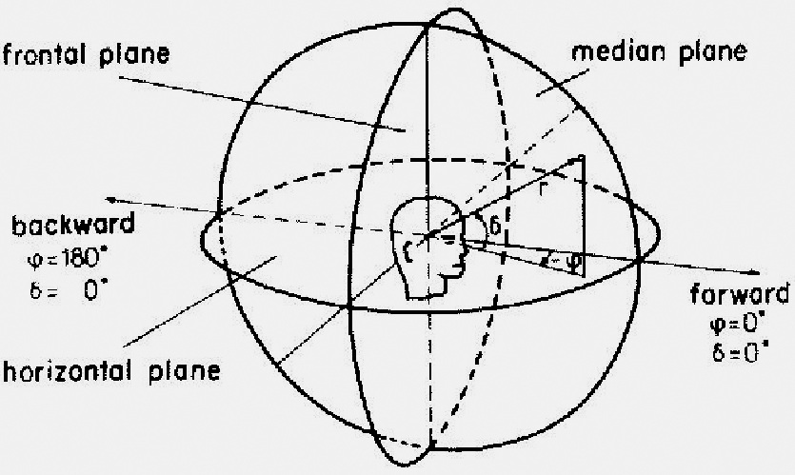
Angle of Arrival
The delay, D, can be related to the angle of arrival of the signal:
where θ is the arrival of bearing angle to the source, and c is the propagation velocity of the signal through the medium.
The estimation of the bearing angle is reduced to the estimation of the delay, D, given the noisy measurements x₁(t) and x₂(t).
Note that this approach can be extended to multiple dimensions using multiple sensors.

Slide 4
Correlation-Based Estimation
The time-delay can be estimated using correlation techniques:
We can set the time-delay as the peak in the correlation function.
A more rigorous approach is known as the Knapp and Carter generalized correlation method:
A maximum likelihood estimate can be derived that achieves the Cramer-Rao lower bound as the estimation time increases.
The ML weighting function can be expressed in terms of the magnitude-squared coherence function (in the frequency domain):
The ML weighting function can be shown to have the form:
assuming that the noises at each sensor have the same spectra, R_{vv}(ω).

Slide 5
The LMS Time-Delay Estimator
We can formulate this using our standard LMS approach:
The delay is taken as the maximum value of the filter’s impulse response.
However, sometimes this peak does not occur exactly at a sample instant, and a more refined estimate of the delay requires interpolation.
However, for simplicity, let’s assume D=kT (integer multiple of samples).
We can write an expression for the error:
Given that v₁(n) and v₂(n) are mutually uncorrelated, a good solution might be:
which produces:
But there are drawbacks to this approach. Why?
+
–

Slide 6
Two-Sided Wiener Filter
Recall our two-sided Wiener solution for the LMS filter:
In the noise-free case ( ):
A more general solution for non-zero noise and is:
To illustrate this process, consider four examples (f_{s} = 1000 Hz, D = 10 samp.):

Slide 7
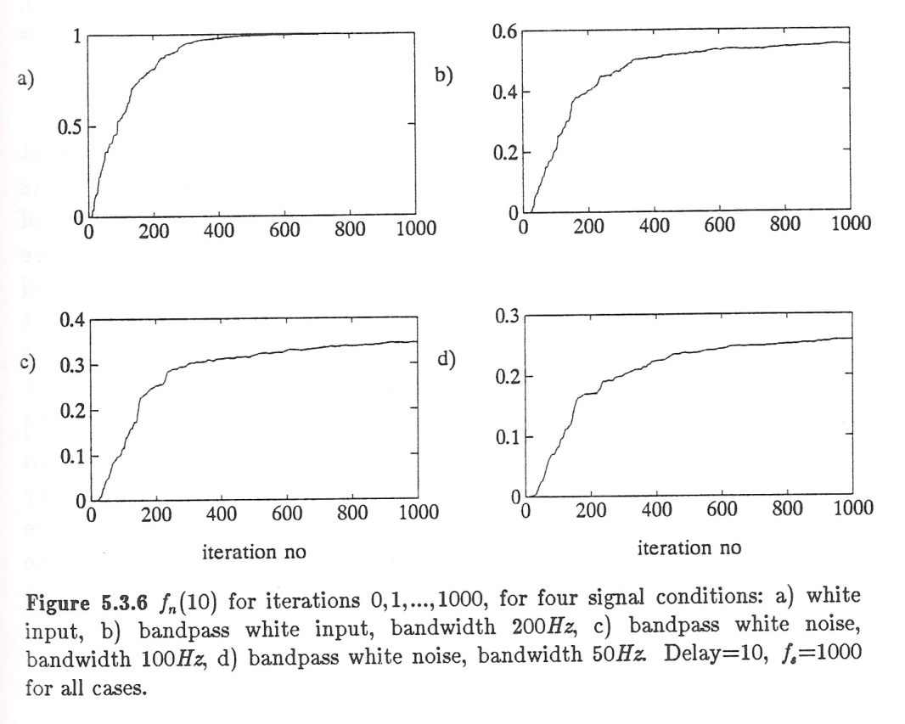
Examples

Slide 8
Adaptive Differential Pulse Code Modulation
We can use our LMS filter as a linear predictor to reduce the dynamic range of and compress an audio signal.
The error signal can be written as:
+
to receiver
–
The error signal is applied to a quantizer:
The prediction filter has the form:
At the receiver:
The filter coefficients are updated using:
The challenge in such systems is to allow the filters at the transmitter and receiver to stay in sync without transmitting side information about the filter.
+
from transmitter
+

Slide 9
Echo Cancellation

Slide 10
Summary
We demonstrated how to use an LMS filter to estimate the time delay (and source location) of a signal.
We discussed correlation and LMS approaches to this problem.
introduced adaptive differential pulse code modulation as an application of LMS filtering.
Briefly discussed an echo cancellation application.
Next: we will investigate new computational forms of the LMS filter (e.g., leaky gradient descent and lattice filters).

