Slide 1
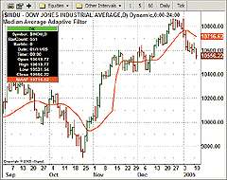
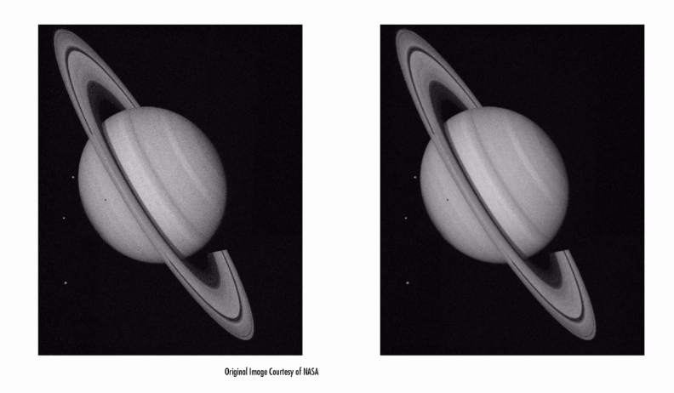
LECTURE 10: IIR AND LATTICE ADAPTIVE FILTERS
Objectives: Derivation Computational Simplifications Stability Lattice Structures Properties The Gradient Adaptive Lattice Joint Process Estimator
Resources: CNX: IIR Adaptive Filters KP: Bibliography MH: Adaptive Filter Applet
• URL: .../publications/courses/ece_8423/lectures/current/lecture_10.ppt
• MP3: .../publications/courses/ece_8423/lectures/current/lecture_10.mp3

Slide 2
Motivation
Thus far we have concentrated on FIR filters and transversal implementations (e.g., direct form or tapped delay lines).
An FIR filter may need many taps to model a smooth frequency response that can be described by an all-pole filter (e.g., voice or music). This leads to a very high computational cost.
A recursive structure can achieve the same performance at a significantly reduced computational cost. But, we must worry about stability (e.g., poles outside the unit circle).
The performance surface associated with an IIR adaptive filter is not guaranteed to be unimodal, leading to convergence to local minima in MSE.
The basic form of a recursive filter is:
We can define an extended coefficient vector:
and an extended data vector:
+
–

Slide 3
Minimization of the Error
As usual, we can set up a minimization of the mean-squared error:
and differentiate the error with respect to the filter coefficients:
Since e(n) is only dependent on θ through y(n):
This minimization is more complex because y(n-j) are also dependent on θ(i), so we need to separate things dependent on h() and f():

Slide 4
Minimization of the Error (Cont.)
Note that this follows because h() and f() are independent. Continuing for f():
Combining these two equations:
which is a recursive update for the gradient. Substituting into :
which are recursive forms of the normal equations. Direct solution of these equations produces a nonlinear set of equations because of the recursive nature of the derivatives. An alternate approach is to try an iterative solution.

Slide 5
Iterative Solution Using Steepest Descent
We seek an update of the form:
We replace by the instantaneous version:
We can summarize the Recursive LMS Algorithm (IIRLMS):
Note that in addition to the approximation for the error, we have an approximation for the derivative that is a function of time.

Slide 6
Computational Simplification
The update for the derivative of y(n) requires N+L N^{th} order recursions. If we assume the coefficients are slowly-varying, we can further reduce computations. Separating components once again for f() and h():
Approximating these derivatives using γ₁(n) and γ₂(n):
We reduce N+L recursions to just 2 recursions to compute the derivatives.
Simpler approximations exist where the gradient is simply approximated by the instantaneous error:

Slide 7
Stability Considerations
To determine the stability of the filter, we can use our Levinson-Durbin recursion discussed previously. If the adaptation step-size is small, we need not perform this check every sample to reduce its computational burden.
Alternately, we introduce a scale factor to push the poles away from the unit circle and closer to the origin:
This factor broadens the bandwidth of the poles. Of course, such heuristics introduce bias and slow convergence.

Slide 8
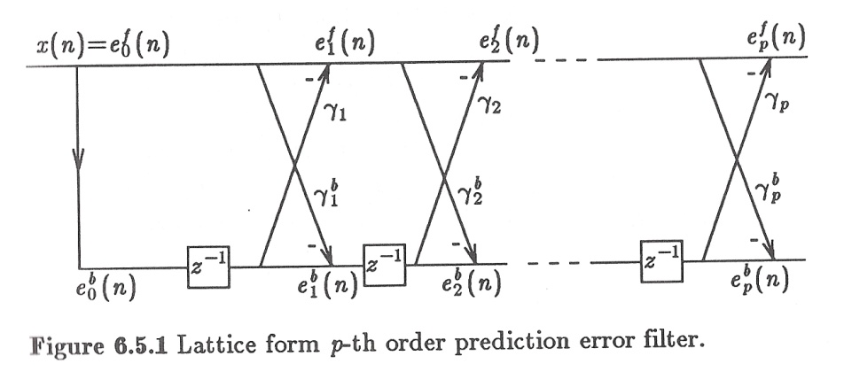
Lattice Structure Adaptive Filters
We can implement the IIR filter using a lattice filter structure. This has some interesting benefits, including a way to directly estimate the filter coefficients.
We can form a prediction of x(n):
The prediction error is defined as:
It is also possible to define a “backwards predictor”:
We can show that minimization of the forward and backward errors produce identical results:
The errors can be computed in an iterative fashion:

Slide 9
Lattice Structure Adaptive Filters (Cont.)
Updates for the filter coefficients can be derived using the orthogonality principle:
The iterative procedure can be summarized as:
For stationary inputs: and . These are the reflection coefficients we previously discussed.
We also previously discussed ways to convert between reflection and prediction coefficients.

Slide 10
The Gradient Adaptive Lattice (GAL) Filter
We can derive an adaptive algorithm for estimating the reflection coefficients by considering the following minimization:
We can invoke a steepest descent update:
We can compute the gradient of the instantaneous error:
We can invoke our update equations for the error terms:
and derive expressions for the derivatives:

Slide 11
The Gradient Adaptive Lattice (GAL) Filter (Cont.)
We can substitute these into our expression for the gradient:
Combining results:
Notes:
We initially set the reflection coefficients to zero, which means:
We can use a time-varying adaptation constant:
GAL generally converges faster than LMS at a rate which is independent of the eigenvalue spread of the input, but has slightly higher bias.
There are several other popular approaches for updating the coefficients based on second derivatives.

Slide 12
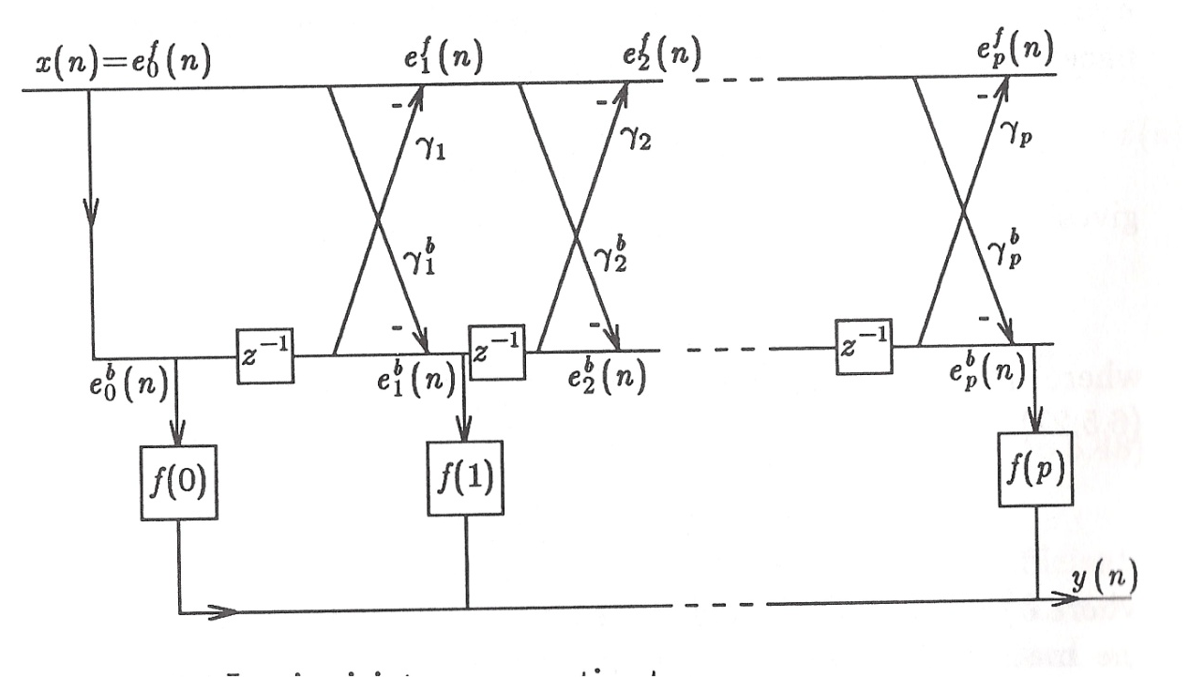
Joint Process Estimator
The lattice structure we described was equivalent to an all-pole, or AR, filter.
We can combine the FIR and all-pole structures to produce an ARMA filter.
We can think about the estimation process as a two-step process.
The coefficients of the lattice structure are adapted as previously described.
The coefficients for the forward structure are also adapted as before:
These types of filters have been successfully applied to a variety of channel equalization problems, such as high-speed modems.

Slide 13
Summary
Introduced an IIR adaptive filter (IIRLMS).
Derived update equations for the case of an all-pole filter.
Discussed a simplified version of this filter for stationary inputs (a linear prediction-based lattice filter).
Generalized this to a joint process estimator, or ladder filter, that is capable of learning a filter with poles and zeroes.

