Slide 1
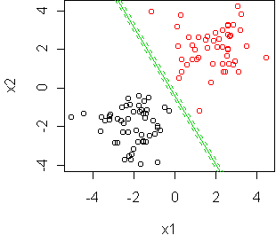
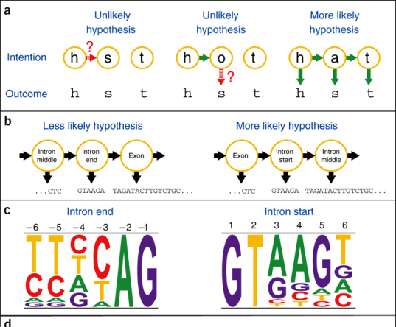
LECTURE 17: BIAS AND VARIANCE OF THE ML REGRESSION ESTIMATE
Objectives: ML and Simple Regression Bias of the ML Estimate Variance of the ML Estimate Overview of HMMs
Resources: MIT: Linear Regression ECE 8443: Hidden Markov Models ECE 8443: Continuous Distributions
• URL: .../publications/courses/ece_8423/lectures/current/lecture_17.ppt
• MP3: .../publications/courses/ece_8423/lectures/current/lecture_17.mp3

Slide 2
Simple Linear Regression
Recall our simple linear regression model:
Let us now revisit this approach using a probabilistic model in which the response variable, Y, is a function of a random variable, X, and some measurement noise:
The noise, ε, is assumed to be independent of X and zero mean.
The average value of Y for a fixed value of X is given by:
We refer to f(x) as the regression function:
Consider a simple linear regression model:
Let’s assume the noise, ε, has a normal, or Gaussian, distribution N(0,σ²).
Suppose we are given a sequence (X₁,Y₁), (X₂,Y₂), …, (X_{n},Y_{n}) generated from:
Y
x
x
x
x
x
x
X

Slide 3
Simple Linear Regression (Cont.)
where ε₁, ε₂, …, ε_{n} are I.I.D. drawn from a Gaussian distribution N(0,σ²).
There are three unknown parameters: β₀, β₁, and σ. For a fixed X_{i}, the distribution of Y_{i} is given by a Gaussian distribution N(f(X_{i}),σ²):
The joint likelihood function of the sequence Y₁,…,Y_{n} is:
The maximum likelihood approach attempts to find the values of β₀, β₁, and σ that maximize this likelihood function.
One obvious way to maximize this function is to minimize:
The solution to this problem is the same as our previous MSE solution:
The MLE estimate of σ is found by minimizing the likelihood over σ, which is achieved using the MLE estimates of β₀ and β₁:

Slide 4
Bias of the ML Estimate
We would like to explore the bias and variance of this estimate. To do so we need to know something about the means, variances and covariance.
Since the X_{i} s are fixed, and are linear combinations of the Y_{i} s, we can note that since the Y_{i} s have a normal distribution, then the ML estimates of β₀ and β₁ also have normal distributions. Therefore:
Therefore, the ML estimate of β₁ is unbiased.

Slide 5
Variance of the ML Estimate
The variance of the ML estimate of β₁ can be computed as:
Why is this significant?
In a similar manner, we can show:
Hence, the LMS estimate and the ML estimate of the regression function are identical, unbiased and consistent.

Slide 6
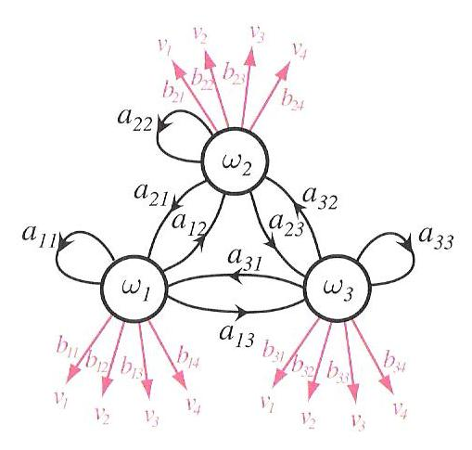
Discrete Hidden Markov Models
Elements of the model:
c states:
M output symbols:
c x c transition probabilities:
Note that the transition probabilities only depend on the previous state and the current state (hence , this is a first-order Markov process).
T x M output probabilities:
Initial state distribution:

Slide 7
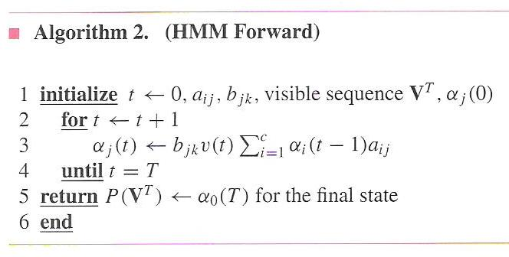
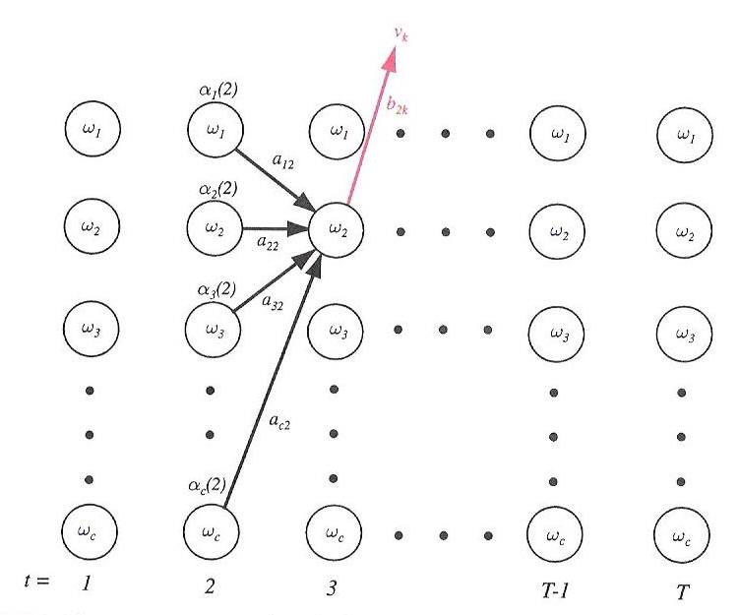
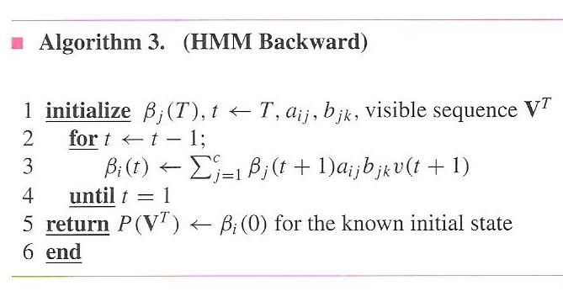
Evaluation and Decoding (Review)

Slide 8
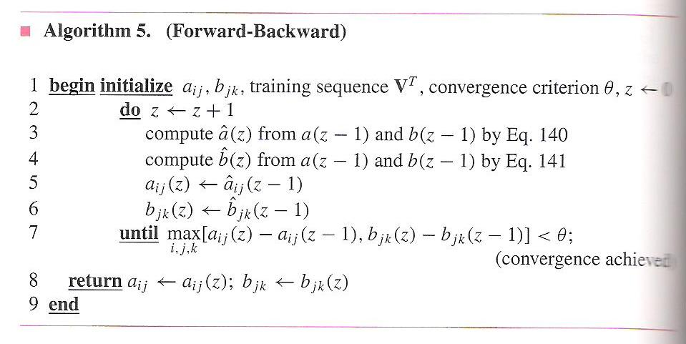
Problem No. 3: Learning (Cont.)
The expected number of any transition from ω_{i}(t) is:
Therefore, a new estimate for the transition probability is:
We can similarly estimate the output probability density function:
The resulting reestimation algorithm is known as the Baum-Welch, or Forward Backward algorithm:
Convergence is very quick, typically within three iterations for complex systems.
Seeding the parameters with good initial guesses is very important.
The forward backward principle is used in many algorithms.

Slide 9
Continuous Probability Density Functions
The discrete HMM incorporates a discrete probability density function, captured in the matrix B, to describe the probability of outputting a symbol.
Signal measurements, or feature vectors, are continuous-valued N-dimensional vectors.
In order to use our discrete HMM technology, we must vector quantize (VQ) this data – reduce the continuous-valued vectors to discrete values chosen from a set of M codebook vectors.
Initially most HMMs were based on VQ front-ends. However, for the past 20 years, the continuous density model has become widely accepted.
We can use a Gaussian mixture model to represent arbitrary distributions:
Note that this amounts to assigning a mean and covariance matrix for each mixture component. If we use a 39-dimensional feature vector, and 128 mixtures components per state, and thousands of states, we will experience a significant increase in complexity ☺
0
1
2
3
4
5
6
…

Slide 10
Continuous Probability Density Functions (Cont.)
It is common to assume that the features are decorrelated and that the covariance matrix can be approximated as a diagonal matrix to reduce complexity. We refer to this as variance-weighting.
Also, note that for a single mixture, the log of the output probability at each state becomes a Mahalanobis distance, which creates a nice connection between HMMs and PCA. In fact, HMMs can be viewed in some ways as a generalization of PCA.
Write the joint probability of the data and the states given the model as:
This can be considered the sum of the product of all densities with all possible state sequences, Ω, and all possible mixture components, K:
and

Slide 11
Application of EM
We can write the auxiliary function, Q, as:
The log term has the expected decomposition:
The auxiliary function has three components:
The first term resembles the term we had for discrete distributions. The remaining two terms are new:

Slide 12
Reestimation Equations
Maximization of requires differentiation with respect to the parameters of the Gaussian: . This results in the following:
where the intermediate variable, , is computed as:
The mixture coefficients can be reestimated using a similar equation:

Slide 13
Summary
Developed a maximum likelihood method for estimating the parameters of a regression function.
Demonstrated that these estimates are the same as the LMS estimate and are unbiased.
Introduced the basics of a hidden Markov model.

