Slide 1
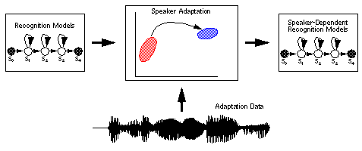
LECTURE 18: MLLR FOR HMMS
Objectives: Definitions Derivation of Mean Adaptation Covariance Adaptation Example
Resources: MG: Mean and Variance MG: Variance OS: MLLR For HMM Recognition HLT: Spoken Language Processing ECE 8463: Adaptation ECE 7000: MLLR
• URL: .../publications/courses/ece_8423/lectures/current/lecture_18.ppt
• MP3: .../publications/courses/ece_8423/lectures/current/lecture_18.mp3

Slide 2
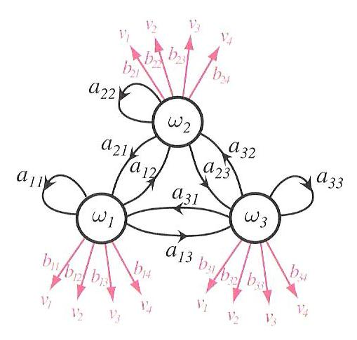
Definitions
Relevant elements of a continuous distribution hidden Markov model (HMM):
b_{s}(o) represents the state output probability (scalar) for a specific state, s; it is modeled by a multivariate Gaussian distribution.
o represents the incoming data, which are referred to as observations; these are typically feature vectors of dimension n.
μ represents the current mean vector, estimated from the training data (it has the same dimension as a feature vector).
Σ_{s} represents the current estimate of the covariance of the observation data.
In this lecture, we are going to focus on adaptation of the mean and covariance matrix of this output distribution.
The HMM also uses transition probabilities to model temporal dynamics of the signal, but we will ignore these.
The HMM also uses Gaussian mixture distributions at each state (a weighted sum of Gaussians) and state-tying to reduce parameter counts.

Slide 3
Definitions (Cont.)
In the hidden Markov model framework, these parameters are estimated from the training data using the EM theorem and the Baum-Welch algorithm (essentially producing estimates that maximize the likelihood of the training data given the Gaussian model).
The reestimation equations can be derived from the EM theorem through maximization of the auxiliary function:
λ is the current model, represents the new (reestimated or adapted) model, O represents a sequence of observation vectors, θ represents the aggregated model parameters (transitions, observations, initial probabilities).
An HMM has one additional complication: many state sequences can result in a given set of observations. Therefore, we must sum over all possible paths that could have produced the data. Θ represents the set of these paths.
Maximization of Q results in iterative algorithms to reestimate these parameters, known as the Baum-Welch algorithm, and guarantees that the new model will be more likely than the old model.
But it does not guarantee a minimization of the error rate in a pattern recognition problem. Hence, later, we will examine discriminative approaches to estimation of these parameters.

Slide 4
Adaptation Framework
Let us consider the problem of adaptation of the mean vector, μ, using a regression transformation:
where W_{s} is an n x (n+1) transformation matrix, and:
is an extended mean vector with an offset of w.
Using this transformed or adapted mean, we can write an expression for the new output probability density function:
Note that technically we should adapt the covariance as well. We will deal with this in a two-step process: adapt the mean and then adapt the covariance. Mean-only adaptation is much more common than adaptation of both the mean and covariance. Why?
The MLLR approach to adaptation involves using a maximum likelihood estimate of the parameters of W_{s}. Because of the complexity of the HMM, this is not as straightforward as the simple linear regression model we explored in the previous lecture.

Slide 5
Mean Adaptation
Assume a series of T observations:
In maximizing our auxiliary function, we can ignore the transition probabilities since the overall probability is the product of transition probabilities and output probabilities, and the log of a product is the sum of the logs. Hence, we can and focus only on the contributions from the observations:
We can define a posterior probability of occupying state s at time t, given that the observation sequence, O, was generated, as:
We can sum this probability across all states, S, in the system:
We can now differentiate this with respect to W_{s}:

Slide 6
Basic MLLR Equations
Substitute in our expression for as a Gaussian:
We can simplify by applying the derivative to the sum:
Equating to zero and collecting terms associated with :
A closed-form solution for this equation does not exist for the general case. However, if we make assumptions about the adaptation matrix and the covariance structure of the data (e.g., diagonal covariance), we can derive some computationally efficient adaptation equations.

Slide 7
Towards a Closed Form Solution
If our transformation is shared by R states, {s₁, s₂, …, s_{r}}:
We can decompose the right-hand side:
Let the right-hand side be an n x (n+1) matrix, Y, with elements y_{ij}:
Since D^{(r)} is symmetric, and if all the covariances are diagonal, then:
The state distribution inverse covariance matrix scaled by the state occupation probability.
The outer product of the extended mean vector.

Slide 8
Towards a Closed Form Solution (Cont.)
We can simplify y_{ij}:
Define an intermediate variable:
Rewrite y_{ij} :
where are the elements of an (n+1) x (n+1) matrix, G^{(i)}.
Let’s also define the left-hand side of
The key observation here is that the z_{ij} and can be computed from the observation vectors and the model parameters, and solving for w_{iq}:

Slide 9
Further Simplifications
We often assume that the transformation matrix is also diagonal:
This reduces the transformation of each mean to a shift and scaling:
Another popular constrained approach applicable to feature vectors that are a concatenation of different features is a block diagonal structure:
For example, this approach has been applied to speech recognition where our feature vector is the concatenation of absolute features and first and second derivatives.
The best structure for the transformation matrix depends on the amount of adaptation data and the complexity of the feature vector.

Slide 10
Variance Adaptation
We can define the adapted variance as:
The same auxiliary function is used:
We can expand our expression for the Gaussian output probability:
We can differentiate with respect to :

Slide 11
Variance Adaptation (Cont.)
Rearranging terms:
For shared states:
Thus, a full covariance matrix can be estimated. However, we typically zero the off-diagonal terms (why?) and still achieve an increase in likelihood.

Slide 12
Summary
Developed the maximum likelihood linear regression adaptation method in the context of a hidden Markov model.
Derived expressions for mean and covariance reestimation assuming diagonal covariance.
Next: We will work an example and discuss some practical issues.

