Slide 1
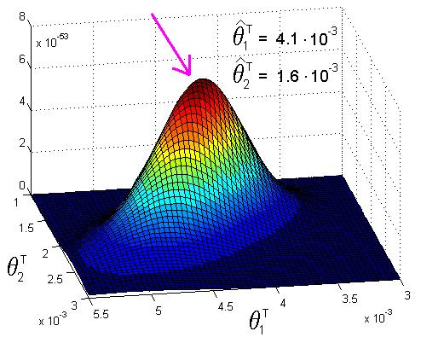
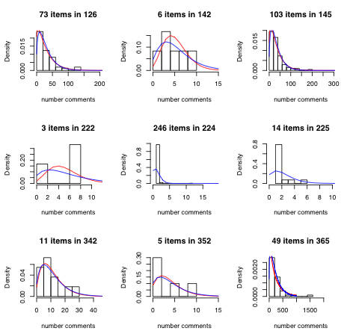
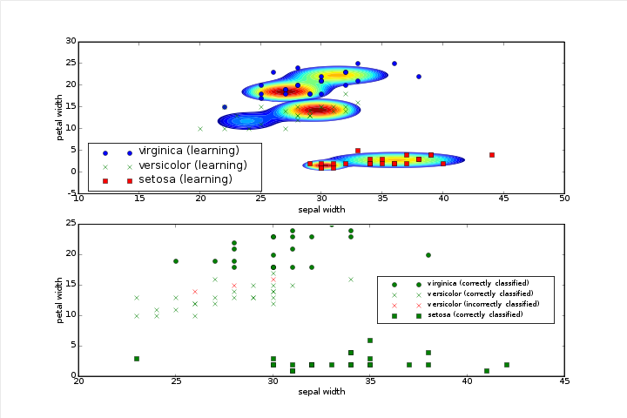
LECTURE 21: MAXIMUM A POSTERIORI ADAPTATION
Objectives: Review of MAP Estimation The EM Framework Mean Adaptation Experimental Results
Resources: Wiki: MAP Estimation CC: MAP Summary JLG: MAP For Markov Chains
• URL: .../publications/courses/ece_8423/lectures/current/lecture_21.ppt
• MP3: .../publications/courses/ece_8423/lectures/current/lecture_21.mp3

Slide 2
A Statistical Approach to Parameter Estimation (Review)
Consider a probabilistic model for generating a set of observations. The model parameters will be denoted by a vector θ. The probability of a feature vector, or observation, given θ, is known as the sampling distribution: .
The maximum likelihood (ML) estimate of θ is given by:
One possible solution would be to assume all possible values of θ are equally likely or equally possible. This is the maximum likelihood solution.
In real applications, we know not all value of a parameter vector are possible or equally probable. Given a set of data, we would like to leverage this prior knowledge to better estimate the best value of the parameters. Maximum a posteriori and Bayesian methods fall into this category of approaches.
Unfortunately, there is a catch. We must somehow parameterize this prior knowledge of the parameter values. We will use a probability distribution, .
The posterior probability of a particular value of is given by:
This is a direct consequence of Bayes’ Rule:

Slide 3
Maximum A Posteriori (MAP) Estimation (Review)
The MAP method estimates θ to maximize the posterior:
However, we observe that the denominator term, which is often called the evidence, is fixed with respect to this maximization. Therefore:
Unfortunately, we still need a model for . When in doubt, assume a multivariate Gaussian distribution. Why?
where D is the dimension of the feature vector, μ_{m} and Σ _{m} are the mean (vector) and the covariance (matrix), respectively, of the distribution.
MAP estimates can be computed in several ways:
Analytic: when closed forms exist for the posterior distribution and the solution to the maximization problem.
Numerical Optimization: using gradient descent approaches that typically require first or second derivatives.

Slide 4
Maximum A Posteriori (MAP) Estimation (Cont.)
Expectation Maximization: a modification of an EM algorithm (which we will use shortly for hidden Markov models). This does not require derivatives of the posterior density, but does require differentiating the auxiliary function.
Example: suppose we are given a set of samples, , drawn from a Gaussian distribution, N(μ_{v}, σ_{v}). We wish to estimate the mean from our new data set.
Of course, we rarely know μ_{v} and σ_{v}. Instead, we can assume these were estimated from a large amount of prior data (our training data set).
Estimating would typically require knowledge of the joint distribution for o. We will assume conditional independence, meaning that the joint probability is simple the product of the individual observation probabilities.
Combining these two assumptions:
Maximization of this function amounts to minimizing:

Slide 5
Maximum A Posteriori (MAP) Estimation (Cont.)
To minimize this function, we differentiate with respect to μ:

Slide 6
Analysis of the MAP Estimate
A similar reestimation can be derived for the variance using the same approach (to be cont.).
For our optimal solution, four observations:
Convergence to the sample mean of the adaptation data:
Convergence to the prior mean of the training data:
The adapted mean, therefore, mixes the prior mean and sample mean of the new data using a weighting that is proportional to the number of samples in the adaptation data set.

Slide 7
Analysis of the MAP Estimate (Cont.)
is called a noninformative prior. This is because this condition implies all values of the mean are equally likely. Our solution converges to the ML estimate, which is the sample mean:
Though a MAP estimates uses a parametric form for the prior distribution, it is considered not a true (or representative) Bayesian estimator.
It is considered a point estimate -- uses sample data to directly estimate a single parameter rather than a distribution or range of values of the parameter.
Bayesian methods estimate the distributions that summarize the data, and then can be used to draw inferences about the optimal parameter value.
Most of the time the Bayes estimate has lower risk than the MAP or ML estimate. Risk is a concept we study extensively in pattern recognition.
It can be shown that the MAP and Bayesian estimates are different even for a uniform prior.
MAP estimates can be combined with MLLR estimates. This is commonly done in speech recognition systems, which use many forms of adaptation.

